Slide 1
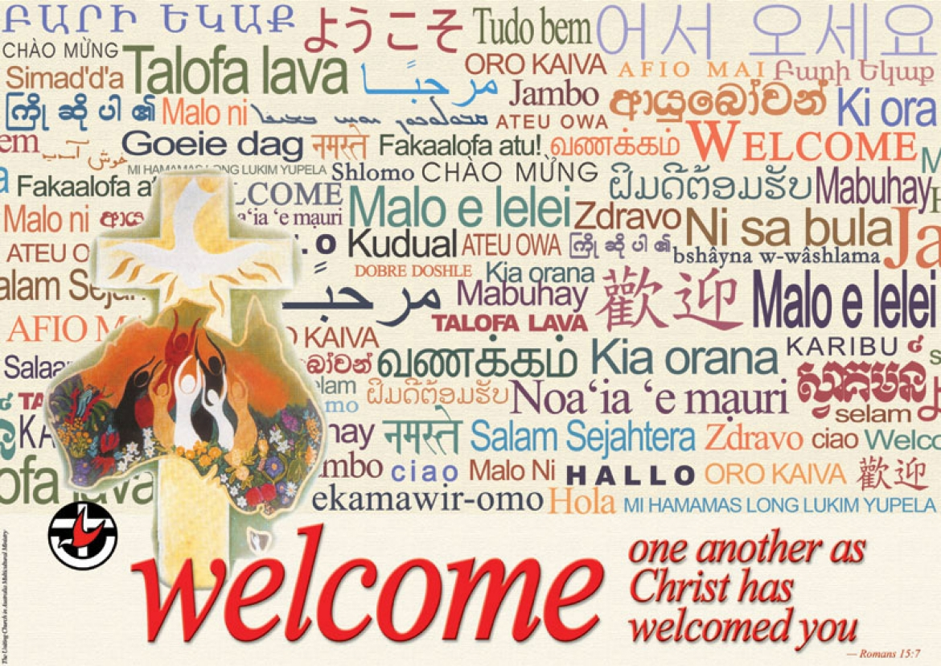

Slide 2

We acknowledge the sovereign First Peoples of these lands and waters
where we meet, the Yuin Nation. We pay our respects to their elders past and present and to all Aboriginal people who have cared for this place since creation.

Slide 3

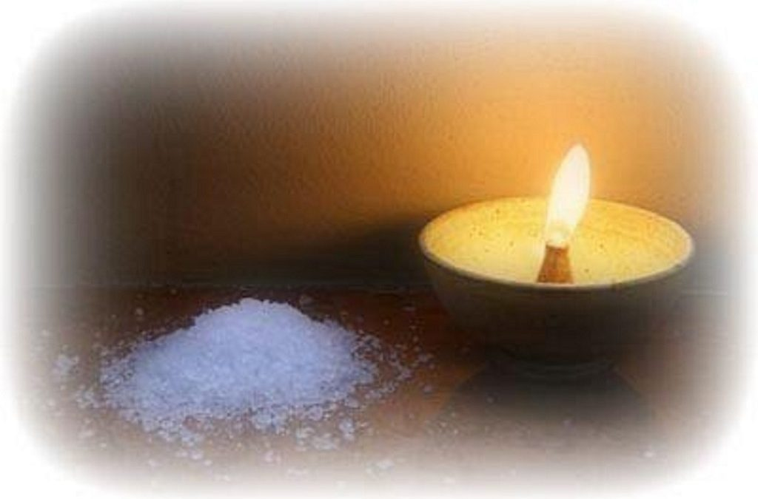
Welcome to worship
at St Georges - Eden

Slide 4
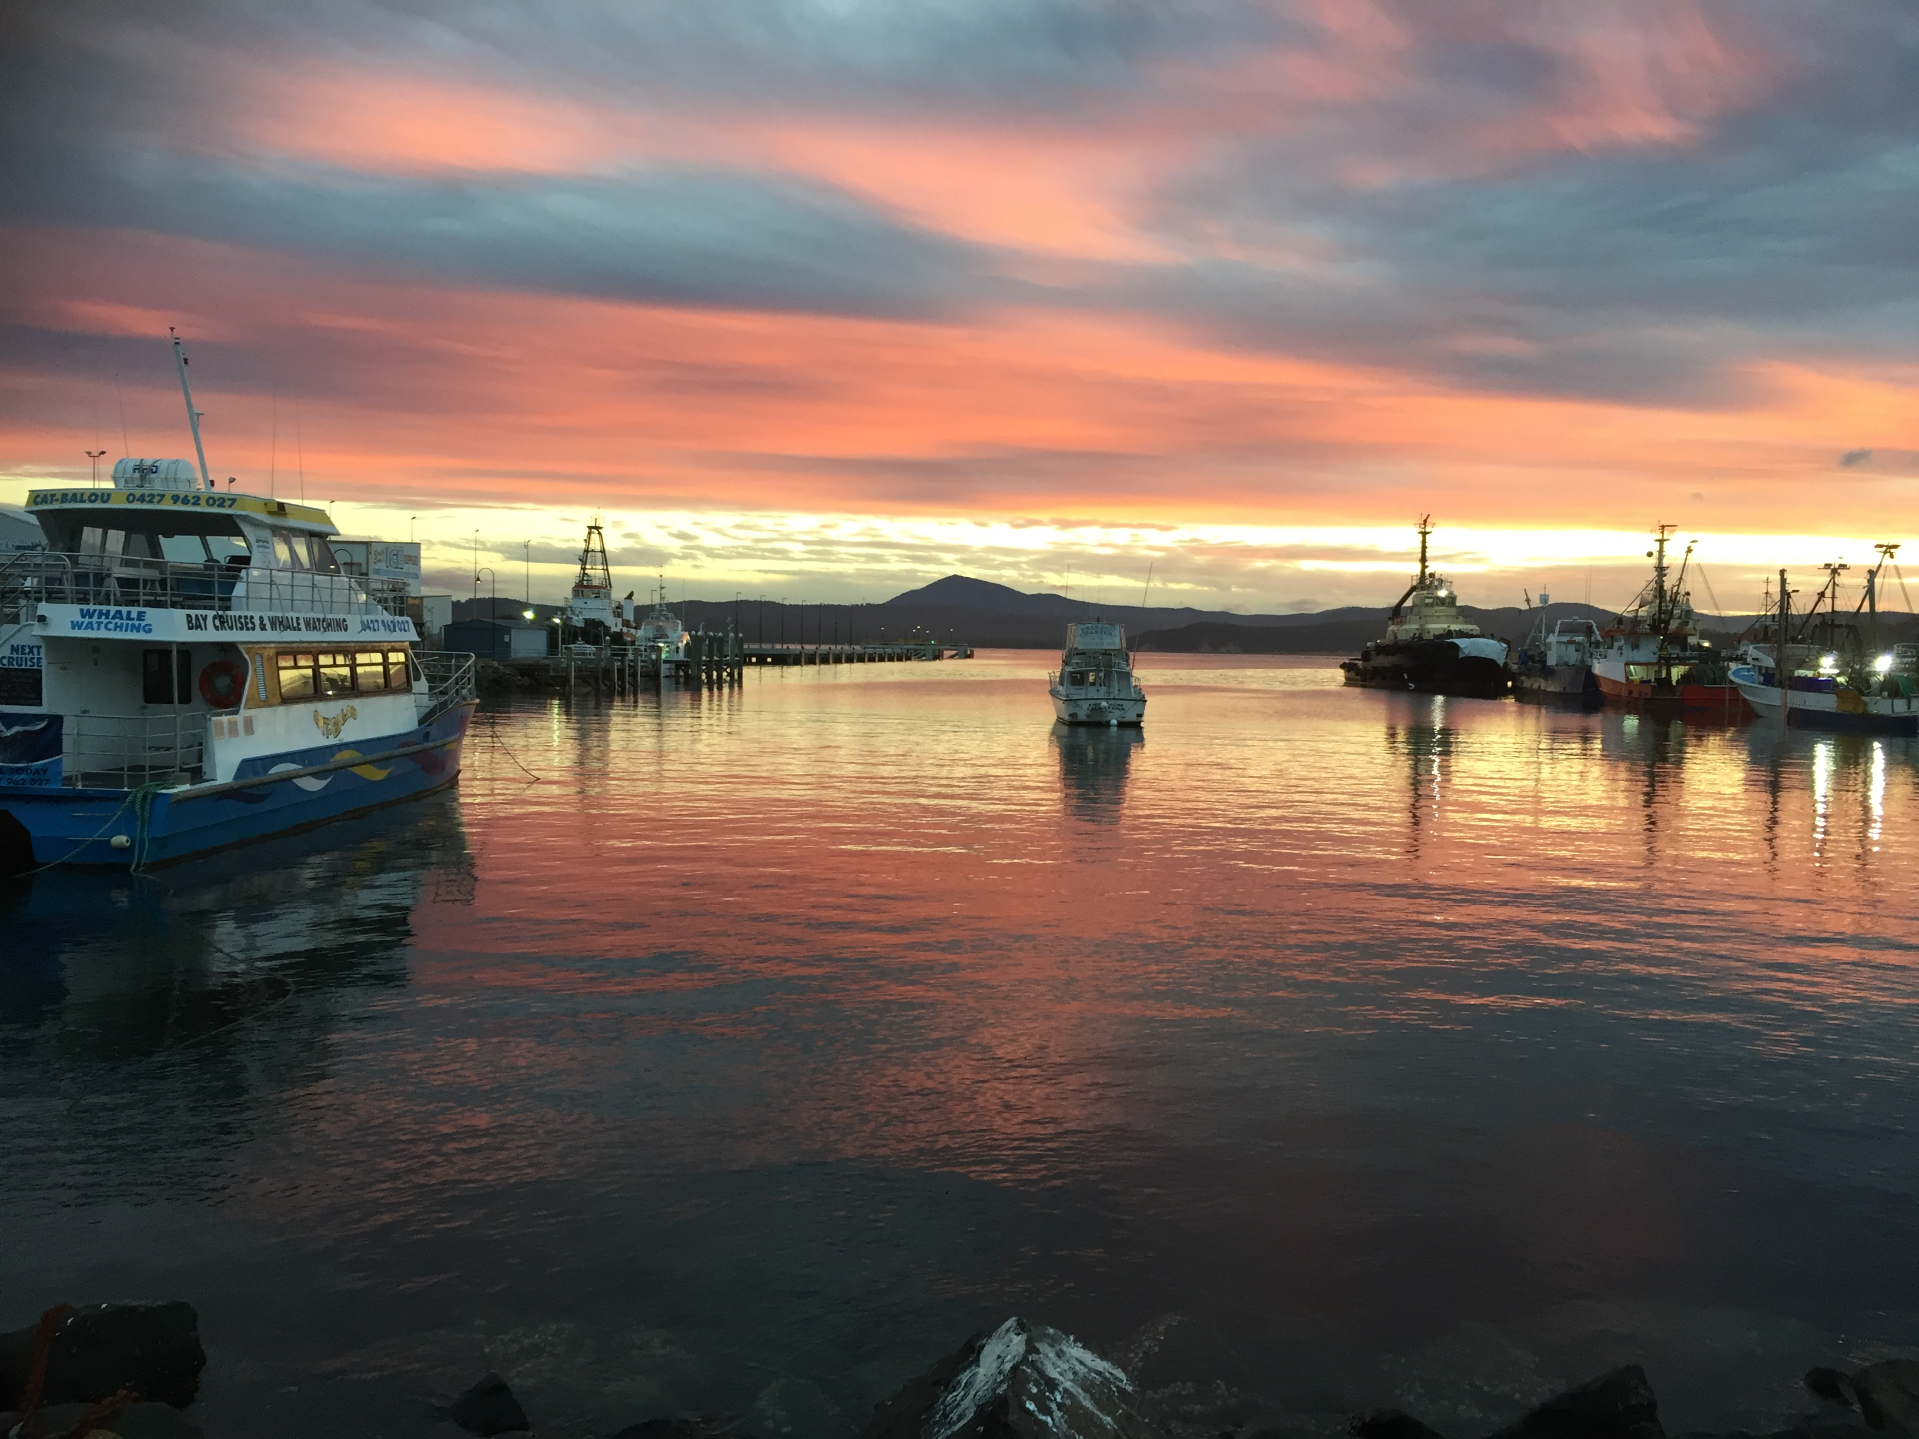

Slide 5
Give thanks with a grateful heart
Give thanks to the Holy One
Give thanks because He's given
Jesus Christ His Son.

Slide 6
Give thanks with a grateful heart
Give thanks to the Holy One
Give thanks because He's given
Jesus Christ His Son.

Slide 7
And now let the weak say I am strong
Let the poor say I am rich
Because of what the Lord has done
for us

Slide 8
And now let the weak say I am strong
Let the poor say I am rich
Because of what the Lord has done for us
Give thanks, Give thanks
Words & music by Henry Smith
© 1978 Integrity’s Hosanna Music
Used by permission cc lic no. 222909

Slide 9
The light [Jesus]has come into the world ........… all who do evil hate the light and do not come to the light, so that their deeds may not be exposed.
But those who do what is true come to the light, so that it may be clearly seen that their deeds have been done in God.’
John 3:19b, 20-21

Slide 11


Slide 12
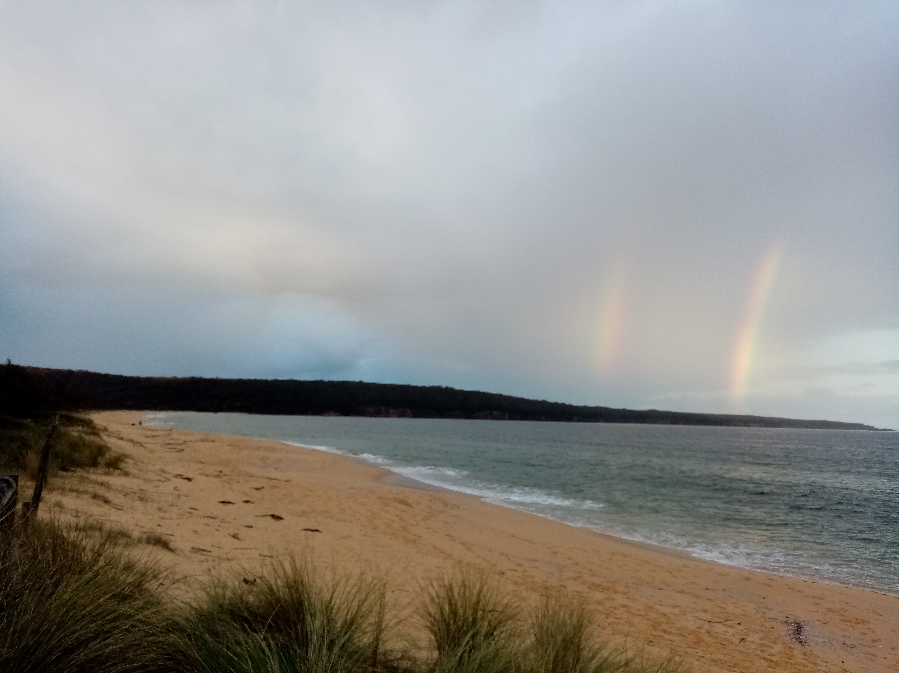

Slide 13
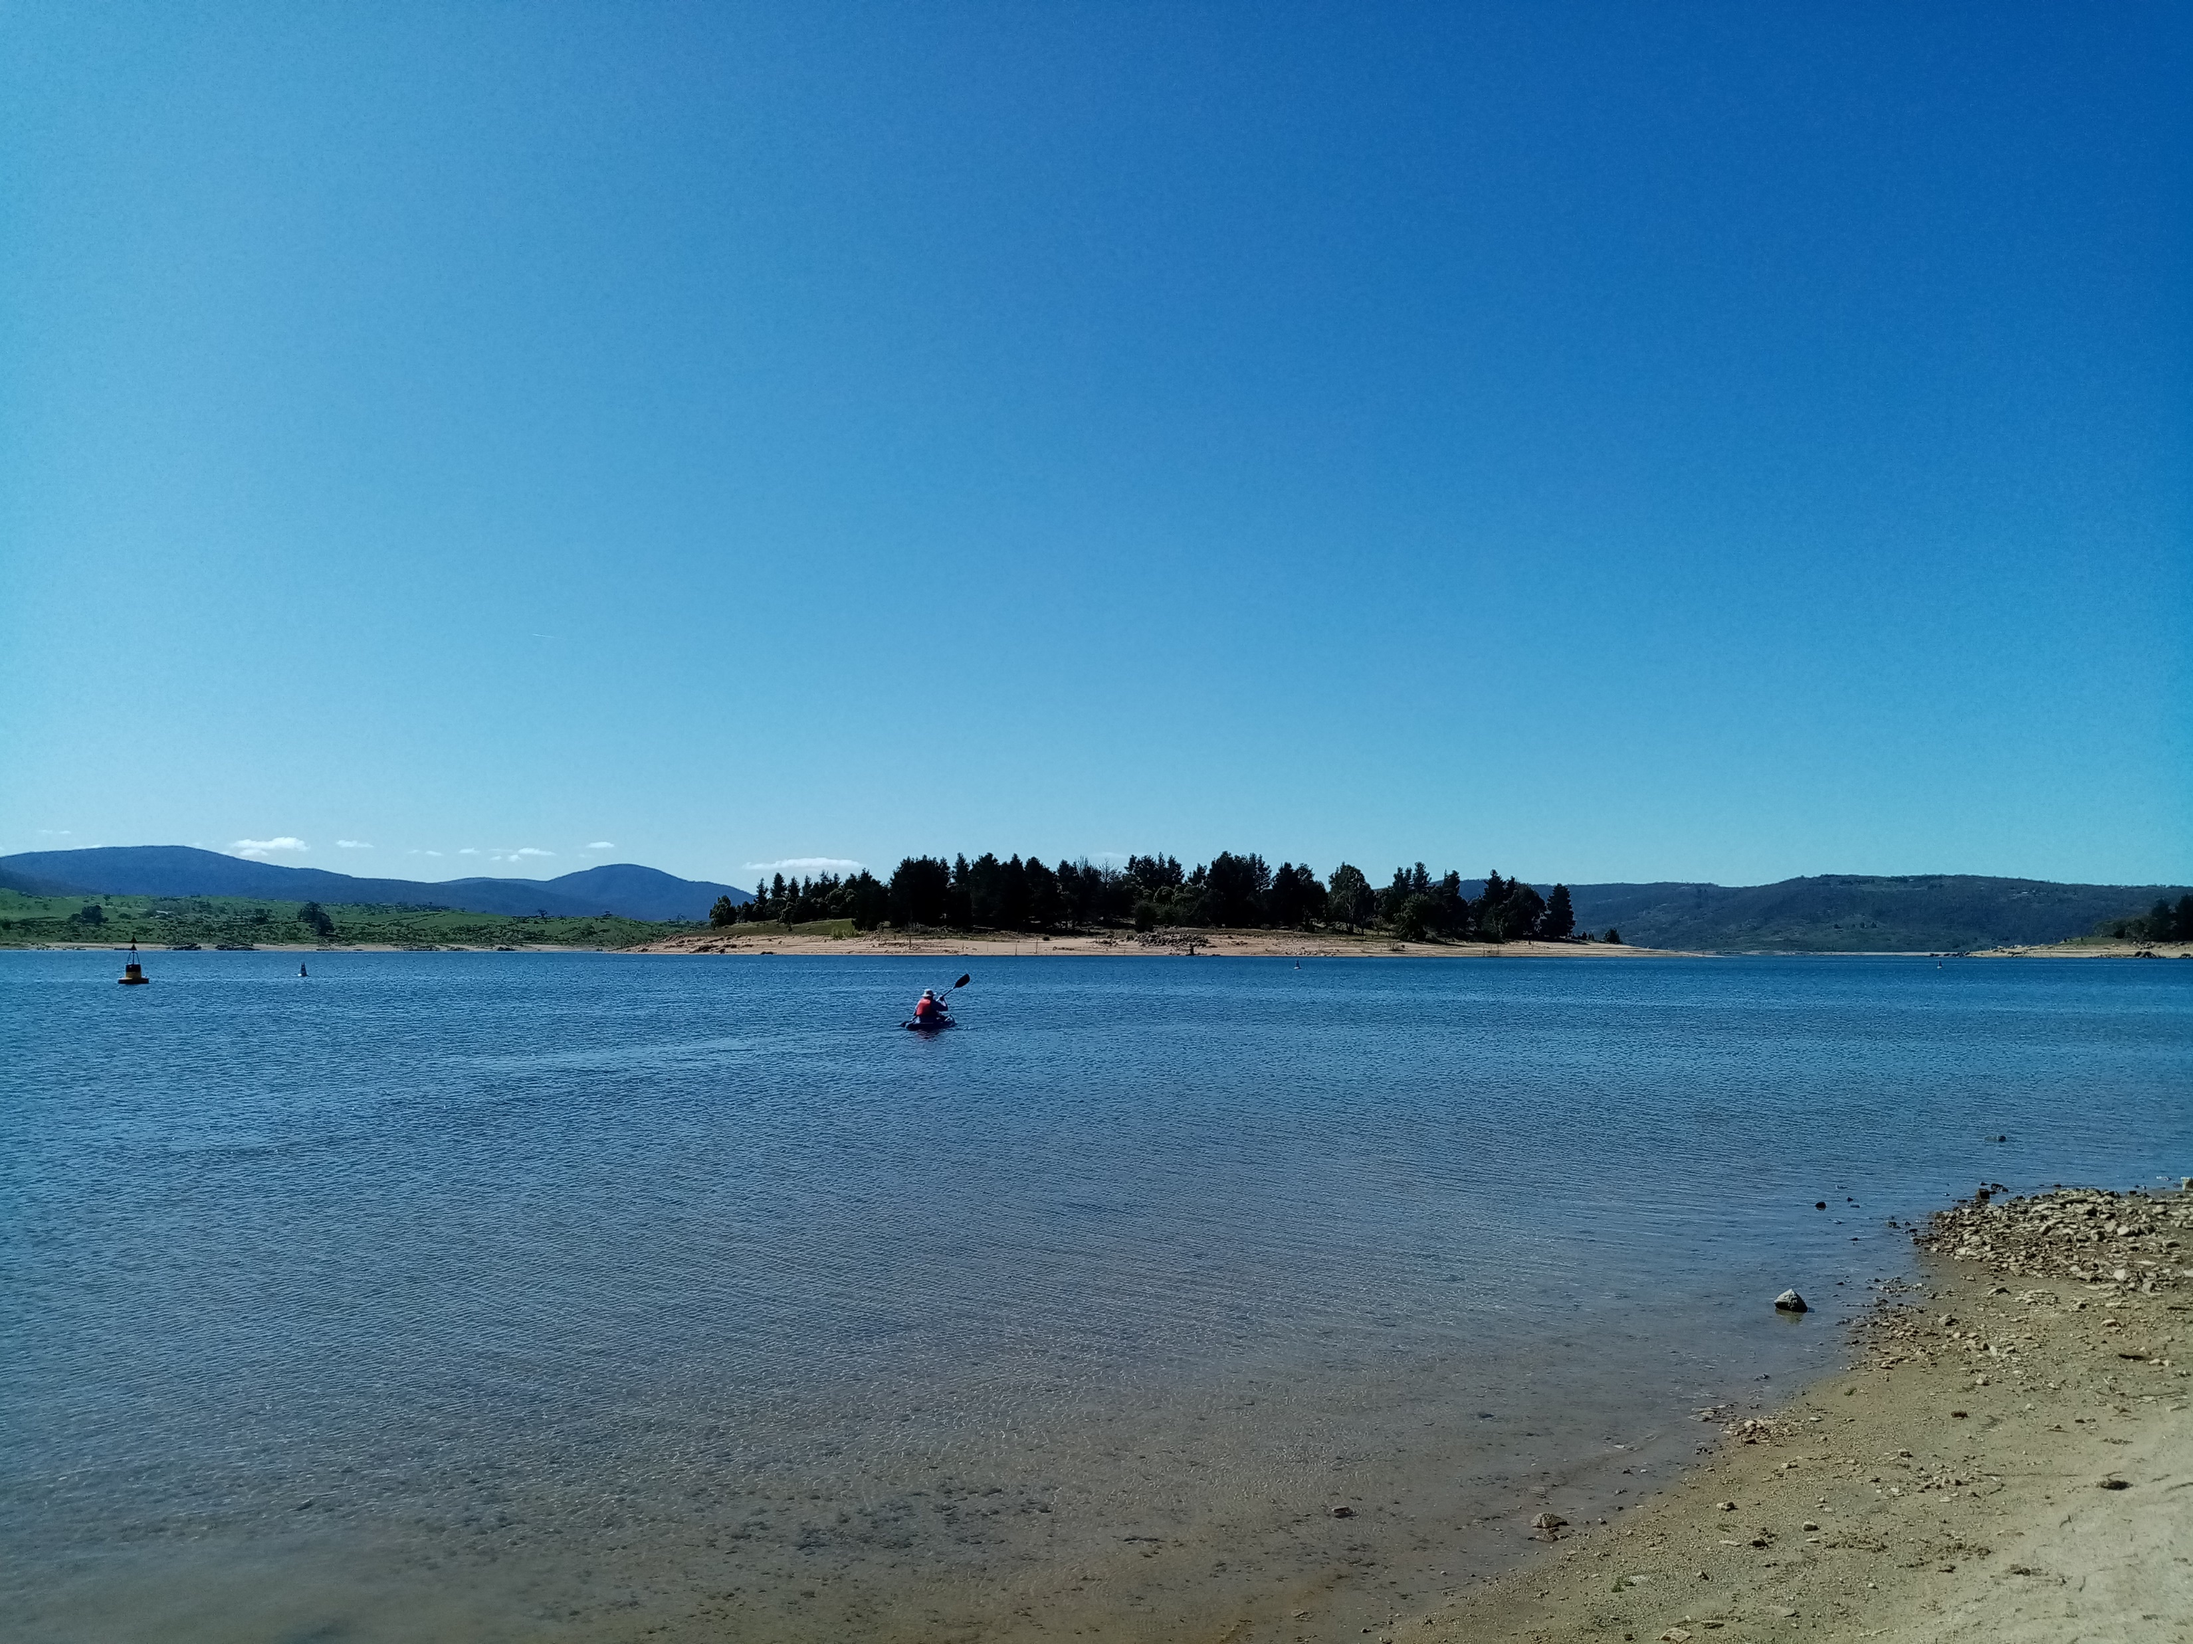

Slide 14
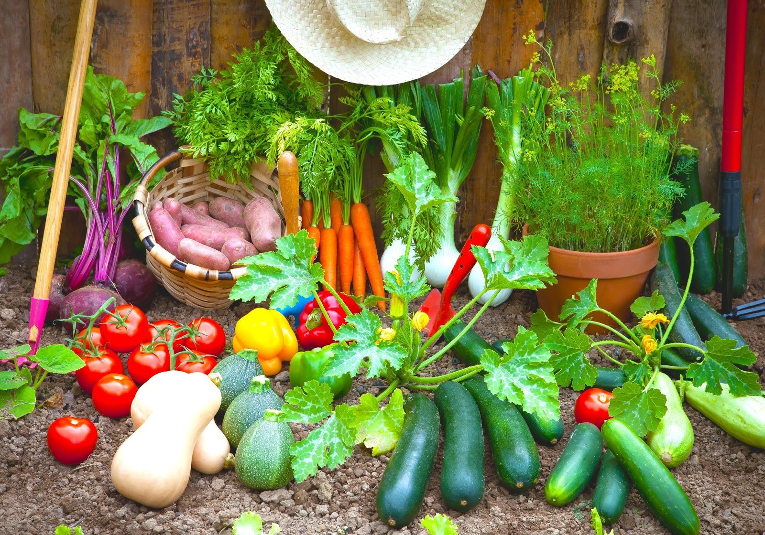
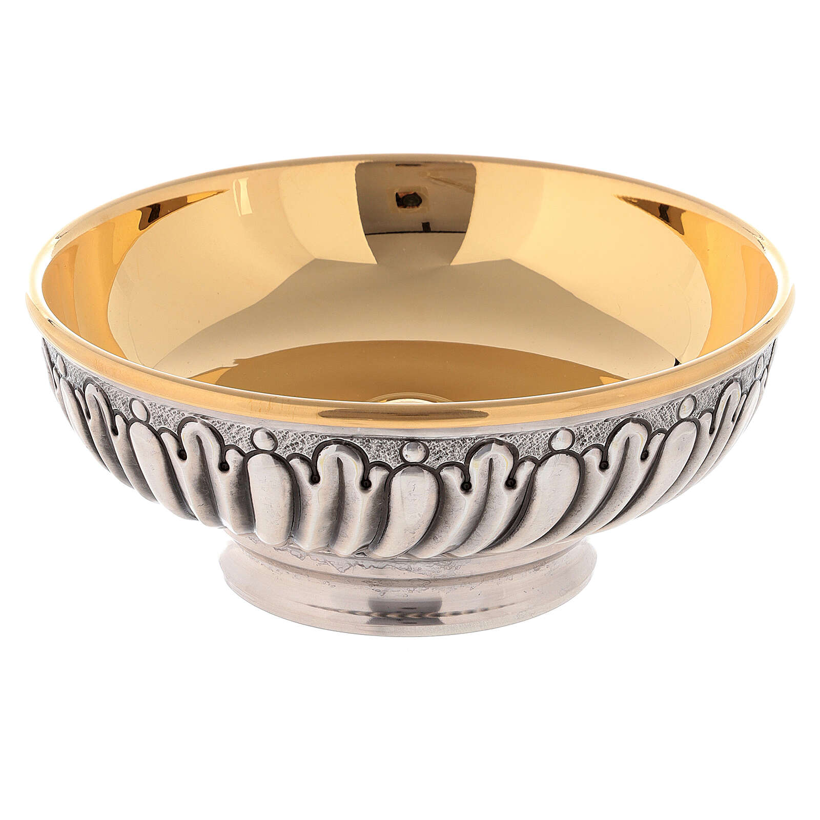

Slide 15
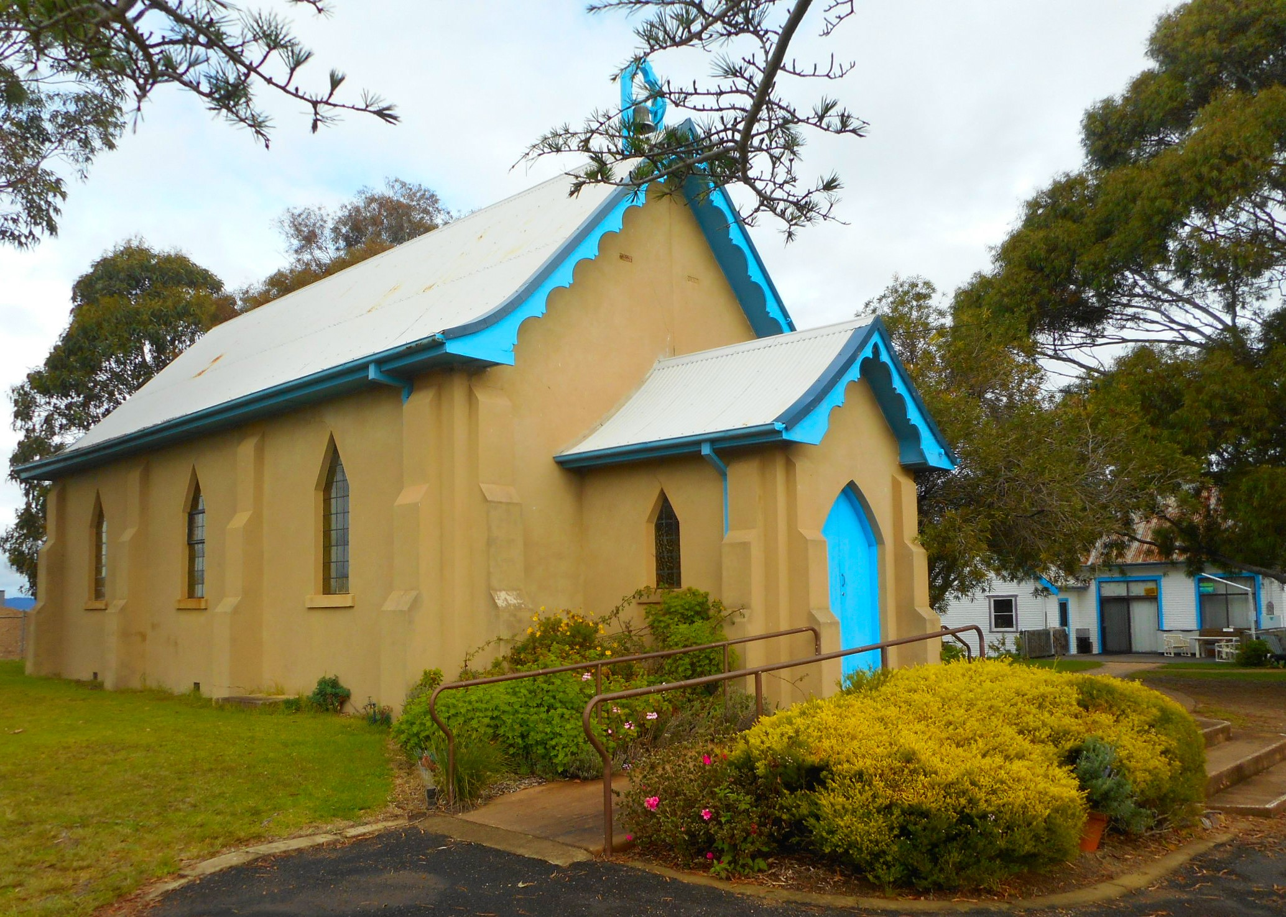
What’s on? Wed 5pm Faith Conversations Thurs 10-1 Pantry Friday World Day of Prayer 3pm Sunday 8th Congregational Council,after morning tea

Slide 17
The Lord's my Shepherd, I'll not want; He makes me down to lie In pastures green; He leadeth me The quiet waters by.

Slide 18
My soul He does restore again And me to walk does make Within the paths of righteousness, E'en for His own name's sake.

Slide 19
Yea, tho' I walk in death's dark vale, Yet will I fear no ill; For You are with me, and your rod And staff me comfort still.

Slide 20
My table You have furnished In presence of my foes; My head You do with oil anoint, And my cup overflows.

Slide 21
Goodness and mercy, all my life, Shall surely follow me; And in God's house forevermore My dwelling place shall be. My dwelling place shall be. Washington Square tune Em Em x 5

Slide 22
Come to me all who labour and are heavy burdened,
And I shall give you rest.
Take up my yoke and learn from me,
For I am meek and humble of heart.
And you’ll find rest for your souls,
Yes, my yoke is easy and my burden is light.
Come to me (Gregory Norbet)

Slide 23
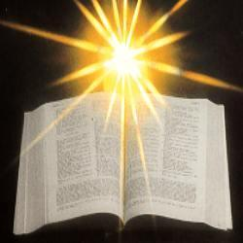

Slide 24
Genesis 12:1–4a The Lord had said to Abram, “Go from your country, your people and your father’s household to the land I will show you. ² “I will make you into a great nation, and I will bless you; I will make your name great, and you will be a blessing.

Slide 25
³ I will bless those who bless you, and whoever curses you I will curse; and all peoples on earth will be blessed through you.” ⁴ So Abram went, as the Lord had told him; and Lot went with him. Abram was seventy-five years old when he set out from Harran. 

Slide 26
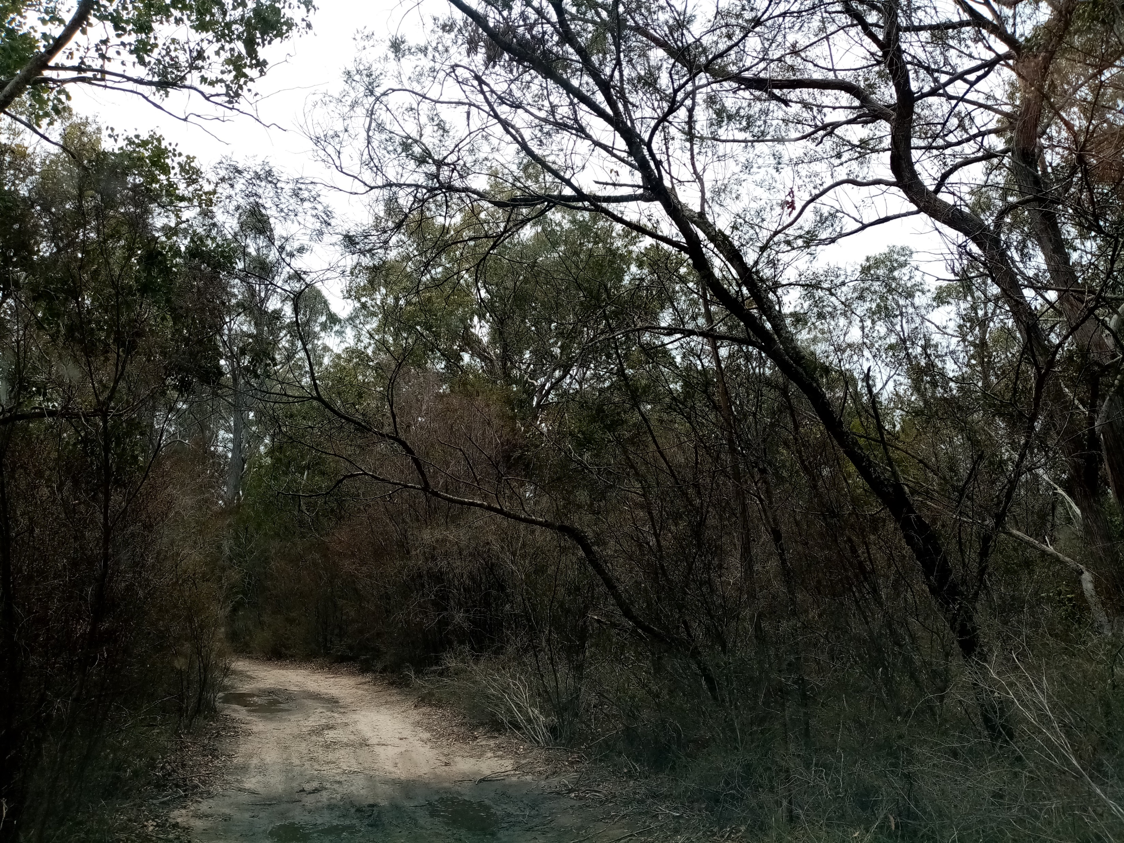
Let’s have a look at
Psalm 121

Slide 27
Psalm 121 CEV (A song for worship.) I look to the hills! Where will I find help? It will come from the Lord, who created heaven and earth. The Lord is your protector, and he won't go to sleep or let you stumble. The protector of Israel doesn't doze or ever get drowsy. The Lord is your protector, there at your right side to shade you from the sun. You won't be harmed by the sun during the day or by the moon at night. The Lord will protect you and keep you safe from all dangers. The Lord will protect you now and always wherever you go.

Slide 28
Romans 4:1-5 Contemporary English Version Well then, what can we say about our ancestor Abraham? If he became acceptable to God because of what he did, then he would have something to brag about. But he would never be able to brag about it to God. The Scriptures say, “God accepted Abraham because Abraham had faith in him.” Money paid to workers isn't a gift. It is something they earn by working. But you cannot make God accept you because of something you do. God accepts sinners only because they have faith in him.

Slide 29
Verses 13-17 God promised Abraham and his descendants that he would give them the world. This promise wasn't made because Abraham had obeyed a law, but because his faith in God made him acceptable. If Abraham and his descendants were given this promise because they had obeyed a law, then faith would mean nothing, and the promise would be worthless.

Slide 30
God becomes angry when his Law is broken. But where there isn't a law, it cannot be broken. Everything depends on having faith in God, so that God's promise is assured by his gift of undeserved grace.

Slide 31
This promise isn't only for Abraham's descendants who have the Law. It is for all who are Abraham's descendants because they have faith, just as he did. Abraham is the ancestor of us all. The Scriptures say that Abraham would become the ancestor of many nations. This promise was made to Abraham because he had faith in God, who raises the dead to life and creates new things. ◊

Slide 32
John 3: 1-21 There was a man named Nicodemus who was a Pharisee and a Jewish leader. One night he went to Jesus and said, “Rabbi, we know that God has sent you to teach us. You could not work these miracles, unless God were with you.” Jesus replied, “I tell you for certain that you must be born from above before you can see God's kingdom!”

Slide 33
Nicodemus asked, “How can a grown man ever be born a second time?” Jesus answered: I tell you for certain that before you can get into God's kingdom, you must be born not only by water, but by the Spirit. Humans give life to their children. Yet only God's Spirit can change you into a child of God.

Slide 34
Don't be surprised when I say that you must be born from above. Only God's Spirit gives new life. The Spirit is like the wind that blows wherever it wants to. You can hear the wind, but you don't know where it comes from or where it is going.

Slide 35
“How can this be?” Nicodemus asked. Jesus replied:How can you be a teacher of Israel and not know these things? I tell you for certain we know what we are talking about because we have seen it ourselves. But none of you will accept what we say. If you don't believe when I talk to you about things on earth, how can you possibly believe if I talk to you about things in heaven?

Slide 36
No one has gone up to heaven except the Son of Man, who came down from there. And the Son of Man must be lifted up, just as the metal snake was lifted up by Moses in the desert. Then everyone who has faith in the Son of Man will have eternal life.

Slide 37
God loved the people of this world so much that he gave his only Son, so that everyone who has faith in him will have eternal life and never really die. God did not send his Son into the world to condemn its people. He sent him to save them! No one who has faith in God's Son will be condemned. But everyone who doesn't have faith in him has already been condemned for not having faith in God's only Son.

Slide 38
The light has come into the world, and people who do evil things are judged guilty because they love the dark more than the light. People who do evil hate the light and won't come to the light, because it clearly shows what they have done. But everyone who lives by the truth will come to the light, because they want others to know that God is really the one doing what they do. 

Slide 40
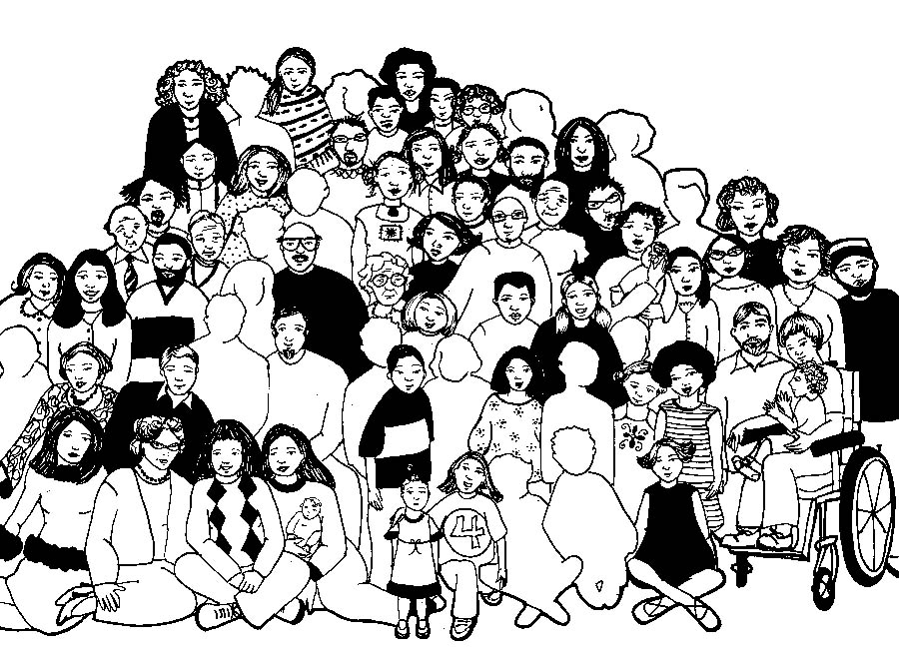

Slide 41
Our Father in Heaven,
Hallowed be your name,
your kingdom come,
your will be done, on earth as in heaven.
Give us today our daily bread.
Forgive our sins
as we forgive those who sin against us.
Save us from the time of trial
and deliver us from evil.
For the Kingdom, the power,
and the glory are yours now and forever. Amen
Notes:
<number>

Slide 42
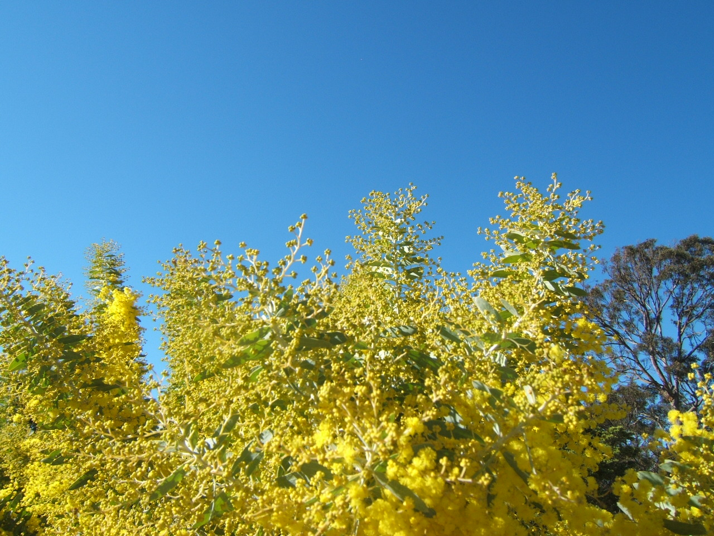
Colours of day
dawn into the mind,
The sun has come up,
the night is behind.
Go down in the city,
into the street,
And let's give the message to the people we meet.

Slide 43
So light up the fire and
let the flame burn,
Open the door,
let Jesus return.
Take seeds of His Spirit,
let the fruit grow,
Tell the people of Jesus,
let His love show.

Slide 44
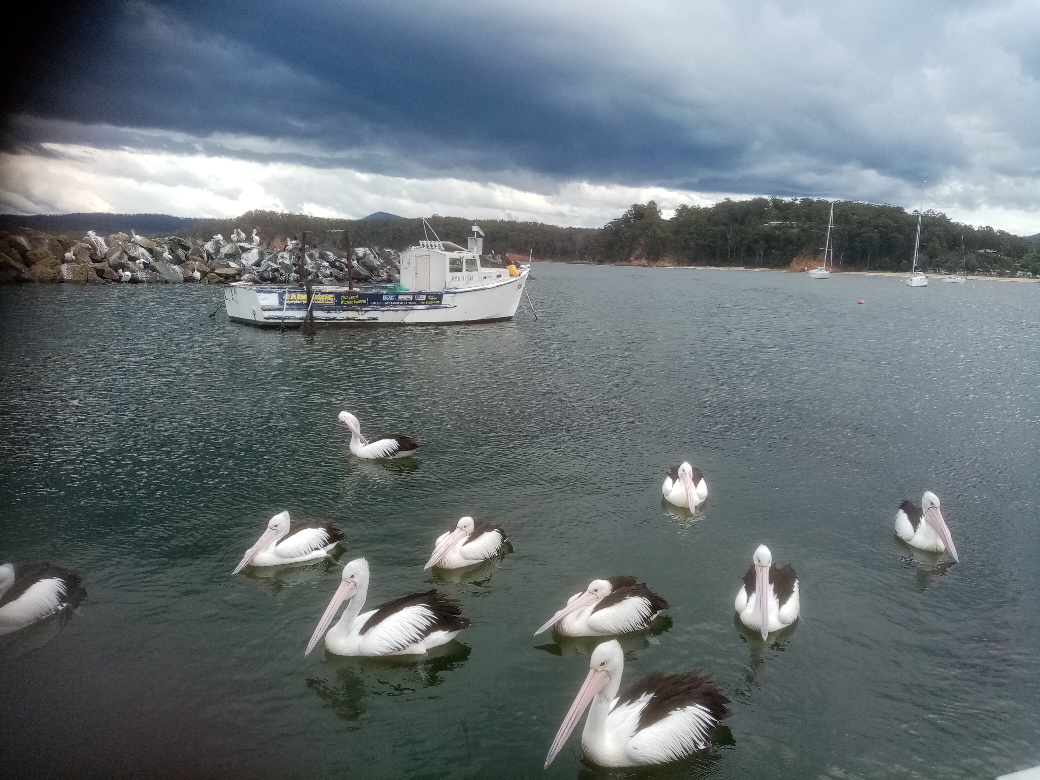
Go through the park, on into the town;
The sun still shines on,
it never goes down.
The light of the world is risen again;
The people of darkness
are needing our friend.

Slide 45
So light up the fire and
let the flame burn,
Open the door,
let Jesus return.
Take seeds of His Spirit,
let the fruit grow,
Tell the people of Jesus,
let His love show.

Slide 46
Open your eyes,
look into the sky,
The darkness has come,
the sun came to die.
The evening draws on,
the sun disappears,
But Jesus is living,
His Spirit is near.

Slide 47
So light up the fire and
let the flame burn,
Open the door,
let Jesus return.
Take seeds of His Spirit,
let the fruit grow,
Tell the people of Jesus,
let His love show.
CCLI Lic 222909
S McLellan, J Pa, K Ryecroft
Kingsway’s Makeway Music
SOF 64 D^D x3

Slide 48
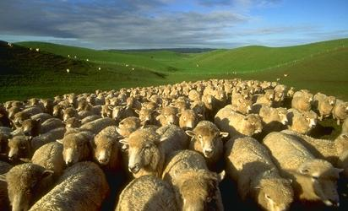
Please follow us over for a drink and a chat after the service

