Slide 2
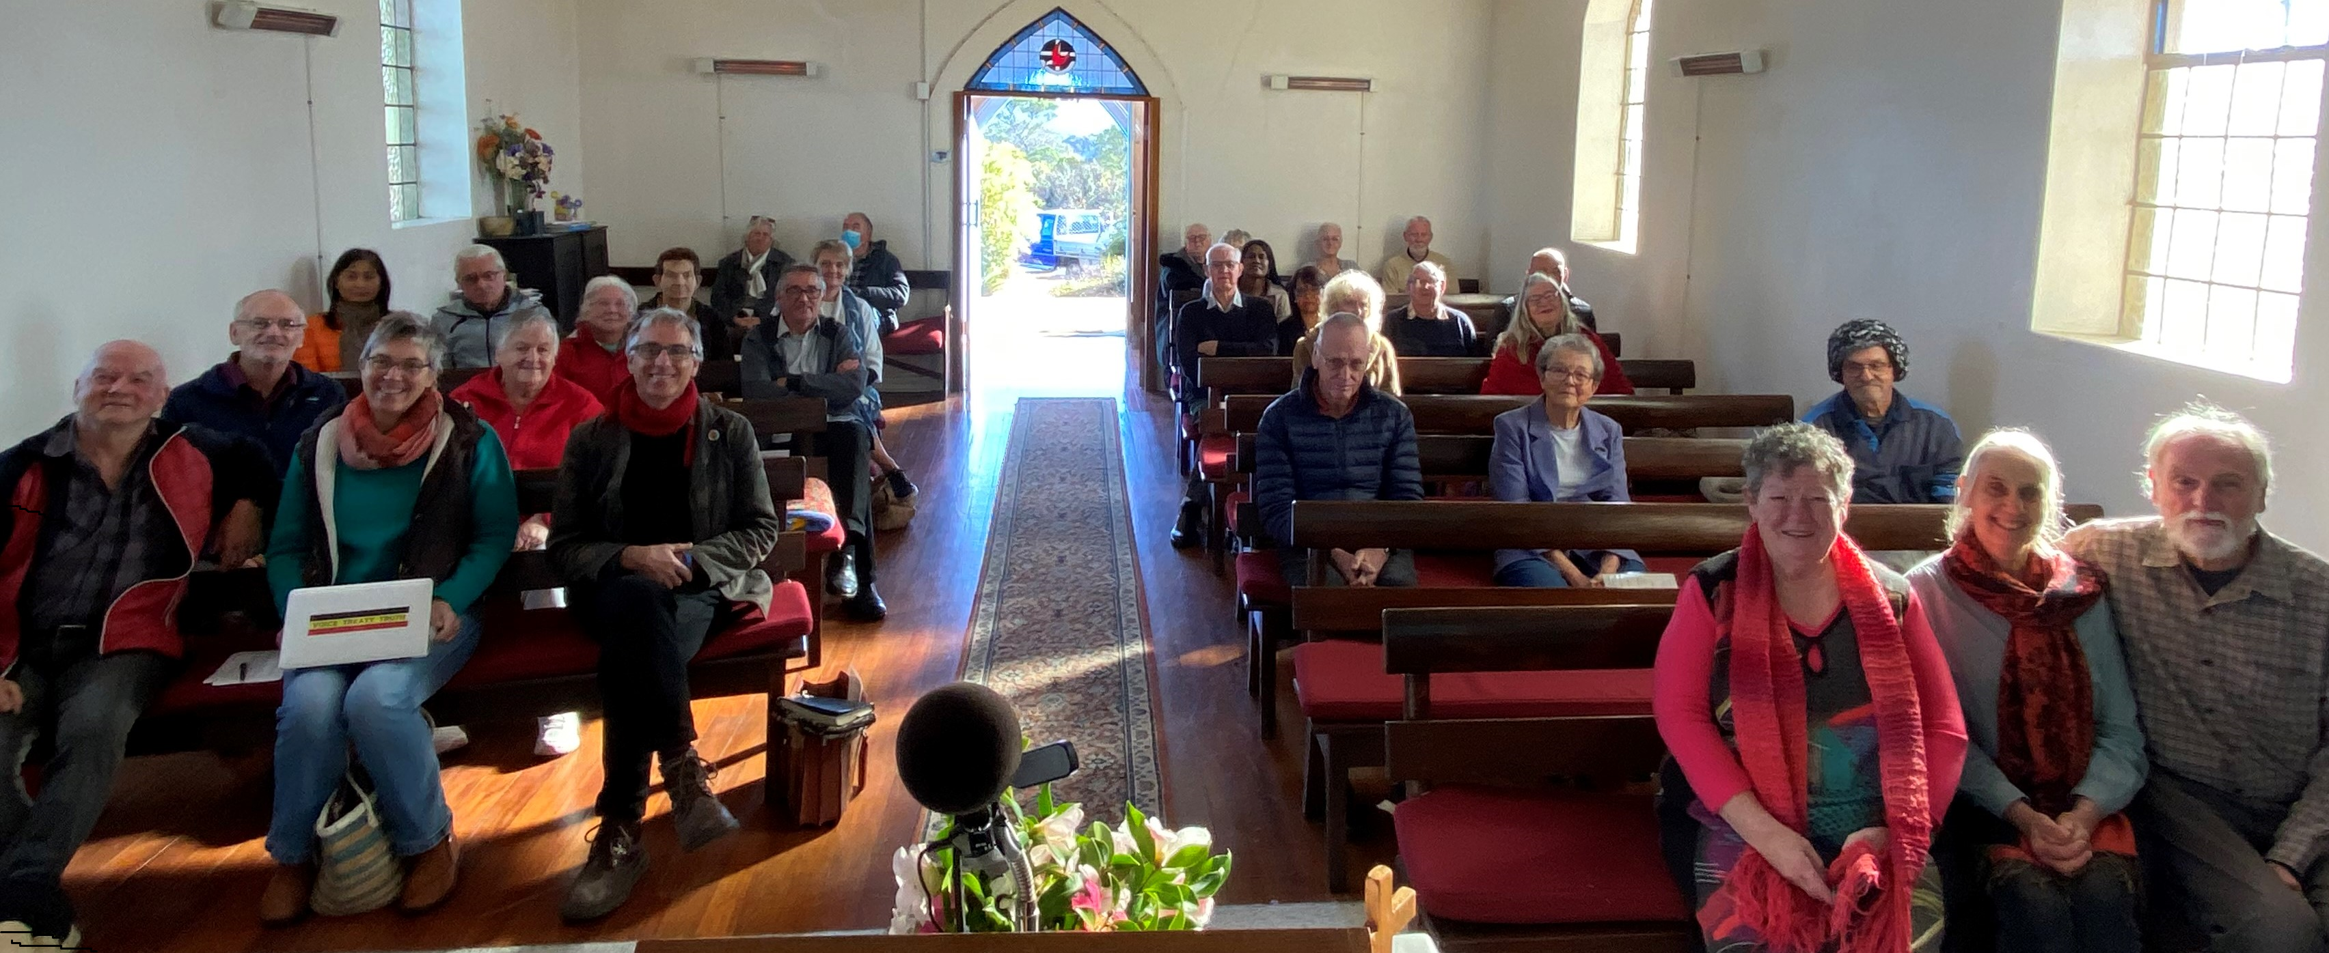
Welcome to worship
at St Georges - Eden

Slide 4
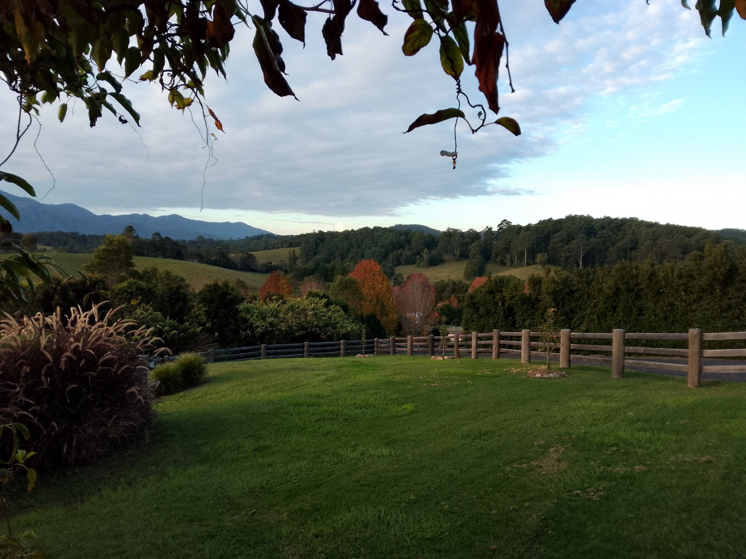

Slide 5
Praise to the Lord, the Almighty, the King of creation! O my soul, praise him, for he is your health and salvation! Come all who hear, brothers and sisters draw near; praise him in glad adoration.

Slide 6
.
Praise to the Lord,
who will prosper our work and defend us; surely his goodness and mercy
shall daily attend us. Ponder anew what the Almighty can do, as with His love he befriends us

Slide 7
.
Praise to the Lord, who,
when darkness of sin is abounding, who, when the godless do triumph,
our best hopes confounding, sends forth His light, scatters the horrors of night, saints with his mercy surrounding

Slide 8
Praise to the Lord,
O let all that is in me adore him! All that has life and breath,
come now with praises before him. Let the amen sound from his people again, gladly for ever adore him. TiS 111 F F Joachim Neander (1650-1680), 1680

Slide 9
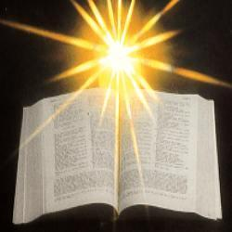

Slide 10
Isaiah 55:1-9 Ho, everyone who thirsts, come to the waters; and you that have no money, come, buy and eat! Come, buy wine and milk without money and without price.

Slide 11
² Why do you spend your money for that which is not bread, and your labour for that which does not satisfy? Listen carefully to me, and eat what is good, and delight yourselves in rich food. ³ Incline your ear, and come to me; listen, so that you may live. I will make with you an everlasting covenant, my steadfast, sure love for David.

Slide 12
⁴ See, I made him a witness to the peoples, a leader and commander for the peoples. ⁵ See, you shall call nations that you do not know, and nations that do not know you shall run to you, because of the Lord your God, the Holy One of Israel, for he has glorified you. ⁶ Seek the Lord while he may be found, call upon him while he is near;

Slide 13
⁷ let the wicked forsake their way, and the unrighteous their thoughts; let them return to the Lord, that he may have mercy on them, and to our God, for he will abundantly pardon. ⁸ For my thoughts are not your thoughts, nor are your ways my ways, says the Lord. ⁹ For as the heavens are higher than the earth, so are my ways higher than your ways and my thoughts than your thoughts. 

Slide 14
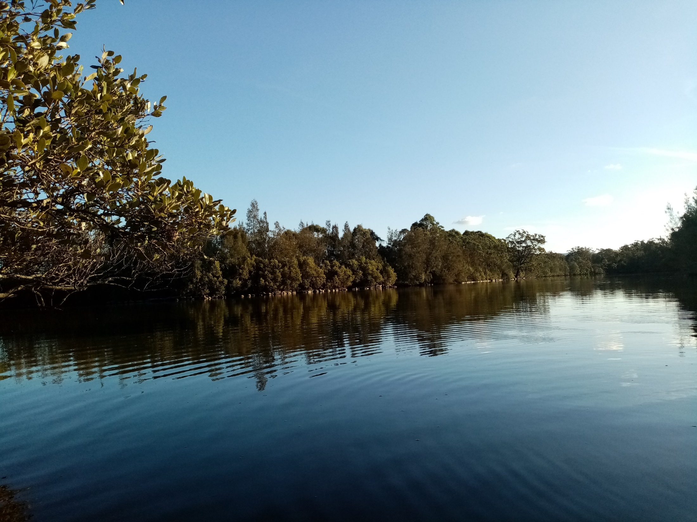
Choices ?? ?? ??

Slide 15
Guide me, O my great Redeemer, pilgrim through this barren land. I am weak, but you are mighty; hold me with your powerful hand. Bread of heaven, bread of heaven, feed me now and evermore; feed me now and evermore.
e

Slide 16
Open now the crystal fountain, where the living waters flow; let the fire and cloudy pillar lead me all my journey through. Strong deliverer, strong deliverer, ever by my strength and shield; ever be my strength and shield
e

Slide 17
When I tread the verge of Jordan, bid my anxious fears subside; death of death and hell's destruction, land me safe on Canaan's side. Songs of praises, songs of praises, I will ever sing to thee; I will ever sing to thee
e
William Williams CCLI 222909

Slide 18
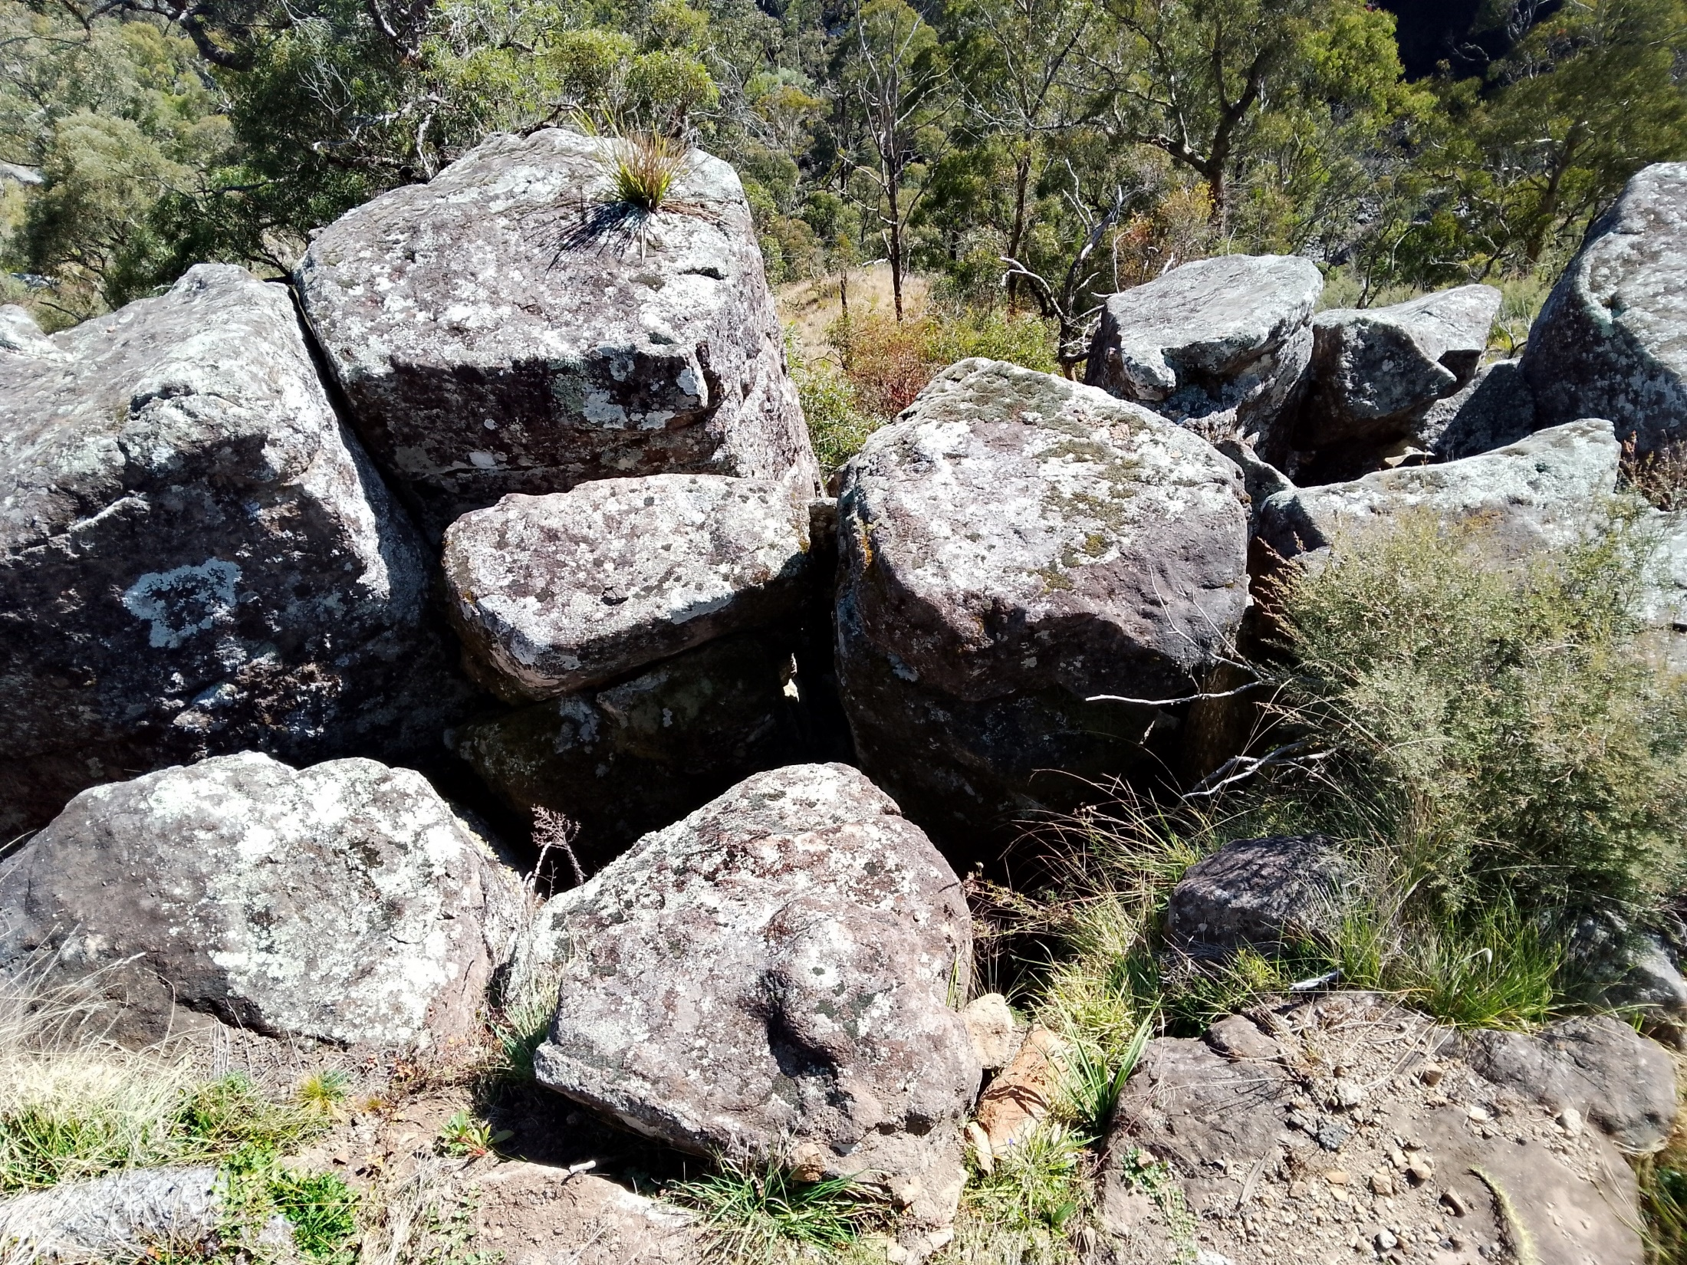

Slide 19
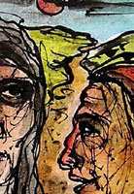
And can it be that I should gain
an interest in my Saviour’s blood?
Died he for me, who caused his pain-
for me, who him to death pursued?
Amazing love! How can it be
that thou, my God, shouldst die for me!
Choices

Slide 20
‘Tis mystery all! The immortal dies:
who can explore this strange design?
In vain the first-born seraph tries
to sound the depths of love divine.
‘Tis mercy all! Let earth adore,
let angel minds inquire no more.

Slide 21
He left his Father’s throne above
(so free, so infinite his grace!),
emptied himself of all but love,
and bled for Adam’s helpless race.
‘Tis mercy all, immense and free:
for, O my God, it found out me.

Slide 22
Long my imprisoned spirit lay
fast bound in sin and nature’s night:
thine eye diffused a quickening ray-
I woke; the dungeon flamed with light!
my chains fell off, my heart was free,
I rose, went forth, and followed thee.

Slide 23
No condemnation now I dread:
Jesus, and all in him, is mine!
Alive in him, my living Head,
and clothed in righteousness divine,
bold I approach the eternal throne,
and claim the crown, through Christ, my own.
Charles Wesley, CCLI 222909

Slide 24
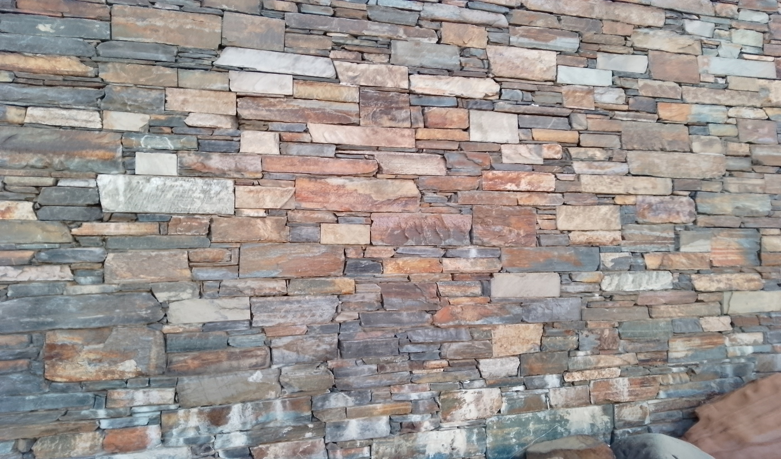
Notices
Faith conversation – Wed evenings
Pantry – Thursdays
Peter Yelds reaffirmation – Tues 5pm

Slide 25
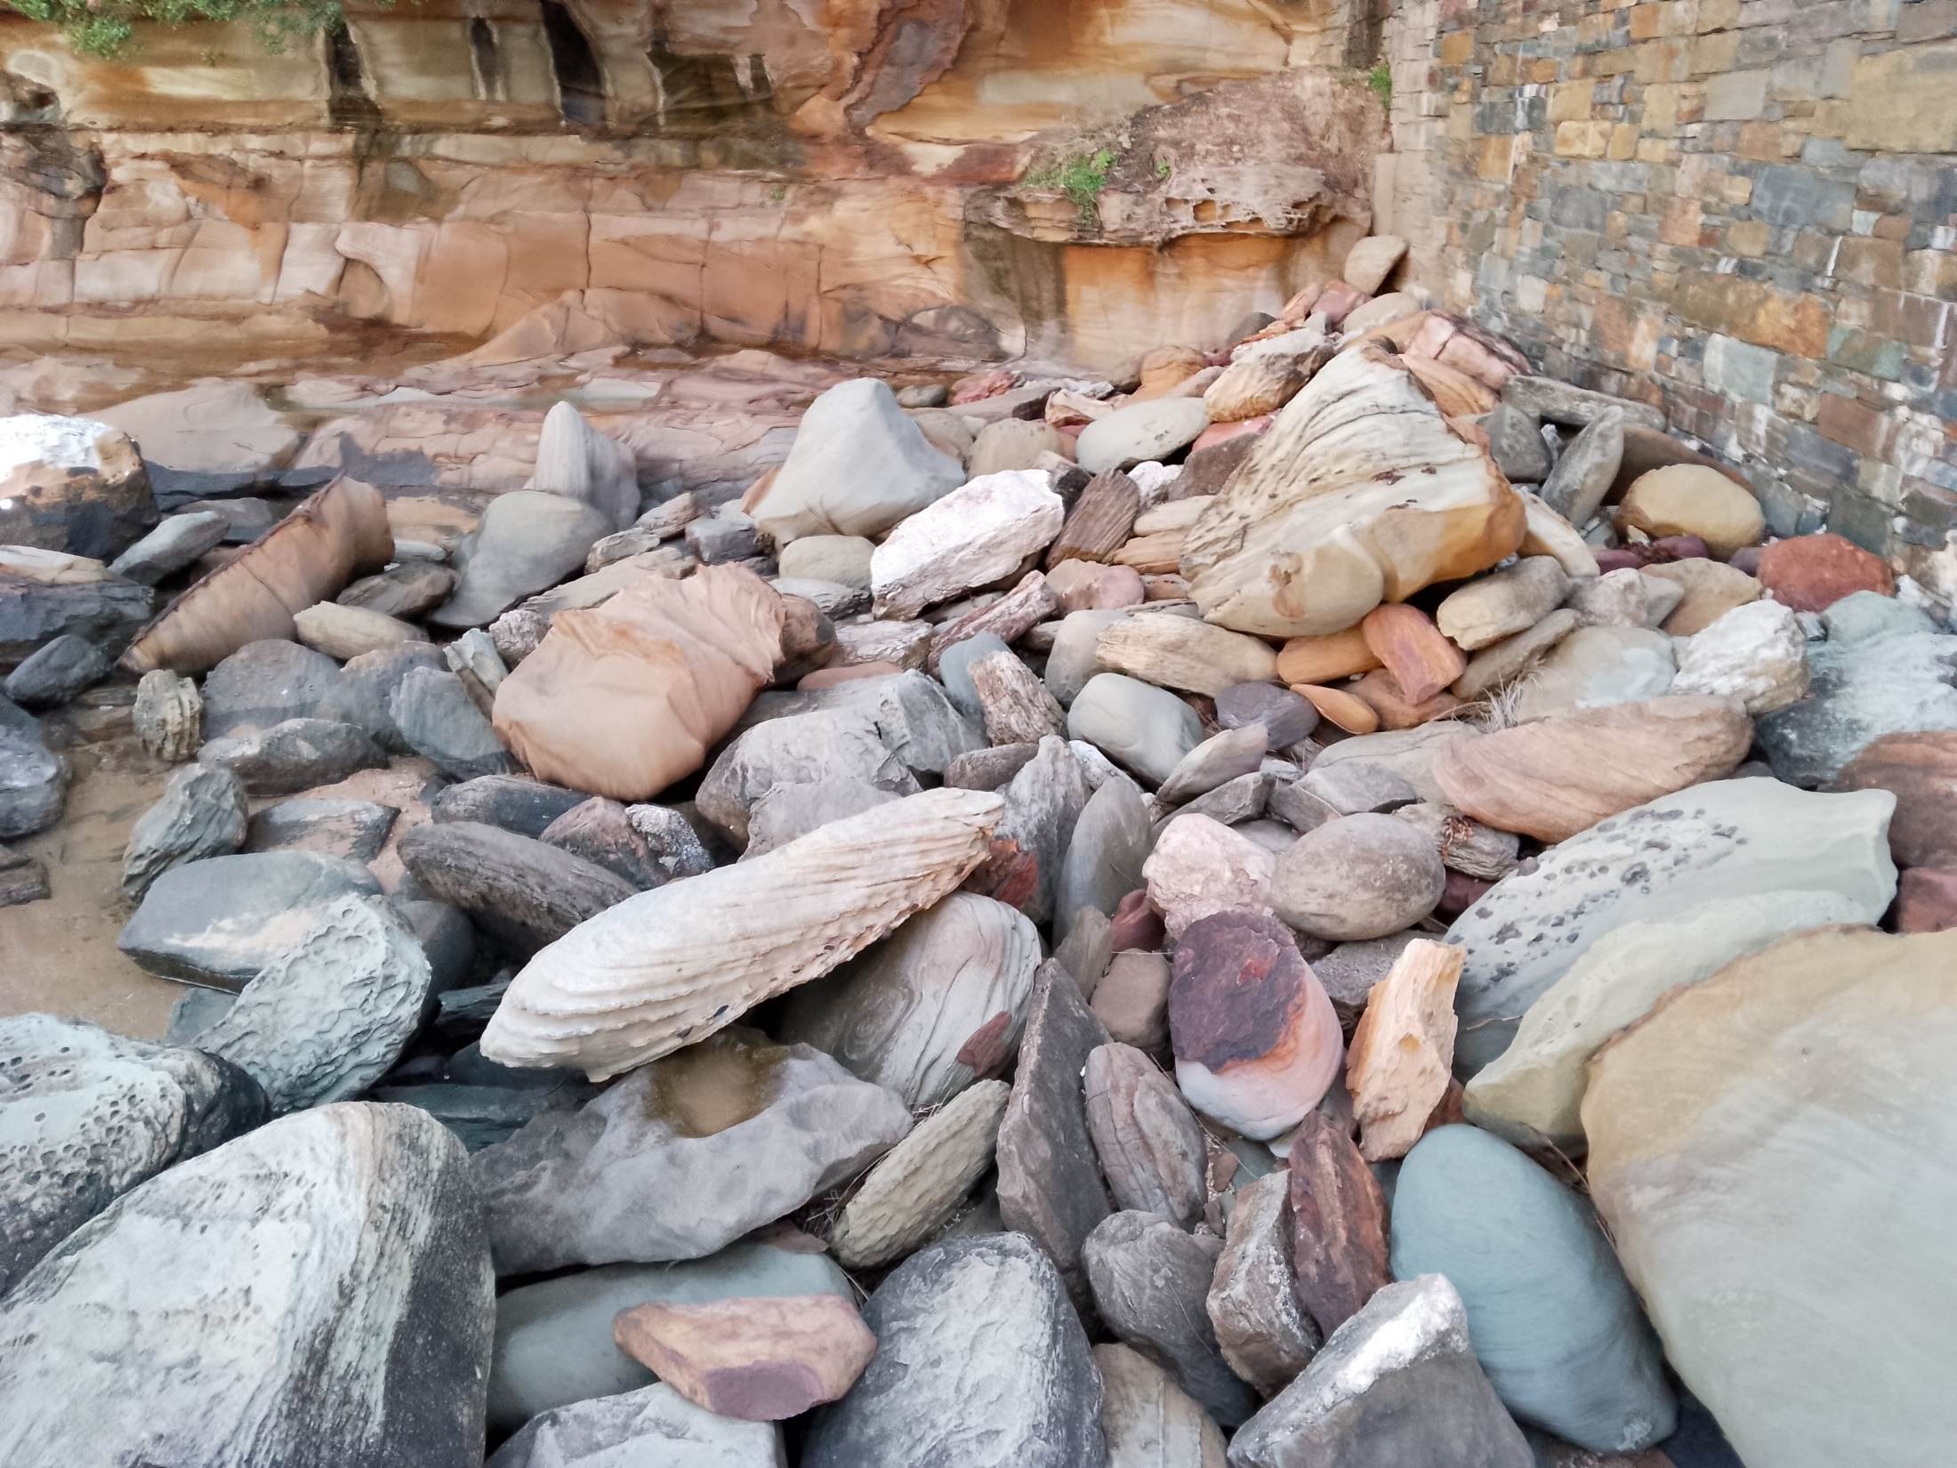

Slide 26
Think of various phrases you have heard or used to explain tragic events. As you look at the list which ones would you choose to use and which ones bother you?

Slide 27
Luke 13: 1-9 Some people came to Jesus and told him that a massacre had occurred in a place of worship. They said that a death squad, sent by Pilate, had butchered a group of Galileans while they were offering sacrifices. Jesus questioned the people about what they thought this meant: ........“Do you think there’s some kind of justice in this? Do you think that because these particular Galileans copped it, they must therefore have been the worst sinners in Galilee? No, they didn’t deserve it any more than anyone else; but all the same, unless you turn your lives around and follow God, you’ll end up just as dead as them.

Slide 28
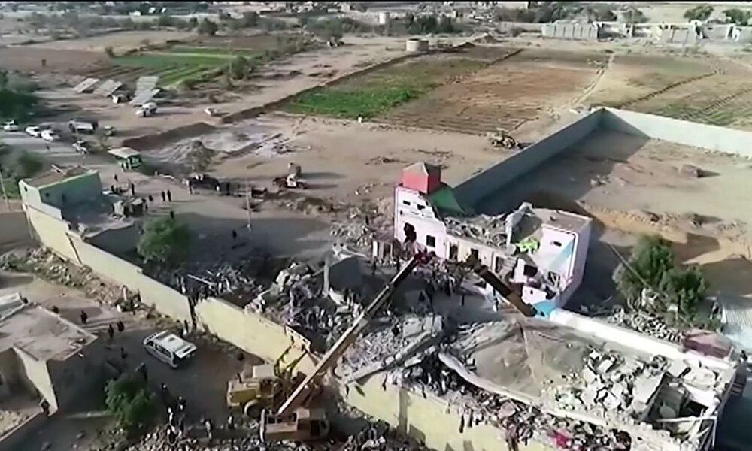

Slide 29
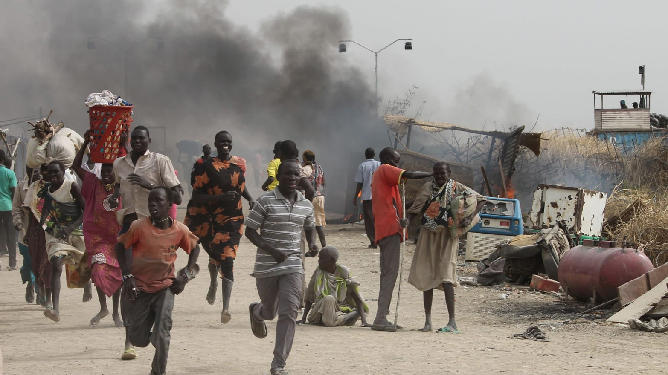

Slide 30
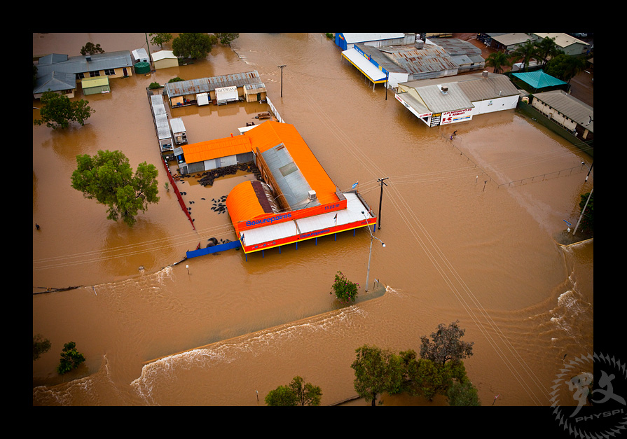

Slide 31
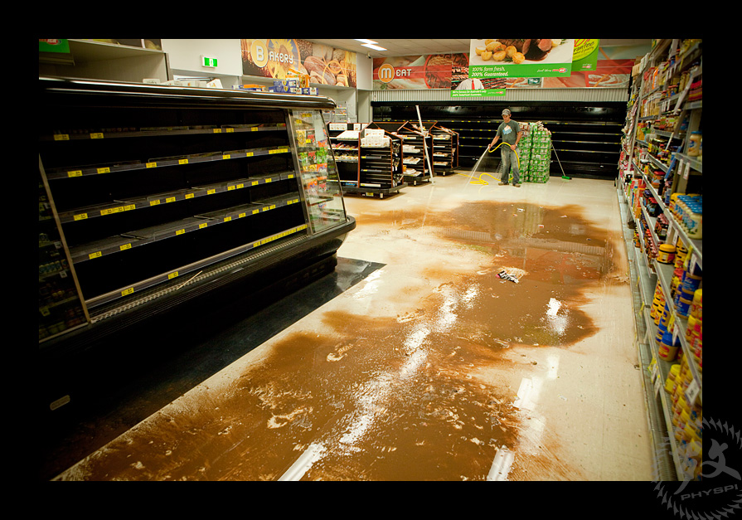

Slide 32
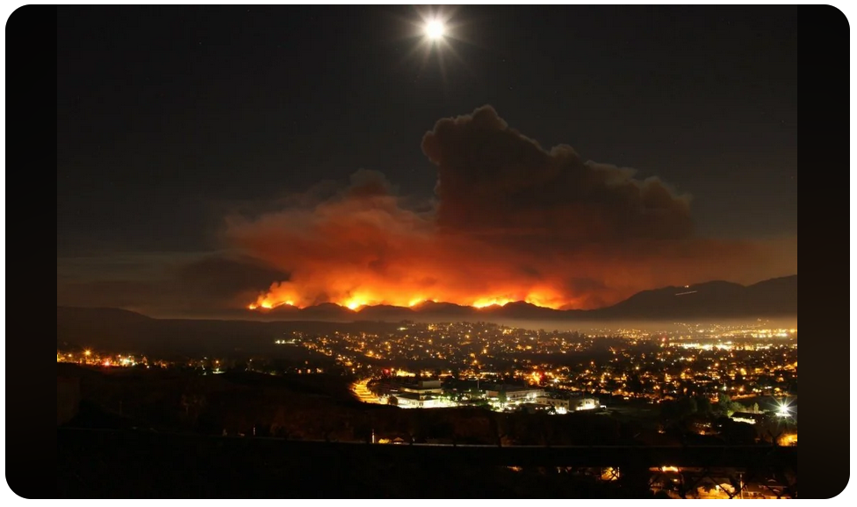

Slide 33
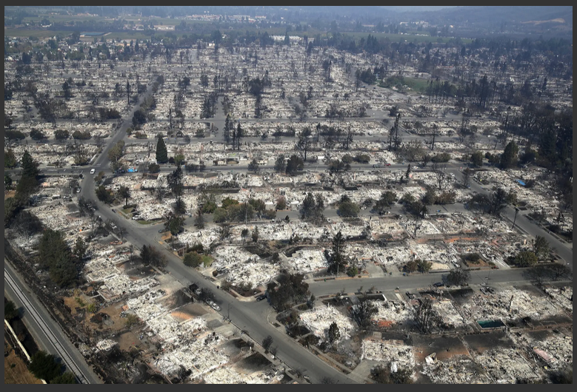

Slide 34
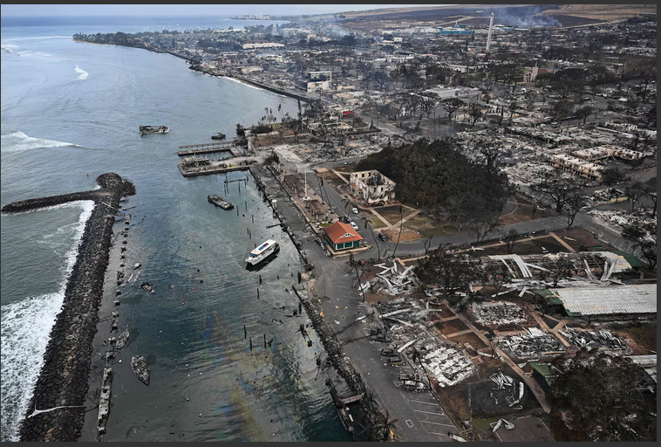
Lahaina, Maui

Slide 35
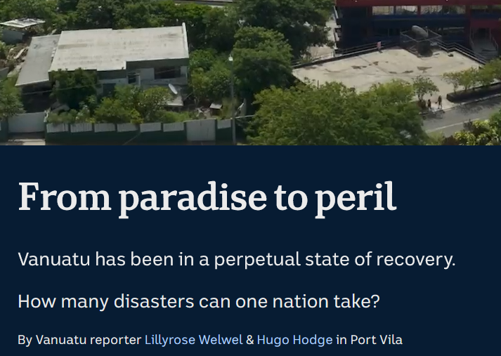
ABC News Friday 21st March 2025

Slide 36
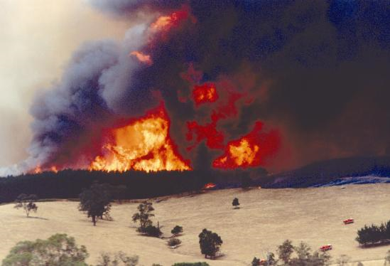

Slide 37
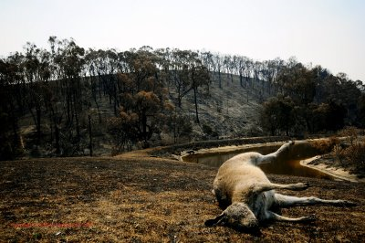

Slide 38
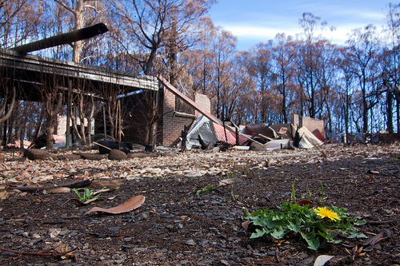

Slide 39
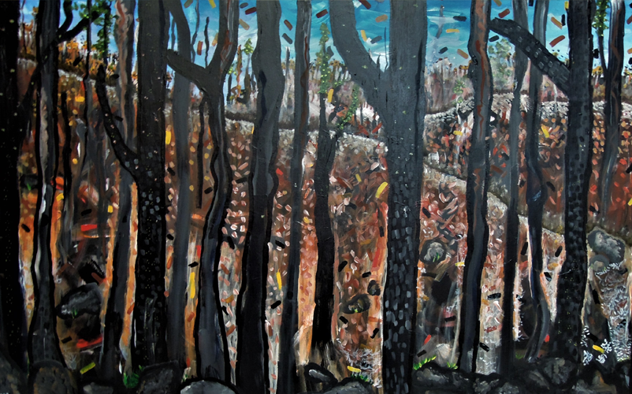

Slide 40
........“What about the eighteen people who were crushed to death when the Tower of Siloam collapsed? Do you think that such a disaster proved that they had offended God more than the rest of the population of Jerusalem? If you do, I can tell you you’re wrong; but I can also tell you that unless you get your lives back on track with God, your number will soon be up too.”

Slide 41
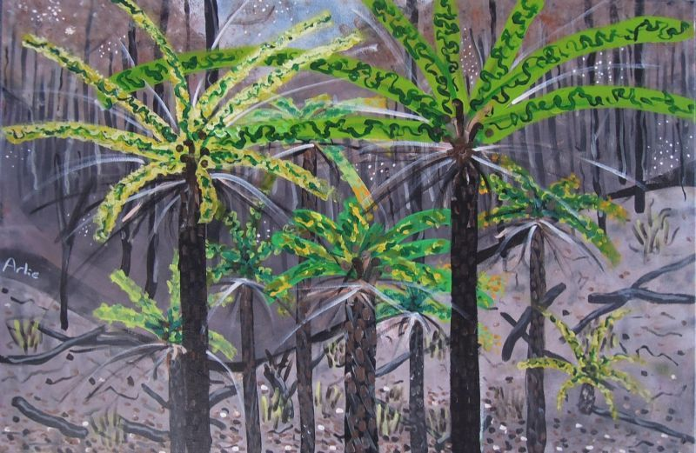
Arlie
Richardson

Slide 42
Then he told a story to illustrate the point: ..“A bloke had a fruit tree planted on his property. One day, after finding that the tree had still not produced any fruit, he ran out of patience with it. He called his gardener and said, ‘I’ve given up on this tree. It’s been here for three years and has produced nothing but leaves. Chop it down! It’s a waste of good soil.’ But the gardener replied, ‘Boss, let’s give it one more year. I’ll loosen up the soil and keep the fertiliser up to it and we’ll see if it gives us a crop next summer. If it does, great; but if there’s still nothing, we’ll take the axe to it then.’”

Slide 43
Arlie
Richardson

Slide 44
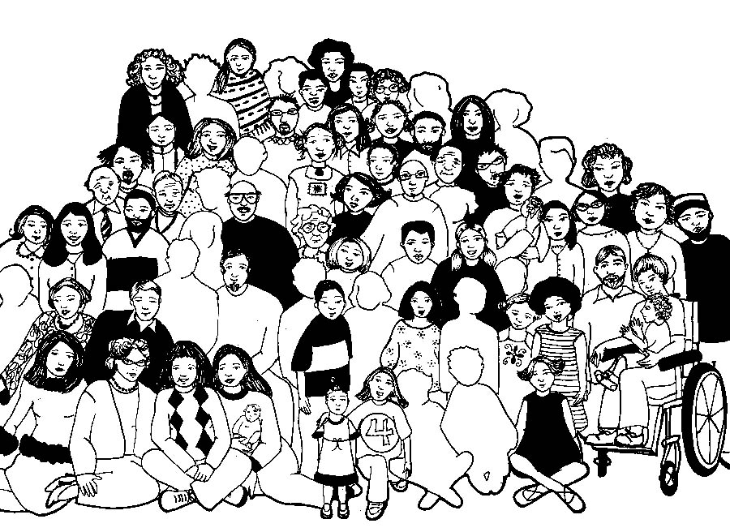

Slide 45
Lord’s Prayer
Our Father in Heaven,
Hallowed be your name,
your kingdom come,
your will be done, on earth as in heaven.
Give us today our daily bread.
Forgive our sins
as we forgive those who sin against us.
Save us from the time of trial
and deliver us from evil.
For the Kingdom, the power,
and the glory are yours now and forever. Amen
Notes:
45

Slide 46
Lord the light of Your love is shining In the midst of the darkness, shining Jesus, Light of the world, shine upon us Set us free by the truth You now bring us Shine on me Shine on me

Slide 47
Shine, Jesus, shine Fill this land with the Father's glory Blaze, Spirit, blaze, Set our hearts on fire Flow, river, flow Flood the nations with grace and mercy Send forth Your Word, Lord And let there be light

Slide 48
Lord, I come into Your awesome presence From the shadows into Your radiance By the blood I may enter Your brightness Search me, try me, consume all my darkness Shine on me Shine on me

Slide 49
Shine, Jesus, shine Fill this land with the Father's glory Blaze, Spirit, blaze, Set our hearts on fire Flow, river, flow Flood the nations with grace and mercy Send forth Your Word, Lord And let there be light

Slide 50
Shine, Jesus, shine Fill this land with the Father's glory Blaze, Spirit, blaze, Set our hearts on fire Flow, river, flow Flood the nations with grace and mercy Send forth Your Word, Lord And let there be light
G Kendrick CCLI 222909

Slide 51
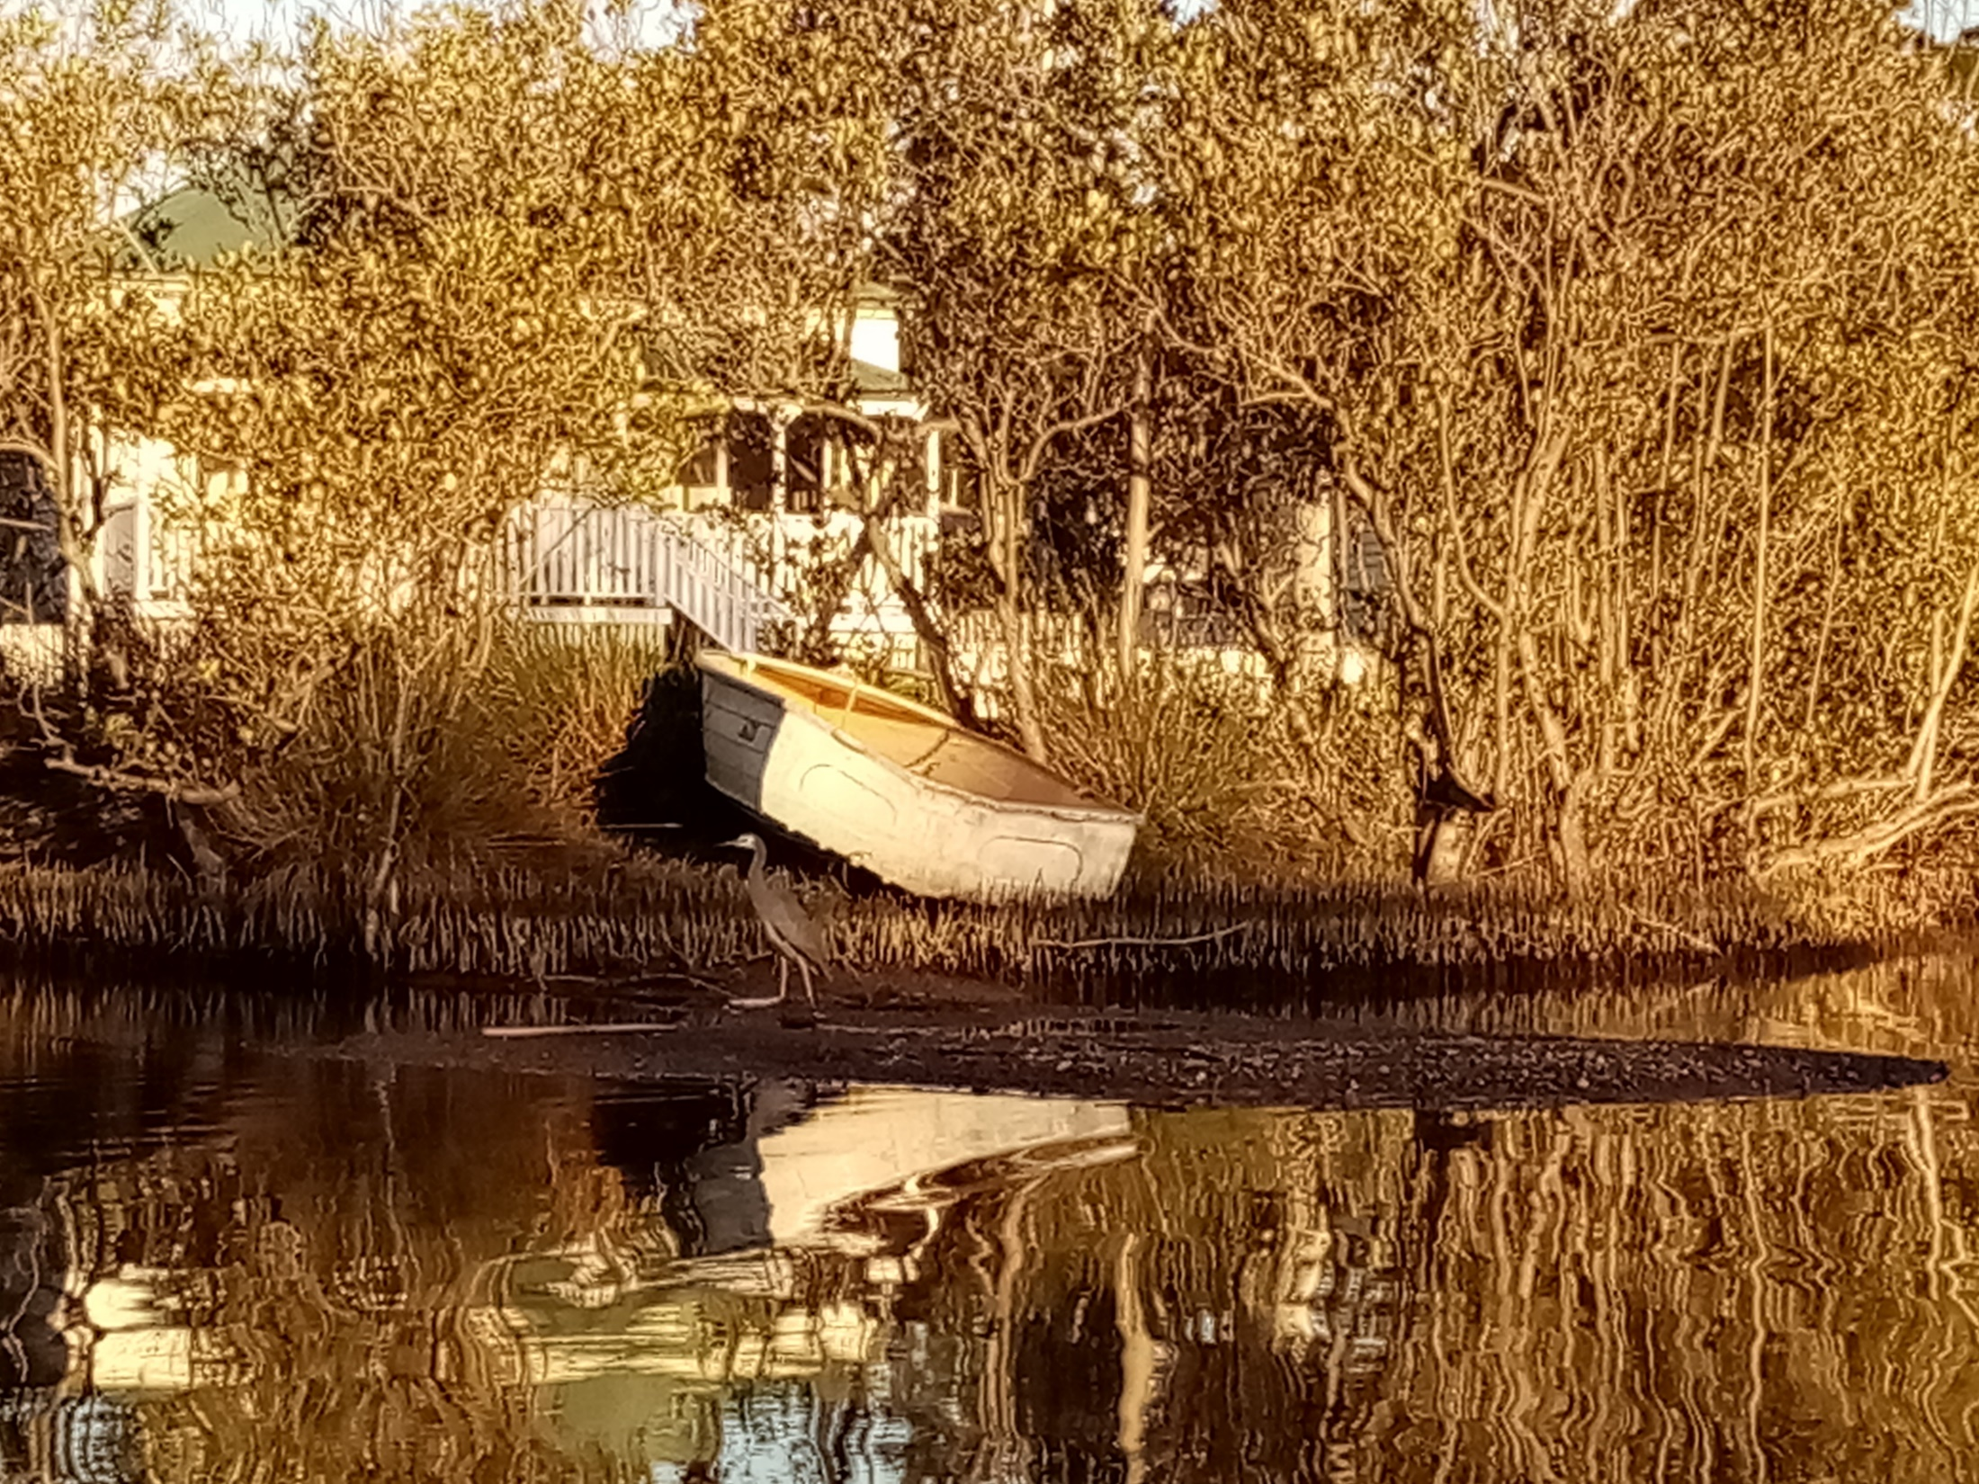

Slide 52
Please follow us over for a drink and a chat after the service

