Slide 2
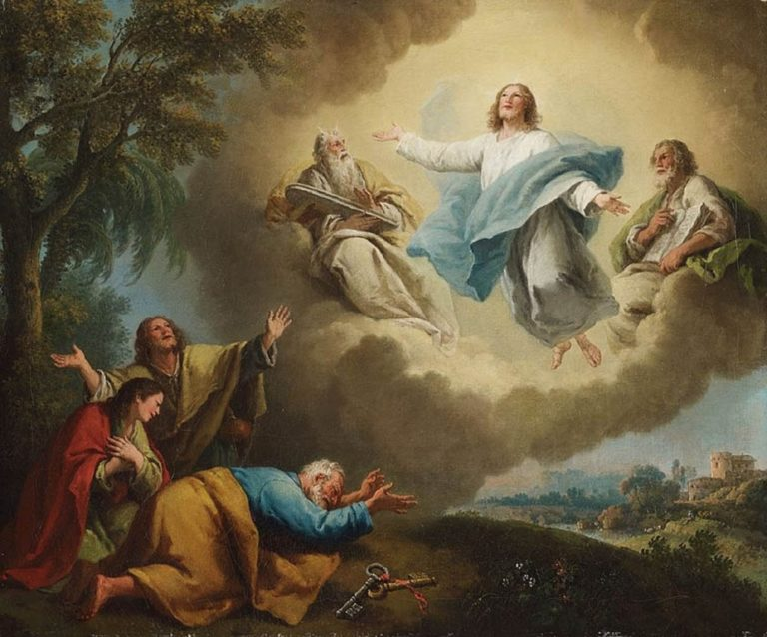
Welcome to worship
at St Georges - Eden
Transfiguration of Jesus

Slide 3
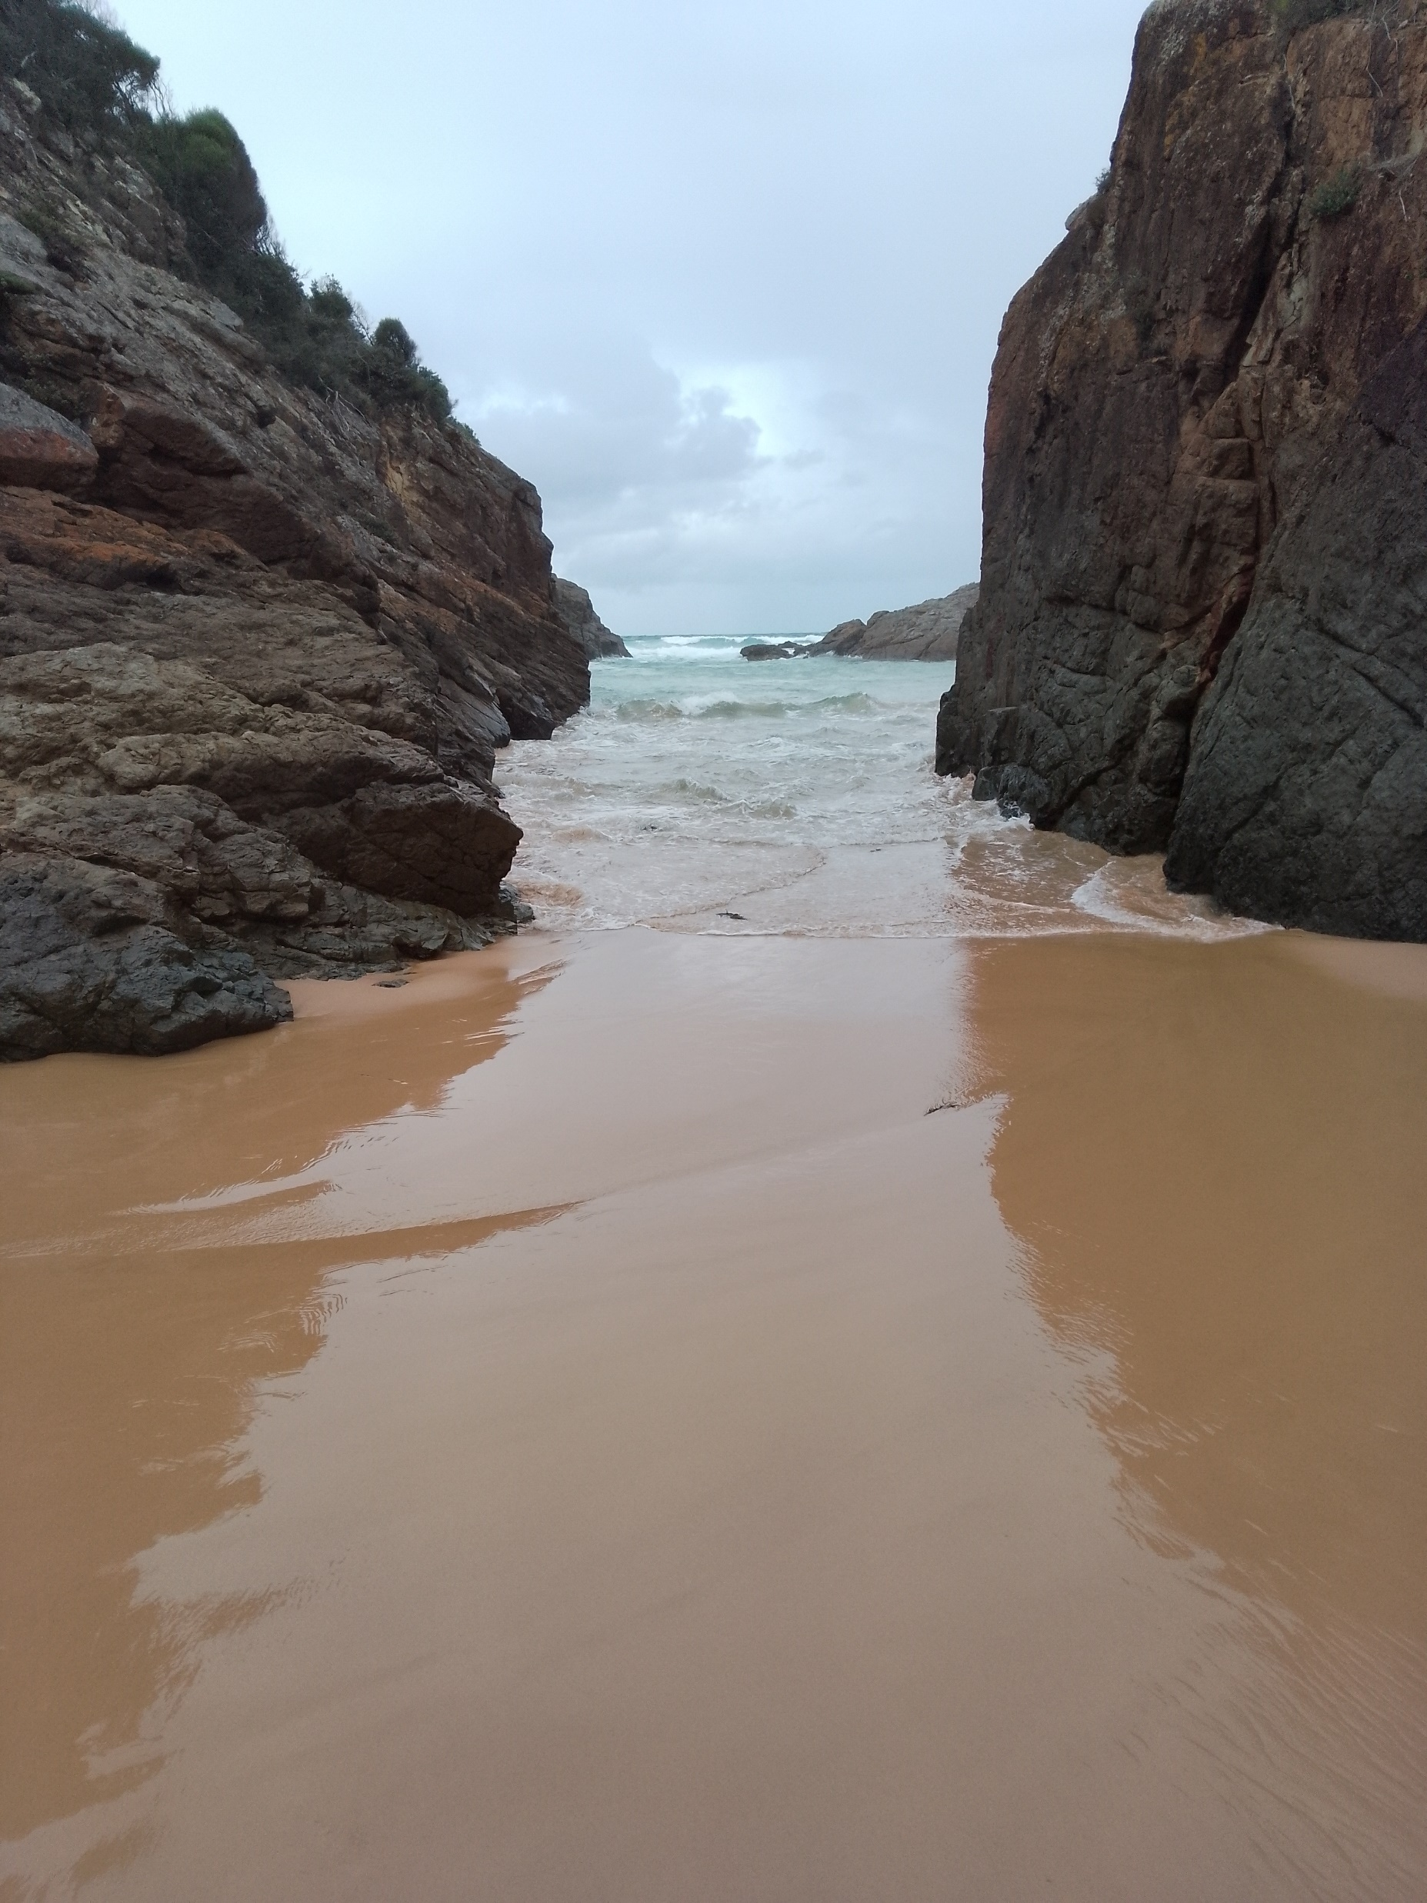

Slide 4
Lord, I lift your name on high, Lord, I love to sing your praises I’m so glad you’re in my life, I’m so glad you came to save us.

Slide 5
You came from heaven to earth to show the way, From the earth to the cross my debt to pay From the cross to the grave, from the grave to the sky, Lord I lift your name on high.

Slide 6
Lord, I lift your name on high, Lord, I love to sing your praises I’m so glad you’re in my life, I’m so glad you came to save us.

Slide 7
You came from heaven to earth to show the way, From the earth to the cross my debt to pay From the cross to the grave, from the grave to the sky, Lord I lift your name on high.

Slide 8
You came from heaven to earth to show the way, From the earth to the cross my debt to pay From the cross to the grave, from the grave to the sky, Lord I lift your name on high. Words & music by Rick Founds © 1989 Maranatha! Music

Slide 9
But we see Jesus, made a little lower Made a little lower than the angels For the suffering of death But we see Jesus, crowned with glory and honour That he by the grace of God Should taste death for every man
SIS 83 Eb x2

Slide 10
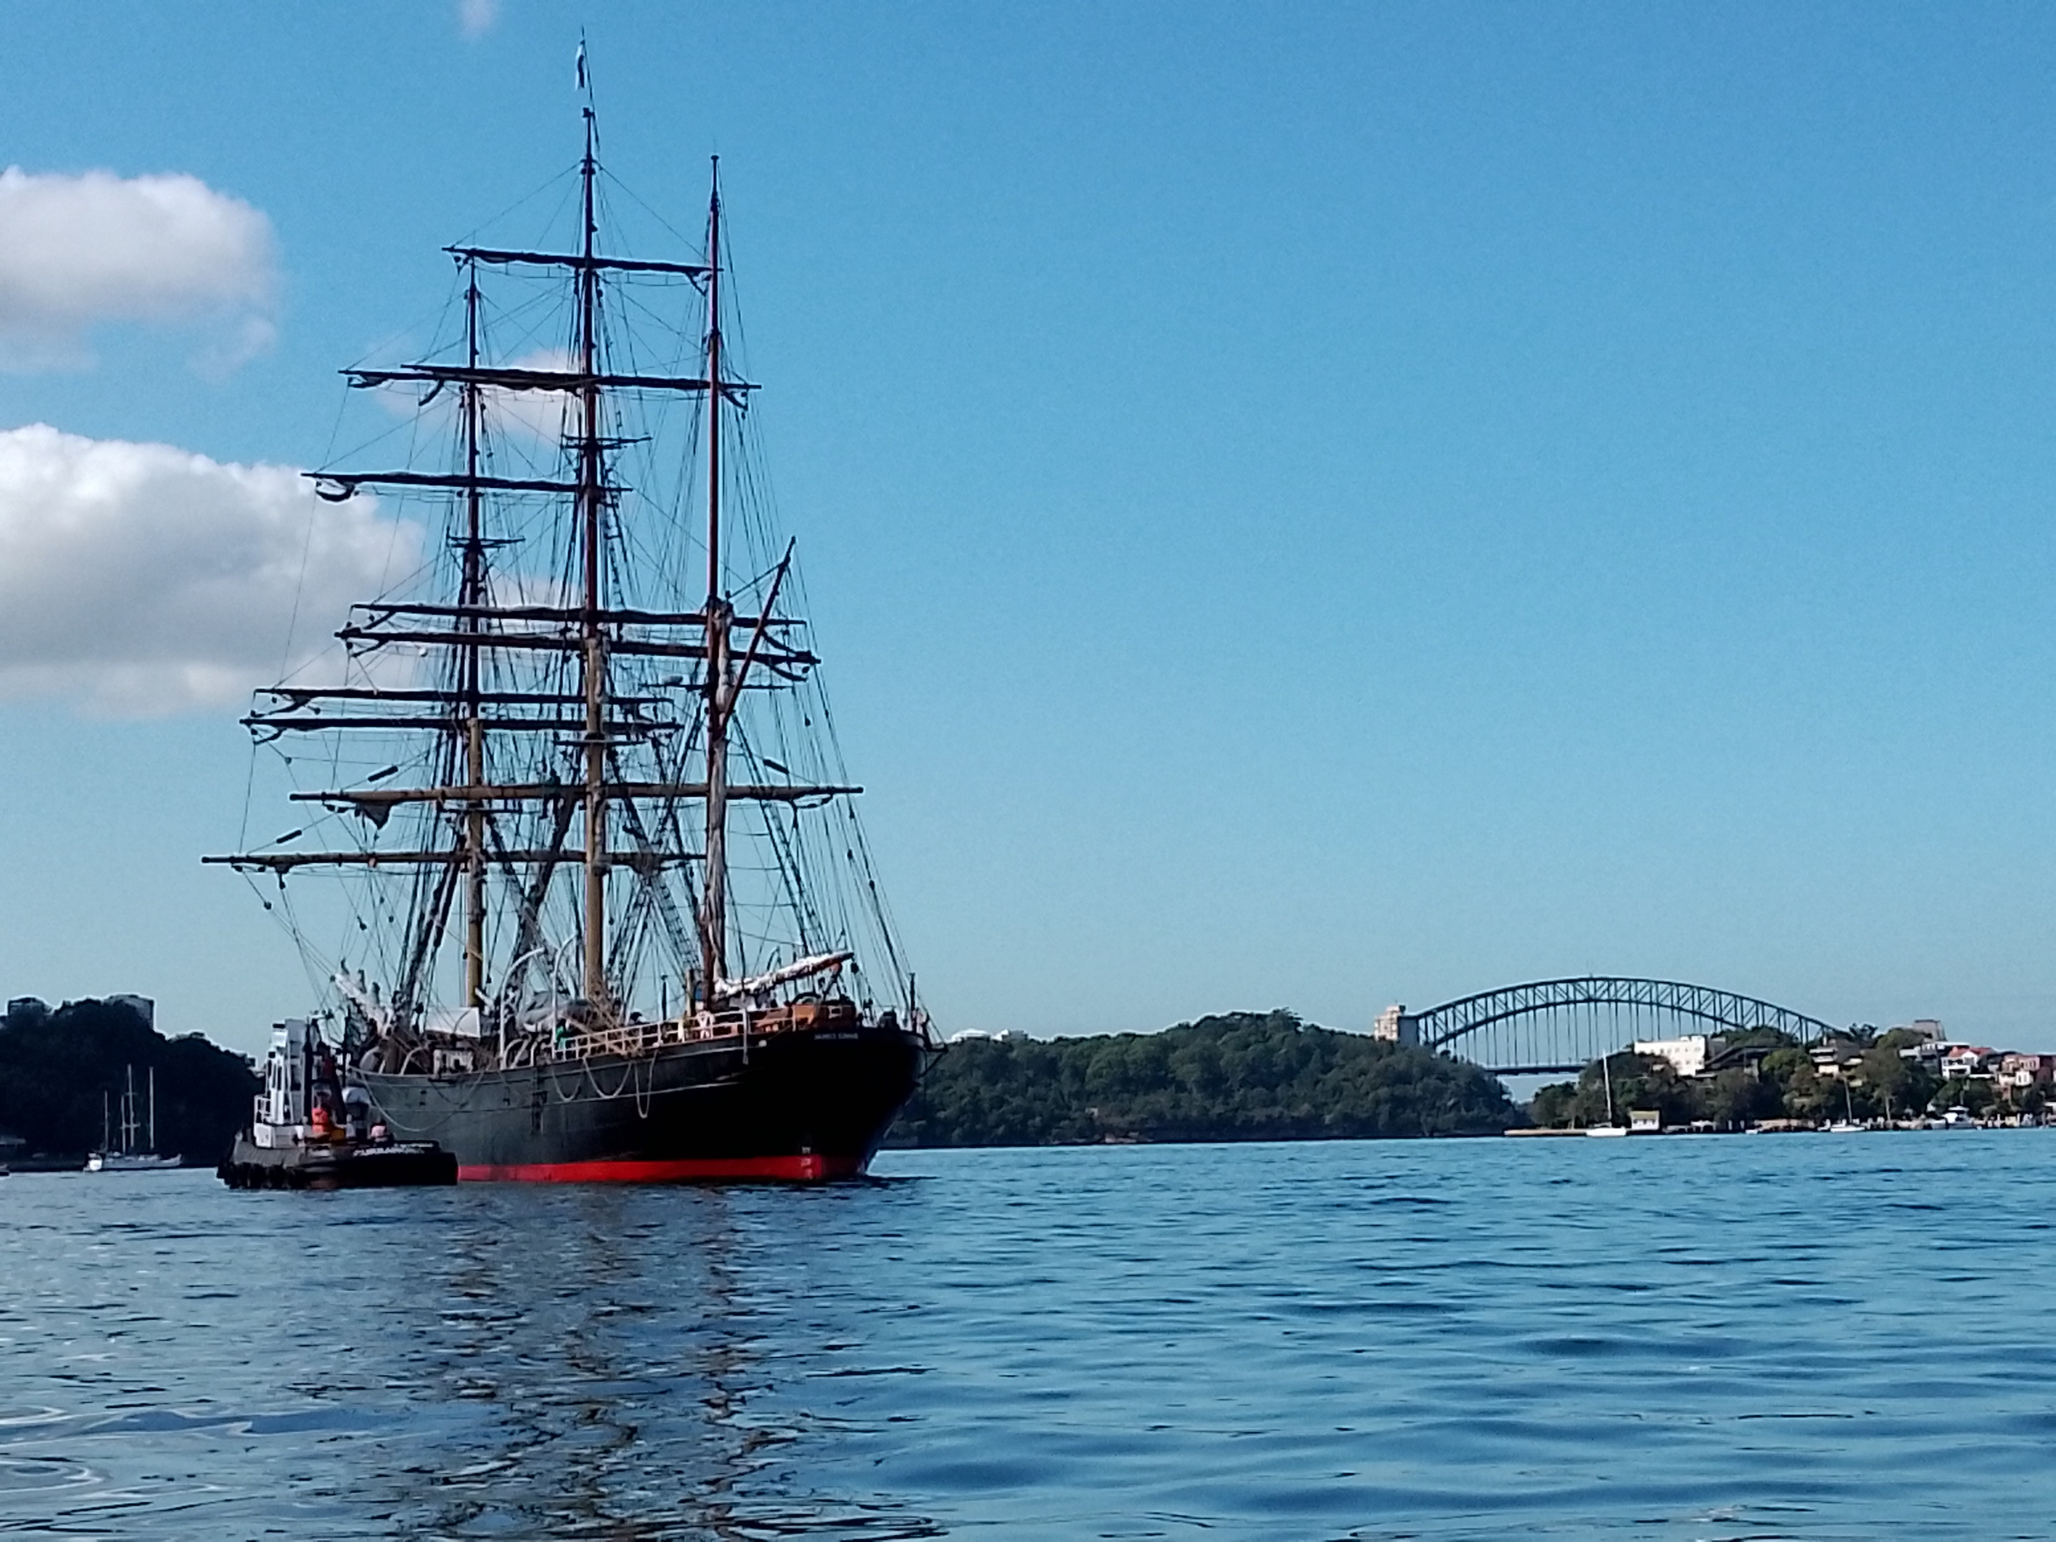

Slide 11
Stir up in us, Loving God, the desire and the determination to glorify you in all our relationships. We pray….
Transfigure Us Lord
Transfigure all who worship You, Dispel self-righteousness and arrogance, discouragement and doubt. May we worship in Spirit and Truth. We pray, ..
Transfigure Us Lord

Slide 12
Transfigure the women and men who preach the Gospel. Enlarge their understanding of Your Word and expand their capacity to love and teach. We pray ..
Transfigure Us Lord
Transfigure the hopes of the down-trodden and dispossessed. Give a new compassion to the strong and the prosperous We pray…
Transfigure Us Lord

Slide 13
Transfigure the values and goals of all leaders. In our churches and in our Nation Inspire them to lead and act justly, to love mercy, and to walk humbly with you. We pray
Transfigure Us Lord
Transfigure the hopes and expectations of the young. Disperse the empty ambitions with which this society indoctrinates them. We pray …
Transfigure Us Lord

Slide 14
Transfigure the anguish of those who tremble or weep, suffer or die today. For all those caught in the agony and futility of war. May the message of peace makers heal the wounds of hatred and revenge. We pray
Transfigure Us Lord
Through Jesus Christ our Lord. Amen!
Transfigure Us Lord

Slide 15
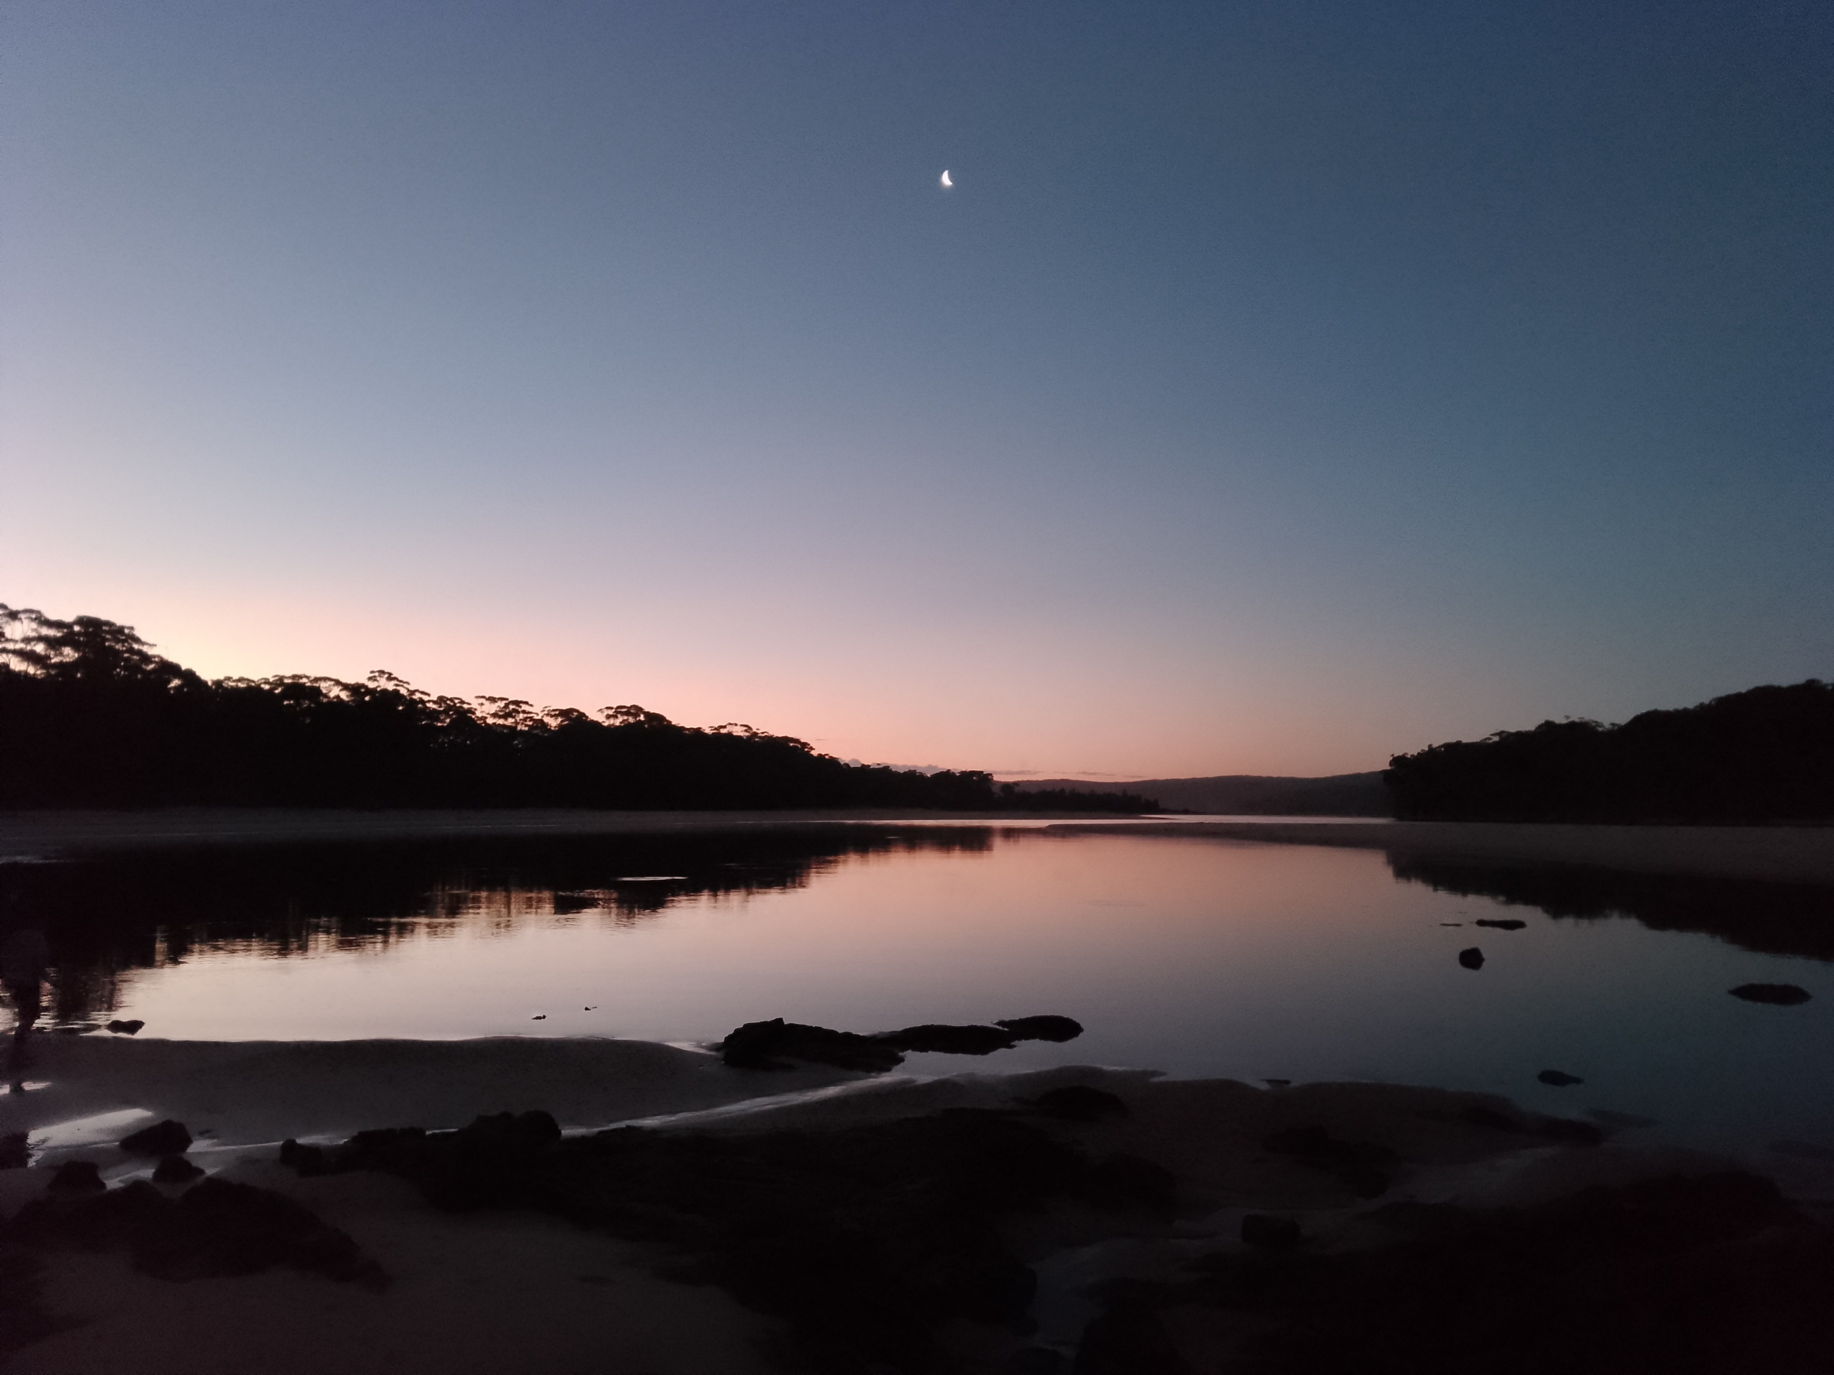

Slide 16
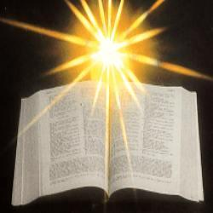

Slide 17
2 Corinthians 3:12-4:2 (NIV)
Therefore, since we have such a hope, we are very bold. We are not like Moses, who would put a veil over his face to prevent the Israelites from seeing the end of what was passing away. But their minds were made dull, for to this day the same veil remains when the old covenant is read. It has not been removed, because only in Christ is it taken away.

Slide 18
Even to this day when Moses is read, a veil covers their hearts. But whenever anyone turns to the Lord, the veil is taken away. Now the Lord is the Spirit, and where the Spirit of the Lord is, there is freedom. And we all, who with unveiled faces contemplate the Lord’s glory, are being transformed into his image with ever-increasing glory, which comes from the Lord, who is the Spirit.

Slide 20
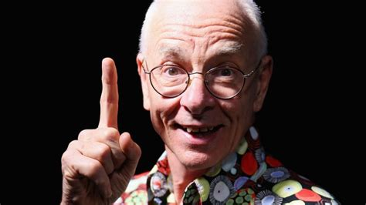

Slide 21
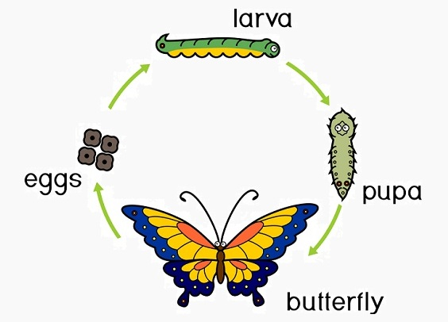
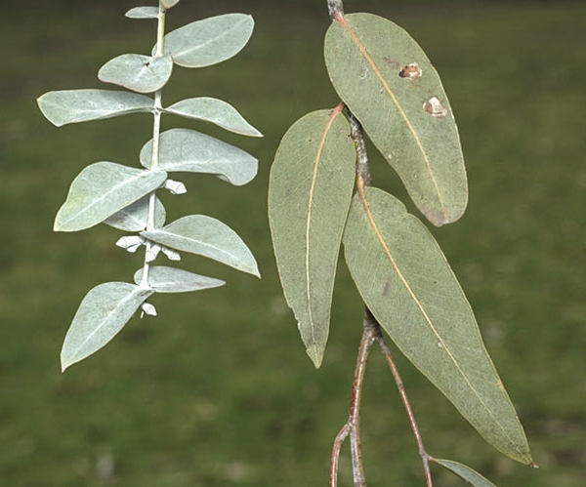

Slide 23
Holy, holy, holy, Lord God Almighty Early in the morning to you our praise shall be, Holy, holy, holy, merciful and mighty, God in three Persons, blessed Trinity.

Slide 24
Holy, holy, holy, All the saints adore thee Casting down their golden crowns around the glassy sea; Cherubim and seraphim falling down before You God everlasting through eternity

Slide 25
Holy, holy, holy, Though the darkness hide You Though the sinful human eye Your glory may not see, You alone are holy, There is none beside You, Perfect in power, in love and purity.

Slide 26
Holy, holy, holy Lord God Almighty. All Your works shall praise Your name in earth and sky and sea. Holy, holy, holy, merciful and mighty, God in three Persons, blessed Trinity.
CCLI No222909
TIS 132 D..Dx4

Slide 28
Luke 9:28-36 New International Version (NIV)
About eight days after Jesus said this, he took Peter, John and James with him and went up onto a mountain to pray. As he was praying, the appearance of his face changed, and his clothes became as bright as a flash of lightning. Two men, Moses and Elijah, appeared in glorious splendour, talking with Jesus.

Slide 29
They spoke about his departure, which he was about to bring to fulfilment at Jerusalem. Peter and his companions were very sleepy, but when they became fully awake, they saw his glory and the two men standing with him. As the men were leaving Jesus, Peter said to him, “Master, it is good for us to be here. Let us put up three shelters—one for you, one for Moses and one for Elijah.” (He did not know what he was saying.)

Slide 30
While he was speaking, a cloud appeared and covered them, and they were afraid as they entered the cloud. A voice came from the cloud, saying, “This is my Son, whom I have chosen; listen to him.” When the voice had spoken, they found that Jesus was alone. The disciples kept this to themselves and did not tell anyone at that time what they had seen.

Slide 31
Transfiguration
- a complete change of form

Slide 32
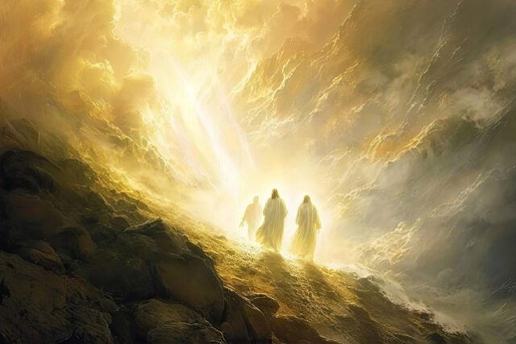

Slide 33
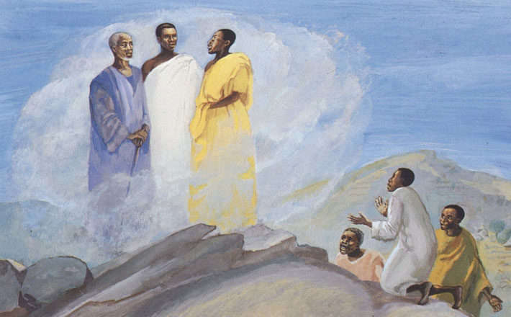

Slide 34
Knowledge
Logic
Feeling
Experience
Each church or congregation
Each person

Slide 35
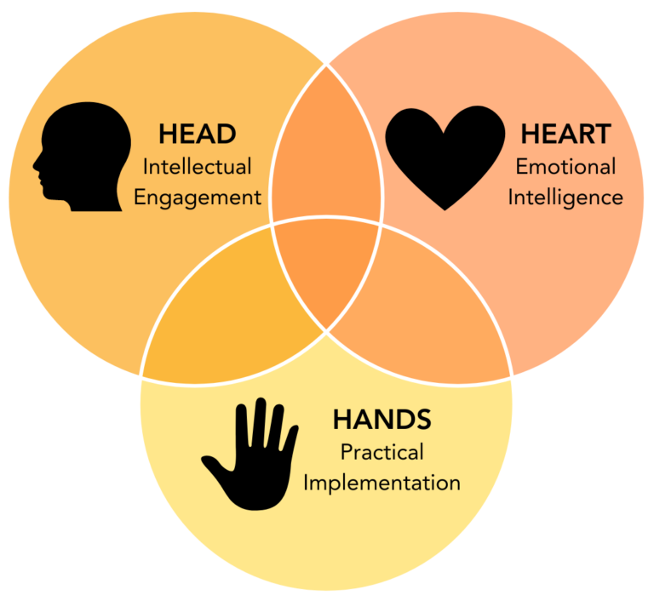
Filters
Paul Livingston on ABC radio Conversations
Knowledge
Wisdom
Learning
Understanding
Feelings
Emotions
Desires
Fears
Actions
Feet and hands
Presence

Slide 36
Paul Livingston on ABC radio Conversations

Slide 37
Earth
Heaven
Earth
Heaven

Slide 38
Did you feel the mountains tremble? Did you hear the oceans roar? When the people rose to sing of Jesus Christ the risen one
04- Did you feel the mountains tremble.mp3

Slide 39
Did you feel the people tremble? Did you hear the singers roar? When the lost began to sing of Jesus Christ the saving one

Slide 40
And we can see that God you're moving A mighty river through the nations And young and old will turn to Jesus Fling wide your heavenly gates Prepare the way of the risen Lord

Slide 41
Open up the doors let the music play Let the streets resound with singing Songs that bring your hope Songs that bring your joy Dancers who dance upon injustice

Slide 42
Do you feel the darkness tremble? When all the saints join in one song And all the streams flow as one river To wash away our brokeness

Slide 43
And here we see that God you're moving A time of Jubilee is coming When young and old return to Jesus Fling wide your heavenly gates Prepare the way of the risen Lord

Slide 44
Open up the doors and let the music play Let the streets resound with singing Open up the doors and let the music play Let the streets resound with singing Songs that bring your hope Songs that bring your joy Dancers who dance upon injustice

Slide 45
Open up the doors and let the music play Let the streets resound with singing Open up the doors and let the music play Let the streets resound with singing Songs that bring your hope Songs that bring your joy Dancers who dance upon injustice

Slide 46
Open up the doors let the music play Let the streets resound with singing Songs that bring your hope and songs that bring your joy Dancers who dance upon injustice Written by Martin Smith ©1995 Curious? Music UK

Slide 47
Notices
World day of prayer. F 7th 11am at Aboriginal Church
Morning Tea- Invitation to Annette’s place in Boydtown or by arrangement with friends
No pantry this week and next. Hampers Tues and Fridays
GoECP sub-committee meeting Tues 2:30 chez Skelton
Faith conversations Wed 5pm in church. Termite theology
Presbytery meeting this Saturday. Invitation rsvp. Catering?
Men’s breakfast cancelled this month
Ladies’ meeting?

Slide 48
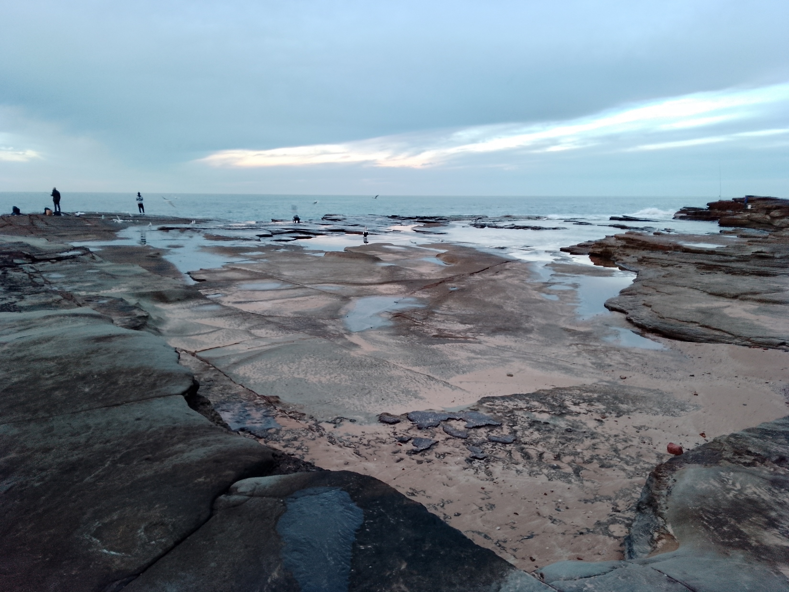
Michael - Intercession

Slide 49
Lord’s Prayer
Our Father in Heaven,
Hallowed be your name,
your kingdom come,
your will be done, on earth as in heaven.
Give us today our daily bread.
Forgive our sins
as we forgive those who sin against us.
Save us from the time of trial
and deliver us from evil.
For the Kingdom, the power,
and the glory are yours now and forever. Amen
Notes:
49

Slide 50
I want to walk as a child of the light; I want to follow Jesus. God set the stars to give light to the world; the star of my life is Jesus.

Slide 51
In him there is no darkness at all; the night and the day are both alike. The Lamb is the light of the city of God: Shine in my heart, Lord Jesus.

Slide 52
I want to see the brightness of God; I want to look at Jesus. Clear Sun of righteousness, shine on my path, and show me the way to the Father.

Slide 53
In him there is no darkness at all; the night and the day are both alike. The Lamb is the light of the city of God: Shine in my heart, Lord Jesus.

Slide 54
I’m looking for the coming of Christ; I want to be with Jesus. When we have run with patience the race, we shall know the joy of Jesus.

Slide 55
In him there is no darkness at all; the night and the day are both alike. The Lamb is the light of the city of God: Shine in my heart, Lord Jesus. TIS 643 C^ Cx3

Slide 56
Follow someone as there will still be a drink and a chat after the service

