Slide 3
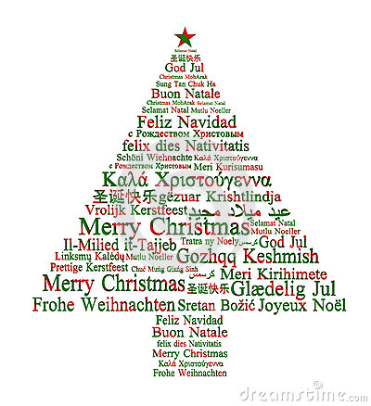

Slide 4
Welcome to worship
at St Georges - Eden

Slide 5
We acknowledge the sovereign First Peoples of these lands and waters
where we meet, the Yuin Nation. We pay our respects to their elders past and present and to all Aboriginal people who have cared for this place since creation.

Slide 6
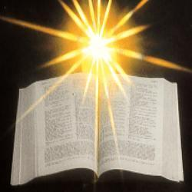

Slide 7
Psalm 128 Praise the Lord! Praise the Lord from the heavens; praise him in the heights!
Praise him, all his angels; praise him, all his host!
Praise him, sun and moon; praise him, all you shining stars!
Praise him, you highest heavens, and you waters above the heavens!
Let them praise the name of the Lord, for he commanded and they were created.

Slide 8
He established them forever and ever; he fixed their bounds, which cannot be passed.
Praise the Lord from the earth, you sea monsters and all deeps,
fire and hail, snow and frost, stormy wind fulfilling his command!
Mountains and all hills, fruit trees and all cedars!
Wild animals and all cattle, creeping things and flying birds!

Slide 9
Kings of the earth and all peoples, princes and all rulers of the earth!
Young men and women alike, old and young together!
Let them praise the name of the Lord, for his name alone is exalted; his glory is above earth and heaven.
He has raised up a horn for his people, praise for all his faithful, for the people of Israel who are close to him. Praise the Lord!! *****

Slide 10
1 Samuel 2:18-20, 26
Samuel was ministering before the Lord, a boy wearing a linen ephod. His mother used to make for him a little robe and take it to him each year, when she went up with her husband to offer the yearly sacrifice. Then Eli would bless Elkanah and his wife, and say, “May the Lord repay you with children by this woman for the gift that she made to the Lord”; and then they would return to their home. Now the boy Samuel continued to grow both in stature and in favour with the Lord and with the people. ******

Slide 11
Colossians 3: 12-17
As God’s chosen ones, holy and beloved, clothe yourselves with compassion, kindness, humility, meekness, and patience. Bear with one another and, if anyone has a complaint against another, forgive each other; just as the Lord has forgiven you, so you also must forgive. Above all, clothe yourselves with love, which binds everything together in perfect harmony. And let the peace of Christ rule in your hearts, to which indeed you were called in the one body. And be thankful.

Slide 12
Let the word of Christ dwell in you richly; teach and admonish one another in all wisdom; and with gratitude in your hearts sing psalms, hymns, and spiritual songs to God. And whatever you do, in word or deed, do everything in the name of the Lord Jesus, giving thanks to God the Father through him *****

Slide 13
Luke 2:41-52
Now every year his parents went to Jerusalem for the festival of the Passover. And when he was twelve years old, they went up as usual for the festival. When the festival was ended and they started to return, the boy Jesus stayed behind in Jerusalem, but his parents did not know it.

Slide 14
Assuming that he was in the group of travellers, they went a day’s journey. Then they started to look for him among their relatives and friends. When they did not find him, they returned to Jerusalem to search for him. After three days they found him in the temple, sitting among the teachers, listening to them and asking them questions. And all who heard him were amazed at his understanding and his answers.

Slide 15
When his parents saw him they were astonished; and his mother said to him, “Child, why have you treated us like this? Look, your father and I have been searching for you in great anxiety.” He said to them, “Why were you searching for me? Did you not know that I must be in my Father’s house?” But they did not understand what he said to them.

Slide 16
Then he went down with them and came to Nazareth, and was obedient to them. His mother treasured all these things in her heart. And Jesus increased in wisdom and in years, and in divine and human favour. *******

Slide 17
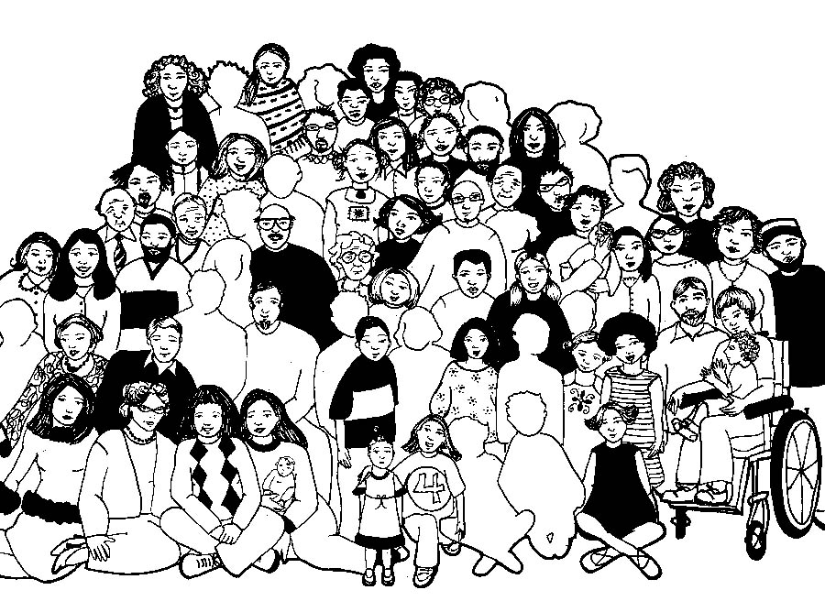

Slide 18
Lord’s Prayer
Our Father in Heaven,
Hallowed be your name,
your kingdom come,
your will be done, on earth as in heaven.
Give us today our daily bread.
Forgive our sins
as we forgive those who sin against us.
Save us from the time of trial
and deliver us from evil.
For the Kingdom, the power,
and the glory are yours now and forever. Amen
Notes:
18

Slide 19
Please follow us over for a drink and a chat after the service

Slide 20
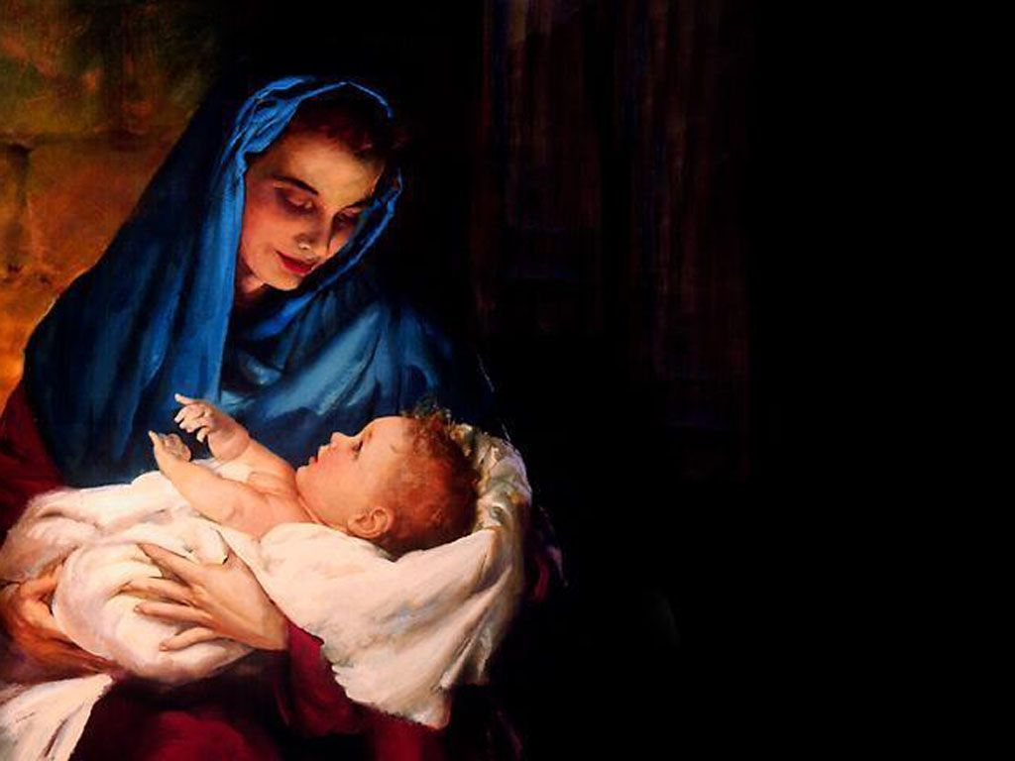
What Child is this, who laid to rest, in Mary’s arms is sleeping? Whom angels greet with anthem sweet, while shepherds watch are keeping?

Slide 22
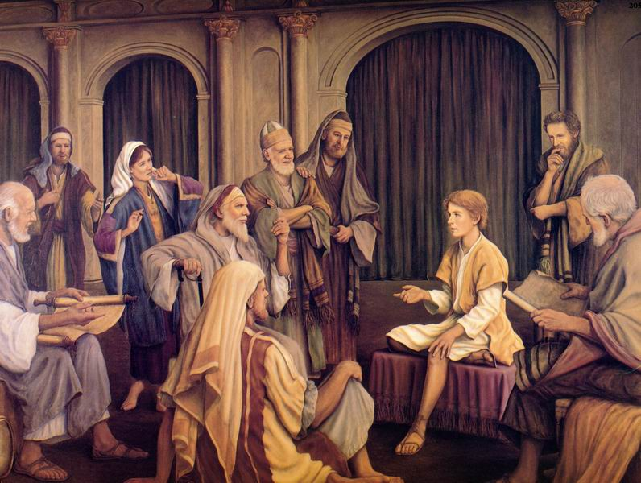

Slide 23
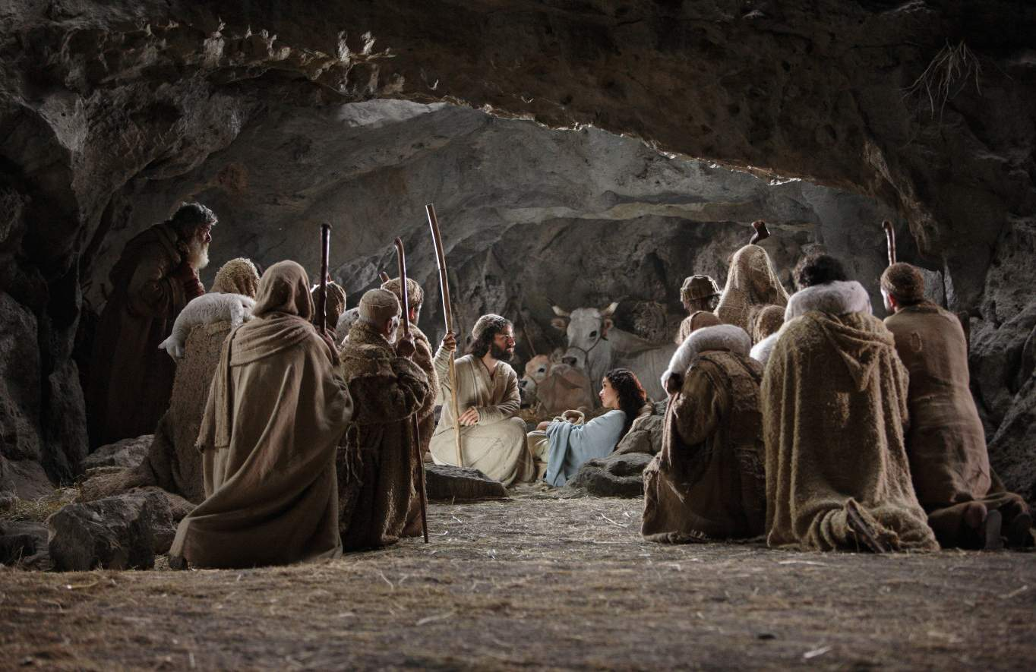
This, this is Christ the King, whom shepherds guard and angels sing; haste, haste to bring Him praise, the Babe, the son of Mary.

Slide 24
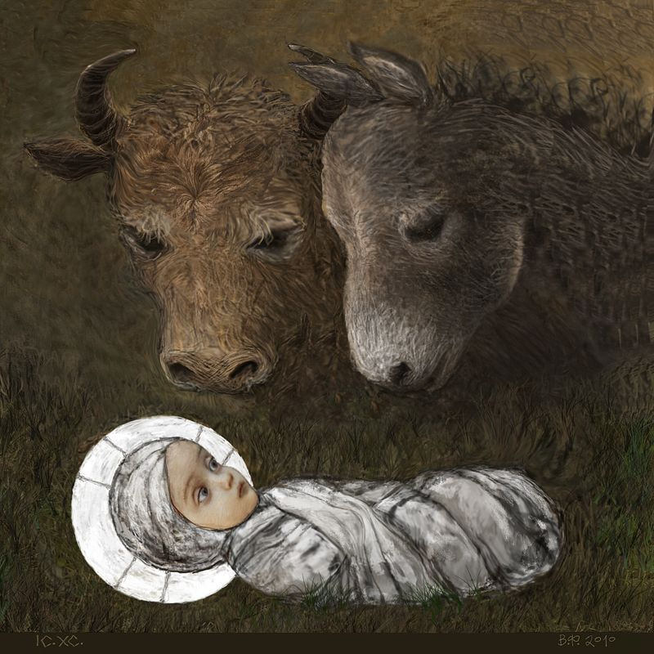
Why lies He in such mean estate where ox and ass are feeding? Good Christian, fear: for sinners here the silent Word is pleading.

Slide 25
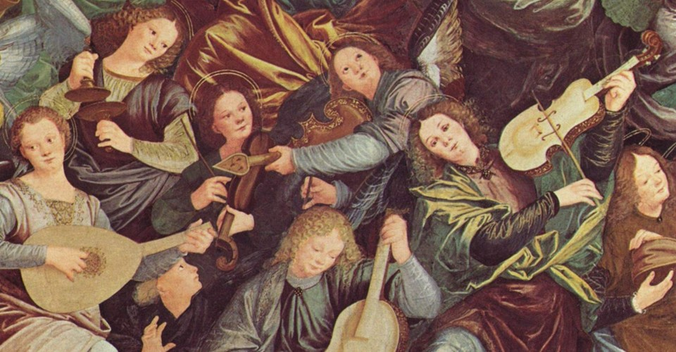
This, this is Christ the King, whom shepherds guard and angels sing; haste, haste to bring Him praise, the Babe, the son of Mary.

Slide 26
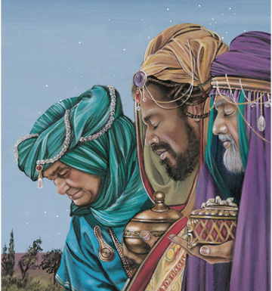
So bring Him incense, gold and myrrh come peasant, king, to own Him; the King of Kings salvation brings, let loving hearts enthrone him.

Slide 27
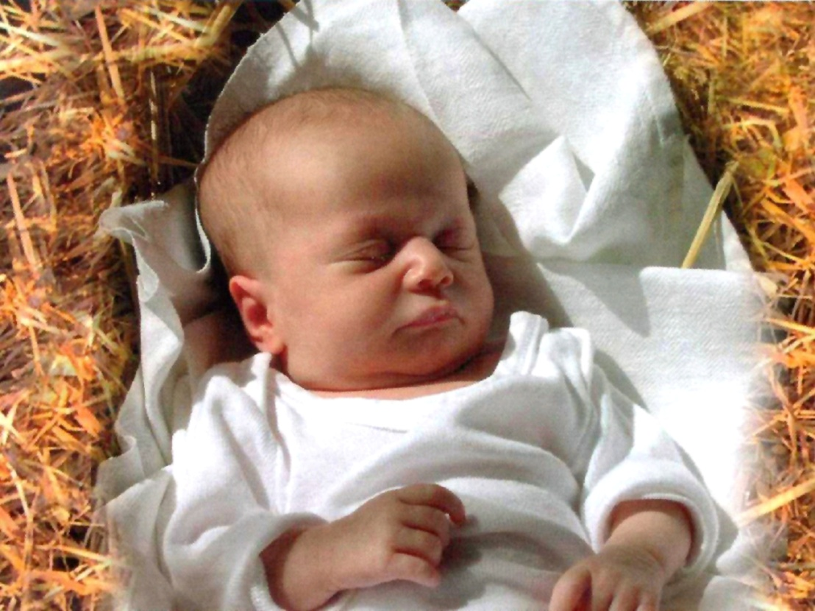
This, this is Christ the King, whom shepherds guard and angels sing; haste, haste to bring Him praise, the Babe, the son of Mary.
Tune Greensleeves Key C, G V,C x3

Slide 28
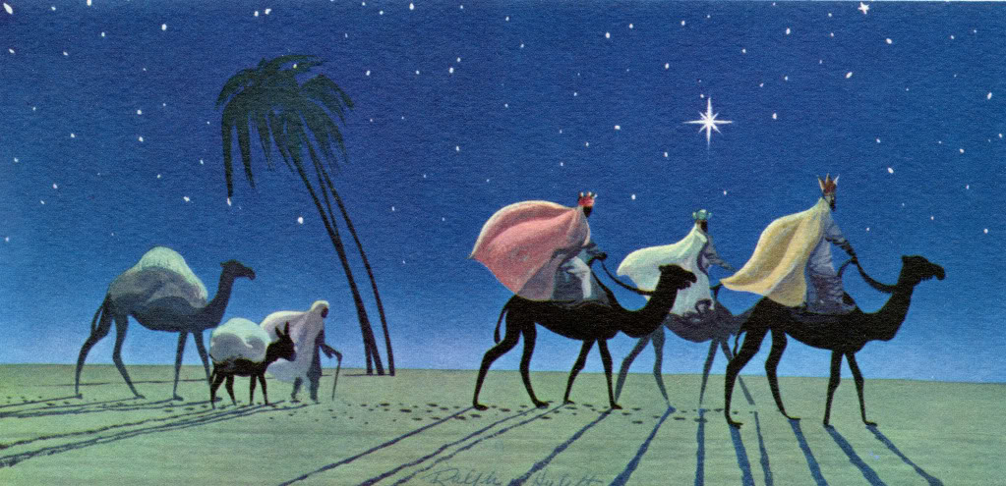
As with gladness, men of old Did the guiding star behold As with joy they hailed its light Leading onward, beaming bright So, most glorious Lord, may we Evermore be led to Thee.

Slide 29
As with joyful steps they sped To that lowly manger bed There to bend the knee before Him Whom Heaven and earth adore; So may we with willing feet Ever seek Thy mercy seat.

Slide 30
As they offered gifts most rare At that simple manger bare; So may we with holy joy, Pure and free from sin’s alloy, All our costliest treasures bring, Christ, to Thee, our heavenly King.
Notes:
Changed rude and bare to simple manger bare

Slide 31
Holy Jesus, every day Keep us in the narrow way; And, when earthly things are past, Bring our ransomed souls at last Where they need no star to guide, Where no clouds Thy glory hide.

Slide 32
In the heavenly country bright, Need they no created light; Thou its Light, its Joy, its Crown, Thou its Sun which goes not down; There forever may we sing Alleluias to our King! CCLI 222909
SOF 31 A^ A x5

Slide 33
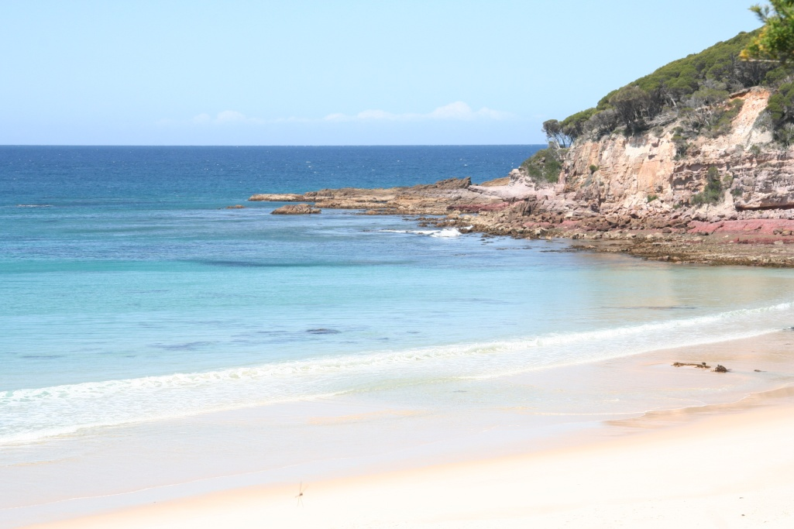
Give thanks with a grateful heart
Give thanks to the Holy One.
Give thanks because He’s given
Jesus Christ, His Son
(Repeat)

Slide 34
And now let the weak say ‘I am strong’,
Let the poor say ‘I am rich’,
Because of what the Lord has done for us.
(Repeat)
(Last time)
Give thanks. Give thanks. Give thanks.
TIS 717
CCLI 222909

Slide 35
10,000 Reasons Matt Redman Video (5min)

