Slide 1
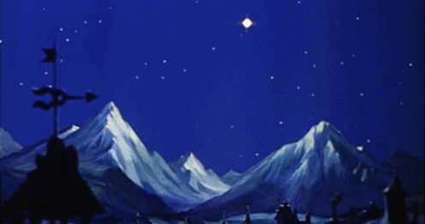
There’s a light upon the mountain and the day is at the spring
When our eyes shall see the beauty
And the glory of the King
Weary was our heart with waiting
And the night-watch seemed so long
But his triumph day is breaking.
And we hail it with a song

Slide 2
There’s a hush of expectation and a quiet in the air and the breath of God is moving in the fervent breath of prayer for the suffering, dying Jesus is the Christ upon the throne and the travail of our spirit is the travail of his own

Slide 3
He is breaking down the barriers he is casting up the way he is calling for his angels to build up the gates of day but his angels here are human, not the shining hosts above for the drum-beats of his army are the heart-beats of our love

Slide 4
Hark, we hear a distant music, and it comes with fuller swell- the great triumph song of Jesus, of our King, Immanuel: Zion, go you forth to meet him and my soul be swift to bring all your finest and your dearest for the triumph of our King. Henry Burton 1840 -1930 TiS.276 G D

Slide 5
Revelation 1:4b–8 John writing …… To the seven churches in the province of Asia: Grace and peace to you from him who is, and who was, and who is to come, and from the seven spirits before his throne, and from Jesus Christ, who is the faithful witness, the firstborn from the dead, and the ruler of the kings of the earth.

Slide 6
To him who loves us and has freed us from our sins by his blood, and has made us to be a kingdom and priests to serve his God and Father—to him be glory and power for ever and ever! Amen. “Look, he is coming with the clouds,” and “every eye will see him, even those who pierced him”; and all peoples on earth “will mourn because of him.” So shall it be! Amen.

Slide 7
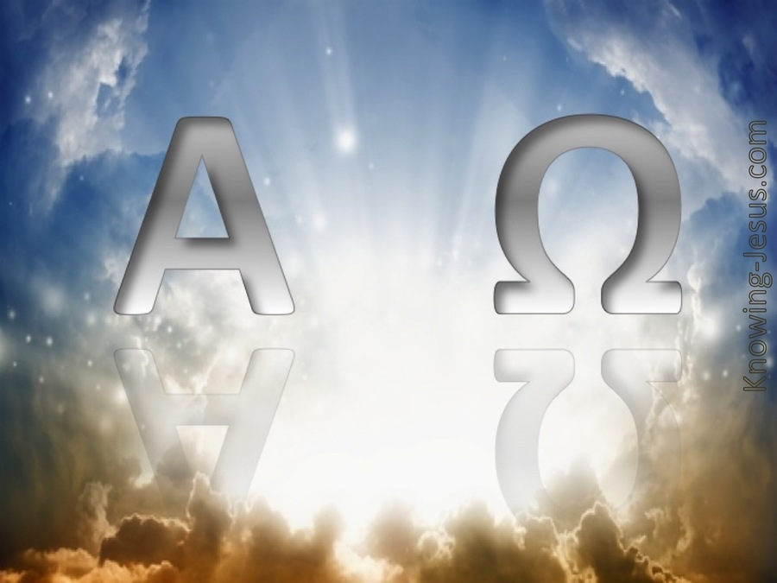
“I am the Alpha and the Omega,” says the Lord God, “who is, and who was, and who is to come, the Almighty.”

Slide 8
Or use video of the John passage instead of files that follow

Slide 9
John 18:33-37
Then Pilate entered the headquarters again, summoned Jesus, and asked him, ‘Are you the King of the Jews?’ Jesus answered, ‘Do you ask this on your own, or did others tell you about me?’ Pilate replied, ‘I am not a Jew, am I? Your own nation and the chief priests have handed you over to me. What have you done?’

Slide 10
Jesus answered, ‘My kingdom is not from this world. If my kingdom were from this world, my followers would be fighting to keep me from being handed over to the Jews. But as it is, my kingdom is not from here.’ Pilate asked him, ‘So you are a king?’ Jesus answered, ‘You say that I am a king. For this I was born, and for this I came into the world, to testify to the truth. Everyone who belongs to the truth listens to my voice.’

Slide 11
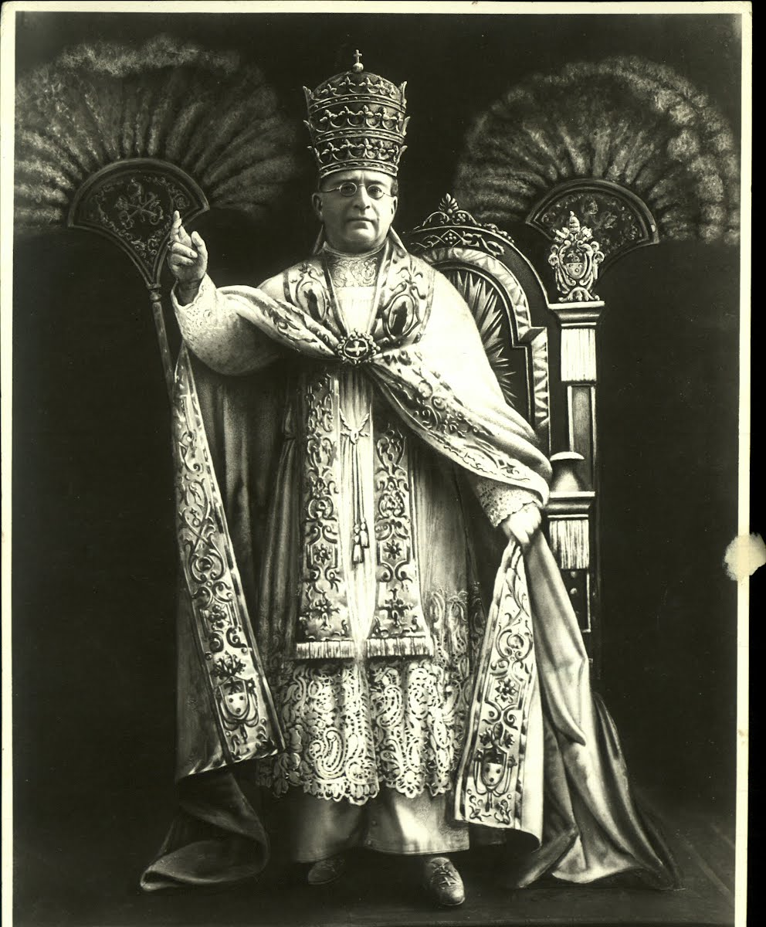
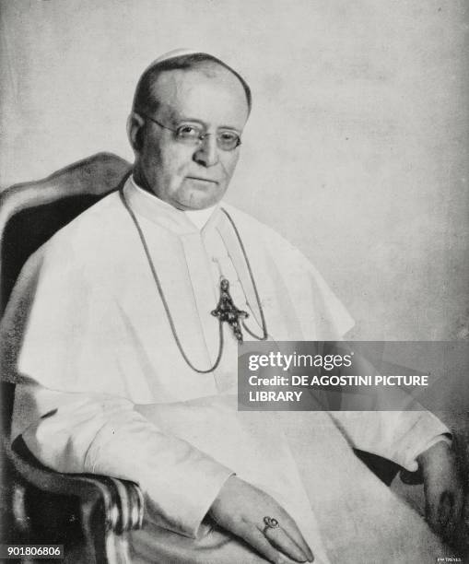
Pope Pius XI

Slide 12
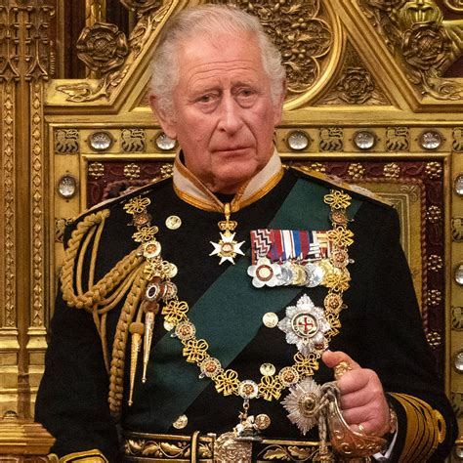
King Charles III

Slide 13
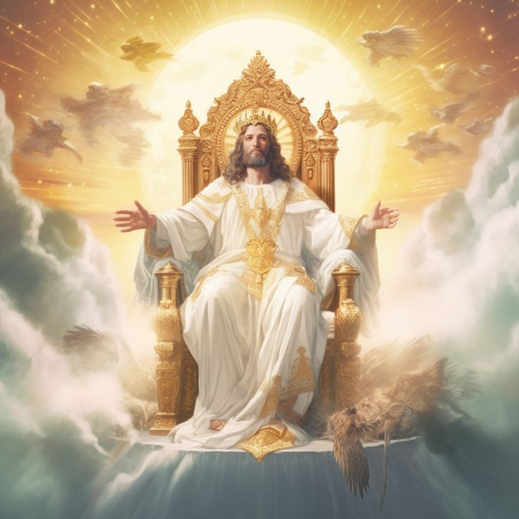

Slide 14
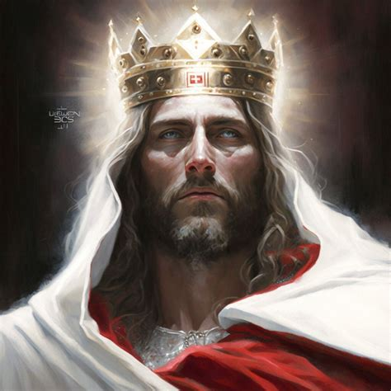
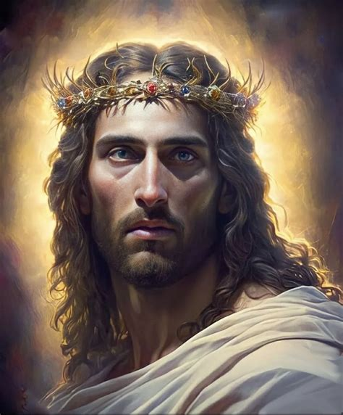

Slide 15
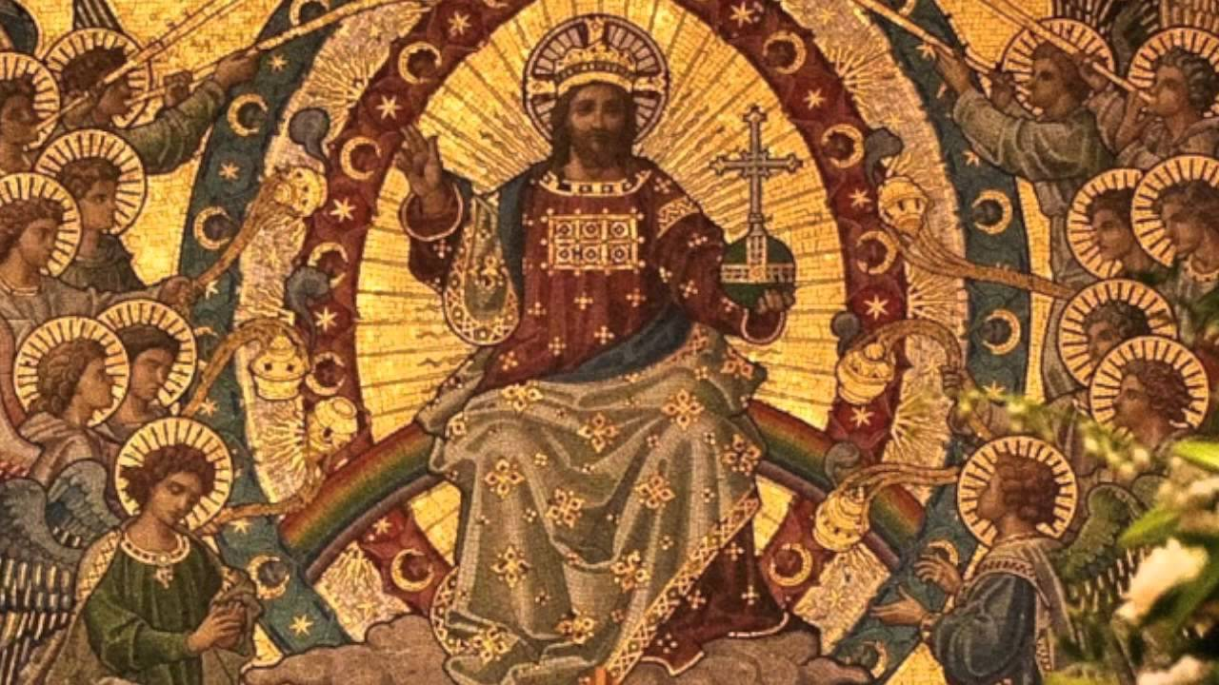

Slide 16
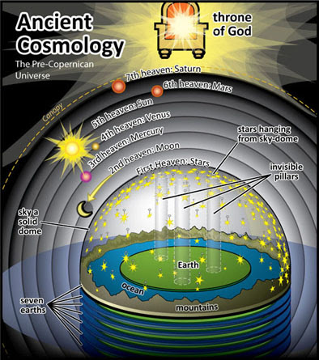

Slide 18
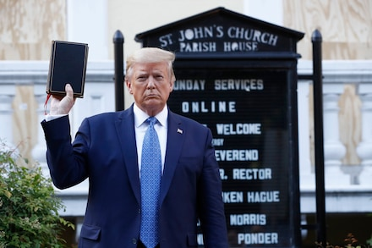
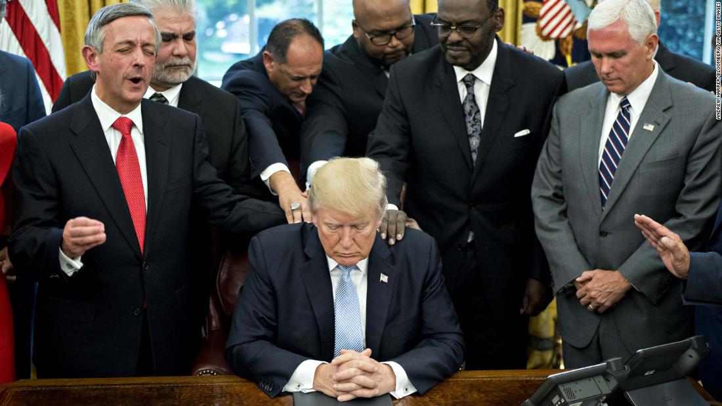

Slide 19
John 18: Verse 38 “What is truth?” retorted Pilate. With this he went out again to the Jews gathered there and said, “I find no basis for a charge against him.

