Slide 1
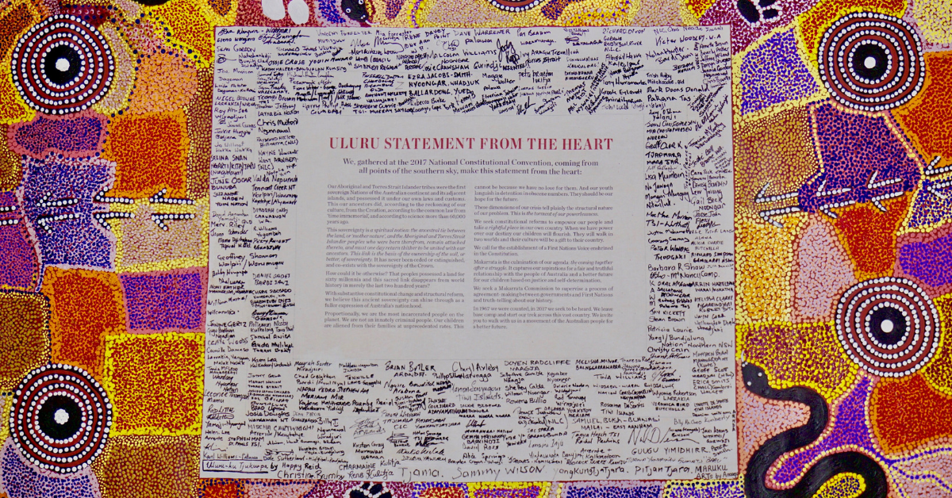
Building Bridges of Understanding with our First Peoples

Slide 2
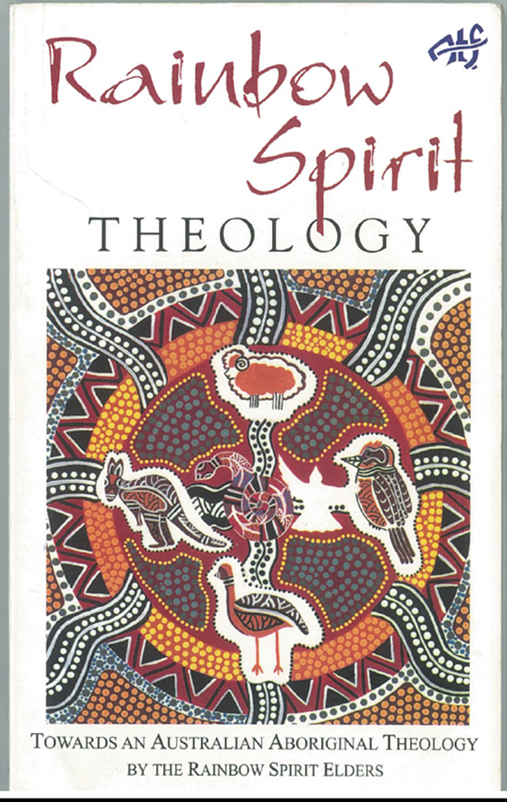

Slide 3
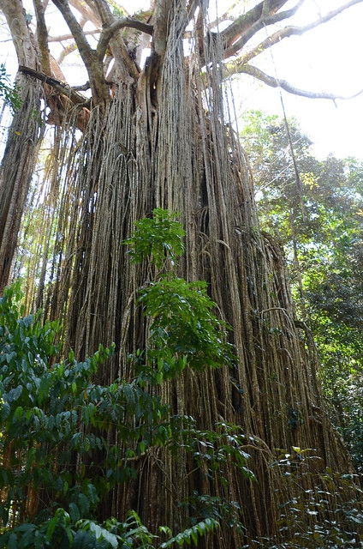
The Curtain Fig, Yungaburra

Slide 4
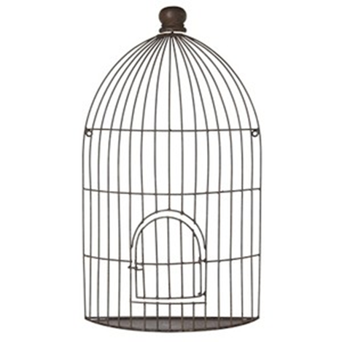
The Bird Cage

Slide 5
Bird Cage Experience for First Peoples & Later Comers

Slide 6
The impact of colonisation on the Spirit of People “The Creator Spirit is crying because the deep spiritual bonds with the land and its people have been broken...The Creator Spirit is suffering because of what has happened to the land. Many Aboriginal people do not realise that our suffering and pain are not caused by drink, drugs or city life, but is a result of our losing our spiritual connection with the land. When Aboriginal people are taken from our spiritual homes we also lose our spiritual contact with the Creator Spirit” (Rainbow Spirit Theology, p42)

Slide 7
“Our elders who knew the law and were responsible for sustaining the life-forces of the land have been removed. We can no longer keep the law of the land and maintain our trust as custodians of the land. But we long to do so again.” (Rainbow Spirit Theology, p47)

Slide 8
The Aboriginal Gift Many Australians hunger for a deeper relationship to the land in which they live. The fact that there are moments when the experience of this land opens out towards transcendence provides the basis for hope that we can learn to relate to the land in a creative way. ... In this area as in others, Aboriginal religion has a providential word to speak to Christian faith.” Denis Edwards, ‘The Aboriginal Gift’, Eugene Stockton

Slide 9
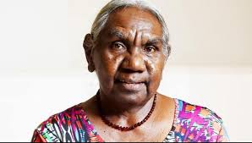
Dr Miriam-Rose Ungunmerr Baumann

Slide 10
Dadirri: an invitation to listen and wait “My people are used to the struggle, and the long waiting. We still wait for the white people to understand us better. We ourselves had to spend many years learning about the white man's ways. Some of the learning was forced; but in many cases people tried hard over a long time, to learn the new ways.

Slide 11
We have learned to speak the white man's language. We have listened to what he had to say. This learning and listening should go both ways. We would like people in Australia to take time to listen to us. We are hoping people will come closer. We keep on longing for the things that we have always hoped for - respect and understanding…

Slide 12
I would like to conclude…by saying again that there are deep springs within each of us. Within this deep spring, which is the very Spirit of God, is a sound. The sound of Deep calling to Deep. The sound is the word of God - Jesus.

Slide 13
Today, I am beginning to hear the Gospel at the very level of my identity. ……If our culture is alive and strong and respected, it will grow. It will not die. And our spirit will not die. And I believe that the spirit of dadirri that we have to offer will blossom and grow, not just within ourselves, but in our whole nation.” Dr Miriam-Rose Ungunmerr Baumann

Slide 14
Celebrating the Covenant between the Uniting Aboriginal & Islander Christian Congress and Uniting Church in Australia

Slide 15
In introducing the Covenant Jill Tabart, then President of the UCA began: “We meet in the presence of God who through the life, death and resurrection of Jesus Christ has reconciled us to God and to one another in the power of the Holy Spirit…. as people who share in this covenant, we are called to carry out faithfully Christ's command to love one another and to order our life in the church in truth and justice.”

Slide 16
UAICC, through its Chair Pastor Bill Hollingsworth responded: We pray that God will guide you together with us in developing a covenant to walk together practically so that the words of your statement may become a tangible expression of His justice and love for all creation. We ask you to remember this covenant by remembering that our land is now also sustaining your people by God's grace.”

Slide 17
Renewing our Covenant with UAICC
This Circle is a space for walking together as First and Second Peoples, for listening to and sharing of the experiences of our First Nations peoples and living out our covenantal relationship. Together we see a destiny together, praying and working for a fuller expression of our reconciliation in Jesus Christ.

Slide 18
Renewing our Covenant Commitment with UAICC We light a candle of hope, healing and new life, renewing our commitment to the covenant signed on 10 July 1994 between the Assembly of the Uniting Church in Australia and the Uniting Aboriginal and Islander Christian Congress. Will you join us in making the following commitment? (If able, please stand)

Slide 19
We are committed to continuing the journey into the future in partnership with our Uniting Aboriginal and Islander Christian Congress colleagues and one another. Prayerfully we will search in our own hearts and reflect on our own attitudes which alienate us from one another.

Slide 20
Together we will work for a future in which we are all able to contribute our gifts to this nation. We will work to end the injustices and prejudices which continue to sideline our First Peoples. We will learn and teach the paths of justice, respect and reconciliation so that we may walk together down this road.

Slide 21
We will work till a person’s lot is not determined by their ancestry or skin colour; and young people no longer bear a grudge against society because it treats their history and culture unfairly.

Slide 22
We will work till the history of 60,000 years is honoured together with the history of the last two centuries; till the glorious parts are celebrated with pride, and the dishonourable parts are acknowledged with shame.

Slide 23
In Christ we pray for a united Australia which respects the prior and continuing custodianship, culture and heritage of Aboriginal and Torres Strait Islander peoples; ensuring justice and equity for all. In the name of Christ: Amen

