Slide 2
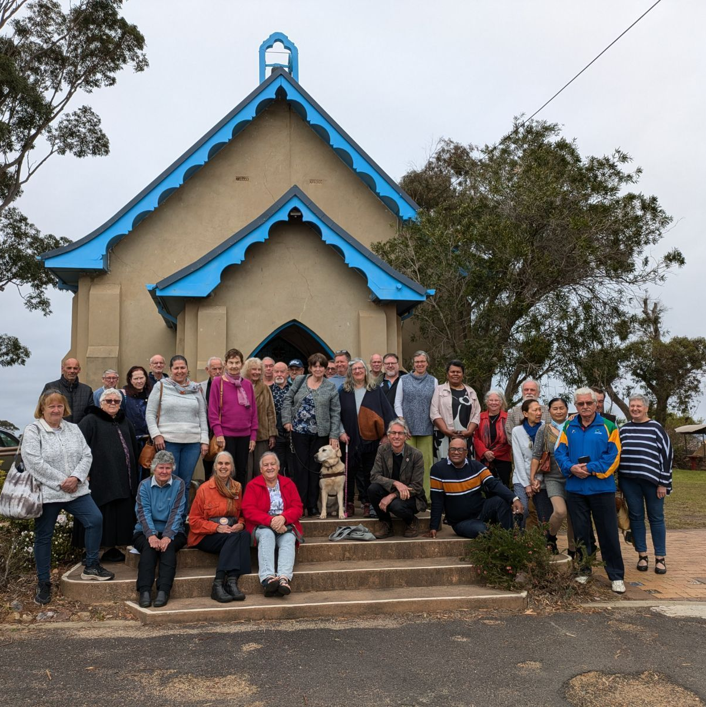
Welcome to worship
at St Georges - Eden

Slide 3
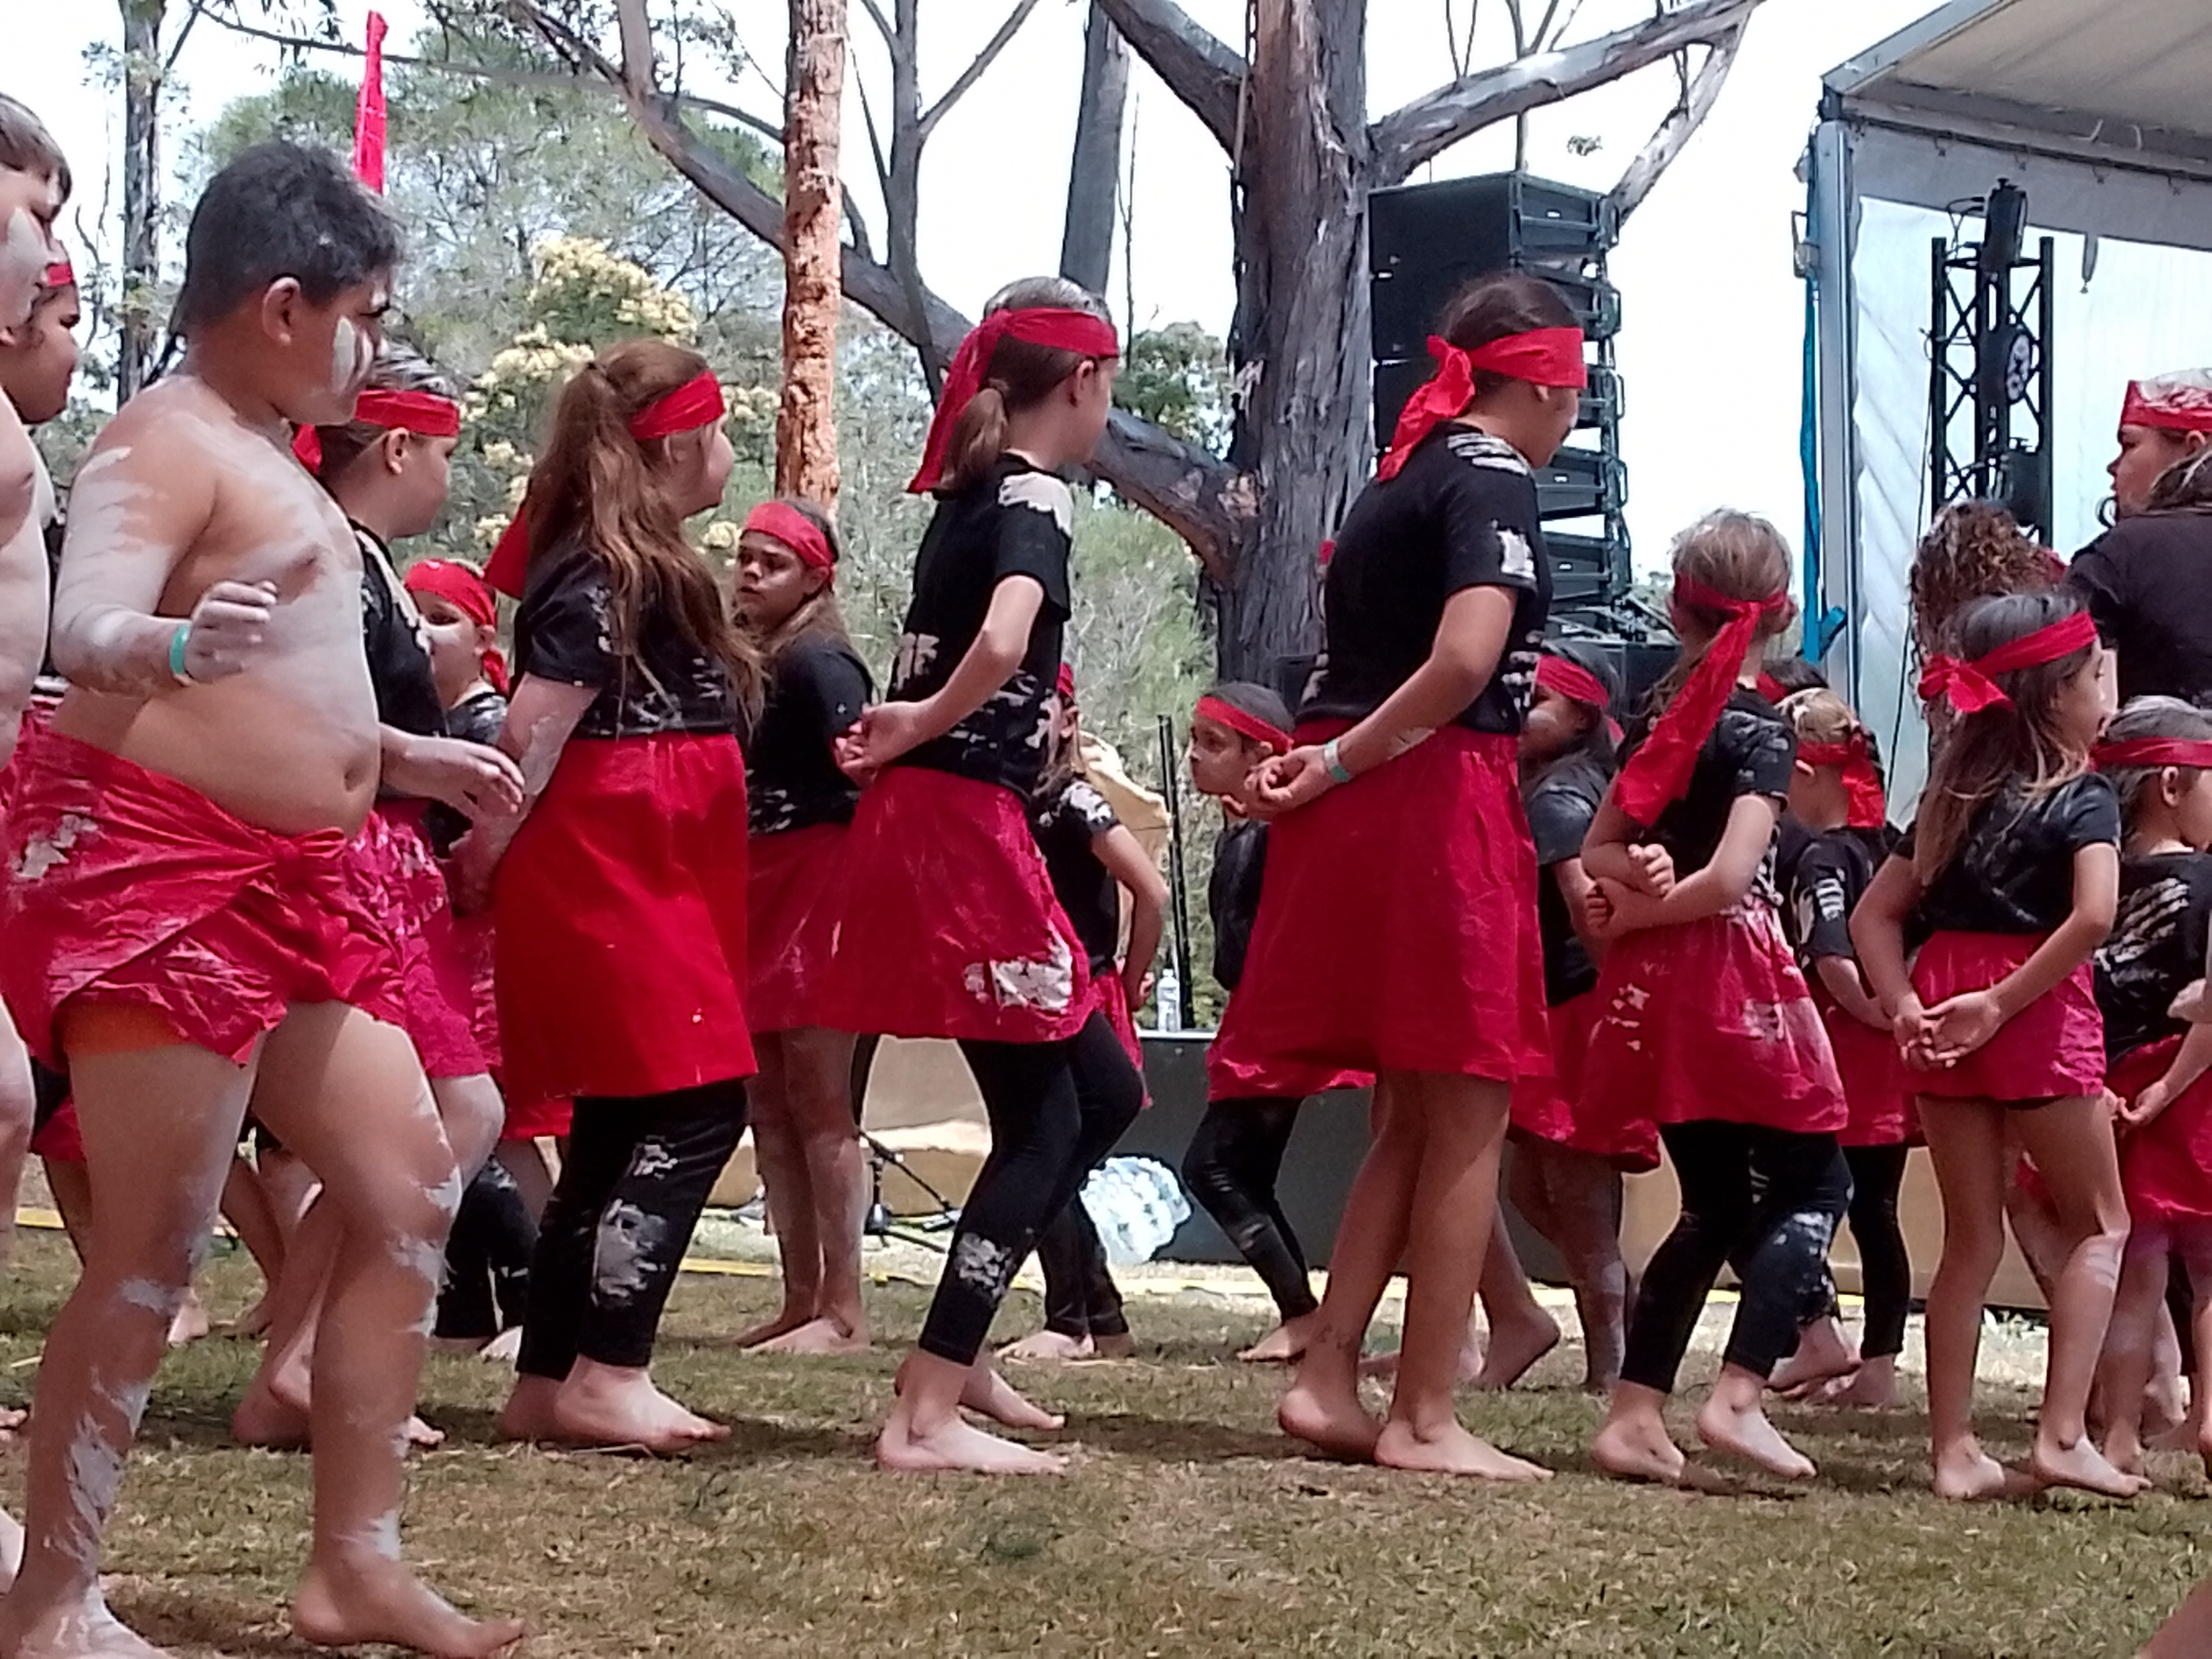
We acknowledge the sovereign First Peoples of these lands and waters
where we meet, the Yuin Nation. We pay our respects to their elders past and present and to all Aboriginal people who have cared for this place since creation.

Slide 4
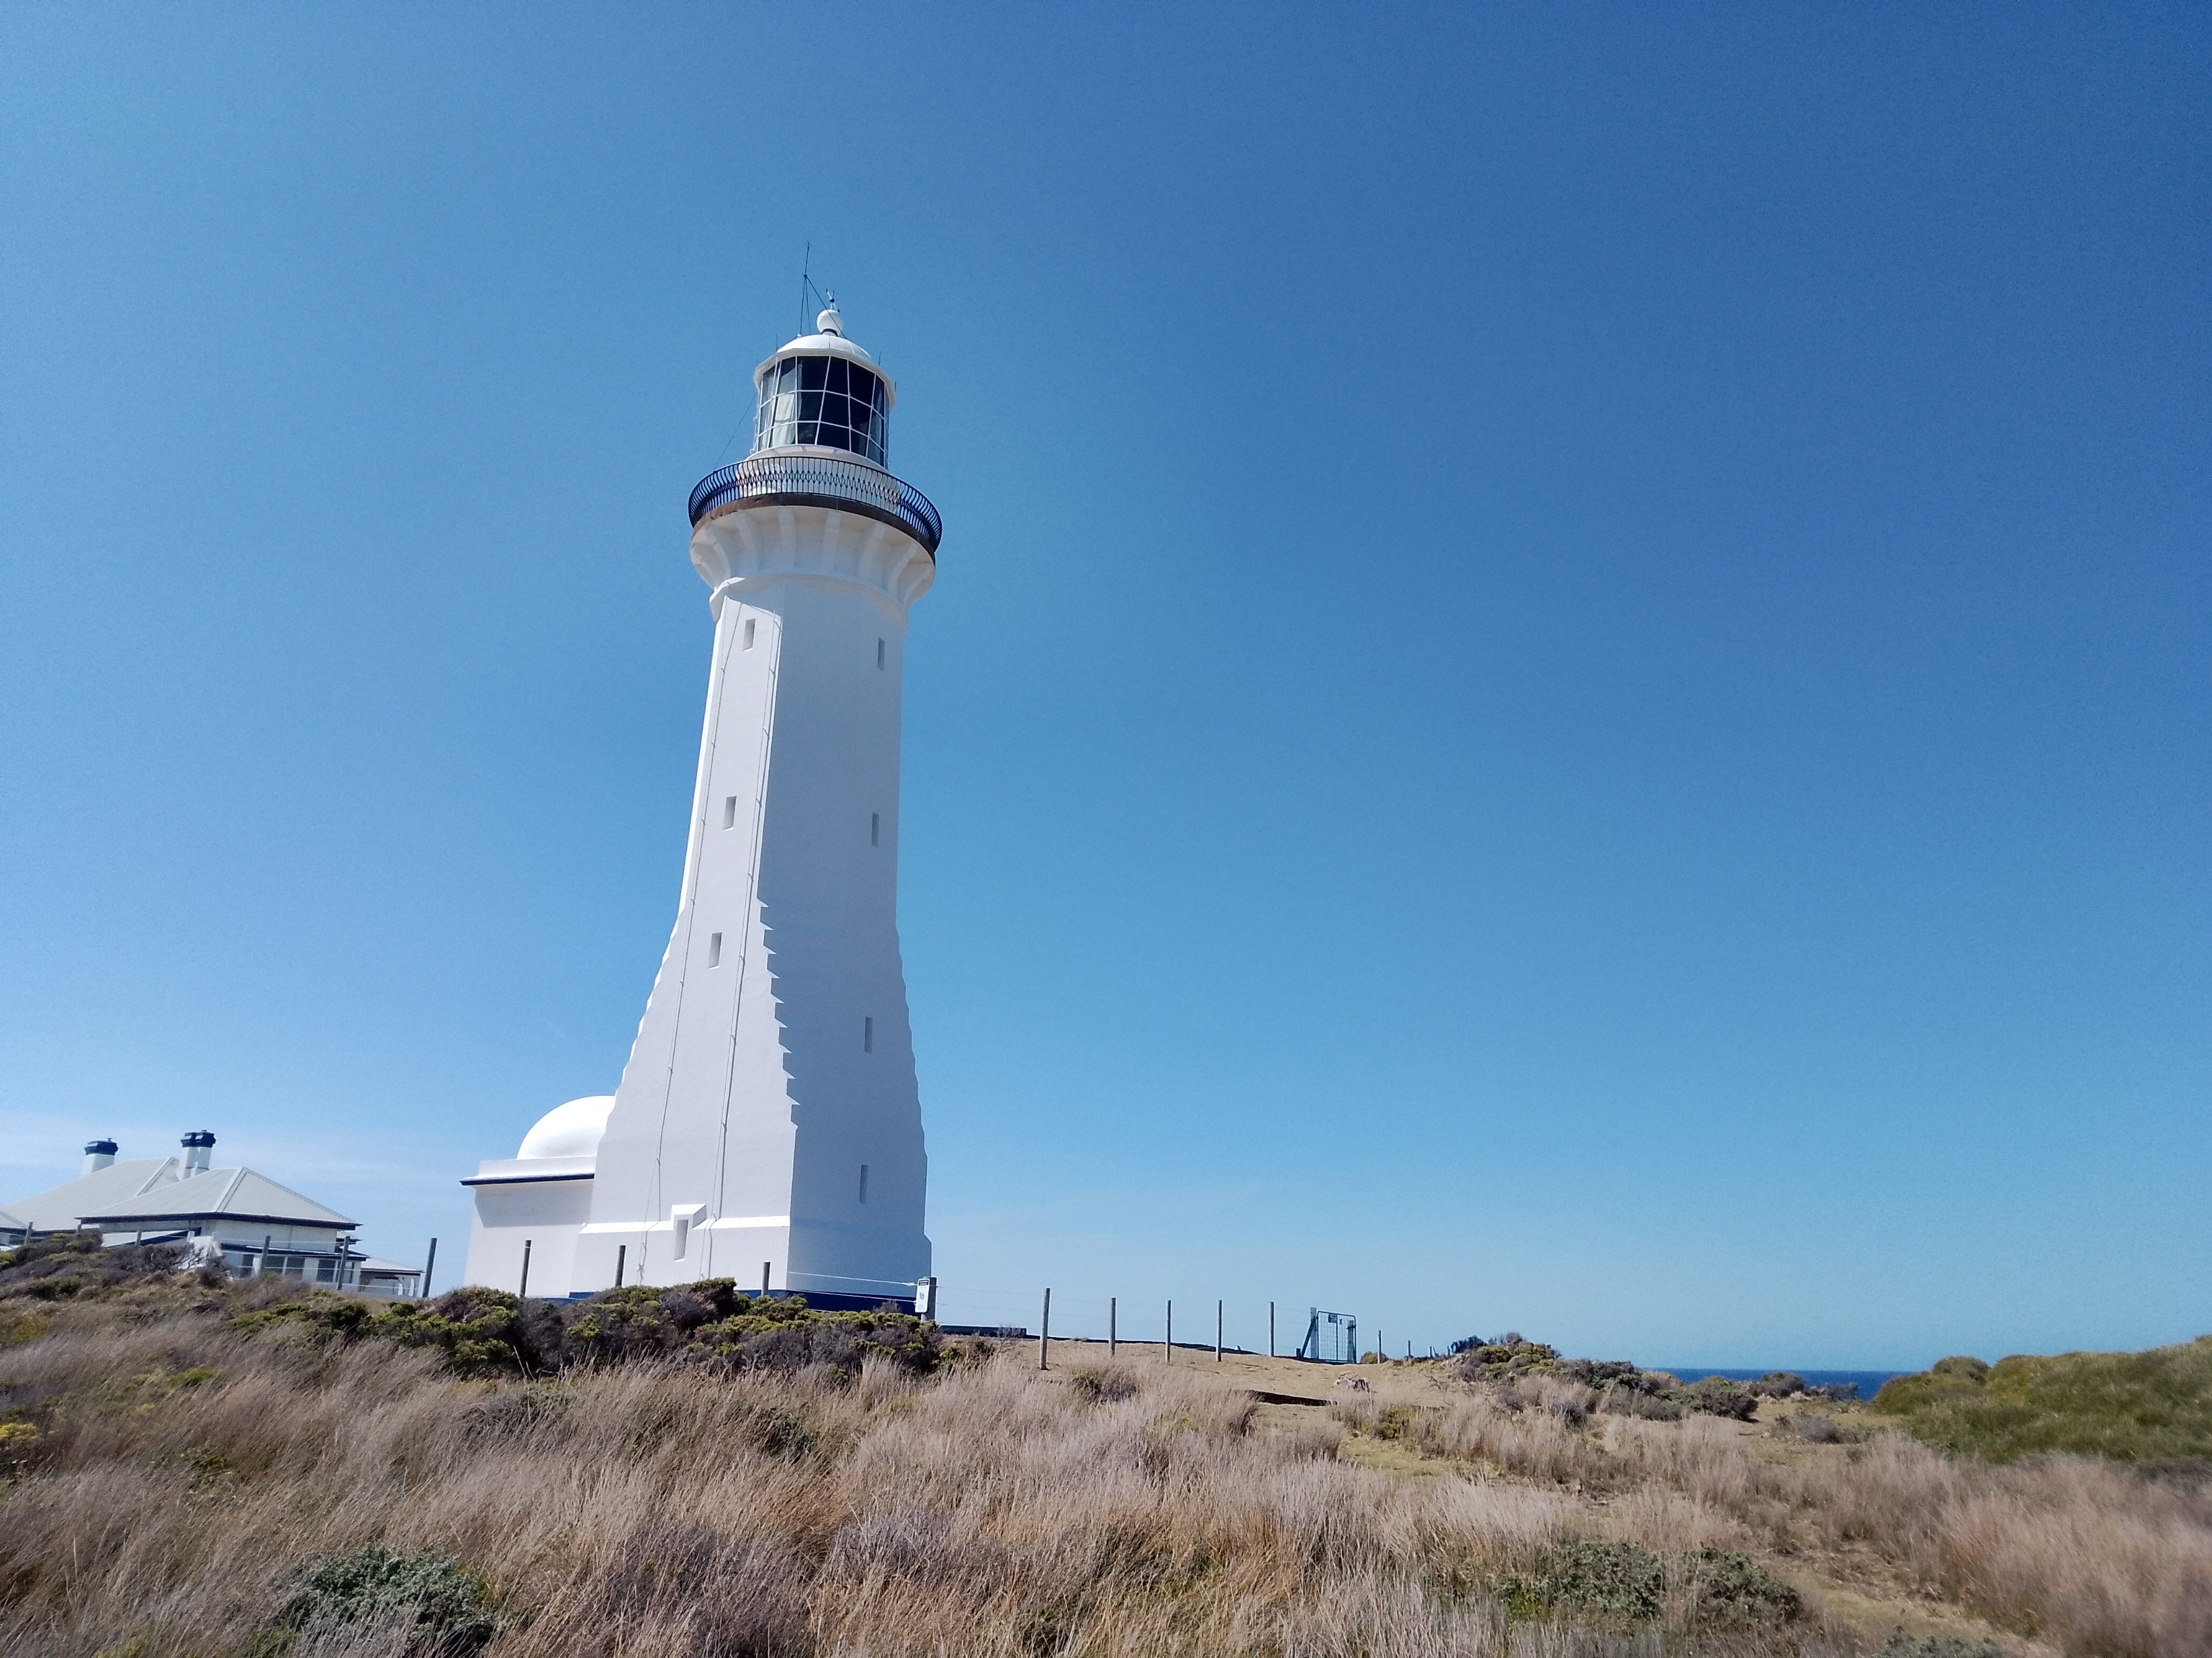

Slide 5
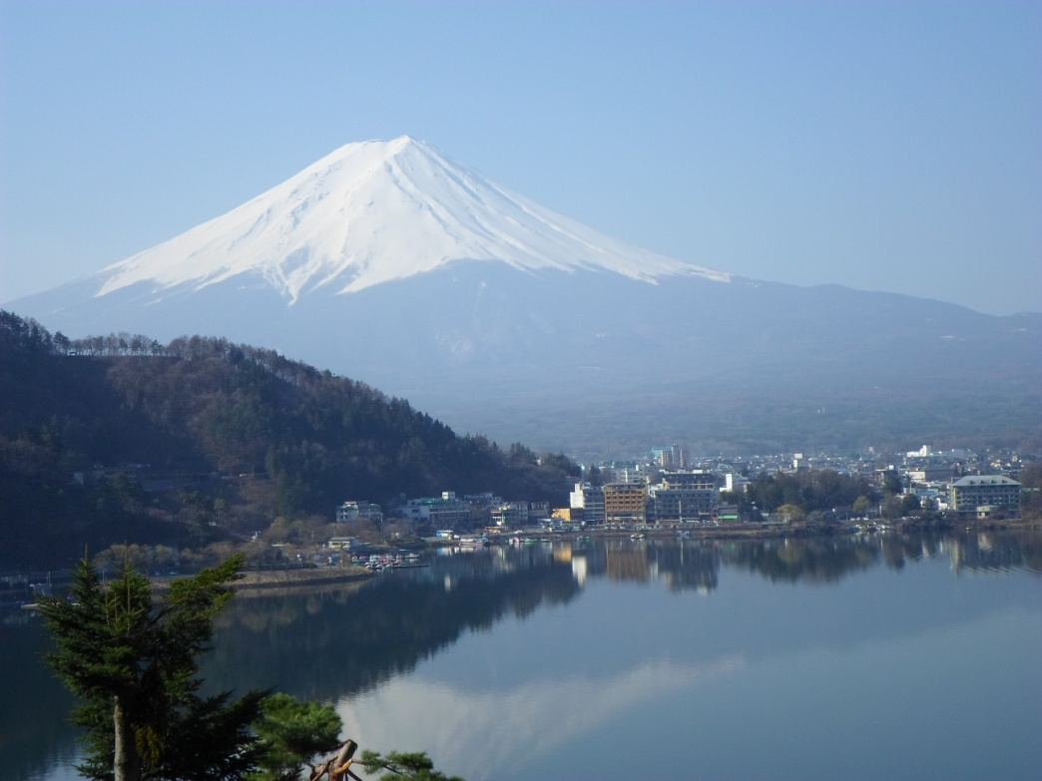
Amazing love that Jesus told,
Two thousand years ago,
A story new, a story old,
A love we all can know.

Slide 6
He spoke to crowds in Palestine,
He speaks to us today,
He tells us all of love divine,
To us he shows the way.

Slide 7
The realm of God is one of love,
Of justice and of peace.
It’s not about a realm above -
Through love this world release.

Slide 8
What we want done to us, can be
The rule by which we live;
To follow it will make us free
To share, to love, to give.

Slide 9
The story comes to challenge us,
It’s not the easy road,
For us to love, as Jesus loved,
To bear another’s load.

Slide 10
The realm of God is here with us
When love and peace we share,
Although we fail, we know God’s grace,
It’s love that helps us there.

Slide 11
Amazing love that Jesus told,
Two thousand years ago,
A story new, a story old,
A love for all to know.
Margaret Rolfe, CCLI 222909

Slide 12
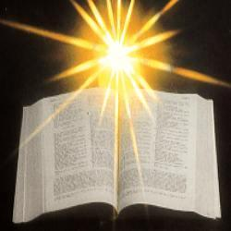

Slide 13
Mark 12:41-44 He sat down opposite the treasury, and watched the crowd putting money into the treasury. Many rich people put in large sums. A poor widow came and put in two small copper coins, which are worth a penny.

Slide 14
Then he called his disciples and said to them, ‘Truly I tell you, this poor widow has put in more than all those who are contributing to the treasury. For all of them have contributed out of their abundance; but she out of her poverty has put in everything she had, all she had to live on.’ 

Slide 15
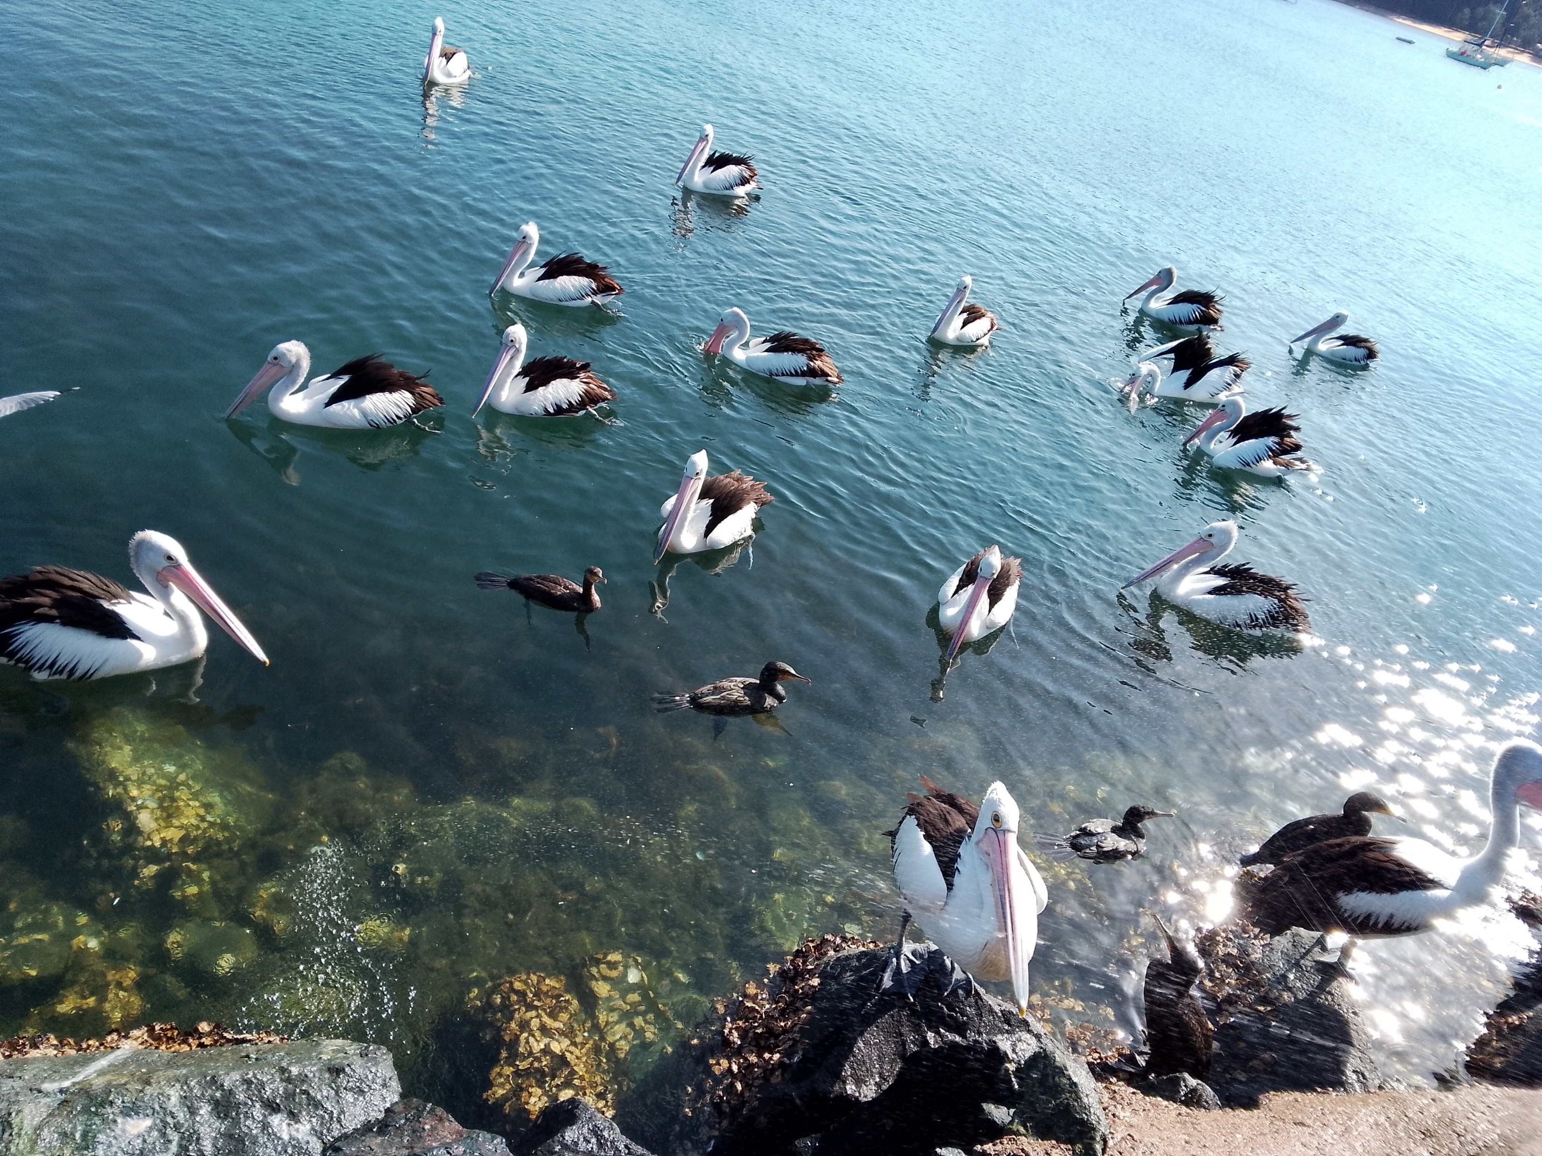

Slide 16
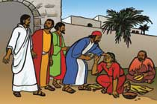
Bring many names, beautiful and good,
celebrate in parable and story,
holiness in glory, living, loving God.
Hail and hosanna!
bring many names!

Slide 17
Strong mother God, working night and day,
planning all the wonders of creation,
setting each equation,
genius at play:
Hail and hosanna,
strong mother God!

Slide 18
Warm father God, hugging every child,
feeling all the strains of human living,
caring and forgiving,
till we’re reconciled:
Hail and hosanna,
warm father God!

Slide 19
Old aching God, grey with endless care,
calmly piercing evil’s new disguises,
glad of good surprises,
wiser than despair:
Hail and hosanna,
old ,aching God.

Slide 20
Young, growing God, eager, on the move,
saying no to falsehood and unkindness,
crying out for justice,
giving all you have:
Hail and hosanna,
Young, growing God!

Slide 21
Great, living God, never fully known,
joyful darkness far beyond our seeing,
closer yet than breathing,
everlasting home:
Hail and hosanna,
great, living God!
Brian Arthur Wren CCLI 222909

Slide 22
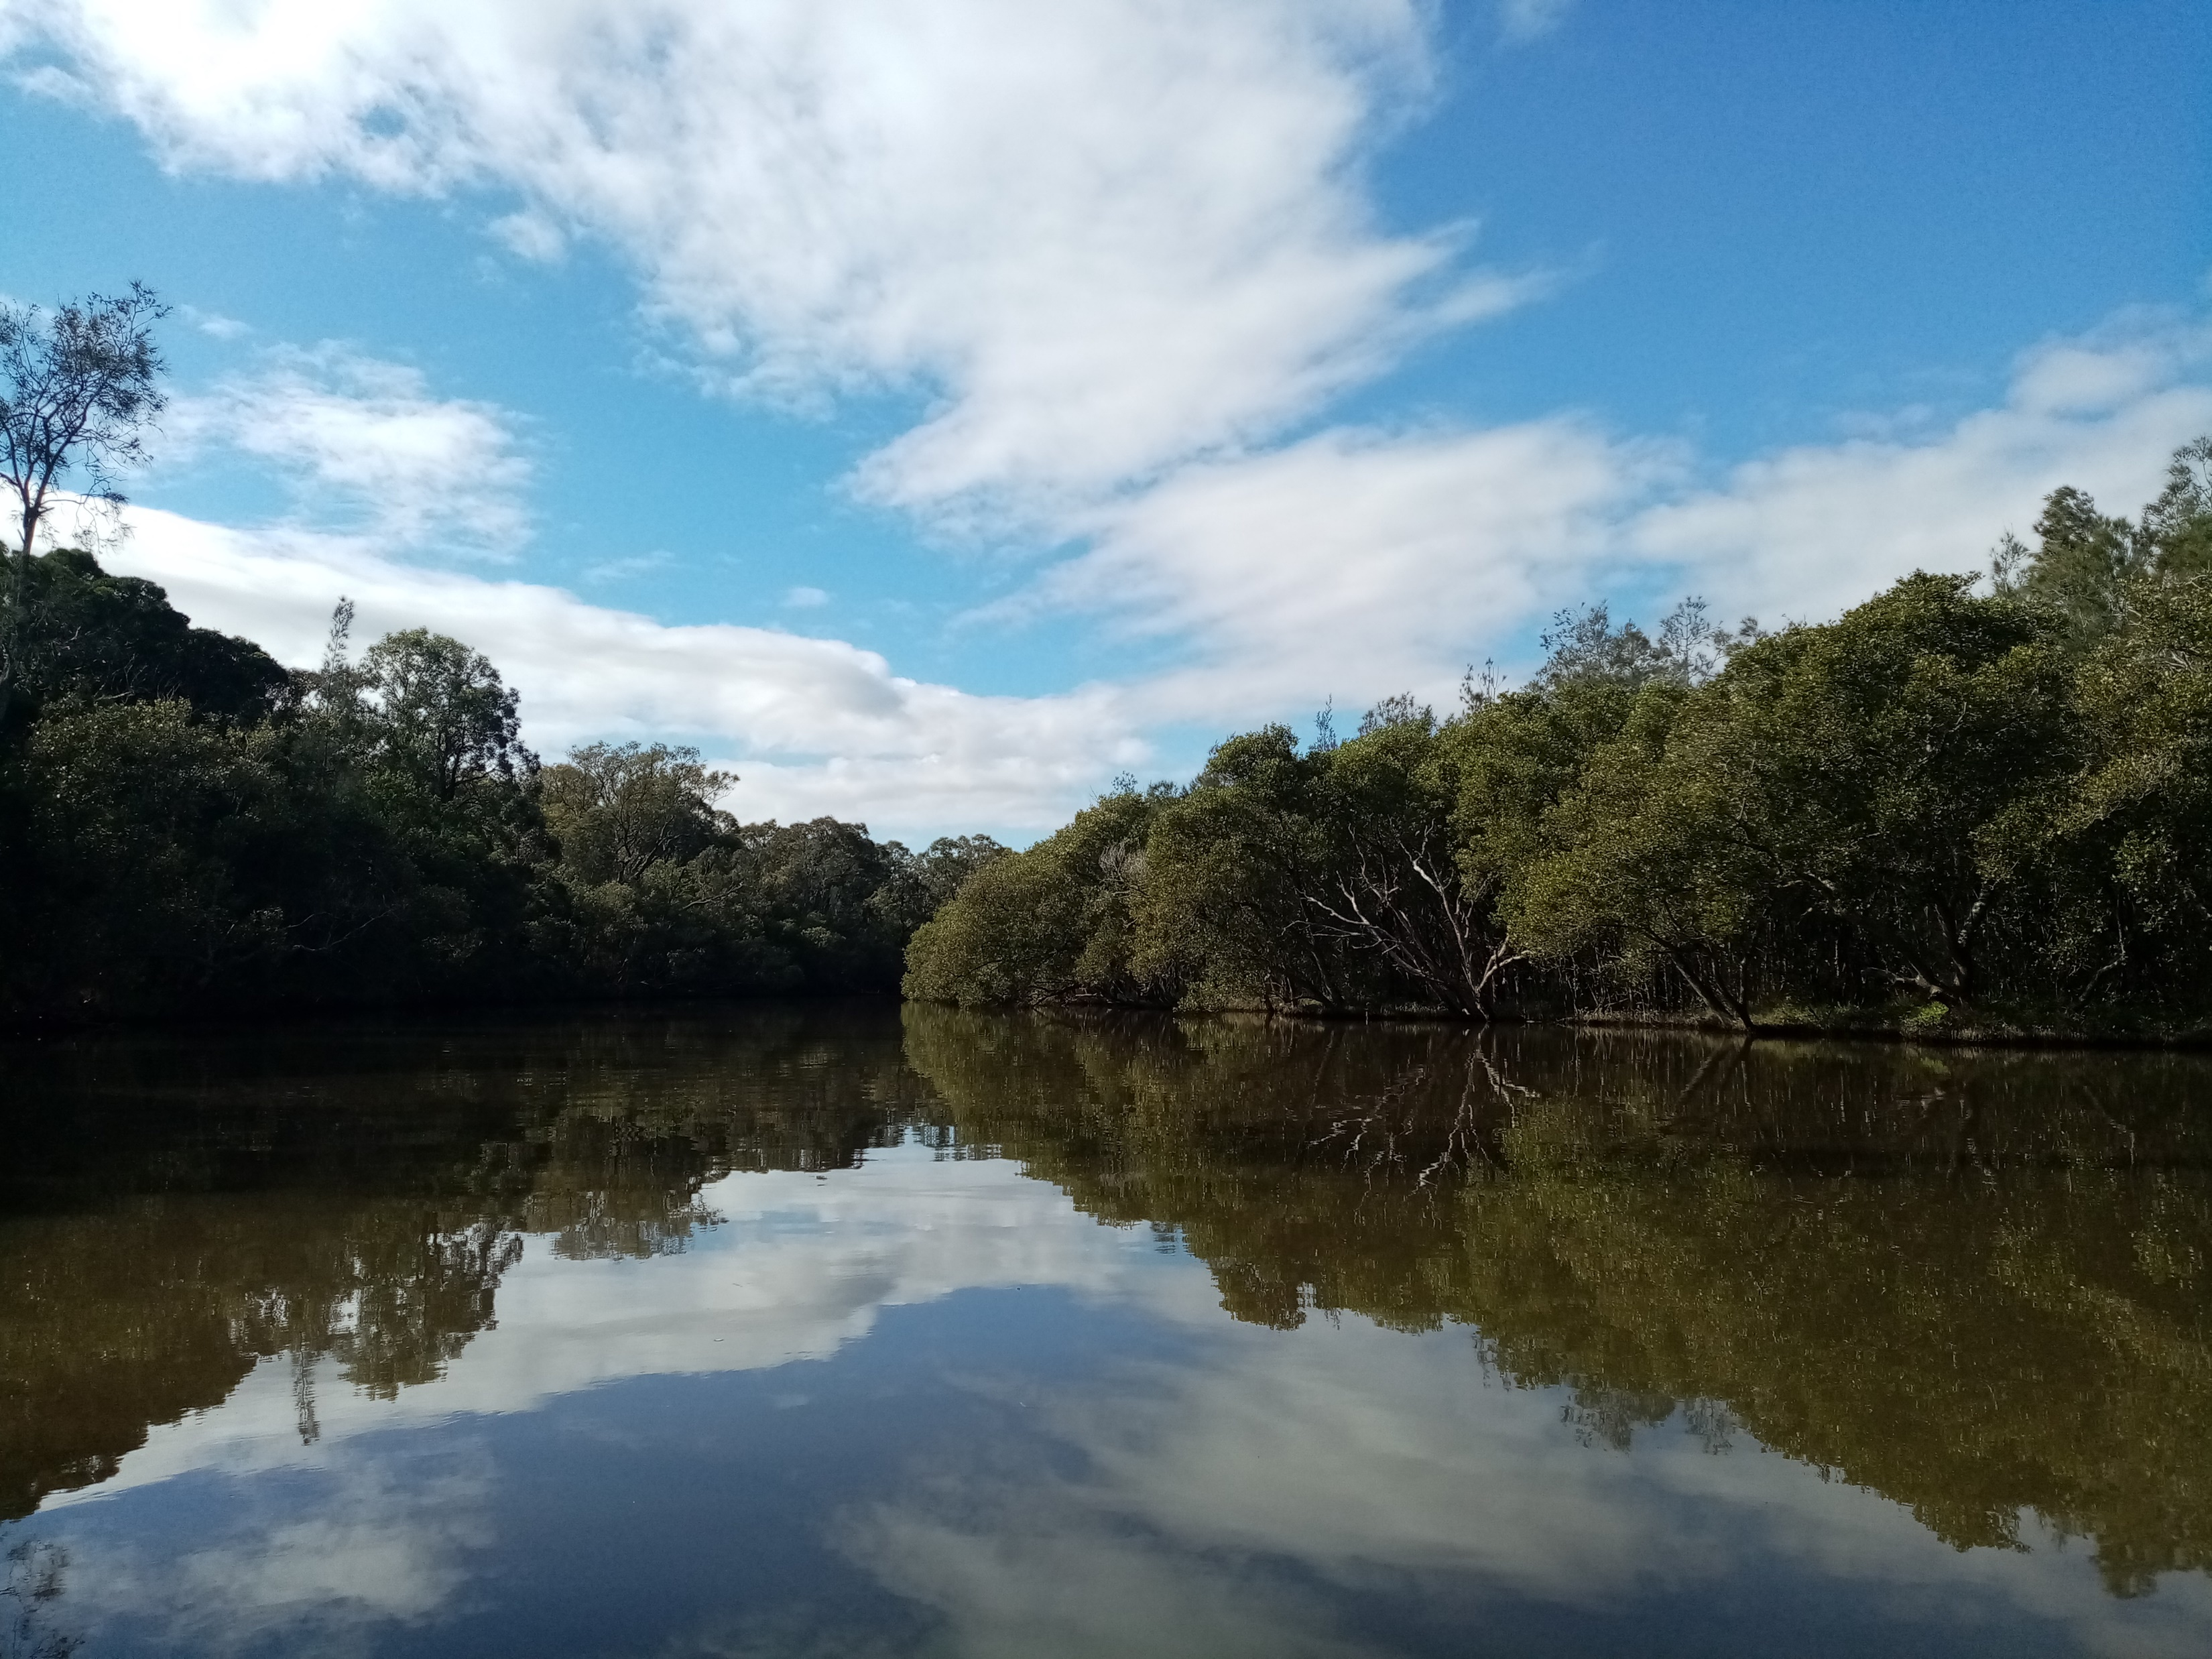

Slide 25
2 Corinthians 5:14-19 ¹⁴For the love of Christ urges us on, because we are convinced that one has died for all; therefore all have died. ¹⁵And he died for all, so that those who live might live no longer for themselves, but for him who died and was raised for them.

Slide 26
16 From now on, therefore, we regard no one from a human point of view; even though we once knew Christ from a human point of view, we know him no longer in that way. ¹⁷So if anyone is in Christ, there is a new creation: everything old has passed away; see, everything has become new!

Slide 27
¹⁸All this is from God, who reconciled us to himself through Christ, and has given us the ministry of reconciliation; ¹⁹that is, in Christ God was reconciling the world to himself, not counting their trespasses against them, and entrusting the message of reconciliation to us.

Slide 28
Luke 4:16-21
16 When he came to Nazareth, where he had been brought up, he went to the synagogue on the sabbath day, as was his custom. He stood up to read, ¹⁷and the scroll of the prophet Isaiah was given to him. He unrolled the scroll and found the place where it was written:

Slide 29
¹⁸ ‘The Spirit of the Lord is upon me, because he has anointed me to bring good news to the poor. He has sent me to proclaim release to the captives and recovery of sight to the blind, to let the oppressed go free, ¹⁹ to proclaim the year of the Lord’s favour.’

Slide 30
²⁰And he rolled up the scroll, gave it back to the attendant, and sat down. The eyes of all in the synagogue were fixed on him. ²¹Then he began to say to them, ‘Today this scripture has been fulfilled in your hearing.’

Slide 31
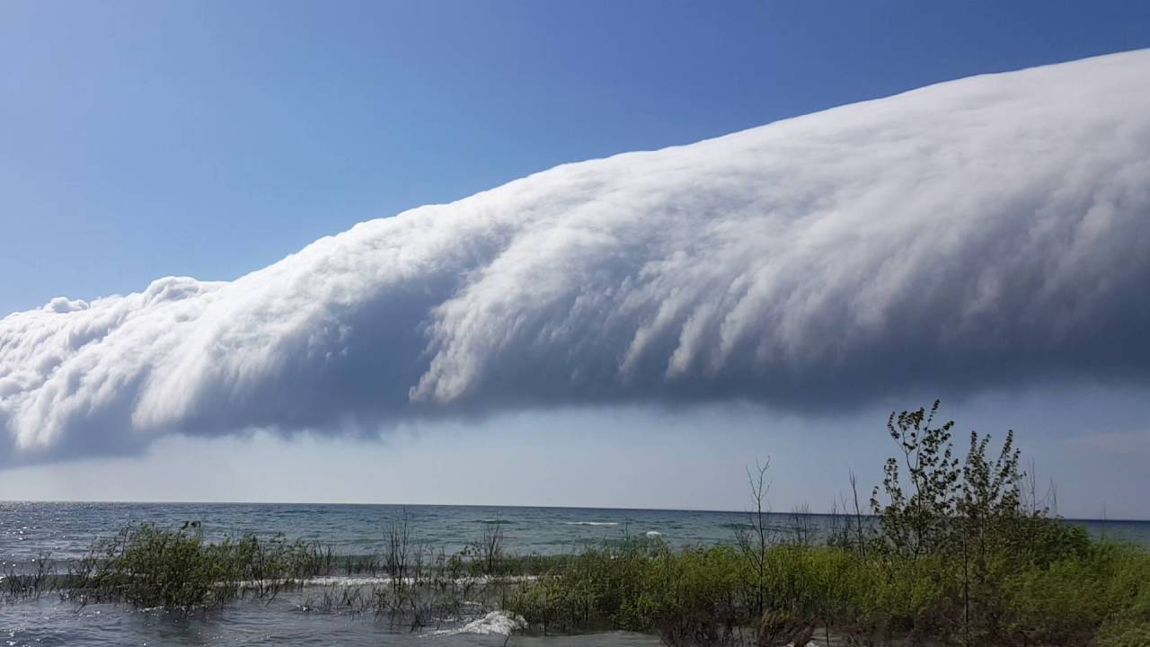
Message from
Ivan Roberts

Slide 32
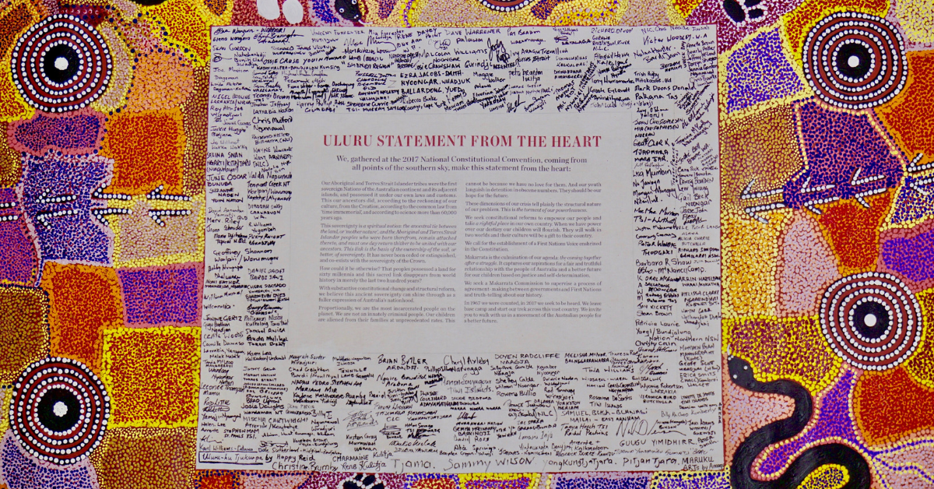
Building Bridges of Understanding with our First Peoples

Slide 33
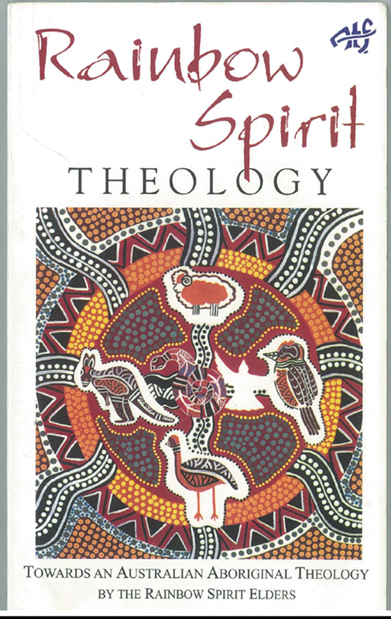

Slide 34
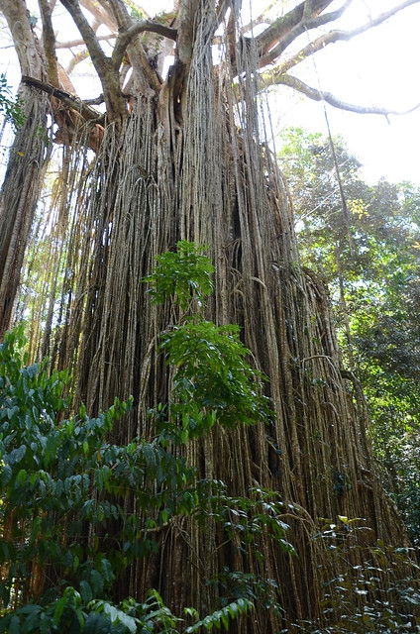
The Curtain Fig, Yungaburra

Slide 35
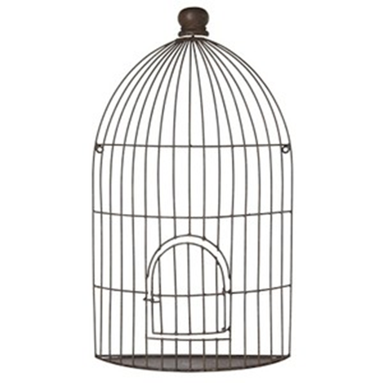
The Bird Cage

Slide 36
Bird Cage Experience for First Peoples & Later Comers

Slide 37
The impact of colonisation on the Spirit of People “The Creator Spirit is crying because the deep spiritual bonds with the land and its people have been broken...The Creator Spirit is suffering because of what has happened to the land.

Slide 38
Many Aboriginal people do not realise that our suffering and pain are not caused by drink, drugs or city life, but is a result of our losing our spiritual connection with the land. When Aboriginal people are taken from our spiritual homes we also lose our spiritual contact with the Creator Spirit” (Rainbow Spirit Theology, p42)

Slide 39
“Our elders who knew the law and were responsible for sustaining the life-forces of the land have been removed. We can no longer keep the law of the land and maintain our trust as custodians of the land. But we long to do so again.” (Rainbow Spirit Theology, p47)

Slide 40
The Aboriginal Gift Many Australians hunger for a deeper relationship to the land in which they live. The fact that there are moments when the experience of this land opens out towards transcendence provides the basis for hope that we can learn to relate to the land in a creative way. ... In this area as in others, Aboriginal religion has a providential word to speak to Christian faith.” Denis Edwards, ‘The Aboriginal Gift’, Eugene Stockton

Slide 41
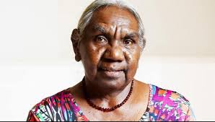
Dr Miriam-Rose Ungunmerr Baumann

Slide 42
Dadirri: an invitation to listen and wait “My people are used to the struggle, and the long waiting. We still wait for the white people to understand us better. We ourselves had to spend many years learning about the white man's ways. Some of the learning was forced; but in many cases people tried hard over a long time, to learn the new ways.

Slide 43
We have learned to speak the white man's language. We have listened to what he had to say. This learning and listening should go both ways. We would like people in Australia to take time to listen to us. We are hoping people will come closer. We keep on longing for the things that we have always hoped for - respect and understanding…

Slide 44
I would like to conclude…by saying again that there are deep springs within each of us. Within this deep spring, which is the very Spirit of God, is a sound. The sound of Deep calling to Deep. The sound is the word of God - Jesus.

Slide 45
Today, I am beginning to hear the Gospel at the very level of my identity. ……If our culture is alive and strong and respected, it will grow. It will not die. And our spirit will not die. And I believe that the spirit of dadirri that we have to offer will blossom and grow, not just within ourselves, but in our whole nation.” Dr Miriam-Rose Ungunmerr Baumann

Slide 46
Celebrating the Covenant between the Uniting Aboriginal & Islander Christian Congress and Uniting Church in Australia

Slide 47
In introducing the Covenant Jill Tabart, then President of the UCA began: “We meet in the presence of God who through the life, death and resurrection of Jesus Christ has reconciled us to God and to one another in the power of the Holy Spirit…. as people who share in this covenant, we are called to carry out faithfully Christ's command to love one another and to order our life in the church in truth and justice.”

Slide 48
UAICC, through its Chair Pastor Bill Hollingsworth responded: We pray that God will guide you together with us in developing a covenant to walk together practically so that the words of your statement may become a tangible expression of His justice and love for all creation. We ask you to remember this covenant by remembering that our land is now also sustaining your people by God's grace.”

Slide 49
Renewing our Covenant with UAICC
This Circle is a space for walking together as First and Second Peoples, for listening to and sharing of the experiences of our First Nations peoples and living out our covenantal relationship. Together we see a destiny together, praying and working for a fuller expression of our reconciliation in Jesus Christ.

Slide 50
Renewing our Covenant Commitment with UAICC We light a candle of hope, healing and new life, renewing our commitment to the covenant signed on 10 July 1994 between the Assembly of the Uniting Church in Australia and the Uniting Aboriginal and Islander Christian Congress. Will you join us in making the following commitment? (If able, please stand)

Slide 51
We are committed to continuing the journey into the future in partnership with our Uniting Aboriginal and Islander Christian Congress colleagues and one another. Prayerfully we will search in our own hearts and reflect on our own attitudes which alienate us from one another.

Slide 52
Together we will work for a future in which we are all able to contribute our gifts to this nation. We will work to end the injustices and prejudices which continue to sideline our First Peoples. We will learn and teach the paths of justice, respect and reconciliation so that we may walk together down this road.

Slide 53
We will work till a person’s lot is not determined by their ancestry or skin colour; and young people no longer bear a grudge against society because it treats their history and culture unfairly.

Slide 54
We will work till the history of 60,000 years is honoured together with the history of the last two centuries; till the glorious parts are celebrated with pride, and the dishonourable parts are acknowledged with shame.

Slide 55
In Christ we pray for a united Australia which respects the prior and continuing custodianship, culture and heritage of Aboriginal and Torres Strait Islander peoples; ensuring justice and equity for all. In the name of Christ: Amen

Slide 56
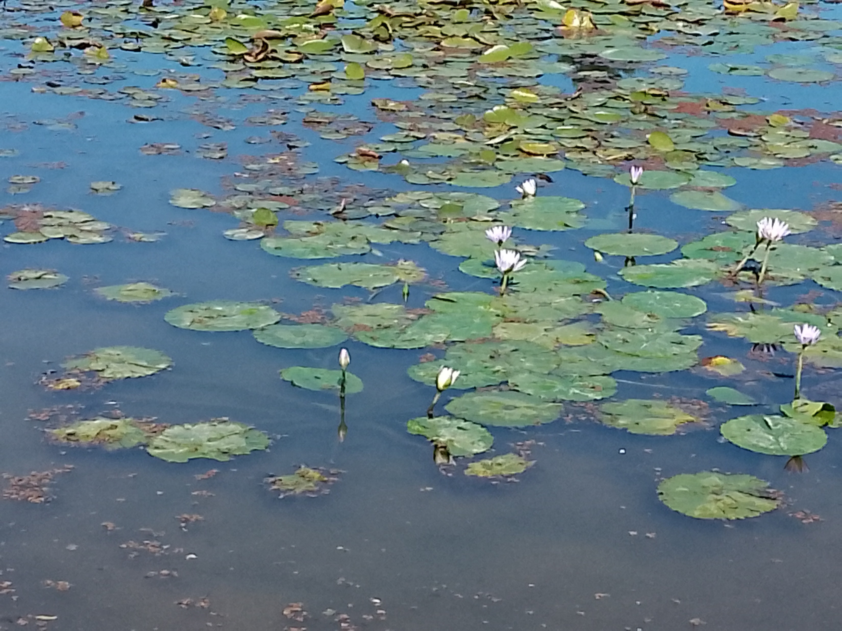
Offertory

Slide 57
What’s on
Invitation to worship at Eden Aboriginal Evangelical Church today
Women’s fellowship Tues 3pm Christmas gathering at Ang hall
Mahjong Tues 10-2 in the hall
Gardening Tues 9-12
Working bee? Wednesday
Faith conversations Wed 5pm
Pantry Thurs 10-1
Market Saturday 16th with Garage sale option
Presbytery Saturday 16th
Cong. Council Sunday 17th

Slide 58
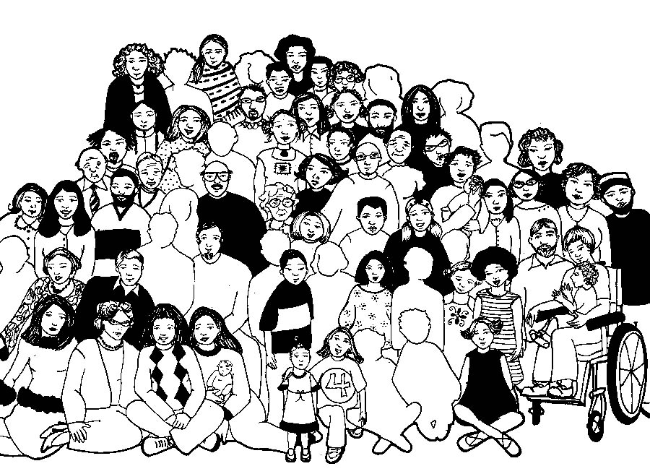

Slide 59
Lord’s Prayer
Our Father in Heaven,
Hallowed be your name,
your kingdom come,
your will be done, on earth as in heaven.
Give us today our daily bread.
Forgive our sins
as we forgive those who sin against us.
Save us from the time of trial
and deliver us from evil.
For the Kingdom, the power,
and the glory are yours now and forever. Amen
Notes:
59

Slide 60
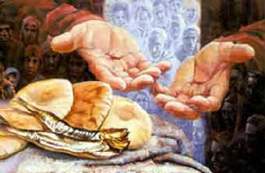

Slide 61
Break now the bread of life, Dear Lord, to me, as once you broke the loaves beside the sea.

Slide 62
Beyond the sacred page I seek you, Lord, my spirit longs for you, O living Word.

Slide 63
Bless your own truth, dear Lord, To me, to me, As when you blessed the bread; By Galilee.

Slide 64
Then shall all bondage cease, All shackles fall, and I shall find my peace, my all in all. Mary Lathbury -1913 CCLI 222909

Slide 65
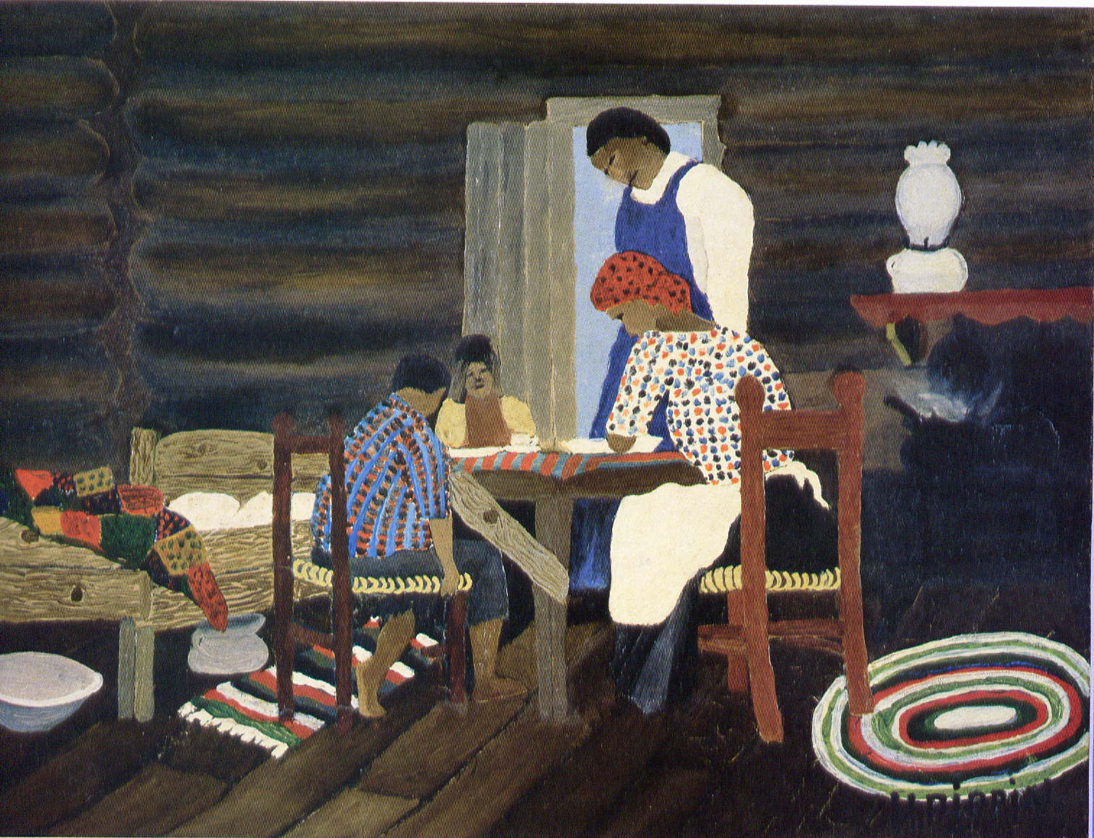

Slide 66
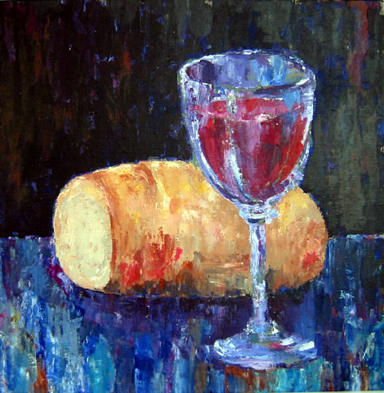
Let us talents and tongues employ,
Reaching out with a shout of joy;
Bread is broken, the wine is poured,
Christ is spoken and seen and heard.

Slide 67
Jesus lives again,
earth can breathe again,
pass the Word around;
loaves abound!
Repeat!

Slide 68
Christ is able to make us one,
at the table he sets the tone,
teaching people to live to bless,
love in word and in deed express.

Slide 69
Jesus lives again,
earth can breathe again,
pass the Word around;
loaves abound!
Repeat!

Slide 70
Jesus calls us in, sends us out
Bearing fruit in a world of doubt,
Gives us love to tell, bread to share:
God-Immanuel everywhere.

Slide 71
Jesus lives again,
earth can breathe again,
pass the Word around;
loaves abound!
Repeat!
Frederik Kaan, CCLI 222909 *

Slide 72
Please follow us over for a drink and a chat after the service
Invitation to continue worship from 11am at Aboriginal Evangelical Church

