Slide 2
Welcome to worship
at St Georges - Eden
Enough is enough

Slide 3
We acknowledge the sovereign First Peoples of these lands and waters
where we meet, the Yuin Nation. We pay our respects to their elders past and present and to all Aboriginal people who have cared for this place since creation.

Slide 4
God is good.
God’s love endures forever.
God is good.
Nothing shall separate us from the love of God.
God is good.
Let us worship with songs of joy and thanksgiving.

Slide 5
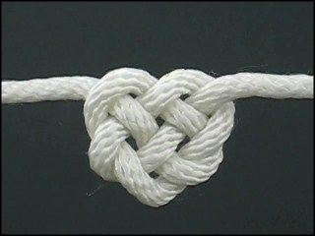
Bind us together, Lord Bind us together With cords that cannot be broken Bind us together, Lord Bind us together Bind us together in Love

Slide 6
There is only one God, There is only one King There is only one Body, That is why we sing.

Slide 7
Bind us together, Lord Bind us together With cords that cannot be broken Bind us together, Lord Bind us together Bind us together in Love

Slide 8
Fit for the glory of God, Purchased by His precious Blood Born with the right to be free Jesus the victory has won.

Slide 9
Bind us together, Lord Bind us together With cords that cannot be broken Bind us together, Lord Bind us together Bind us together in Love

Slide 10
We are the family of God We are the promise divine We are God's chosen desire We are the glorious new wine.

Slide 11
Bind us together, Lord Bind us together With cords that cannot be broken Bind us together, Lord Bind us together Bind us together in Love SIS 185 F F (extra verse 3 from SOF NB ‘Lord’ inc second last line

Slide 12
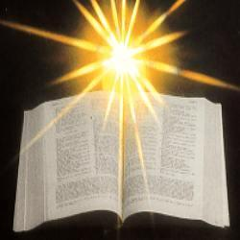
Warning
Rated M
This passage is recommended for mature audiences.
Contains violence
and sex scenes

Slide 13
2 Samuel 11:1-15 NIV David and Bathsheba In the spring, at the time when kings go off to war, David sent Joab out with the king’s men and the whole Israelite army. They destroyed the Ammonites and besieged Rabbah. But David remained in Jerusalem. One evening David got up from his bed and walked around on the roof of the palace. From the roof he saw a woman bathing. The woman was very beautiful, and David sent someone to find out about her. The man said, “She is Bathsheba, the daughter of Eliam and the wife of Uriah the Hittite.”

Slide 14
Then David sent messengers to get her. She came to him, and he slept with her. (Now she was purifying herself from her monthly uncleanness.) Then she went back home. The woman conceived and sent word to David, saying, “I am pregnant.” So David sent this word to Joab: “Send me Uriah the Hittite.” And Joab sent him to David. When Uriah came to him, David asked him how Joab was, how the soldiers were and how the war was going. Then David said to Uriah, “Go down to your house and wash your feet.” So Uriah left the palace, and a gift from the king was sent after him. But Uriah slept at the entrance to the palace with all his master’s servants and did not go down to his house.

Slide 15
David was told, “Uriah did not go home.” So he asked Uriah, “Haven’t you just come from a military campaign? Why didn’t you go home?” Uriah said to David, “The ark and Israel and Judah are staying in tents, and my commander Joab and my lord’s men are camped in the open country. How could I go to my house to eat and drink and make love to my wife? As surely as you live, I will not do such a thing!”

Slide 16
Then David said to him, “Stay here one more day, and tomorrow I will send you back.” So Uriah remained in Jerusalem that day and the next. At David’s invitation, he ate and drank with him, and David made him drunk. But in the evening Uriah went out to sleep on his mat among his master’s servants; he did not go home. In the morning David wrote a letter to Joab and sent it with Uriah. In it he wrote, “Put Uriah out in front where the fighting is fiercest. Then withdraw from him so he will be struck down and die.” 

Slide 18
Psalm 14 For the director of music. Of David. The fool says in his heart, “There is no God.” They are corrupt, their deeds are vile; there is no one who does good. The Lord looks down from heaven on all mankind to see if there are any who understand, any who seek God.

Slide 19
All have turned away, all have become corrupt; there is no one who does good, not even one. Do all these evildoers know nothing? They devour my people as though eating bread; they never call on the Lord. But there they are, overwhelmed with dread, for God is present in the company of the righteous. You evildoers frustrate the plans of the poor, but the Lord is their refuge. Oh, that salvation for Israel would come out of Zion! When the Lord restores his people, let Jacob rejoice and Israel be glad!  (NIV)

Slide 20
Ephesians 3:14-21 NIV A Prayer for the Ephesians For this reason I kneel before the Father, from whom every family in heaven and on earth derives its name. I pray that out of his glorious riches he may strengthen you with power through his Spirit in your inner being, so that Christ may dwell in your hearts through faith. And I pray that you, being rooted and established in love, may have power, together with all the Lord’s holy people, to grasp how wide and long and high and deep is the love of Christ, and to know this love that surpasses knowledge—that you may be filled to the measure of all the fullness of God.

Slide 21
Now to him who is able to do immeasurably more than all we ask or imagine, according to his power that is at work within us, to him be glory in the church and in Christ Jesus throughout all generations, for ever and ever! Amen. 

Slide 22
John 6:1-21 NIV Jesus Feeds the Five Thousand
Some time after this, Jesus crossed to the far shore of the Sea of Galilee (that is, the Sea of Tiberias), and a great crowd of people followed him because they saw the signs he had performed by healing the sick. Then Jesus went up on a mountainside and sat down with his disciples. The Jewish Passover Festival was near.
When Jesus looked up and saw a great crowd coming toward him, he said to Philip, “Where shall we buy bread for these people to eat?” He asked this only to test him, for he already had in mind what he was going to do.

Slide 23
Philip answered him, “It would take more than half a year’s wages to buy enough bread for each one to have a bite!”
Another of his disciples, Andrew, Simon Peter’s brother, spoke up, “Here is a boy with five small barley loaves and two small fish, but how far will they go among so many?”
Jesus said, “Have the people sit down.” There was plenty of grass in that place, and they sat down (about five thousand men were there). Jesus then took the loaves, gave thanks, and distributed to those who were seated as much as they wanted. He did the same with the fish.

Slide 24
When they had all had enough to eat, he said to his disciples, “Gather the pieces that are left over. Let nothing be wasted.” So they gathered them and filled twelve baskets with the pieces of the five barley loaves left over by those who had eaten.
After the people saw the sign Jesus performed, they began to say, “Surely this is the Prophet who is to come into the world.” Jesus, knowing that they intended to come and make him king by force, withdrew again to a mountain by himself.

Slide 25
Jesus Walks on the Water
When evening came, his disciples went down to the lake, where they got into a boat and set off across the lake for Capernaum. By now it was dark, and Jesus had not yet joined them. A strong wind was blowing and the waters grew rough. When they had rowed about three or four miles, they saw Jesus approaching the boat, walking on the water; and they were frightened. But he said to them, “It is I; don’t be afraid.” Then they were willing to take him into the boat, and immediately the boat reached the shore where they were heading.

Slide 26
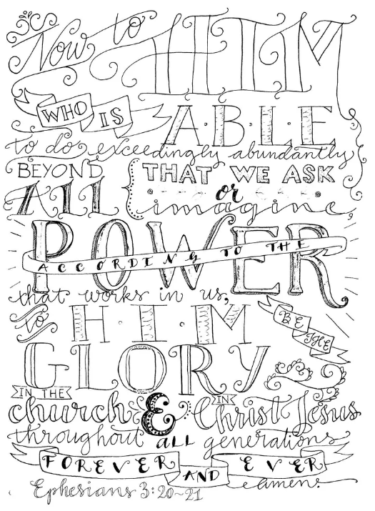

Slide 27
Prayer of confession

Slide 28
WORDS OF ASSURANCE
God’s forgiveness is offered to all. The promise of Christ is that we can live freely and forgiven through his saving grace. So, let us declare– Our sins are forgiven. Thanks be to God.

Slide 29
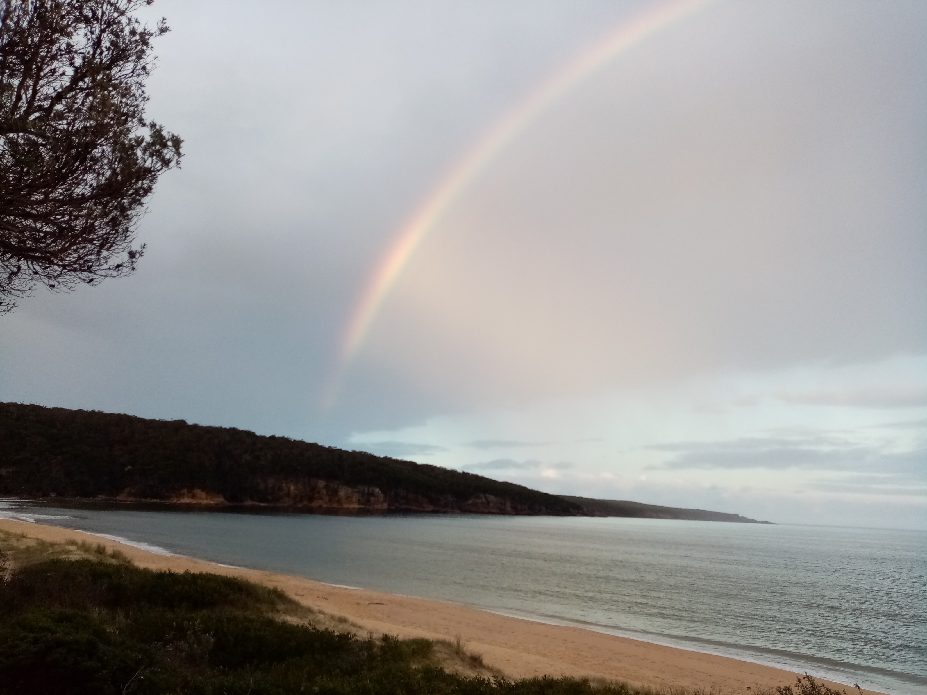

Slide 30
It passes knowledge, that dear love of thine,
my Saviour Jesus; yet this soul of mine
would of thy love, in all its breadth and length,
its height and depth and everlasting strength,
know more and more.

Slide 31
It passes telling, that dear love of thine,
my Saviour Jesus; yet these lips of mine
would fain proclaim to sinners far and near
a love which can remove all guilty fear
and love beget.

Slide 32
It passes praises, that dear love of thine,
my saviour Jesus; yet this heart of mine
would sing that love, so full, so rich, so free,
which brings a rebel sinner, such as me,
nigh unto God.

Slide 33
At last, when Jesus face to face I see,
when at his lofty throne I bow the knee,
then of his love, in all its breadth and length,
Its height and depth, its everlasting strength,
My soul shall sing.
Mary Shekleton CCLI 222909

Slide 34
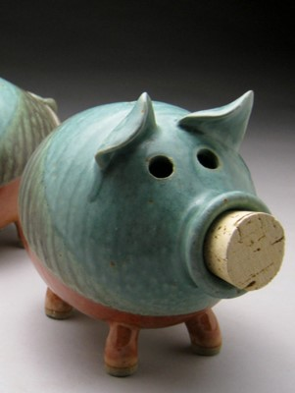

Slide 35
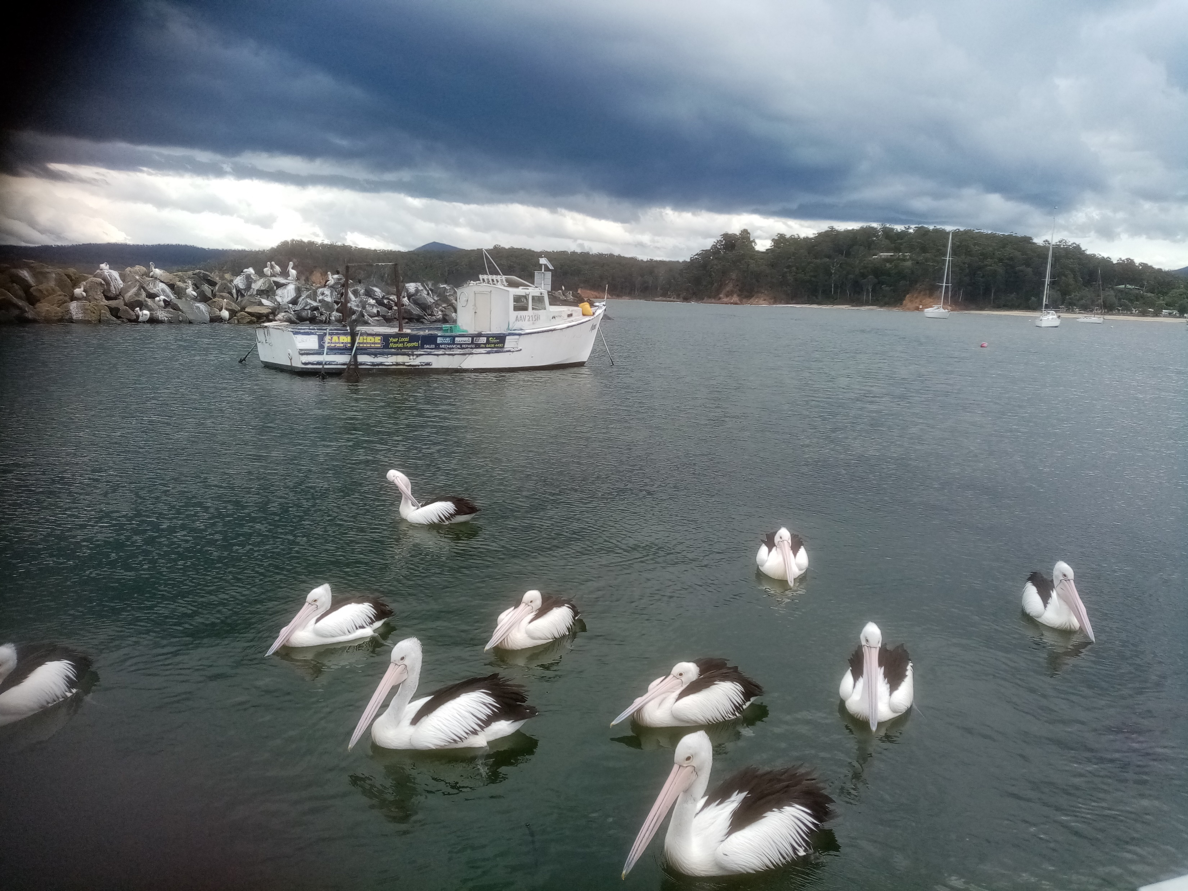

Slide 36
Warning
Rated M
This passage is recommended for mature audiences.
Contains violence
and sex scenes

Slide 37
2 Samuel 11:1-15 NIV David and Bathsheba In the spring, at the time when kings go off to war, David sent Joab out with the king’s men and the whole Israelite army. They destroyed the Ammonites and besieged Rabbah. But David remained in Jerusalem. One evening David got up from his bed and walked around on the roof of the palace. From the roof he saw a woman bathing. The woman was very beautiful, and David sent someone to find out about her. The man said, “She is Bathsheba, the daughter of Eliam and the wife of Uriah the Hittite.”

Slide 38
Then David sent messengers to get her. She came to him, and he slept with her. (Now she was purifying herself from her monthly uncleanness.) Then she went back home. The woman conceived and sent word to David, saying, “I am pregnant.” So David sent this word to Joab: “Send me Uriah the Hittite.” And Joab sent him to David. When Uriah came to him, David asked him how Joab was, how the soldiers were and how the war was going. Then David said to Uriah, “Go down to your house and wash your feet.” So Uriah left the palace, and a gift from the king was sent after him. But Uriah slept at the entrance to the palace with all his master’s servants and did not go down to his house.

Slide 39
David was told, “Uriah did not go home.” So he asked Uriah, “Haven’t you just come from a military campaign? Why didn’t you go home?” Uriah said to David, “The ark and Israel and Judah are staying in tents, and my commander Joab and my lord’s men are camped in the open country. How could I go to my house to eat and drink and make love to my wife? As surely as you live, I will not do such a thing!”

Slide 40
Then David said to him, “Stay here one more day, and tomorrow I will send you back.” So Uriah remained in Jerusalem that day and the next. At David’s invitation, he ate and drank with him, and David made him drunk. But in the evening Uriah went out to sleep on his mat among his master’s servants; he did not go home. In the morning David wrote a letter to Joab and sent it with Uriah. In it he wrote, “Put Uriah out in front where the fighting is fiercest. Then withdraw from him so he will be struck down and die.” 

Slide 41
Psalm 14 For the director of music. Of David. The fool says in his heart, “There is no God.” They are corrupt, their deeds are vile; there is no one who does good. The Lord looks down from heaven on all mankind to see if there are any who understand, any who seek God.

Slide 42
All have turned away, all have become corrupt; there is no one who does good, not even one. Do all these evildoers know nothing? They devour my people as though eating bread; they never call on the Lord. But there they are, overwhelmed with dread, for God is present in the company of the righteous. You evildoers frustrate the plans of the poor, but the Lord is their refuge. Oh, that salvation for Israel would come out of Zion! When the Lord restores his people, let Jacob rejoice and Israel be glad!  (NIV)

Slide 43
Ephesians 3:14-21 NIV A Prayer for the Ephesians For this reason I kneel before the Father, from whom every family in heaven and on earth derives its name. I pray that out of his glorious riches he may strengthen you with power through his Spirit in your inner being, so that Christ may dwell in your hearts through faith. And I pray that you, being rooted and established in love, may have power, together with all the Lord’s holy people, to grasp how wide and long and high and deep is the love of Christ, and to know this love that surpasses knowledge—that you may be filled to the measure of all the fullness of God.

Slide 44
Now to him who is able to do immeasurably more than all we ask or imagine, according to his power that is at work within us, to him be glory in the church and in Christ Jesus throughout all generations, for ever and ever! Amen. 

Slide 45
How many scenes or issues are in the song “The Outlaw” and also in the John 6: 1-21 passage?

Slide 46
John 6:1-21 NIV Jesus Feeds the Five Thousand
Some time after this, Jesus crossed to the far shore of the Sea of Galilee (that is, the Sea of Tiberias), and a great crowd of people followed him because they saw the signs he had performed by healing the sick. Then Jesus went up on a mountainside and sat down with his disciples. The Jewish Passover Festival was near.
When Jesus looked up and saw a great crowd coming toward him, he said to Philip, “Where shall we buy bread for these people to eat?” He asked this only to test him, for he already had in mind what he was going to do.

Slide 47
Philip answered him, “It would take more than half a year’s wages to buy enough bread for each one to have a bite!”
Another of his disciples, Andrew, Simon Peter’s brother, spoke up, “Here is a boy with five small barley loaves and two small fish, but how far will they go among so many?”
Jesus said, “Have the people sit down.” There was plenty of grass in that place, and they sat down (about five thousand men were there). Jesus then took the loaves, gave thanks, and distributed to those who were seated as much as they wanted. He did the same with the fish.

Slide 48
When they had all had enough to eat, he said to his disciples, “Gather the pieces that are left over. Let nothing be wasted.” So they gathered them and filled twelve baskets with the pieces of the five barley loaves left over by those who had eaten.
After the people saw the sign Jesus performed, they began to say, “Surely this is the Prophet who is to come into the world.” Jesus, knowing that they intended to come and make him king by force, withdrew again to a mountain by himself.

Slide 49
Jesus Walks on the Water
When evening came, his disciples went down to the lake, where they got into a boat and set off across the lake for Capernaum. By now it was dark, and Jesus had not yet joined them. A strong wind was blowing and the waters grew rough. When they had rowed about three or four miles, they saw Jesus approaching the boat, walking on the water; and they were frightened. But he said to them, “It is I; don’t be afraid.” Then they were willing to take him into the boat, and immediately the boat reached the shore where they were heading.

Slide 50
How many scenes or issues are in the song “The Outlaw” and also in the John 6: 1-21 passage?

Slide 52
Enough is enough

Slide 53
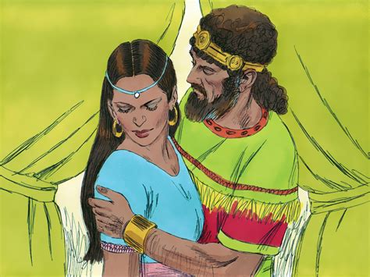

Slide 54
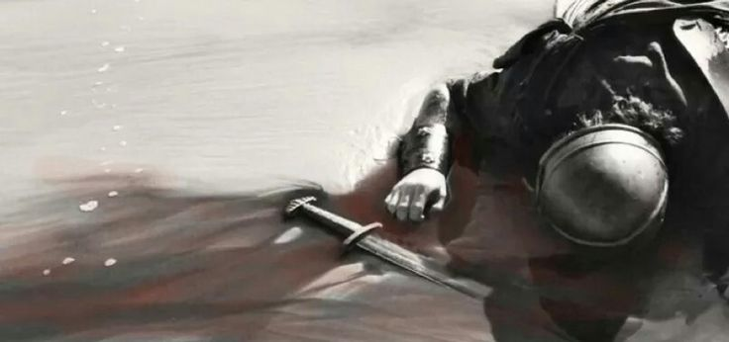

Slide 55
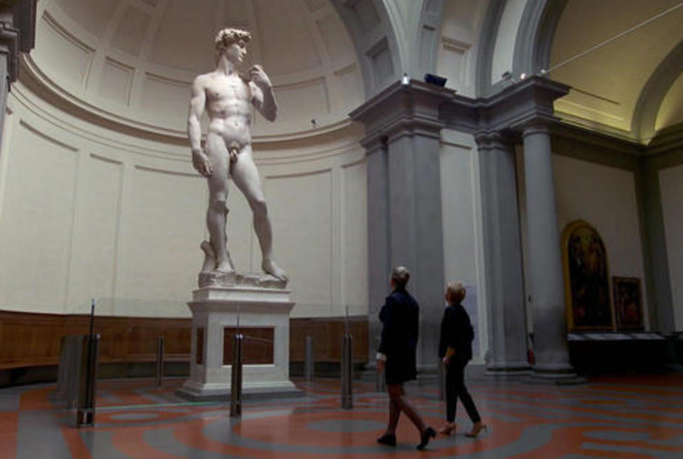
Michelangelo's iconic marble statue David. Florence's Galleria dell' Accademia.

Slide 56
Enough is enough

Slide 57
Enough is enough
Enough is enough
Enough is enough
Enough is enough
Enough is enough
Enough is enough
Enough is enough
Enough is enough
Enough is enough
Enough is enough
Enough is enough

Slide 58
God of freedom, God of justice, you whose love is strong as death, you who saw the dark of prison, you who knew the price of faith -- touch our world of sad oppression with your Spirit's healing breath.

Slide 59
Rid the earth of torture's terror, you whose hands were nailed to wood; hear the cries of pain and protest, you who shed the tears and blood -- move in us the power of pity restless for the common good.

Slide 60
Make in us a captive conscience quick to hear, to act, to plead; make us truly sisters, brothers of whatever race or creed -- teach us to be fully human, open to each other's needs. Shirley Erena Murray 

Slide 61
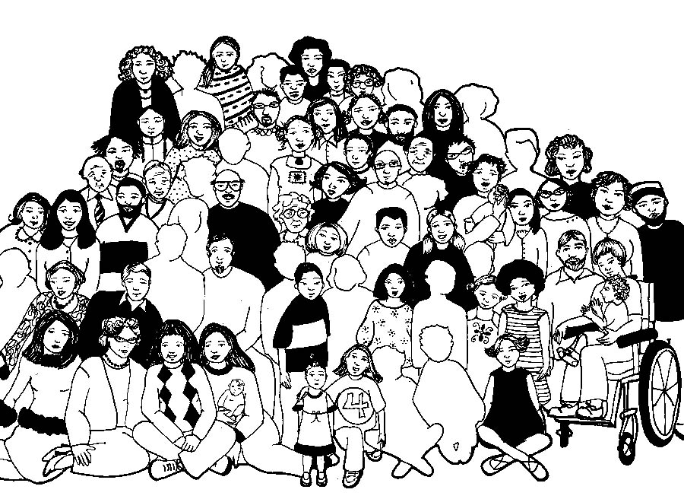

Slide 62
Lord’s Prayer
Our Father in Heaven,
Hallowed be your name,
your kingdom come,
your will be done, on earth as in heaven.
Give us today our daily bread.
Forgive our sins
as we forgive those who sin against us.
Save us from the time of trial
and deliver us from evil.
For the Kingdom, the power,
and the glory are yours now and forever. Amen
Notes:
62

Slide 64
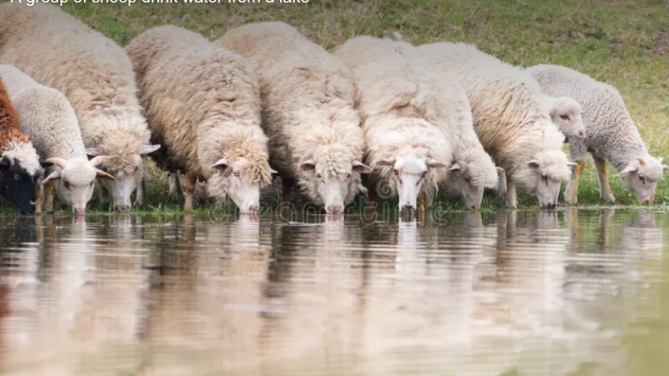
Please follow us over for a drink and a chat after the service

