Slide 1
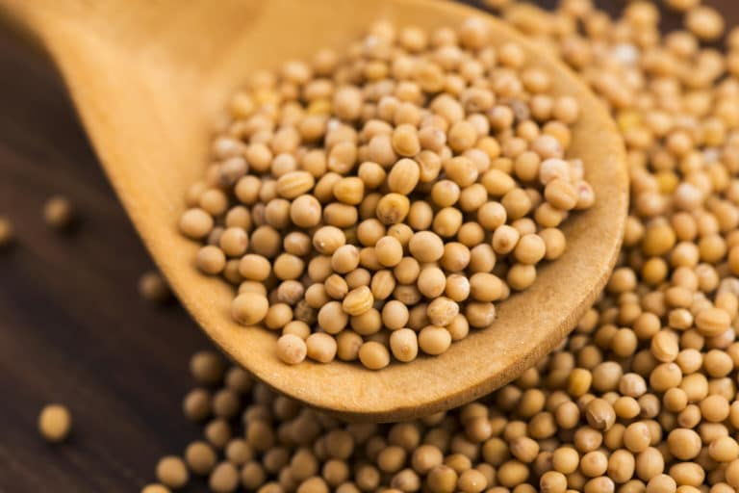
"It's not what it seems"

Slide 2
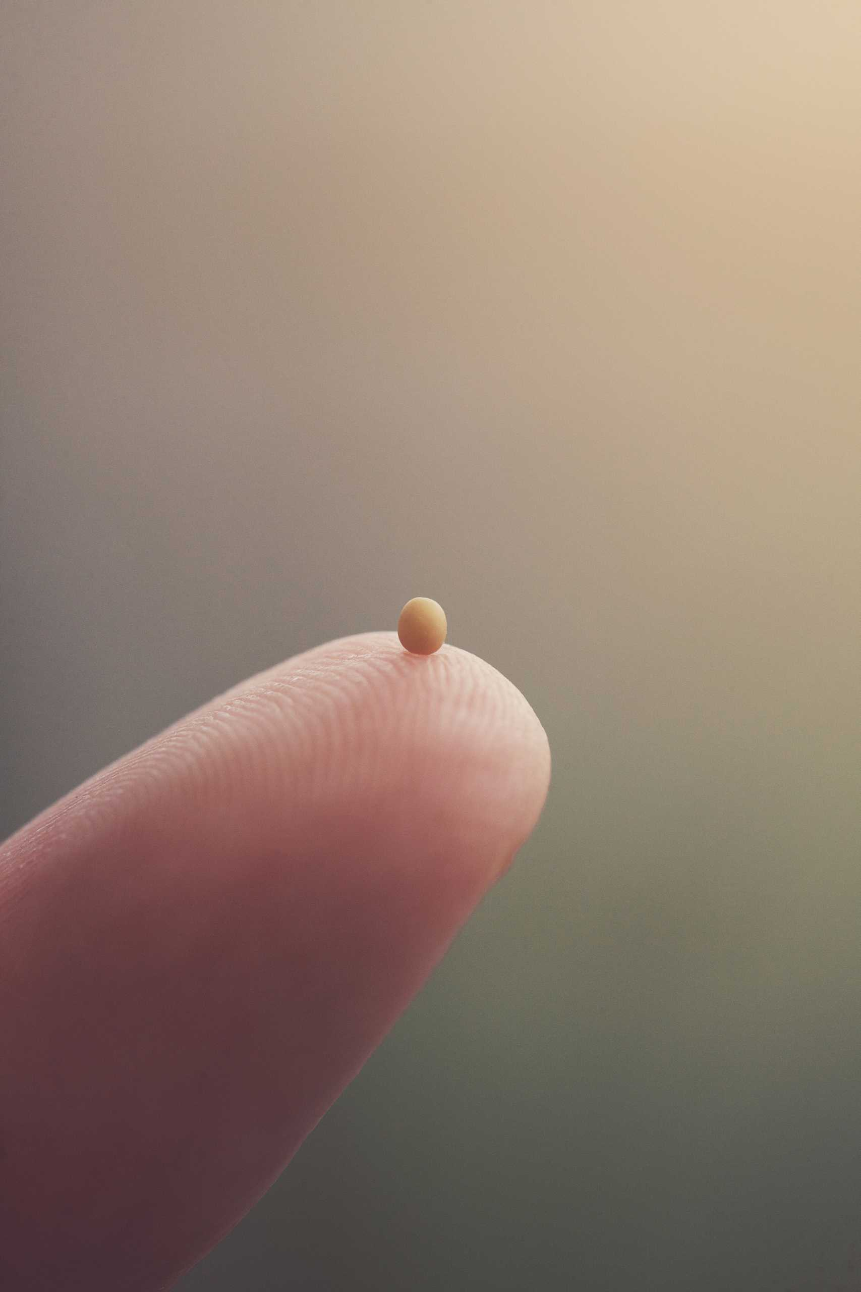

Slide 3
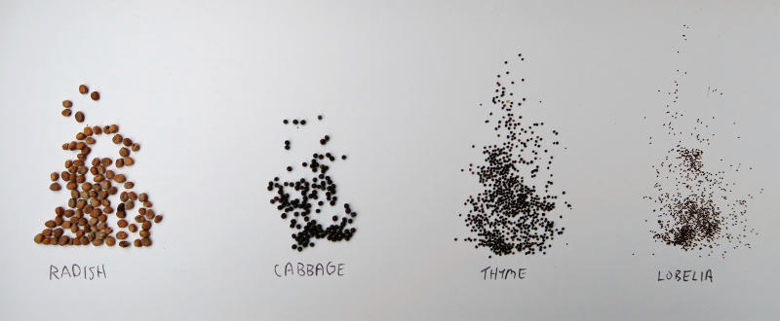

Slide 4
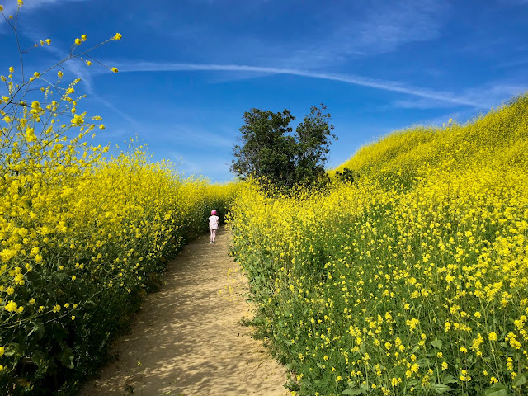

Slide 5
Thus says the Lord GOD: I myself will take a sprig from the lofty top of a cedar; I will set it out. I will break off a tender one from the topmost of its young twigs; I myself will plant it on a high and lofty mountain.

Slide 6
On the mountain height of Israel I will plant it, in order that it may produce boughs and bear fruit, and become a noble cedar. Under it every kind of bird will live; in the shade of its branches will nest winged creatures of every kind. Ezekiel 17

Slide 7
Mark chapter 4
It is like a mustard seed, which, when sown upon the ground, is the smallest of all the seeds on earth; yet when it is sown it grows up and becomes the greatest of all shrubs, and puts forth large branches, so that the birds of the air can make nests in its shade.’

Slide 8
"It's not what it seems"

Slide 9
And he died for all, so that those who live might live no longer for themselves, but for him who died and was raised for them. From now on, therefore, we regard no one from a human point of view; even though we once knew Christ from a human point of view, we know him no longer in that way. So if anyone is in Christ, there is a new creation: everything old has passed away; see, everything has become new! I Corinthinans 5

Slide 10
