Slide 2
We acknowledge the sovereign First Peoples of these lands and waters
where we meet, the Yuin Nation. We pay our respects to their elders past and present and to all Aboriginal people who have cared for this place since creation.

Slide 3
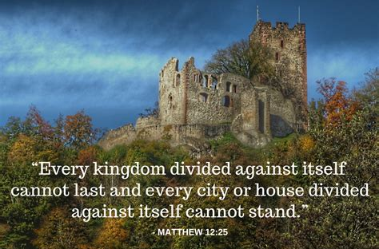
Welcome to worship
at St Georges - Eden

Slide 4
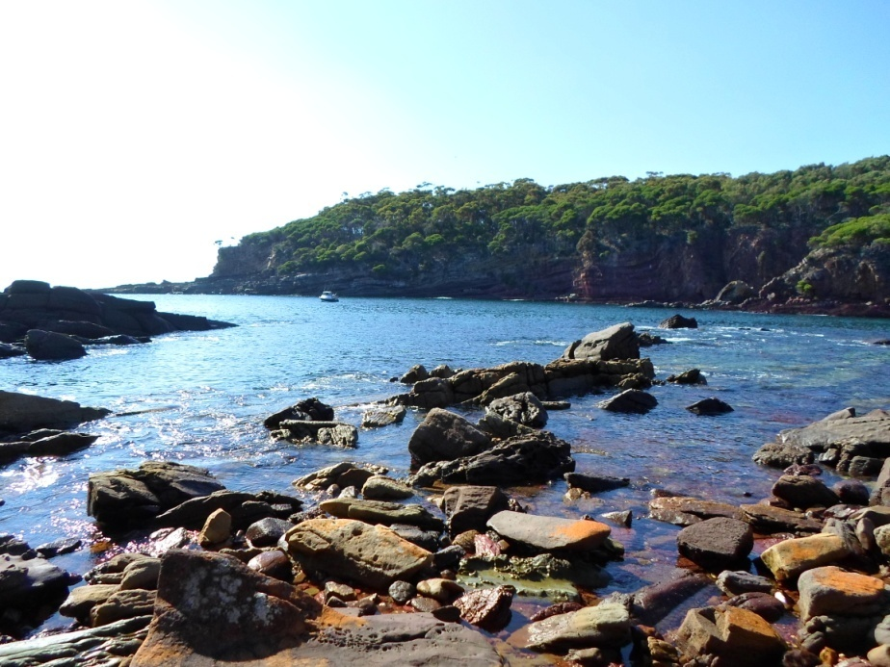
Gather us in. TIS 474
Here in this place new light is streaming,
now is the darkness vanished away,
see, in this space, our fears and our dreamings,
brought here to you in the light of this day.

Slide 5
Gather us in, the lost and forsaken,
gather us in, the blind and the lame;
call to us now, and we shall awaken,
we shall arise at the sound of our name.

Slide 6
We are the young, our lives are a mystery;
we are the old, who yearn for your face;
we have been sung throughout all of history,
called to be light to the whole human race.

Slide 7
Gather us in, the rich and the haughty;
gather us in, the proud and the strong;
give us a heart so meek and so lowly,
give us the courage to enter the song.

Slide 8
Here we will take of the wine and the water,
here we will take the bread of new birth,
here you shall call your sons and your daughters,
call us anew to be salt of the earth.

Slide 9
Give us to drink the wine of compassion,
give us to eat the bread that is you;
nourish us well, and teach us to fashion
lives that are holy and hearts that are true.

Slide 10
Not in the dark of buildings confining,
not in some heaven light years away,
but here in the space,
the new light is shining,
now is the kingdom, now is the day.

Slide 11
Gather us in, and hold us forever;
gather us in, and make us you own;
gather us in, all peoples together,
fire of love in our flesh and our bone.
Marty Haugen, CCLI 222909
TIS 474 D D x4 *

Slide 12
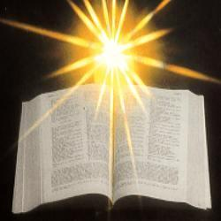

Slide 13
Psalm 138 Of David. I give you thanks, O Lord, with my whole heart; before the gods I sing your praise; I bow down towards your holy temple and give thanks to your name for your steadfast love and your faithfulness; for you have exalted your name and your word above everything. On the day I called, you answered me, you increased my strength of soul.

Slide 14
All the kings of the earth shall praise you, O Lord, for they have heard the words of your mouth. They shall sing of the ways of the Lord, for great is the glory of the Lord. For though the Lord is high, he regards the lowly; but the haughty he perceives from far away.

Slide 15
Though I walk in the midst of trouble, you preserve me against the wrath of my enemies; you stretch out your hand, and your right hand delivers me. The Lord will fulfil his purpose for me; your steadfast love, O Lord, endures for ever. Do not forsake the work of your hands.

Slide 16
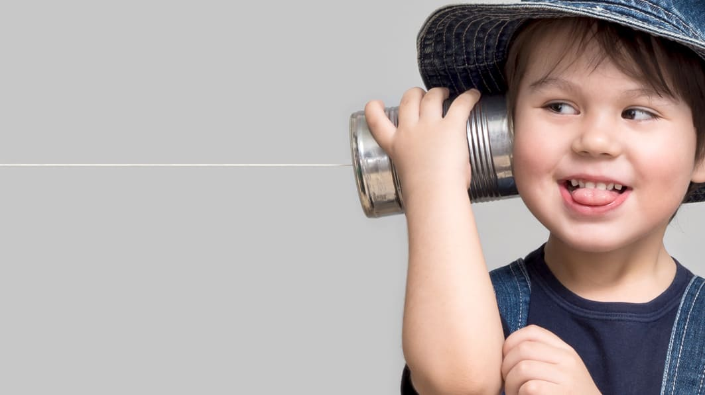
Let’s get involved
Sharing with the children and each other
Thankfulness

Slide 17
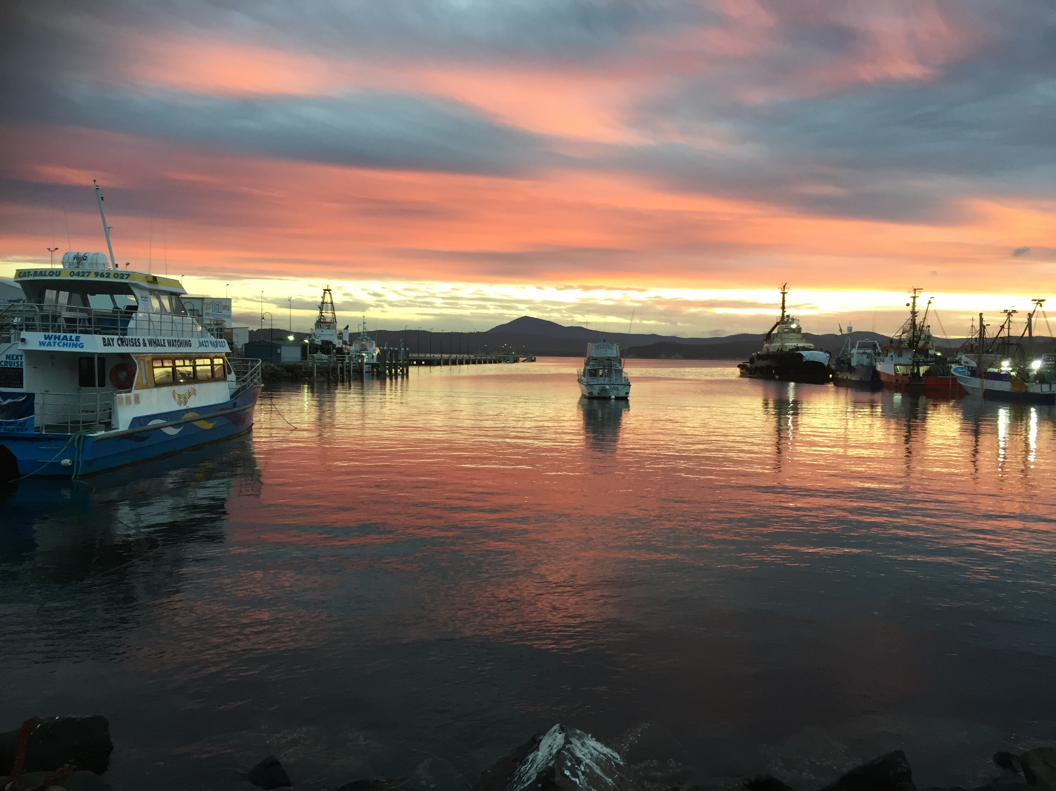

Slide 18
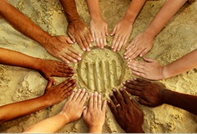
In Christ there is no East or West, In Him no South or North; But one great fellowship of love Throughout the whole wide earth.

Slide 19
In Christ shall true hearts everywhere Their high communion find; His service is the golden cord, Close-binding humankind.

Slide 20
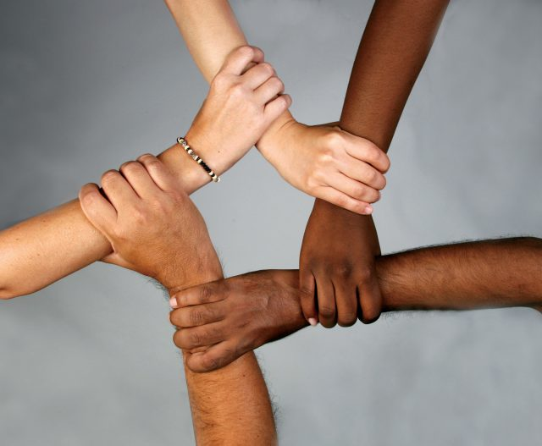
Join hands, then, people of the faith, What ever your race may be; Who serves my Father as His child Is surely kin to me.

Slide 21
In Christ now meet both East and West, In Him meet South and North; All Christlike souls are one in Him Throughout the whole wide earth. Willliam Arthur Dnakerly TiS 459 (i) Bb b

Slide 22
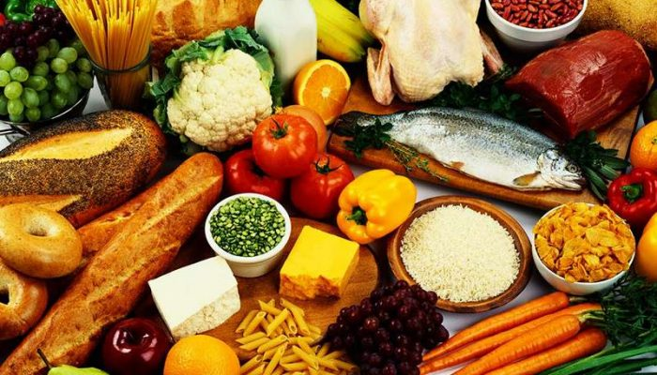
Offering

Slide 23
Coming up Faith conversations Wednesday 5pm Pantry with morning tea and light lunch – Thursday Ladies’ meeting – Tuesday 3pm at Anglican church Market – Saturday 15th Information session about transitional housing after church, 11:30 next week (16th)

Slide 24
Mark 3:20–35
and the crowd came together again, so that they could not even eat. When his family heard it, they went out to restrain him, for people were saying, ‘He has gone out of his mind.’ And the scribes who came down from Jerusalem said, ‘He has Beelzebul, and by the ruler of the demons he casts out demons.’

Slide 25
And he called them to him, and spoke to them in parables, ‘How can Satan cast out Satan? If a kingdom is divided against itself, that kingdom cannot stand. And if a house is divided against itself, that house will not be able to stand. And if Satan has risen up against himself and is divided, he cannot stand, but his end has come. But no one can enter a strong man’s house and plunder his property without first tying up the strong man; then indeed the house can be plundered.

Slide 26
‘Truly I tell you, people will be forgiven for their sins and whatever blasphemies they utter; but whoever blasphemes against the Holy Spirit can never have forgiveness, but is guilty of an eternal sin’— for they had said, ‘He has an unclean spirit.’

Slide 27
Then his mother and his brothers came; and standing outside, they sent to him and called him. A crowd was sitting around him; and they said to him, ‘Your mother and your brothers and sisters* are outside, asking for you.’ And he replied, ‘Who are my mother and my brothers?’ And looking at those who sat around him, he said, ‘Here are my mother and my brothers! Whoever does the will of God is my brother and sister and mother.’

Slide 28
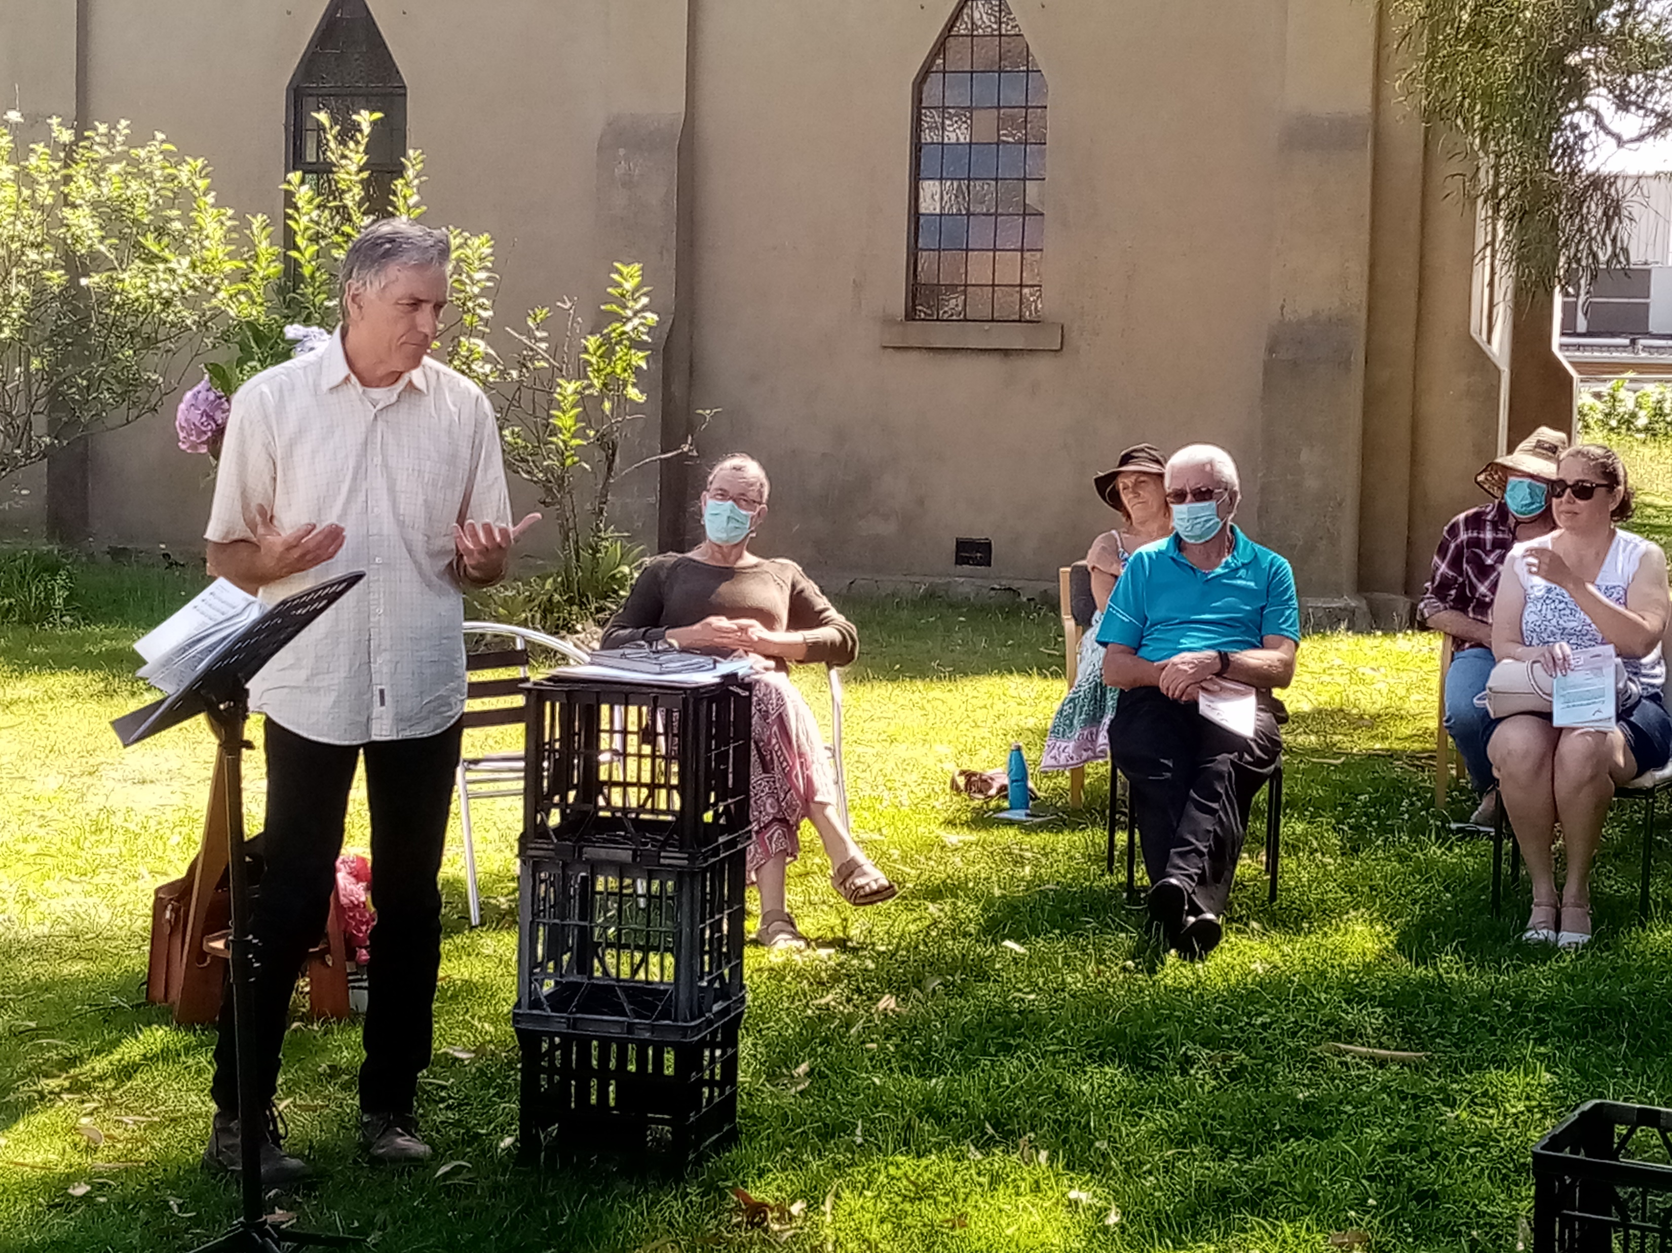
Michael to
helps us understand
Living in the
Wake of Justice
January 2022

Slide 29
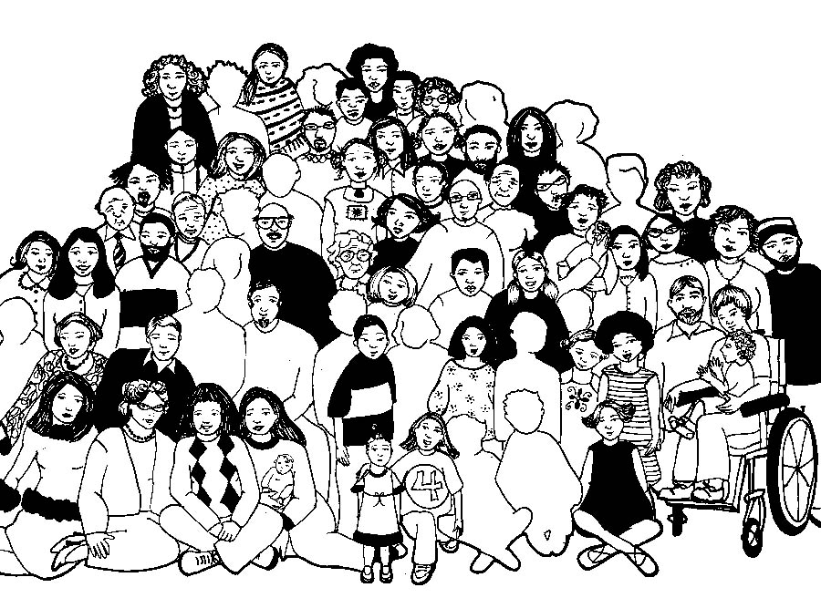

Slide 30
Lord’s Prayer
Our Father in Heaven,
Hallowed be your name,
your kingdom come,
your will be done, on earth as in heaven.
Give us today our daily bread.
Forgive our sins
as we forgive those who sin against us.
Save us from the time of trial
and deliver us from evil.
For the Kingdom, the power,
and the glory are yours now and forever. Amen
Notes:
30

Slide 31
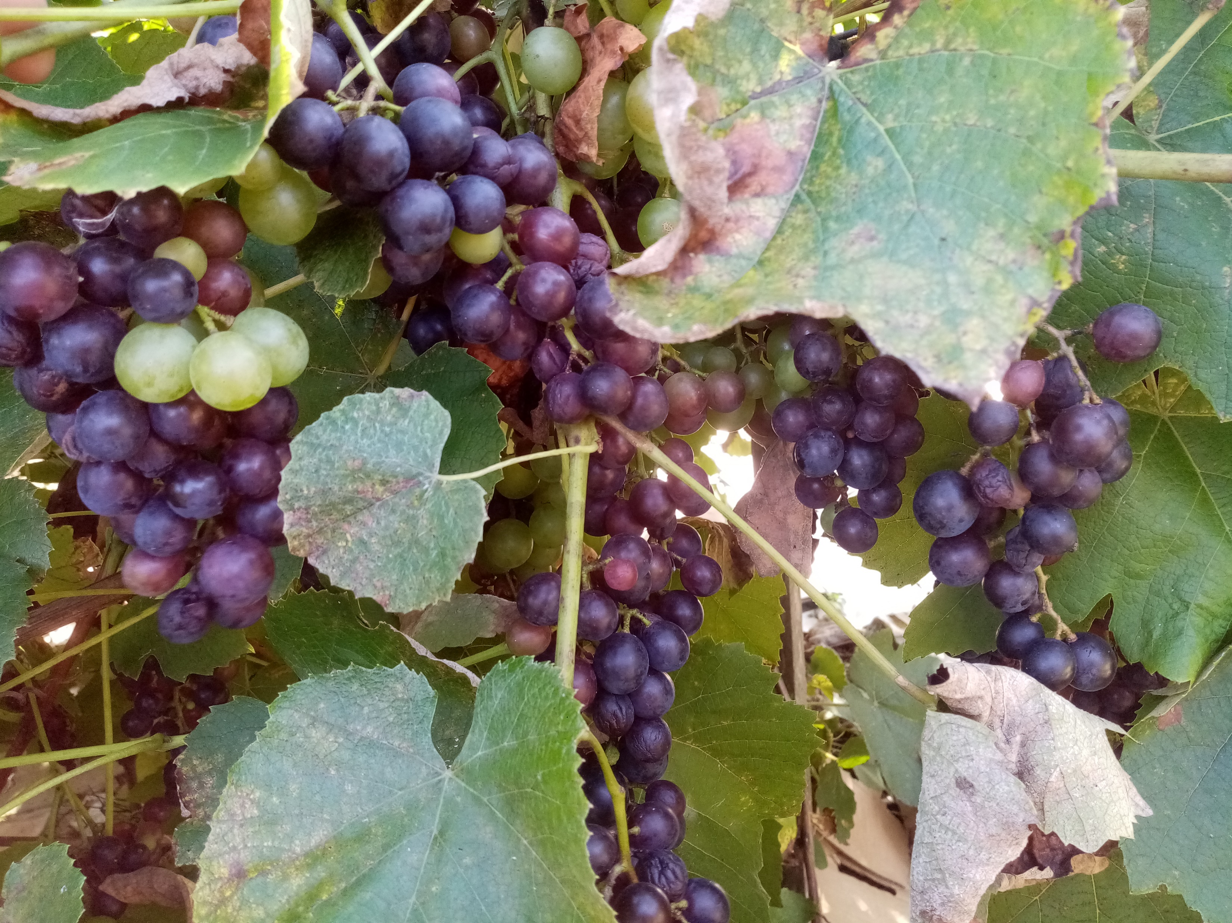
Feed us now, Bread of life, in this holy meal; let us know your love anew: we hunger for you. Feed us now, Bread of life, come and live within; let your peace be ours today, Lord Jesus, we pray.

Slide 32
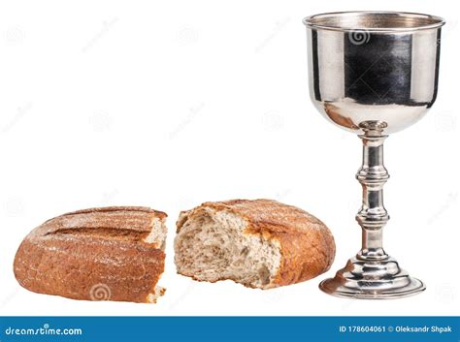
Piece of bread, glass of wine: Lord, this food is good; love and mercy come to us — your promise we trust. Piece of bread, glass of wine; who can understand how his mercy works in these? Yet, Lord, we believe.

Slide 33
God is here, O so near, nearer than our thoughts. Stay with us where’er we go; Lord, help us to grow. God is here, O so near, in this heaven’s meal. May we always feed on you — on the bread that is true. TIS 538 CCLI 222909

Slide 34
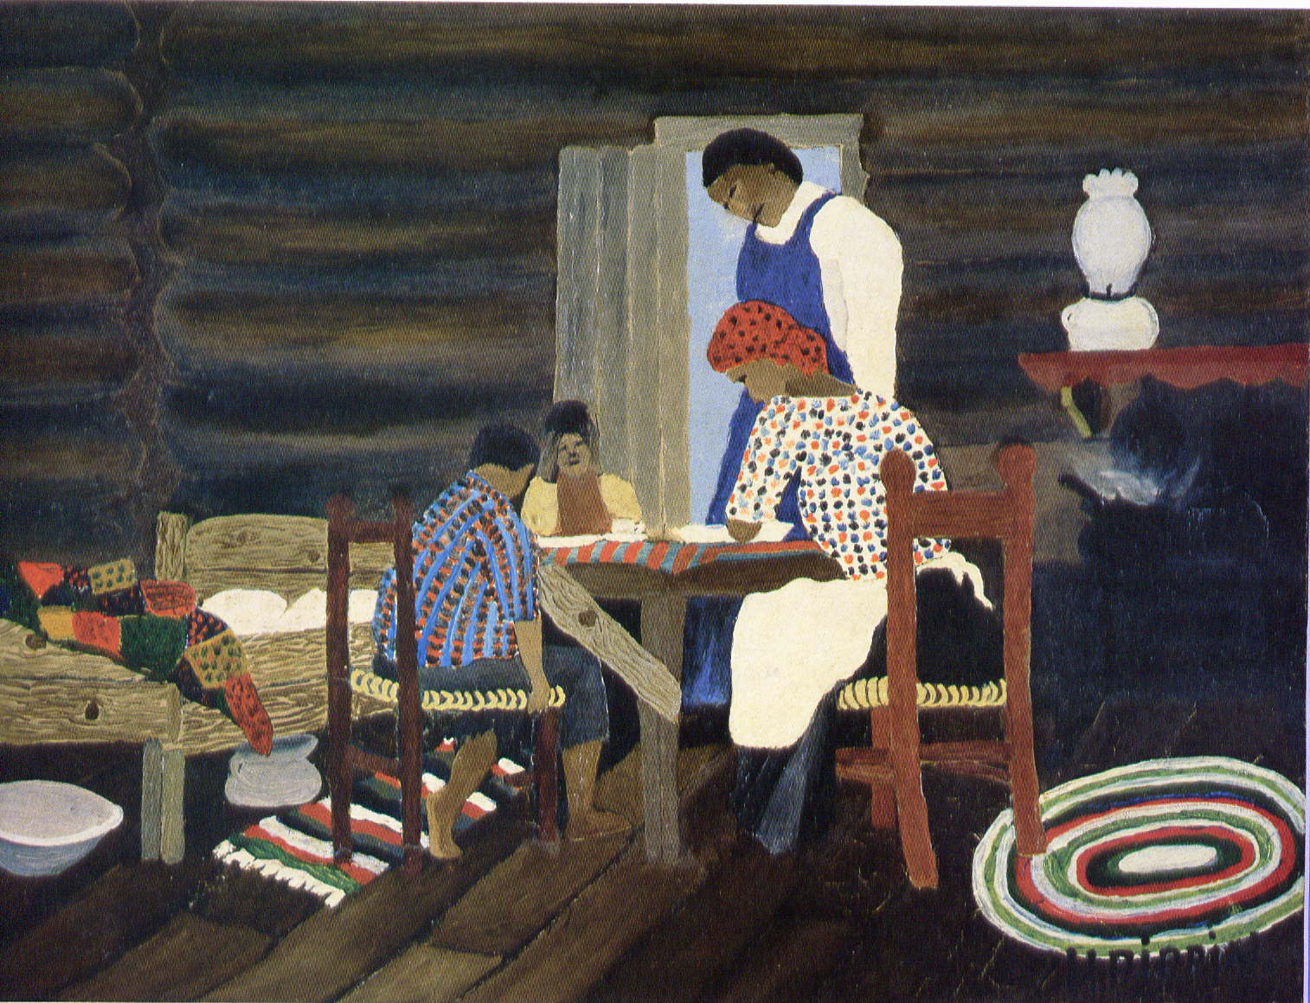

Slide 35
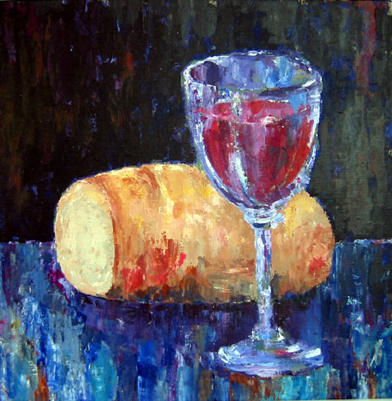
TIS 537
Let us talents and tongues employ,
Reaching out with a shout of joy;
Bread is broken, the wine is poured,
Christ is spoken and seen and heard.

Slide 36
Jesus lives again,
earth can breathe again,
pass the Word around;
loaves abound!
Repeat!

Slide 37
Christ is able to make us one,
at the table he sets the tone,
teaching people to live to bless,
love in word and in deed express.

Slide 38
Jesus lives again,
earth can breathe again,
pass the Word around;
loaves abound!
Repeat!

Slide 39
Jesus calls us in, sends us out
Bearing fruit in a world of doubt,
Gives us love to tell, bread to share:
God-Immanuel everywhere.

Slide 40
Jesus lives again,
earth can breathe again,
pass the Word around;
loaves abound!
Repeat!
CCLI 222909
Frederik Kaan, CCLI 222909 *

Slide 41
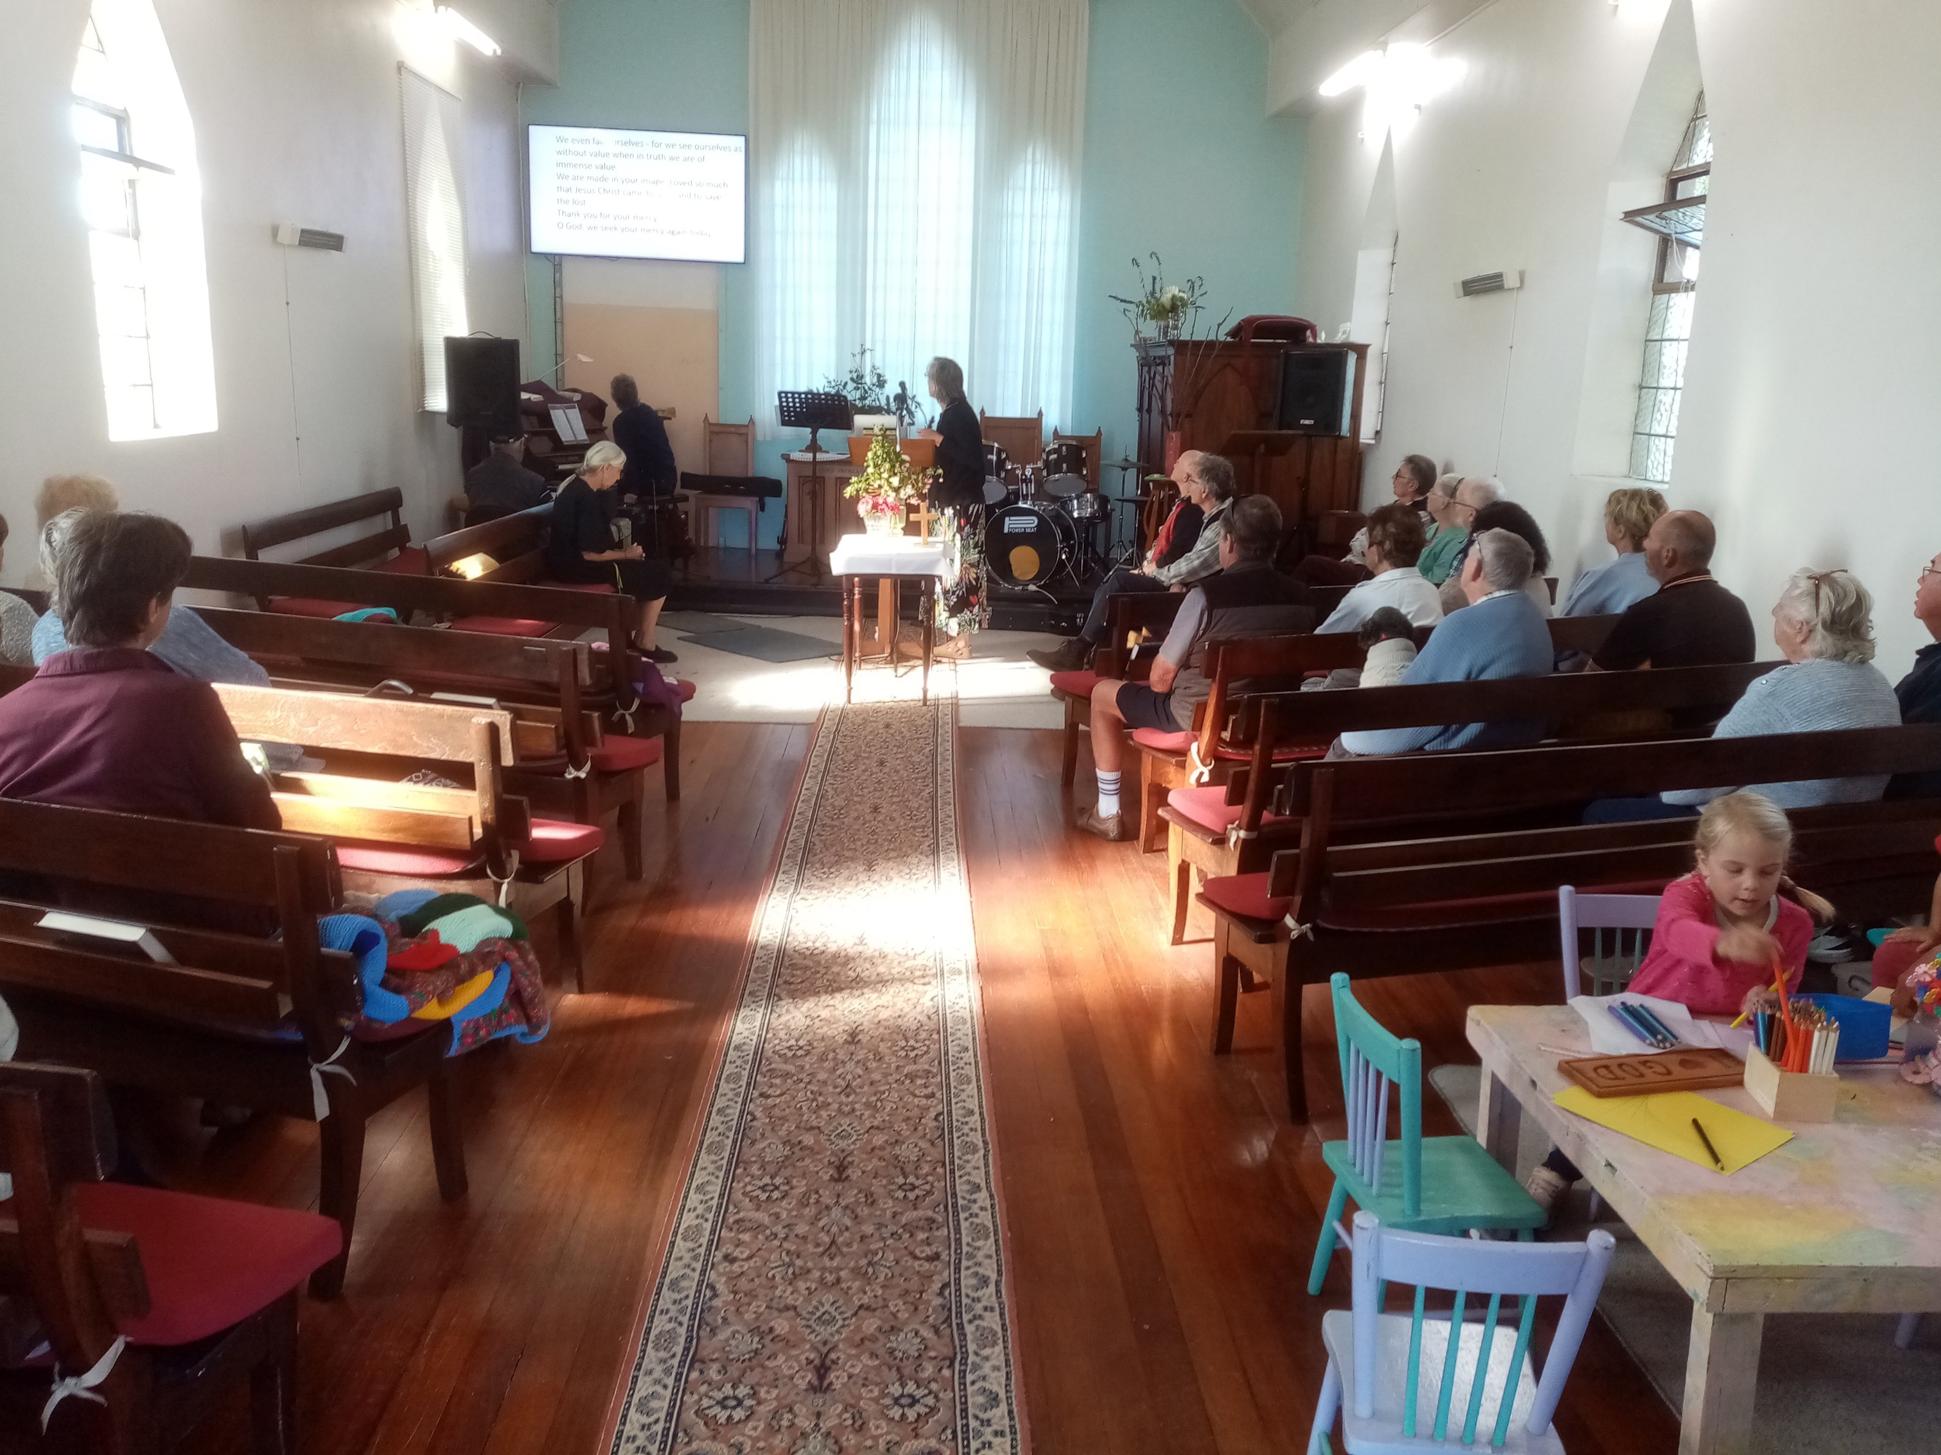
Please follow us over for a drink and a chat after the service

Slide 42
1 Samuel 8:4–11, 16–20, CEV
Then all the elders of Israel gathered together and came to Samuel at Ramah, and said to him, ‘You are old and your sons do not follow in your ways; appoint for us, then, a king to govern us, like other nations.’ But the thing displeased Samuel when they said, ‘Give us a king to govern us.’

Slide 43
Samuel prayed to the Lord, and the Lord said to Samuel, ‘Listen to the voice of the people in all that they say to you; for they have not rejected you, but they have rejected me from being king over them. Just as they have done to me, from the day I brought them up out of Egypt to this day, forsaking me and serving other gods, so also they are doing to you. Now then, listen to their voice; only—you shall solemnly warn them, and show them the ways of the king who shall reign over them.’

Slide 44
So Samuel reported all the words of the Lord to the people who were asking him for a king. He said, ‘These will be the ways of the king who will reign over you: he will take your sons and appoint them to his chariots and to be his horsemen, and to run before his chariots; He will take your male and female slaves, and the best of your cattle and donkeys, and put them to his work. He will take one-tenth of your flocks, and you shall be his slaves. And in that day you will cry out because of your king, whom you have chosen for yourselves; but the Lord will not answer you in that day.’

Slide 45
But the people refused to listen to the voice of Samuel; they said, ‘No! but we are determined to have a king over us, so that we also may be like other nations, and that our king may govern us and go out before us and fight our battles.’

Slide 46
2 Corinthians 4:13–5:1
But just as we have the same spirit of faith that is in accordance with scripture—‘I believed, and so I spoke’—we also believe, and so we speak, because we know that the one who raised the Lord Jesus will raise us also with Jesus, and will bring us with you into his presence. Yes, everything is for your sake, so that grace, as it extends to more and more people, may increase thanksgiving, to the glory of God.

Slide 47
So we do not lose heart. Even though our outer nature is wasting away, our inner nature is being renewed day by day. For this slight momentary affliction is preparing us for an eternal weight of glory beyond all measure, because we look not at what can be seen but at what cannot be seen; for what can be seen is temporary, but what cannot be seen is eternal.

Slide 48
For we know that if the earthly tent we live in is destroyed, we have a building from God, a house not made with hands, eternal in the heavens.

Slide 49
Please follow us over for a drink and a chat after the service

