Slide 1
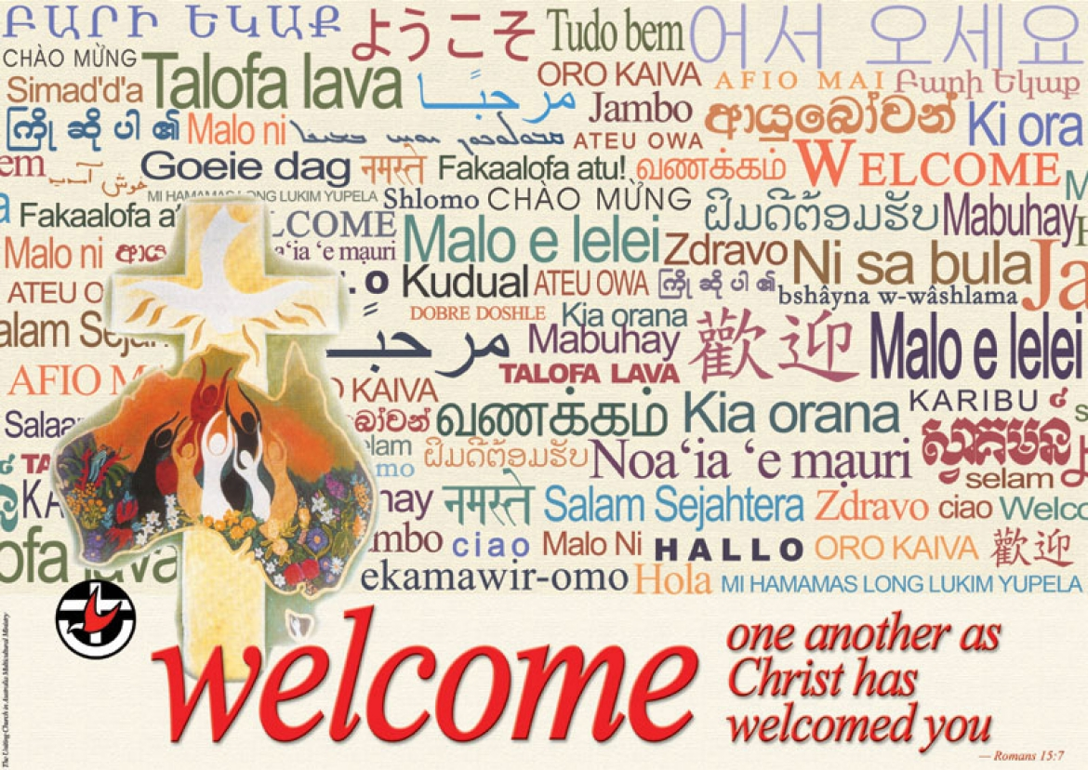

Slide 2

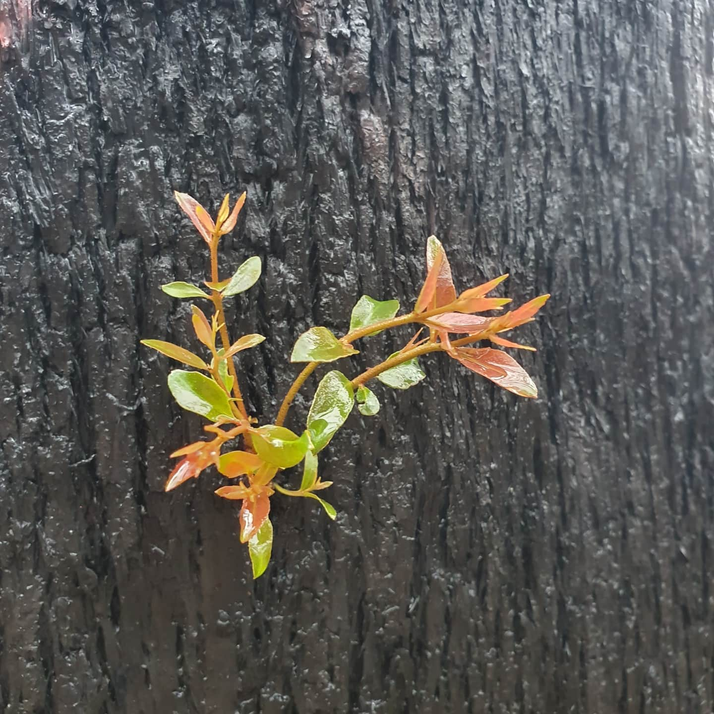
Welcome to worship
at St Georges - Eden

Slide 3

We acknowledge the sovereign First Peoples of these lands and waters
where we meet, the Yuin Nation.
We pay our respects to their elders past and present and to all Aboriginal people who have cared for this place since creation.

Slide 4
CALL TO WORSHIP

Slide 5
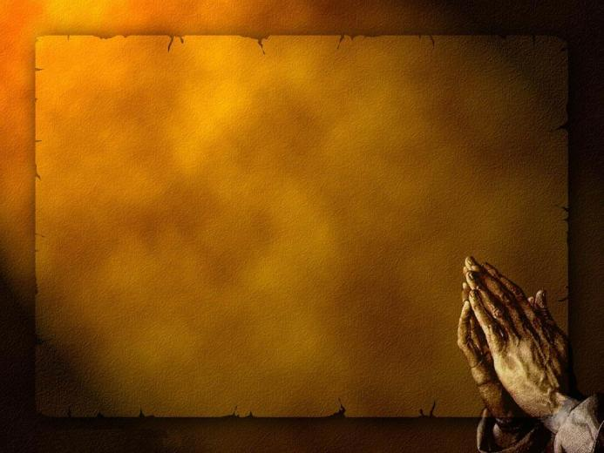

Slide 6
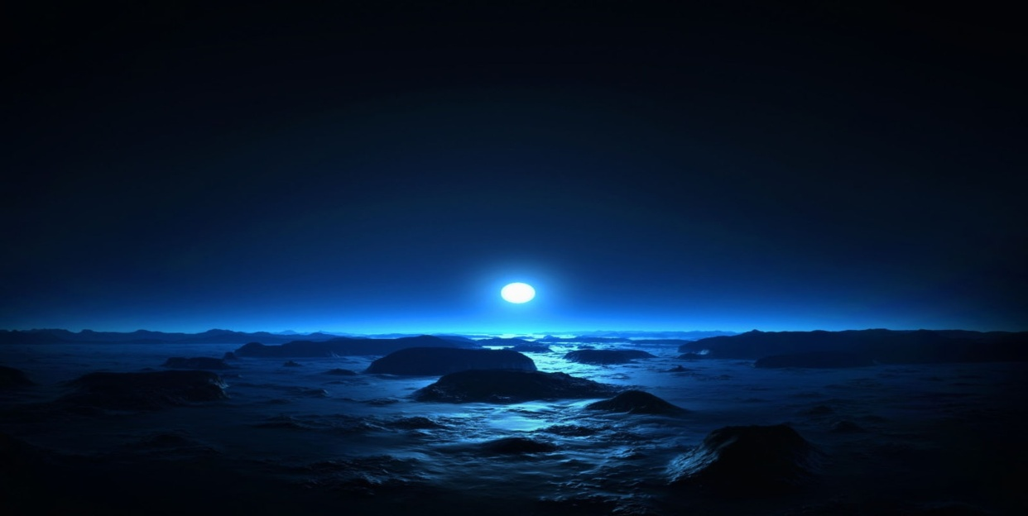
Light of the world
You stepped down into darkness
Open my eyes let me see,
Beauty that made this heart adore You
Hope of a life spent with You.

Slide 7
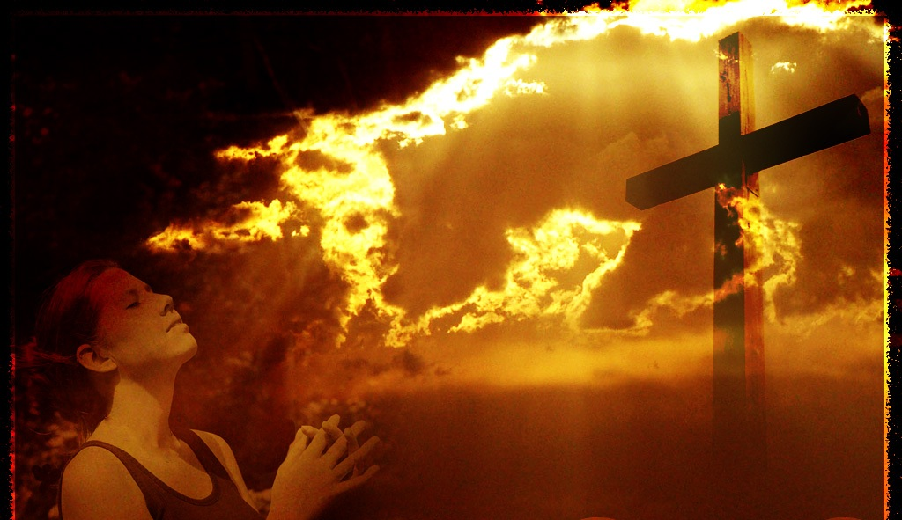
King of all days
Oh so highly exalted
Glorious in heaven above
Humbly You came to the earth You created
All for love's sake became poor

Slide 8
Here I am to worship
Here I am to bow down
Here I am to say that You're my God
You're altogether lovely
Altogether worthy
Altogether wonderful to me,

Slide 9
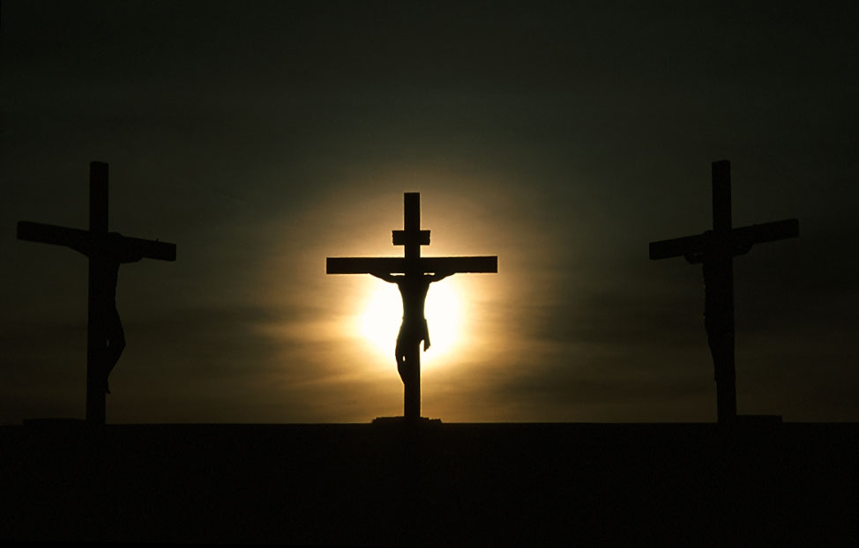
And I'll never know how much it cost
To see my sin upon that cross
I'll never know, how much it cost
To see my sin, upon that cross

Slide 10

Here I am to worship
Here I am to bow down
Here I am to say that You're my God
You're altogether lovely
Altogether worthy
Altogether wonderful to me,
.....Here I am.....,
Hillsongs CCLI222909

Slide 12
Psalm 123
Contemporary English Version
(A song for worship.)
A Prayer for Mercy
Our Lord and our God,
I turn my eyes to you, on your throne in heaven.
Servants look to their master, but we will look to you, until you have mercy on us.

Slide 13
Please have mercy, Lord!
We have been insulted more than we can stand, and we can't take more abuse from those proud, conceited people.
**************************

Slide 14
Interactive talk – Pam

Slide 15
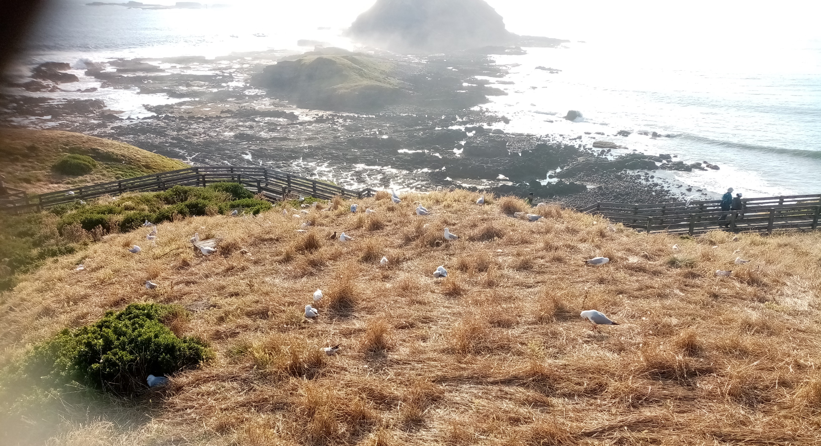
Offertory

Slide 16
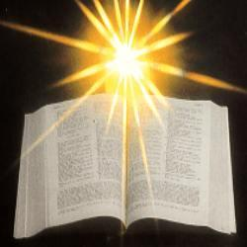

Slide 17
Matthew 25:14-30 CEV
A Story about Three Servants
The kingdom is also like what happened when a man went away and put his three servants in charge of all he owned. The man knew what each servant could do. So he handed 5,000 coins to the first servant, 2,000 to the second, and 1,000 to the third. Then he left the country.

Slide 18
As soon as the man had gone, the servant with the 5,000 coins used them to earn 5,000 more. The servant who had 2,000 coins did the same with his money and earned 2,000 more. But the servant with 1,000 coins dug a hole and hid his master's money in the ground.

Slide 19
Some time later the master of those servants returned. He called them in and asked what they had done with his money. The servant who had been given 5,000 coins brought them in with the 5,000 that he had earned. He said, “Sir, you gave me 5,000 coins, and I have earned 5,000 more.

Slide 20
”
“Wonderful!” his master replied. “You are a good and faithful servant. I left you in charge of only a little, but now I will put you in charge of much more. Come and share in my happiness!”
Next, the servant who had been given 2,000 coins came in and said, “Sir, you gave me 2,000 coins, and I have earned 2,000 more.”

Slide 21
“Wonderful!” his master replied. “You are a good and faithful servant. I left you in charge of only a little, but now I will put you in charge of much more. Come and share in my happiness!”

Slide 22
The servant who had been given 1,000 coins then came in and said, “Sir, I know that you are hard to work for. You harvest what you don't plant and gather crops where you haven't scattered seed. I was frightened and went out and hid your money in the ground. Here is every single coin!”

Slide 23
The master of the servant told him, “You are lazy and good-for-nothing! You know I harvest what I don't plant and gather crops where I haven't scattered seed. You could have at least put my money in the bank, so I could have earned interest on it.”

Slide 24
Then the master said, “Now your money will be taken away and given to the servant with 10,000 coins! Everyone who has something will be given more, and they will have more than enough. But everything will be taken from those who don't have anything. You are a worthless servant, and you will be thrown out into the dark where people will cry and grit their teeth in pain.”
**********************************

Slide 25
Leone - sermon

Slide 26
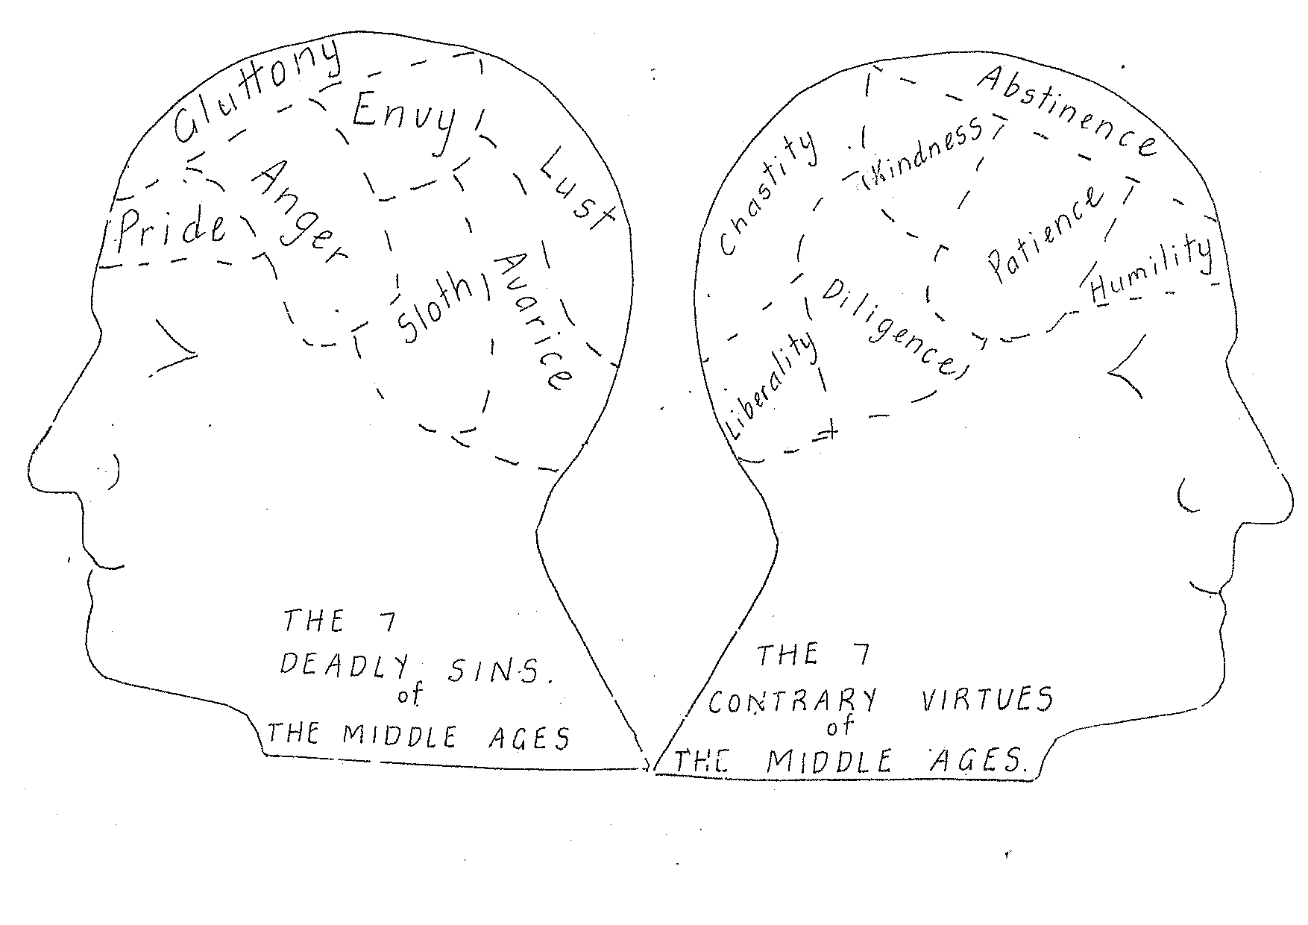

Slide 27
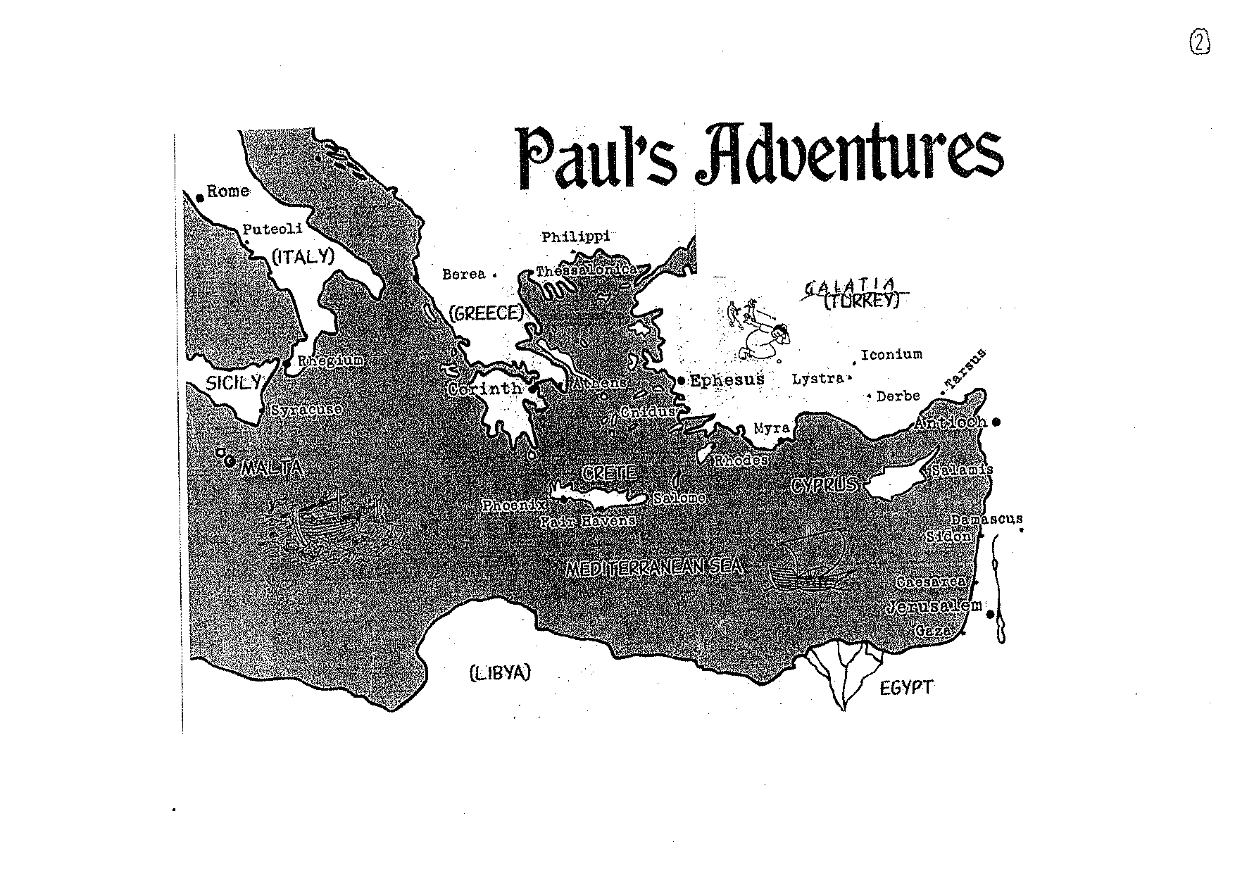

Slide 28
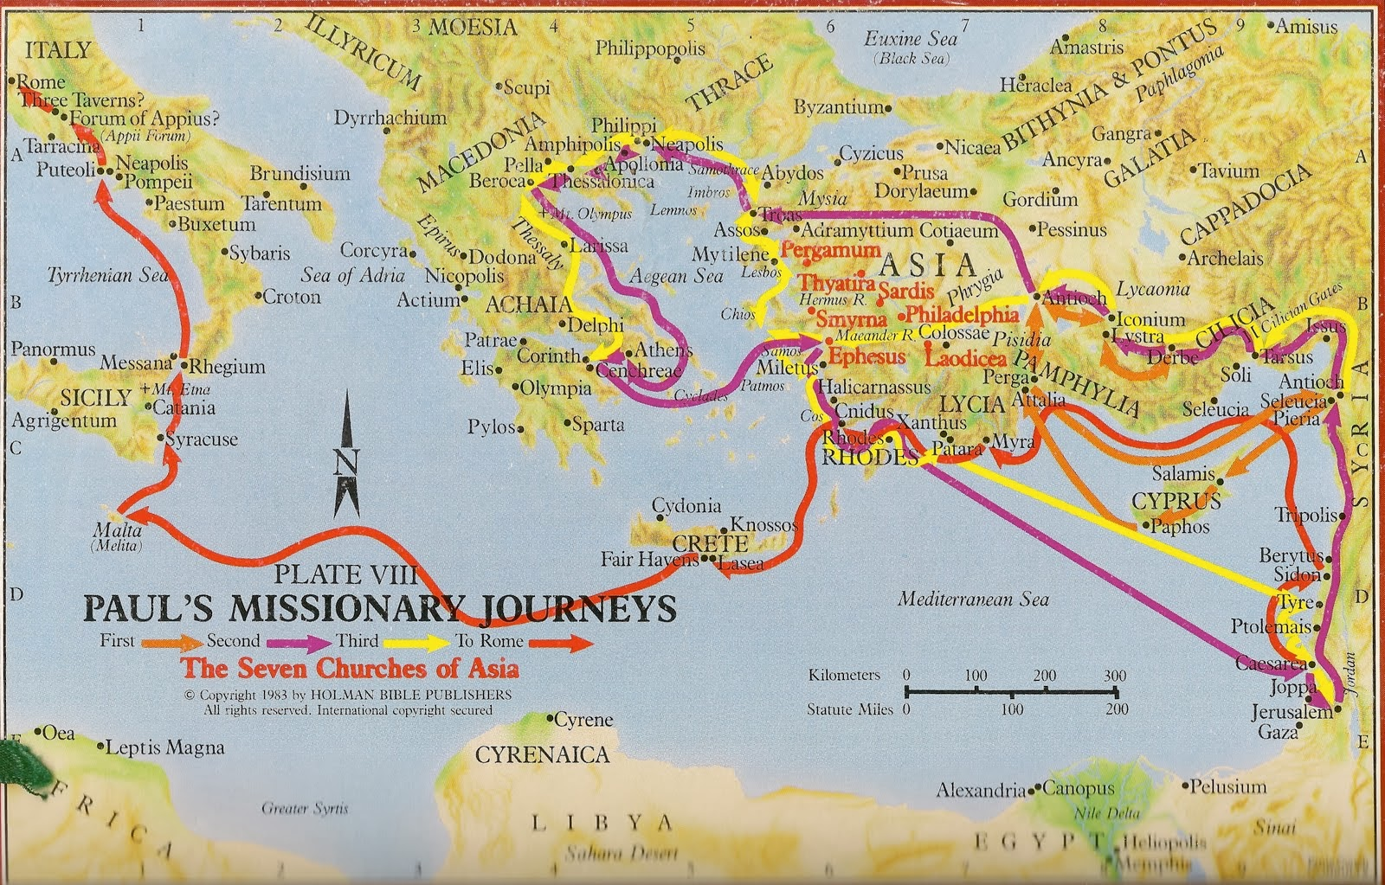

Slide 29
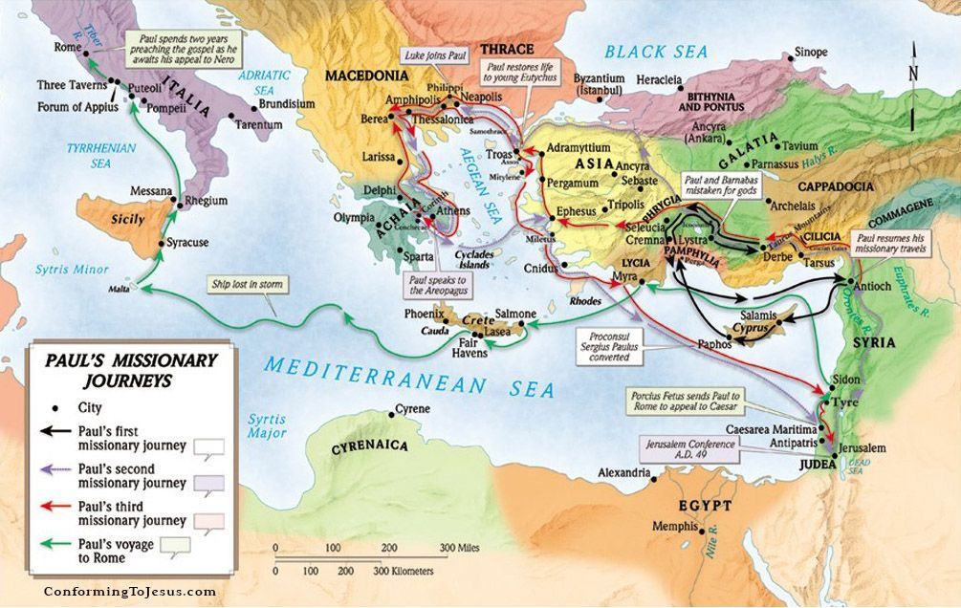

Slide 30
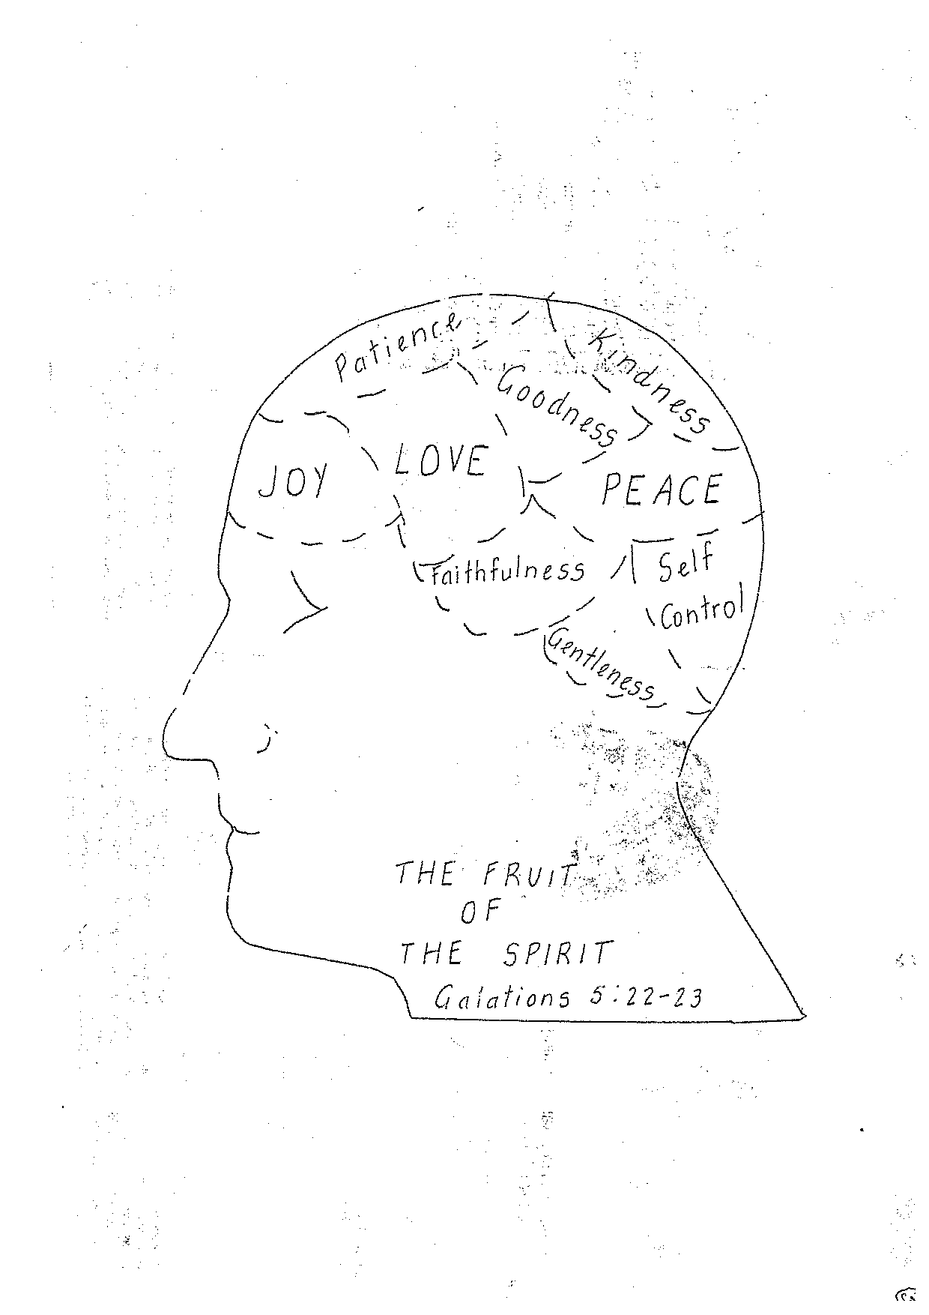

Slide 31
The Potters Hand
Words & Music by Darlene Zschech
Beautiful Lord,
wonderful Saviour,
I know for sure all of my days are
Held in Your hand
Crafted into Your perfect plan.

Slide 32
You gently call me into Your presence
Guiding me by Your Holy Spirit
Teach me dear Lord
To live all of my life through Your eyes.

Slide 33
Pre Chorus
I'm captured by Your Holy calling
Set me apart, I know You're drawing
Me to Yourself, lead me Lord I pray.

Slide 34
Chorus
Take me, mould me, use me, fill me
I give my life to the Potter's hand
Call me, guide me, lead me, walk beside me
I give my life to the Potter's hand.
Repeat Pre Chorus & Chorus
© 1997 Hillsong Australia

Slide 35
Prayers for Others

Slide 36
Lord’s Prayer
Our Father in Heaven,
Hallowed be your name,
your kingdom come,
your will be done, on earth as in heaven.
Give us today our daily bread.
Forgive our sins
as we forgive those who sin against us.
Save us from the time of trial
and deliver us from evil.
For the Kingdom, the power,
and the glory are yours now and forever. Amen
Notes:
36

Slide 37
Notices
Presbytery,
Market
Pantry & Hampers last day 14th Dec
Movie at Amy and Michaels Sat 25th
Christmas Lunch 5th December
DRCN training
Understanding Trauma and the Brain
29th Nov 9-11am

Slide 38
Just let me say how much I love you
Let me speak of your mercy and grace
Just let me live in a shadow of your beauty
Let me see you face to face

Slide 39
And the earth will shake as your Word goes forth and the heavens will tremble and fall but let me say how much I love you oh my Saviour, my Lord and friend

Slide 40
Just let me hear your finest whispers as you gently call my name and let me see your power and your glory let me feel your spirit’s flame

Slide 41
Let me find you in the desert till this sand is holy ground and I am found completely surrendered to you my Lord and friend

Slide 42
So let me say how much I love you with all my heart I long for you for I am caught in this passion of knowing this endless love I’ve found in you

Slide 43
and the depth of grace, the forgiveness found to be called a child of God just makes me say how much I love you oh my saviour, my Lord and friend
Just makes me say how much I love you oh my saviour, my Lord and friend

Slide 44
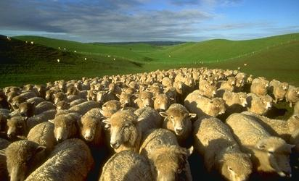
return now to the everyday, still giving in each moment yourself, your all, to God.

Slide 45
