Slide 2
Welcome to worship
at St Georges - Eden

Slide 3
We acknowledge the sovereign First Peoples of these lands and waters
where we meet, the Yuin Nation. We pay our respects to their elders past and present and to all Aboriginal people who have cared for this place since creation.

Slide 5
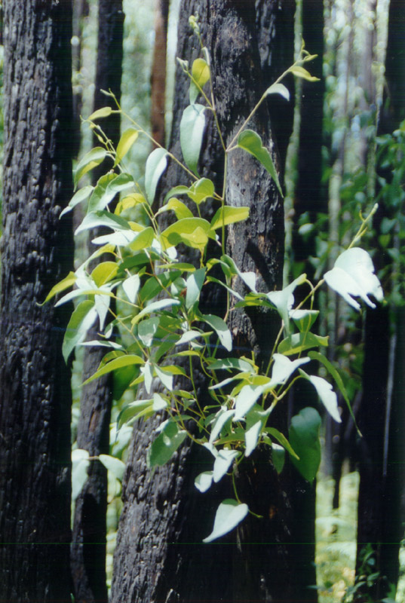
SEEK YOU FIRST
Seek you first the kingdom of God
And his righteousness
And all these things shall be added unto you,
Hallelu, Hallelujah
Hallelujah, Hallelujah,
Hallelujah, Hallelu, Hallelujah,

Slide 6
Ask and it shall be given unto you,
seek and you shall find,
knock and it shall be
opened unto you.
Hallelu, Hallelujah
Hallelujah, Hallelujah,
Hallelujah, Hallelu, Hallelujah,

Slide 7
Man shall not live
by bread alone
But by every word
That proceeds from the mouth of God
Hallelu, Hallelujah Hallelujah, Hallelujah,
Hallelujah, Hallelu, Hallelujah,
SOF 493 D^ f# x3 brightly

Slide 8
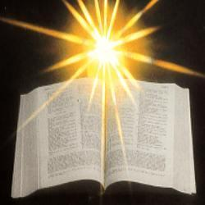

Slide 9
1 Thessalonians 1:1–10 Paul, Silvanus, and Timothy, To the church of the Thessalonians in God the Father and the Lord Jesus Christ: Grace to you and peace. We always give thanks to God for all of you and mention you in our prayers, constantly remembering before our God and Father your work of faith and labour of love and steadfastness of hope in our Lord Jesus Christ. For we know, brothers and sisters

Slide 10
beloved by God, that he has chosen you, because our message of the gospel came to you not in word only, but also in power and in the Holy Spirit and with full conviction; just as you know what kind of people we proved to be among you for your sake.

Slide 11
And you became imitators of us and of the Lord, for in spite of persecution you received the word with joy inspired by the Holy Spirit, so that you became an example to all the believers in Macedonia and in Achaia.

Slide 12
For the word of the Lord has sounded forth from you not only in Macedonia and Achaia, but in every place where your faith in God has become known, so that we have no need to speak about it. For the people of those regions report about us what kind of welcome we had among you, and how you turned to God from idols, to serve a living and true God, and to wait for his Son from heaven, whom he raised from the dead—Jesus, who rescues us from the wrath that is coming. 

Slide 13
Psalm 99 CEV The Lord is king; let the peoples tremble! He sits enthroned upon the cherubim; let the earth quake! The Lord is great in Zion; he is exalted over all the peoples. Let them praise your great and awesome name. Holy is he! Mighty King, lover of justice, you have established equity; you have executed justice and righteousness in Jacob. Extol the Lord our God; worship at his footstool. Holy is he!

Slide 14
Moses and Aaron were among his priests, Samuel also was among those who called on his name. They cried to the Lord, and he answered them. He spoke to them in the pillar of cloud; they kept his decrees, and the statutes that he gave them. O Lord our God, you answered them; you were a forgiving God to them, but an avenger of their wrongdoings. Extol the Lord our God, and worship at his holy mountain; for the Lord our God is holy. 

Slide 15
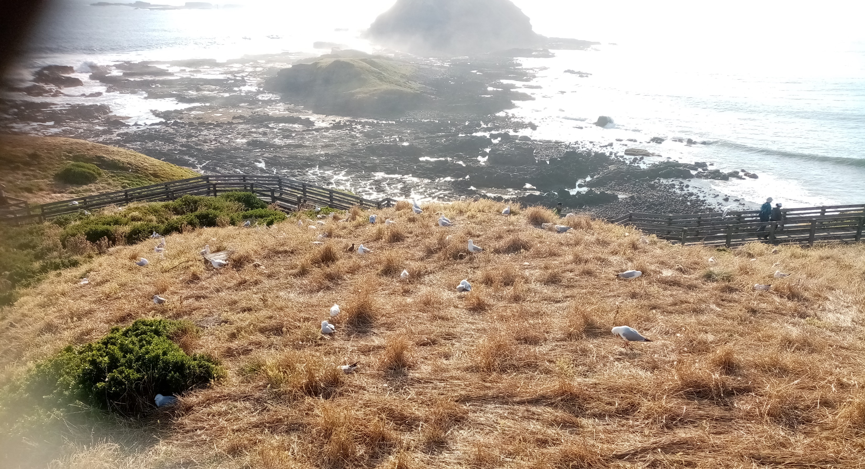
Michael’s Talk

Slide 16
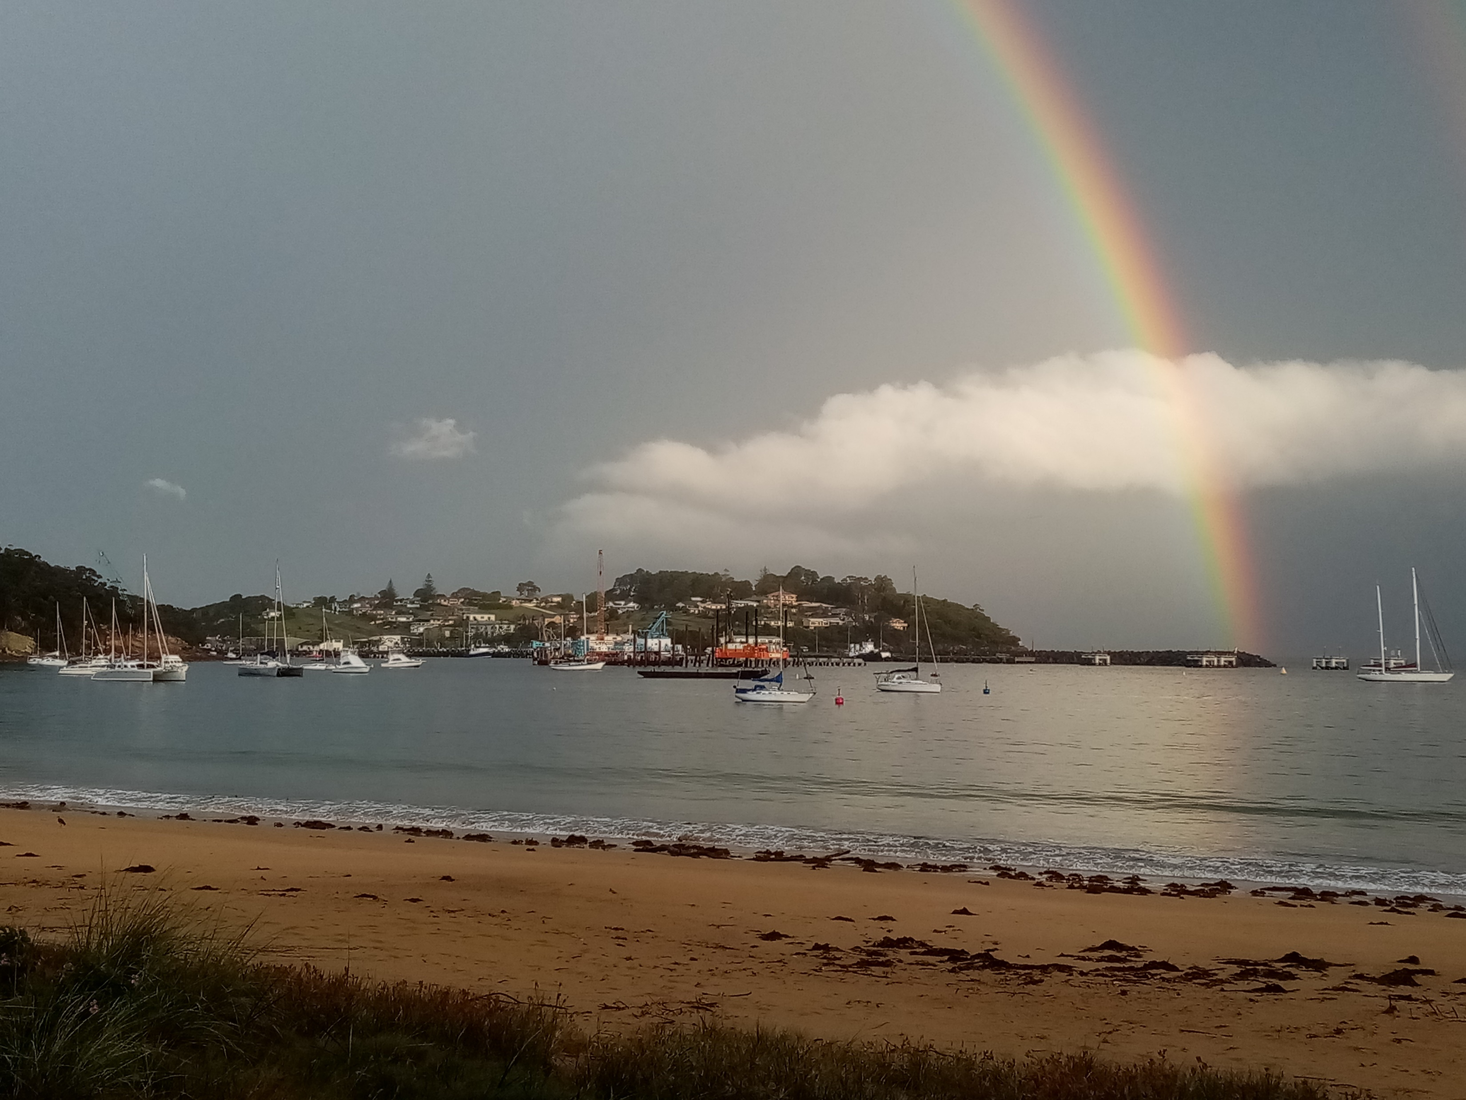

Slide 17
We are one in the spirit
We are one in the Lord
We are one in the spirit
We are one in the Lord
And we pray that all unity
may one day be restored

Slide 18
And they’ll know we are Christians by our love, by our love
Yes they’ll know we are Christians by our love

Slide 19
We will walk with each other
We will walk hand in hand
We will walk with each other
We will walk hand in hand
And together we’ll spread the news
that God is in our land

Slide 20
And they’ll know we are Christians by our love, by our love
Yes they’ll know we are Christians by our love

Slide 21
We will work with each other
We will work side by side
We will work with each other
We will work side by side
And we’ll guard each man’s dignity
And save each man’s pride

Slide 22
And they’ll know we are Christians by our love, by our love
Yes they’ll know we are Christians by our love

Slide 23
All praise to the Father
from whom all things come
And all praise to Christ Jesus His only son
and all praise to the Spirit
Who makes us one

Slide 24
And they’ll know we are Christians by our love, by our love
Yes they’ll know we are Christians by our love
1966 Peter Scholte
SIS E
CCLI 222909
See doc also

Slide 25
Exodus 33:12–23 CEV Moses said to the Lord, ‘See, you have said to me, “Bring up this people”; but you have not let me know whom you will send with me. Yet you have said, “I know you by name, and you have also found favour in my sight.” Now if I have found favour in your sight, show me your ways, so that I may know you and find favour in your sight. Consider too that this nation is your people.’

Slide 26
He said, ‘My presence will go with you, and I will give you rest.’ And he said to him, ‘If your presence will not go, do not carry us up from here. For how shall it be known that I have found favour in your sight, I and your people, unless you go with us? In this way, we shall be distinct, I and your people, from every people on the face of the earth.’

Slide 27
The Lord said to Moses, ‘I will do the very thing that you have asked; for you have found favour in my sight, and I know you by name.’ Moses said, ‘Show me your glory, I pray.’ And he said, ‘I will make all my goodness pass before you, and will proclaim before you the name, “The Lord”; and I will be gracious to whom I will be gracious, and will show mercy on whom I will show mercy. But’, he said, ‘you cannot see my face; for no one shall see me and live.’

Slide 28
And the Lord continued, ‘See, there is a place by me where you shall stand on the rock; and while my glory passes by I will put you in a cleft of the rock, and I will cover you with my hand until I have passed by; then I will take away my hand, and you shall see my back; but my face shall not be seen.’ 

Slide 29
Matthew 22:15–22 Laughing Bird version Some members of the devoutly religious Pharisee Party were out to get Jesus. They put their heads together and came up with a plan to get him to trip himself up with what he said in public. They sent a delegation to him consisting of some of their own followers and some members of Herod’s party.

Slide 30
The group approached him in the Temple and said, “Teacher, we know that you are a man of integrity. You are honest and straight down the line in your teaching about the way of God. It is clear that you do not think anyone is above the law, because you call a spade a spade, without fear or favour, no matter who is listening. So give us your opinion on this: is it okay by our law to pay taxes to the Roman emperor, or not?”

Slide 31
But sensing the venom that lay behind their attempts to butter him up, Jesus replied, “Why are you trying to force me into a catch twenty-two, you hypocrites? Show me the coin that is required for paying the tax.” So they handed him one of the Roman coins that was the only legal tender for the tax. He held it up and said to them, “Who is shown in this graven image? Who is named with a divine title on this coin?” They answered, “The emperor.”

Slide 32
"Well then,” said Jesus, “if it belongs to the emperor, then give it to the emperor. But don’t go short-changing God. Give to God everything that rightly belongs to God.” His reply left them in shock, and they turned tail and left. 

Slide 33
Matthew 22: 15-22

Slide 34
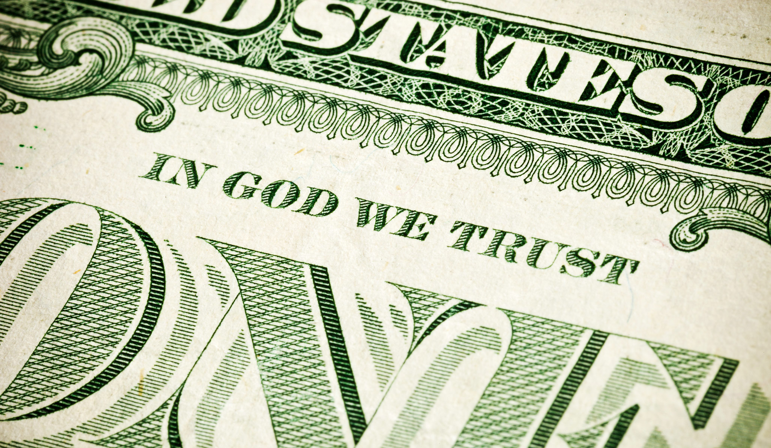

Slide 35
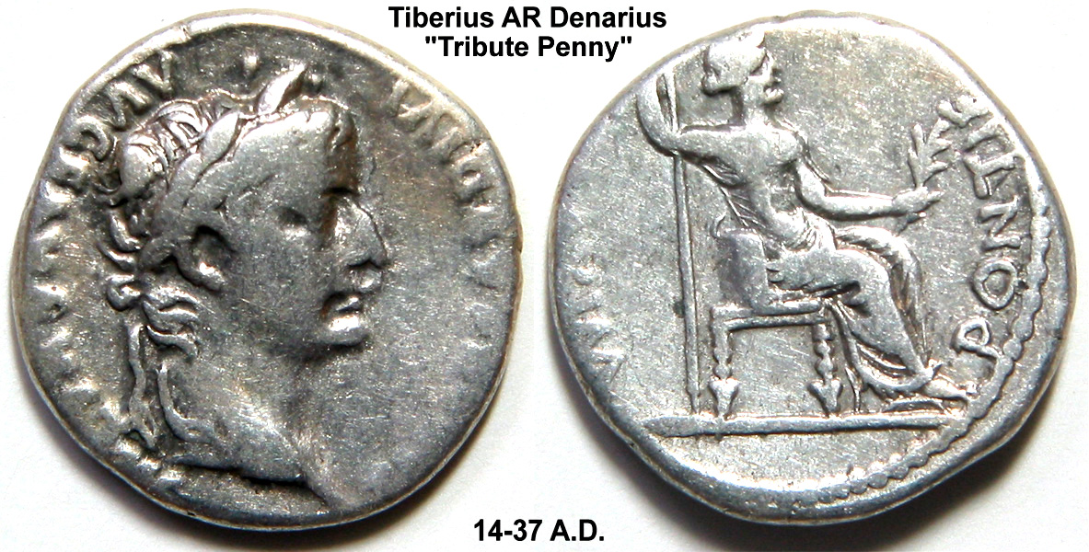

Slide 36
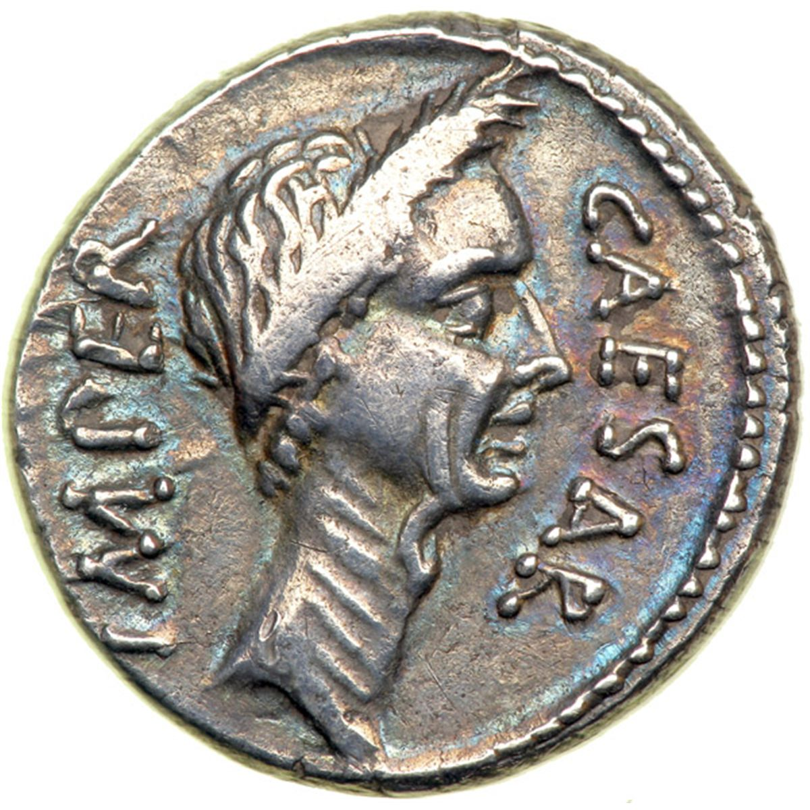

Slide 37
Kneels at the feet of his friends,
silently washes their feet:
master who acts as a slave to them,
Yesu, Yesu, fill us with your love,
show us how to serve
the neighbours we have from you.

Slide 38
Neighbours are wealthy and poor,
Varied in colour and race
neighbours are near us and far away.
Yesu, Yesu,
fill us with your love,
show us how to serve
the neighbours we have from you.

Slide 39
These are the ones we should serve,
these are the ones we should love;
all these are neighbours to us and you.
Yesu, Yesu,
fill us with your love,
show us how to serve
the neighbours we have from you.

Slide 40
Loving puts us on our knees,
Silently washing their feet
this is the way we should live with you.
Yesu, Yesu,
fill us with your love,
show us how to serve
the neighbours we have from you.
Words & music by Tom Colvin and people of Ghana
© 640 TIS

Slide 41
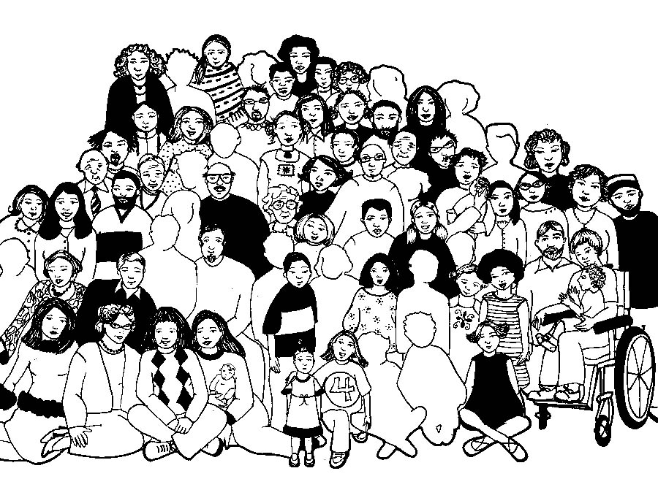

Slide 42
Lord’s Prayer
Our Father in Heaven,
Hallowed be your name,
your kingdom come,
your will be done, on earth as in heaven.
Give us today our daily bread.
Forgive our sins
as we forgive those who sin against us.
Save us from the time of trial
and deliver us from evil.
For the Kingdom, the power,
and the glory are yours now and forever. Amen
Notes:
42

Slide 43
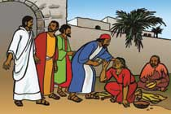
Bring many names, beautiful and good,
celebrate in parable and story,
holiness in glory, living, loving God.
Hail and hosanna!
bring many names!

Slide 44
Strong mother God, working night and day,
planning all the wonders of creation,
setting each equation,
genius at play:
Hail and hosanna,
strong mother God!

Slide 45
Warm father God, hugging every child,
feeling all the strains of human living,
caring and forgiving,
till we’re reconciled:
Hail and hosanna,
warm father God!

Slide 46
Old aching God, grey with endless care,
calmly piercing evil’s new disguises,
glad of good surprises,
wiser than despair:
Hail and hosanna,
old ,aching God.

Slide 47
Young, growing God, eager, on the move,
saying no to falsehood and unkindness,
crying out for justice,
giving all you have:
Hail and hosanna,
Young, growing God!

Slide 48
Great, living God, never fully known,
joyful darkness far beyond our seeing,
closer yet than breathing,
everlasting home:
Hail and hosanna,
great, living God!
Brian Arthur Wren CCLI 222909

Slide 49
Bring many names

Slide 50
return now to the everyday, still giving in each moment yourself, your all, to God.

Slide 51
Matthew 22:15–22 The Question about Paying Taxes Then the Pharisees went and plotted to entrap him in what he said. So they sent their disciples to him, along with the Herodians, saying, ‘Teacher, we know that you are sincere, and teach the way of God in accordance with truth, and show deference to no one; for you do not regard people with partiality. Tell us, then, what you think. Is it lawful to pay taxes to the emperor, or not?’

Slide 52
But Jesus, aware of their malice, said, ‘Why are you putting me to the test, you hypocrites? Show me the coin used for the tax.’ And they brought him a denarius. Then he said to them, ‘Whose head is this, and whose title?’ They answered, ‘The emperor’s.’ Then he said to them, ‘Give therefore to the emperor the things that are the emperor’s, and to God the things that are God’s.’ When they heard this, they were amazed; and they left him and went away. 

