Slide 2
We acknowledge the sovereign First Peoples of these lands and waters
where we meet, the Yuin Nation. We pay our respects to their elders past and present and to all Aboriginal people who have cared for this place since creation.

Slide 3
Welcome to worship
at St Georges - Eden
'Awakened by compassion’'

Slide 4
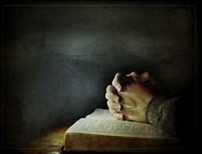

Slide 5
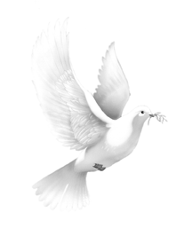
Spirit of the living God,
Fall afresh on me
Spirit of the living God,
Fall afresh on me,
Break me, melt me
Mould me and fill me
Spirit of the living God,
Fall afresh on me
CCLI 222909 Daniel Iverson
Moody Press 1963
SOF 510, F^ (a) x2, SIS 303

Slide 7
Our God never gives up on us.
God’s steadfast love endures forever.
God finishes what God starts in us.
Grace is the only way forward for all of us.
So, trust in God’s love, which gives us both the courage to act and the freedom to fail.
We are forgiven, cherished, and restored. Thanks be to God.

Slide 8
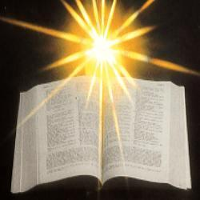

Slide 9
Romans 12:1-8 New International Version
A Living Sacrifice
Therefore, I urge you, brothers and sisters, in view of God’s mercy, to offer your bodies as a living sacrifice, holy and pleasing to God—this is your true and proper worship. Do not conform to the pattern of this world, but be transformed by the renewing of your mind. Then you will be able to test and approve what God’s will is—his good, pleasing and perfect will.
Humble Service in the Body of Christ

Slide 10
For by the grace given me I say to every one of you: Do not think of yourself more highly than you ought, but rather think of yourself with sober judgment, in accordance with the faith God has distributed to each of you. For just as each of us has one body with many members, and these members do not all have the same function, so in Christ we, though many, form one body, and each member belongs to all the others.

Slide 11
We have different gifts, according to the grace given to each of us. If your gift is prophesying, then prophesy in accordance with your faith; if it is serving, then serve; if it is teaching, then teach; if it is to encourage, then give encouragement; if it is giving, then give generously; if it is to lead, do it diligently; if it is to show mercy, do it cheerfully. *****************************************

Slide 12
Michaels Talk
to the Young at Heart
1 of 1
Steve Apirana Riverside Productions
Used with permission CCLI Lic. No 222909

Slide 13
Lord I give myself to you
As a living sacrifice
Holy and acceptable
Holy and acceptable
Holy and acceptable to God
May the words of my mouth
And the meditation of my heart
Be acceptable in Thy sight, O Lord.
Used with permission CCLI Lic. No 222909
Steve Apirana Riverside Productions

Slide 14
Blessed be our Creator who made all things good,
Everything we can see, and everything we can’t!
We join in thanks and praise to You our God because you care about us!
When enemies surround us on every side,
when the waters threaten to swallow us whole or sweep us away,
You are always at our side, God! You never leave or abandon us!

Slide 15
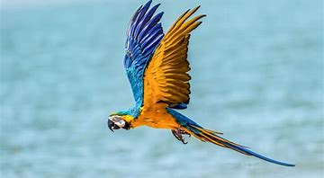
You free us from the jaws of the predators,
you break open the snares of hunters.
We’re free like birds soaring with freedom.
When we call on Your name Lord , you help us and set us free.

Slide 16
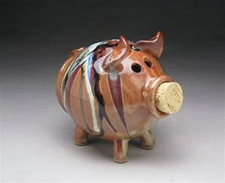

Slide 17
Exodus 1:8-2:10 New International Version
Then a new king, to whom Joseph meant nothing, came to power in Egypt. “Look,” he said to his people, “the Israelites have become far too numerous for us. Come, we must deal shrewdly with them or they will become even more numerous and, if war breaks out, will join our enemies, fight against us and leave the country.”

Slide 18
So they put slave masters over them to oppress them with forced labour, and they built Pithom and Rameses as store cities for Pharaoh. But the more they were oppressed, the more they multiplied and spread; so the Egyptians came to dread the Israelites and worked them ruthlessly. They made their lives bitter with harsh labour in brick and mortar and with all kinds of work in the fields; in all their harsh labour the Egyptians worked them ruthlessly.

Slide 19
The king of Egypt said to the Hebrew midwives, whose names were Shiphrah and Puah, “When you are helping the Hebrew women during childbirth on the delivery stool, if you see that the baby is a boy, kill him; but if it is a girl, let her live.” The midwives, however, feared God and did not do what the king of Egypt had told them to do; they let the boys live. Then the king of Egypt summoned the midwives and asked them, “Why have you done this? Why have you let the boys live?”

Slide 20
The midwives answered Pharaoh, “Hebrew women are not like Egyptian women; they are vigorous and give birth before the midwives arrive.”
So God was kind to the midwives and the people increased and became even more numerous. And because the midwives feared God, he gave them families of their own.
Then Pharaoh gave this order to all his people: “Every Hebrew boy that is born you must throw into the Nile, but let every girl live.”

Slide 21
Now a man of the tribe of Levi married a Levite woman, and she became pregnant and gave birth to a son. When she saw that he was a fine child, she hid him for three months. But when she could hide him no longer, she got a papyrus basket for him and coated it with tar and pitch. Then she placed the child in it and put it among the reeds along the bank of the Nile. His sister stood at a distance to see what would happen to him.

Slide 22
Then Pharaoh’s daughter went down to the Nile to bathe, and her attendants were walking along the riverbank. She saw the basket among the reeds and sent her female slave to get it. She opened it and saw the baby. He was crying, and she felt sorry for him. “This is one of the Hebrew babies,” she said.
Then his sister asked Pharaoh’s daughter, “Shall I go and get one of the Hebrew women to nurse the baby for you?”

Slide 23
“Yes, go,” she answered. So the girl went and got the baby’s mother. Pharaoh’s daughter said to her, “Take this baby and nurse him for me, and I will pay you.” So the woman took the baby and nursed him. When the child grew older, she took him to Pharaoh’s daughter and he became her son. She named him Moses, saying, “I drew him out of the water.” ******************************************

Slide 24
“Awakened by compassion”

Slide 25
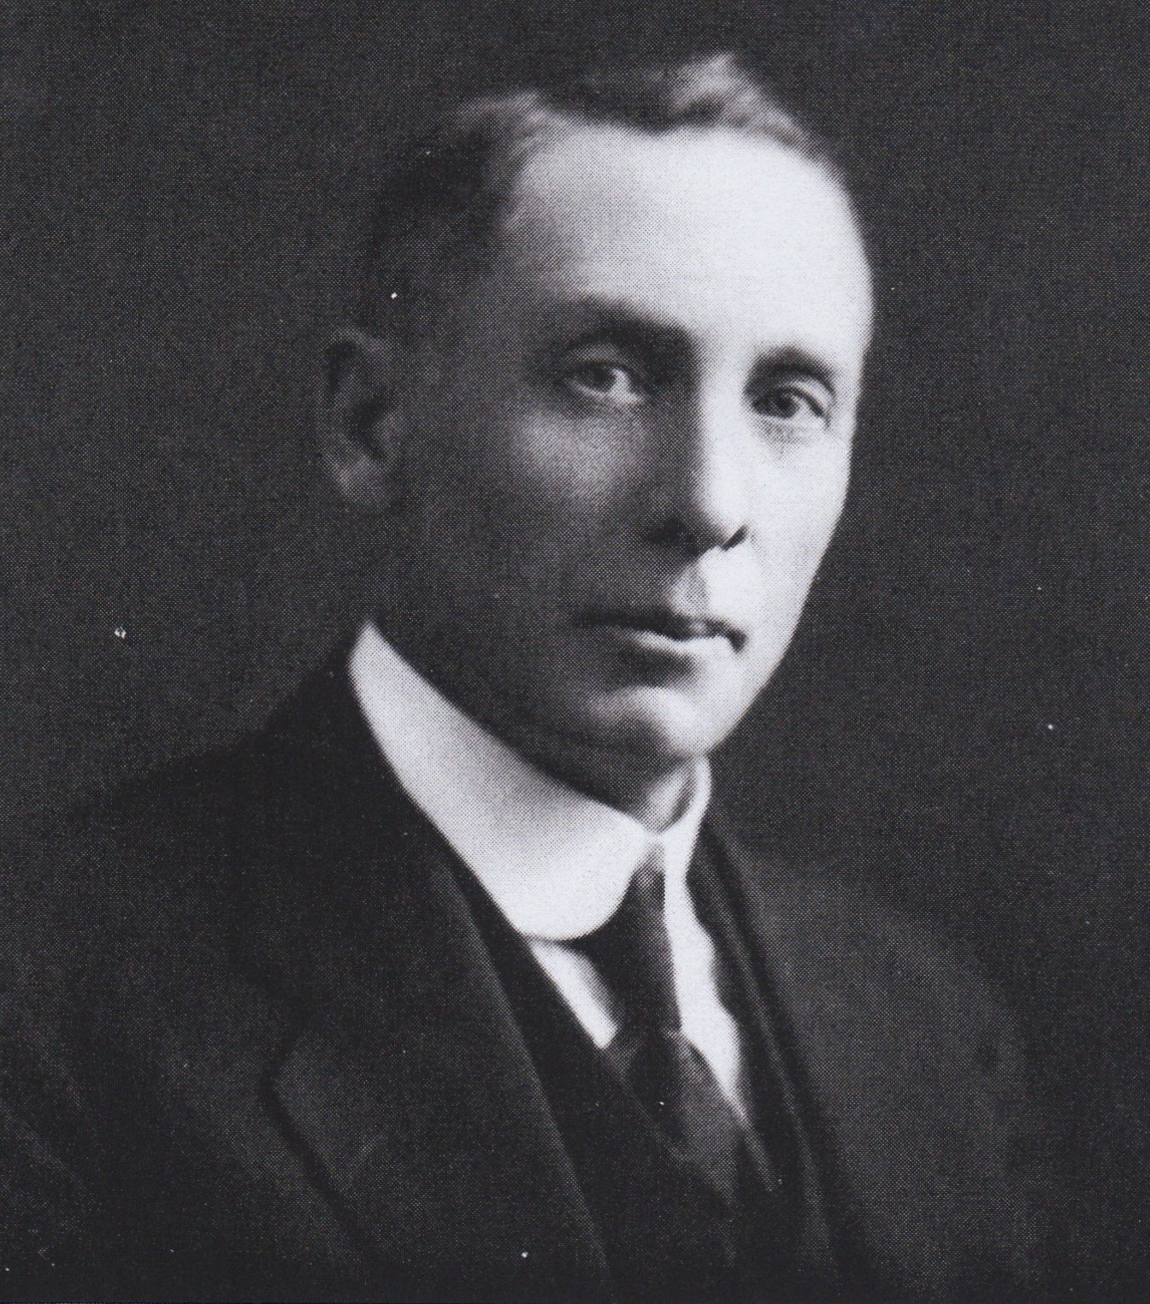
Awakened by compassion

Slide 26
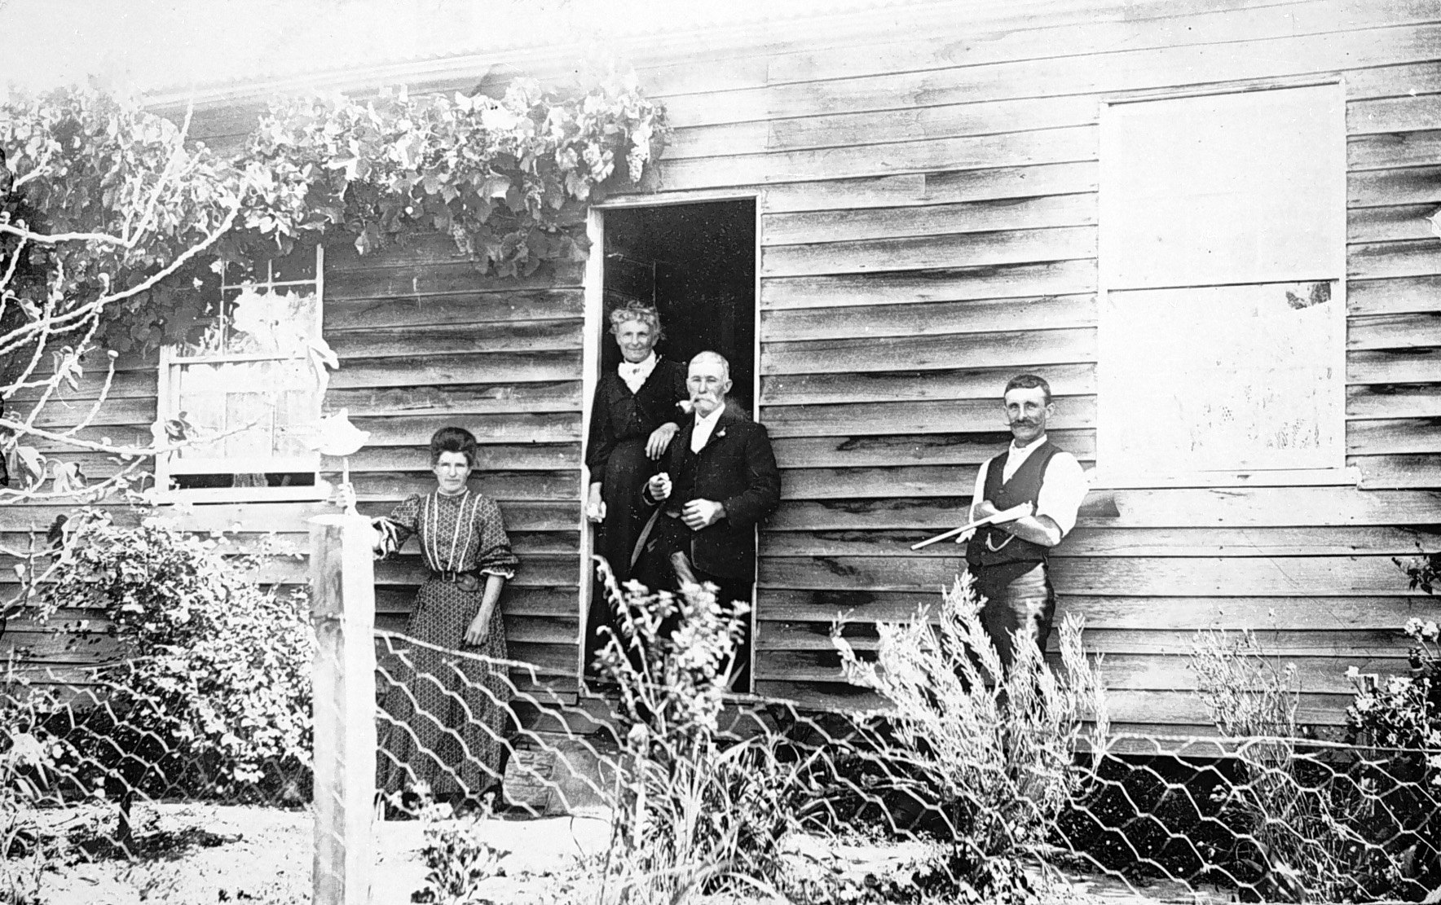
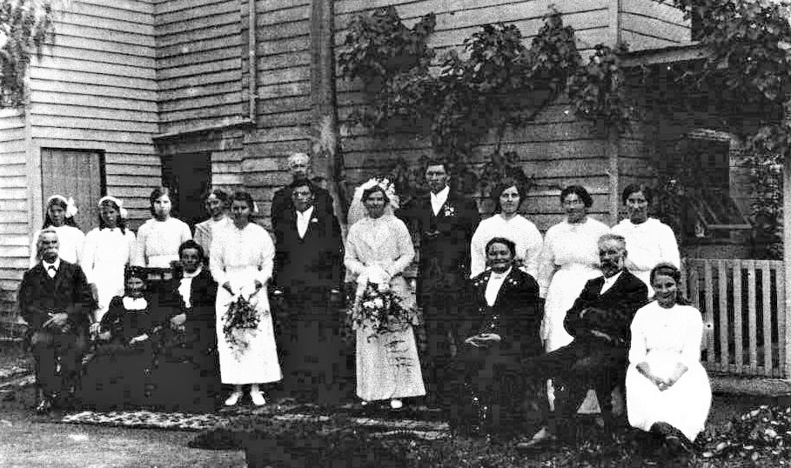
Eel Hole Creek School, 1901

Slide 27
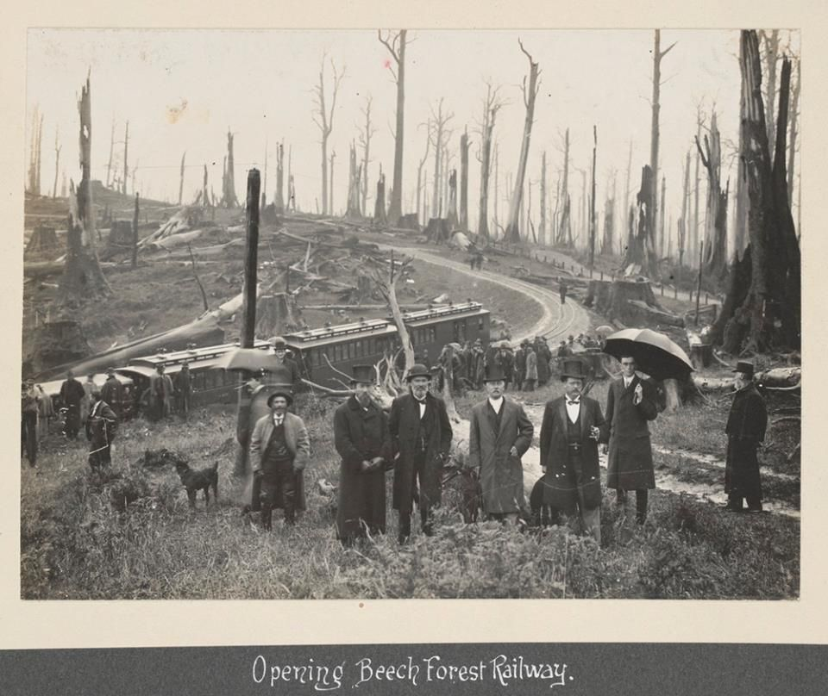
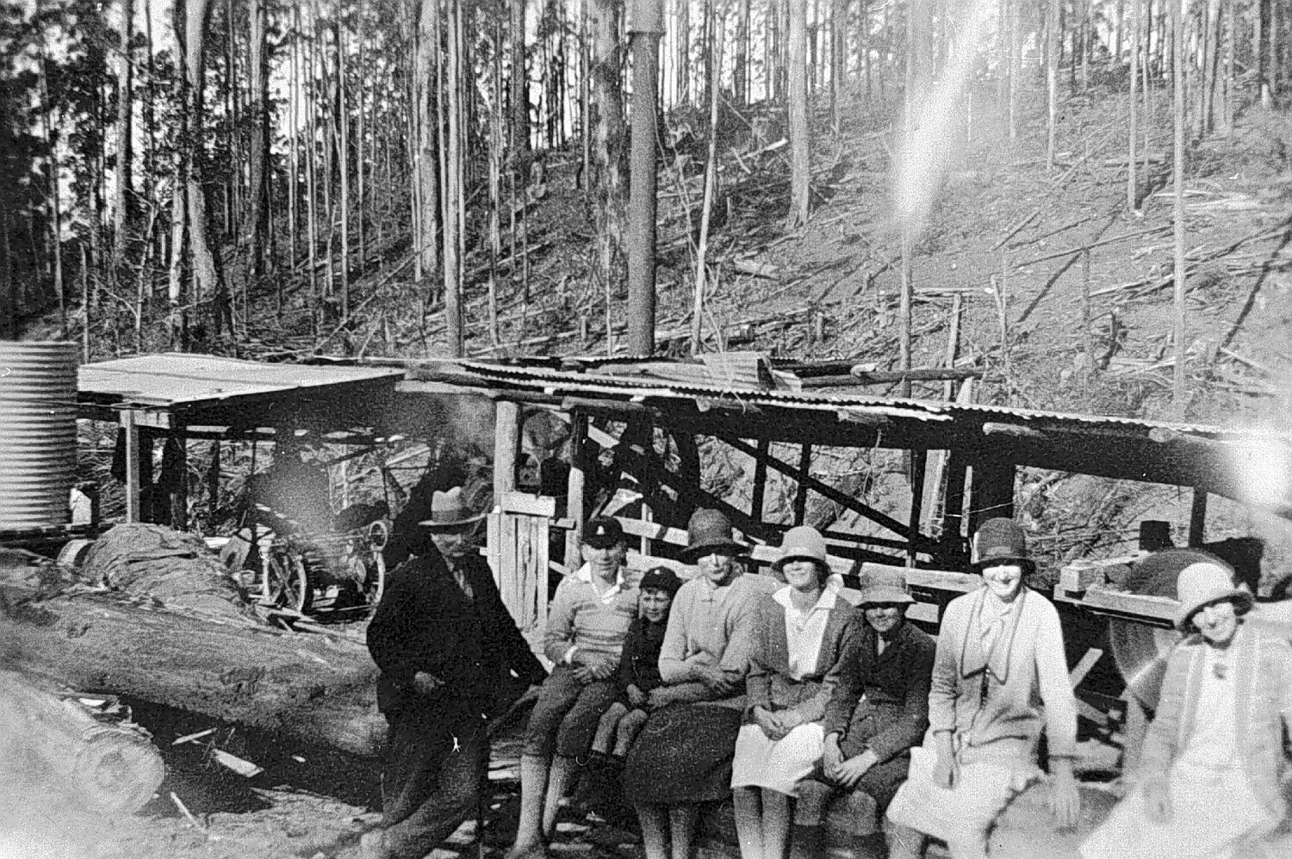
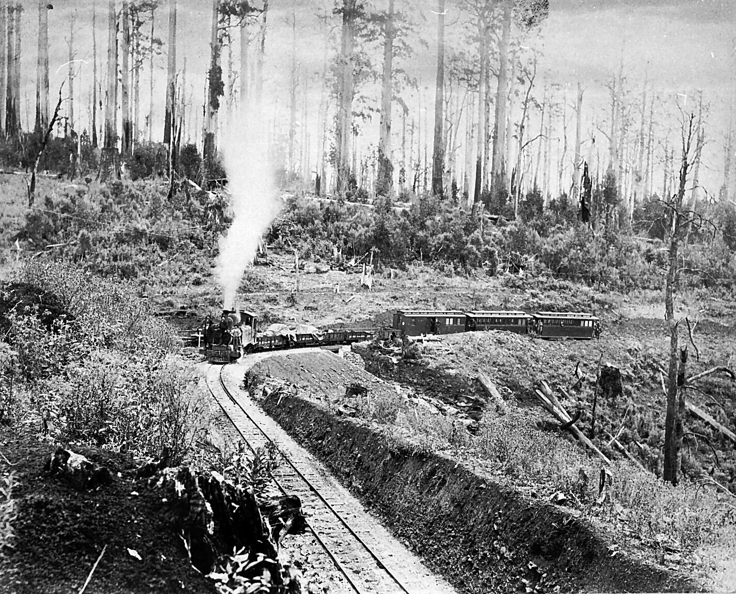
Beech Forest, 1903

Slide 28
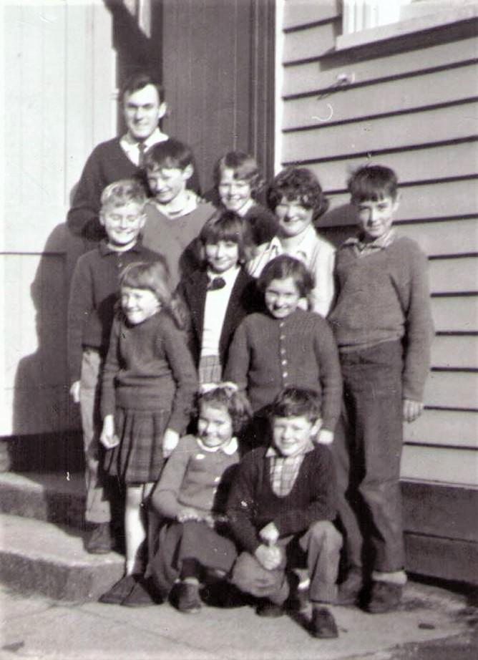
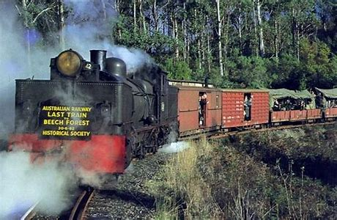
Beech Forest, 1962
Beech Forest Primary School,1962
The Beechy, 1962, last train to Beech Forest

Slide 29
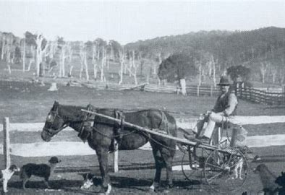
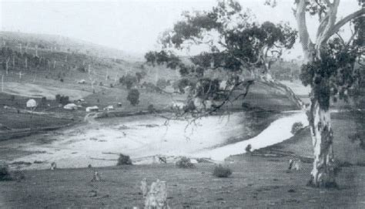
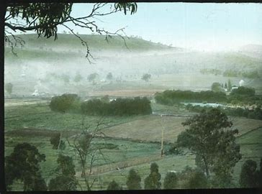
Buchan 1905

Slide 30
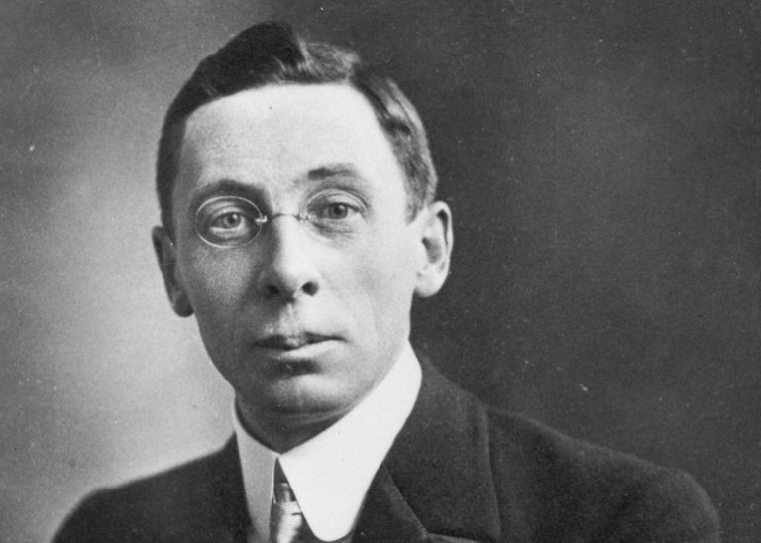
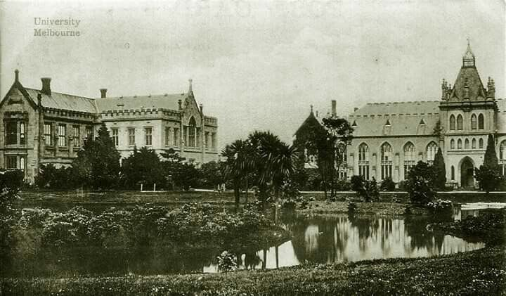
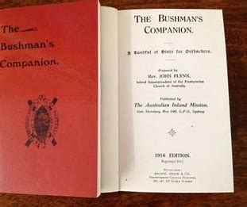
Ormond College, Melbourne Uni, 1907

Slide 31
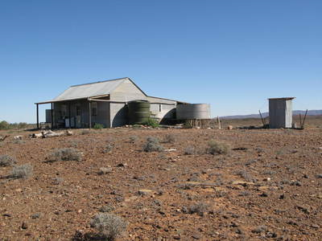
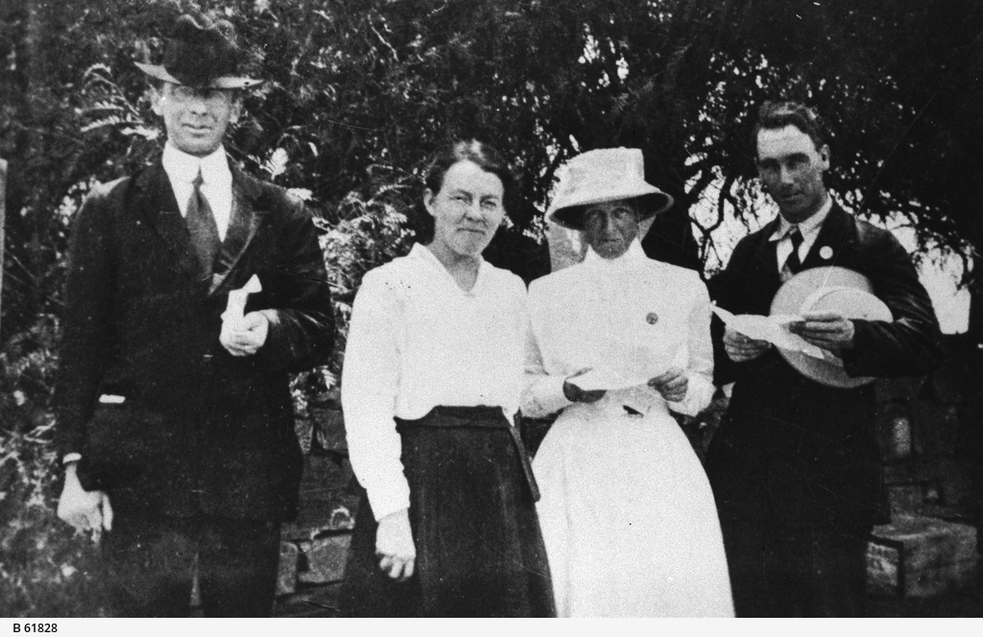
Beltana, South Australia, 540 k north of Adelaide, 1911

Slide 33
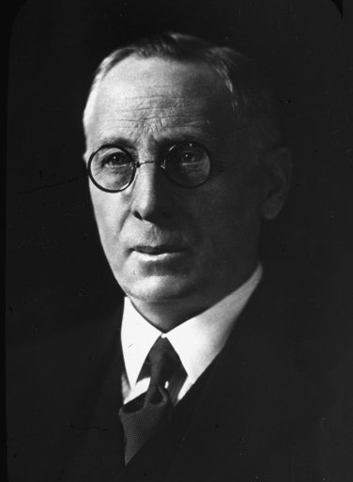
Royal Flying Doctor Service, 1928

Slide 34
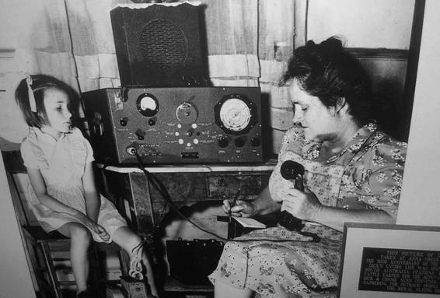
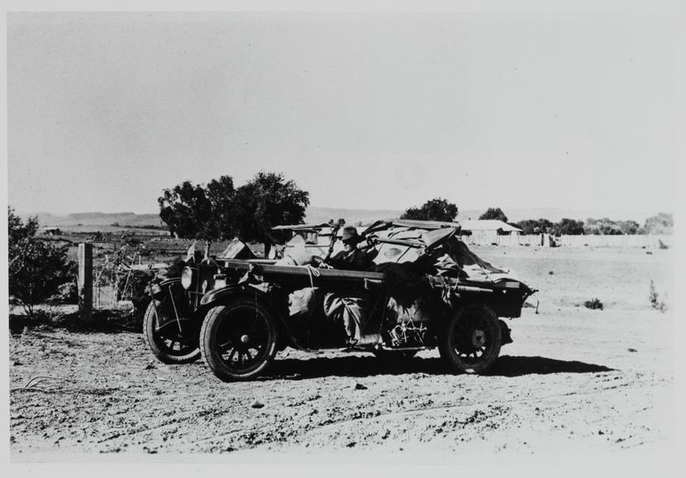
Pedal radio, 1929 Trager and Flynn

Slide 35
School of the Air, 1951

Slide 36
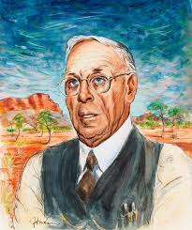
John Flynn
Achievements:
Bushman’s companion
Magazine: The Islander
Australian Inland Mission
Bush Nursing Hospitals
Aerial medical services
Pedal radio (with Traeger)
School of the Air
Hostels for the elderly
Frontier services
Moderator-General Presbyterian Church 1939
Darwin United Church

Slide 37
John Flynn A mantle of safety

Slide 38
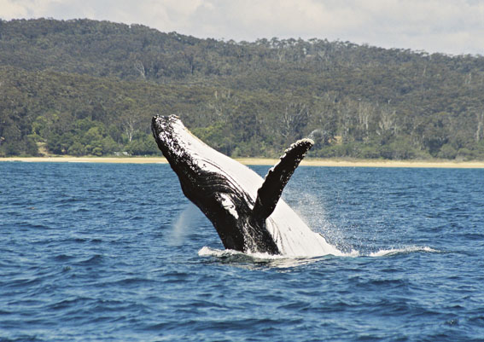
TIS 658
I, the Lord of sea and sky,
I have heard my people cry.
All who dwell in dark and sin
My hand will save.

Slide 39
I who made the stars of night,
I will make their darkness bright.
Who will bear my light to them?
Whom shall I send?

Slide 40
Here I am Lord; Is it I , Lord?
I have heard you calling in the night;
I will go, Lord, If you lead me.
I will hold your people in my heart.

Slide 41
I, the Lord of snow and rain,
I have borne my people’s pain;
I have wept for love of them
They turn away.

Slide 42
I will break their hearts of stone,
Give them hearts for love alone,
I will speak my word to them.
Whom shall I send?

Slide 43
Here I am Lord; Is it I , Lord?
I have heard you calling in the night;
I will go, Lord, If you lead me.
I will hold your people in my heart.

Slide 44
I, the Lord of wind and flame,
I will tend the poor and lame;
I will set a feast for them.
My hand will save.

Slide 45
Finest bread I will provide
Till their hearts are satisfied.
I will give my life to them.
Whom shall I send?

Slide 46
Here I am Lord; Is it I , Lord?
I have heard you calling in the night;
I will go, Lord, If you lead me.
I will hold your people in my heart.
Daniel L. Schutte CCLI 222909

Slide 48
Our Father in heaven, hallowed be your name, your kingdom come, your will be done, on earth as in heaven. Give us today our daily bread. Forgive us our sins as we forgive those who sin against us. Lead us not into temptation but deliver us from evil. For the kingdom, the power, and the glory are yours now and for ever. Amen.

Slide 49
Notices: Faith Conversations Wednesday 5pm at the Manse September - Season of Creation 2023 theme- 'Let justice and peace flow’

Slide 50
What are Uniting Churches in our region are doing to live out our Christian mission by using their church property to build relationships with people in their local community. Tuesday 19 September 2023 with a focus on rural congregations with presentations by Alpine, Braidwood, Bateman's Bay and Yass.

Slide 51
Give thanks with a grateful heart
Give thanks to the Holy One
Give thanks because He's given
Jesus Christ His Son.

Slide 52
Give thanks with a grateful heart
Give thanks to the Holy One
Give thanks because He's given
Jesus Christ His Son.

Slide 53
And now let the weak say I am strong
Let the poor say I am rich
Because of what the Lord has done for us

Slide 54
And now let the weak say I am strong
Let the poor say I am rich
Because of what the Lord has done for us
Give thanks, Give thanks
Words & music by Henry Smith
© 1978 Integrity’s Hosanna Music
Used by permission cc lic no. 222909

Slide 55
Please follow us over to the hall for a drink and a chat after the service

Slide 56
'

Slide 57
How great is our God

Slide 58
Psalm 124 New International Version
A song of ascents. Of David.
If the Lord had not been on our side— let Israel say— if the Lord had not been on our side when people attacked us, they would have swallowed us alive when their anger flared against us; the flood would have engulfed us, the torrent would have swept over us, the raging waters would have swept us away.

Slide 59
Praise be to the Lord, who has not let us be torn by their teeth. We have escaped like a bird from the fowler’s snare; the snare has been broken, and we have escaped. Our help is in the name of the Lord, the Maker of heaven and earth. ******************************************

Slide 60
Matthew 16:13-20 New International Version
Peter Declares That Jesus Is the Messiah
When Jesus came to the region of Caesarea Philippi, he asked his disciples, “Who do people say the Son of Man is?”
They replied, “Some say John the Baptist; others say Elijah; and still others, Jeremiah or one of the prophets.”
“But what about you?” he asked. “Who do you say I am?”
Simon Peter answered, “You are the Messiah, the Son of the living God.”

Slide 61
Jesus replied, “Blessed are you, Simon son of Jonah, for this was not revealed to you by flesh and blood, but by my Father in heaven. And I tell you that you are Peter, and on this rock I will build my church, and the gates of Hades will not overcome it. I will give you the keys of the kingdom of heaven; whatever you bind on earth will be bound in heaven, and whatever you loose on earth will be loosed in heaven.” Then he ordered his disciples not to tell anyone that he was the Messiah. ************************************

Slide 62
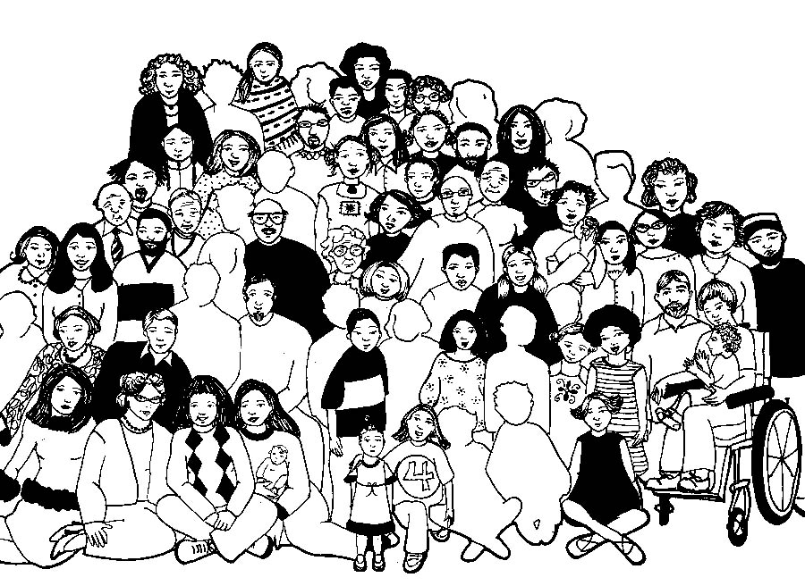

Slide 63
Lord’s Prayer
Our Father in Heaven,
Hallowed be your name,
your kingdom come,
your will be done, on earth as in heaven.
Give us today our daily bread.
Forgive our sins
as we forgive those who sin against us.
Save us from the time of trial
and deliver us from evil.
For the Kingdom, the power,
and the glory are yours now and forever. Amen
Notes:
63

Slide 64
Song CCLI 222909

