Slide 2
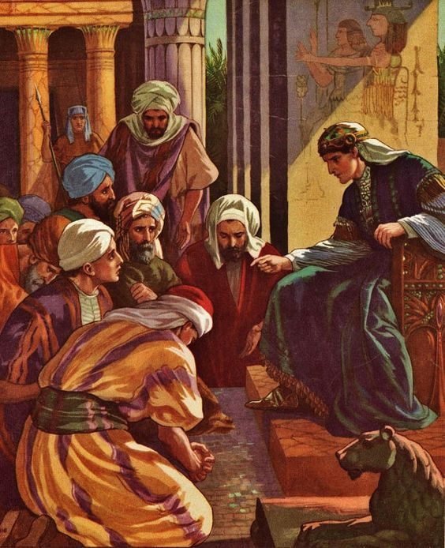
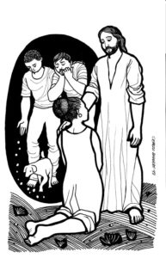
Welcome to worship
at St Georges - Eden
Forgiveness
Peace
Reconciliation

Slide 3
We acknowledge the sovereign First Peoples of these lands and waters
where we meet, the Yuin Nation. We pay our respects to their elders past and present and to all Aboriginal people who have cared for this place since creation.

Slide 5
This is a day of new beginnings, time to remember and move on, time to believe what love is bringing, laying to rest the pain that’s gone.

Slide 6
For by the life and death of Jesus, God’s mighty spirit, now as then, can make for us a world of difference, as faith and hope are born again.

Slide 7
Then let us, with the spirit’s daring, step from the past and leave behind our disappointment, guilt, and grieving, seeking new paths, and sure to find.

Slide 8
Christ is alive, and goes before us to show and share what love can do. this is a day of new beginnings; our God is making all things new. Brian Wren CCLI 222909

Slide 9
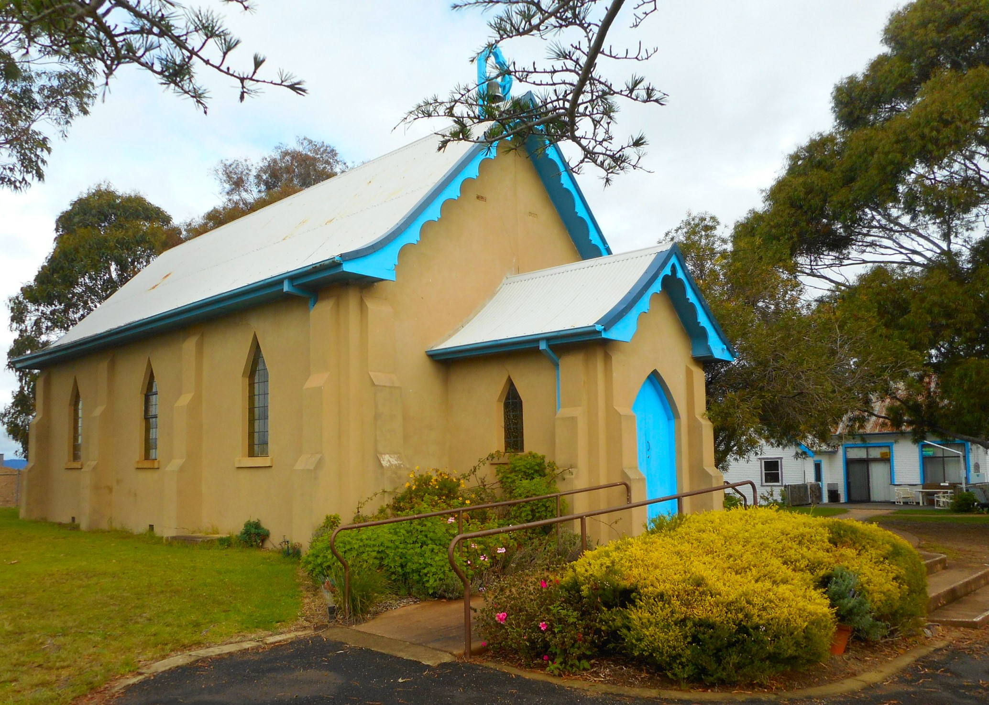
A talk for the young at heart

Slide 10
Psalm 133 NIV A song of ascents of David How good and pleasant it is when God’s people live together in unity!

Slide 11
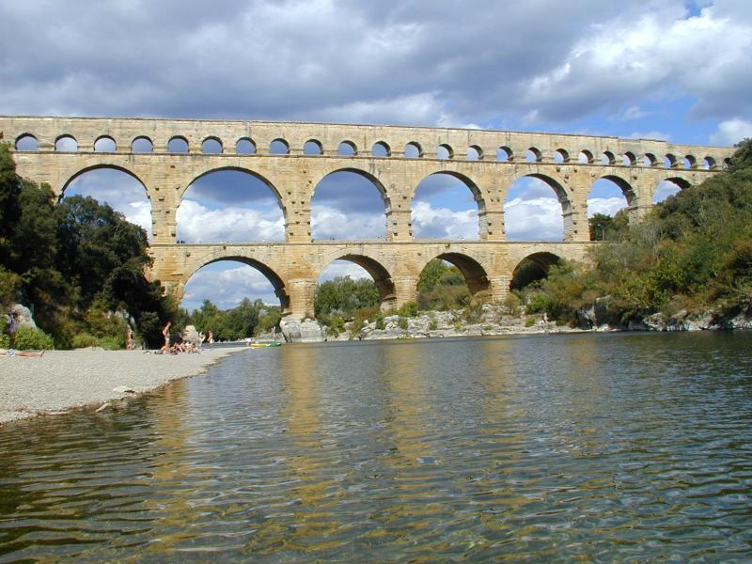
Make me a channel of your peace,
Where there is hatred let me bring your love,
Where there is injury, your pardon, Lord;
And where there's doubt, true faith in you.

Slide 12
O Master, grant that I may never seek
so much to be consoled as to console,
to be understood as to understand,
to be loved as to love with all my soul.

Slide 13
Make me a channel of your peace,
Where there's despair in life,
let me bring hope,
Where there is darkness,
let me bring your light,
And where there's sadness, ever joy.

Slide 14
O Master, grant that I may never seek
so much to be consoled as to console,
to be understood as to understand,
to be loved as to love with all my soul.

Slide 15
Make me a channel of your peace,
It is in pardoning that we are pardoned,
In giving of ourselves that we receive,
and in dying that
we're born to eternal life.
By Sebastian Temple
© 1967 Franciscan Communications
Used by permission cc lic no. 222909
TIS 607 D F x3

Slide 17
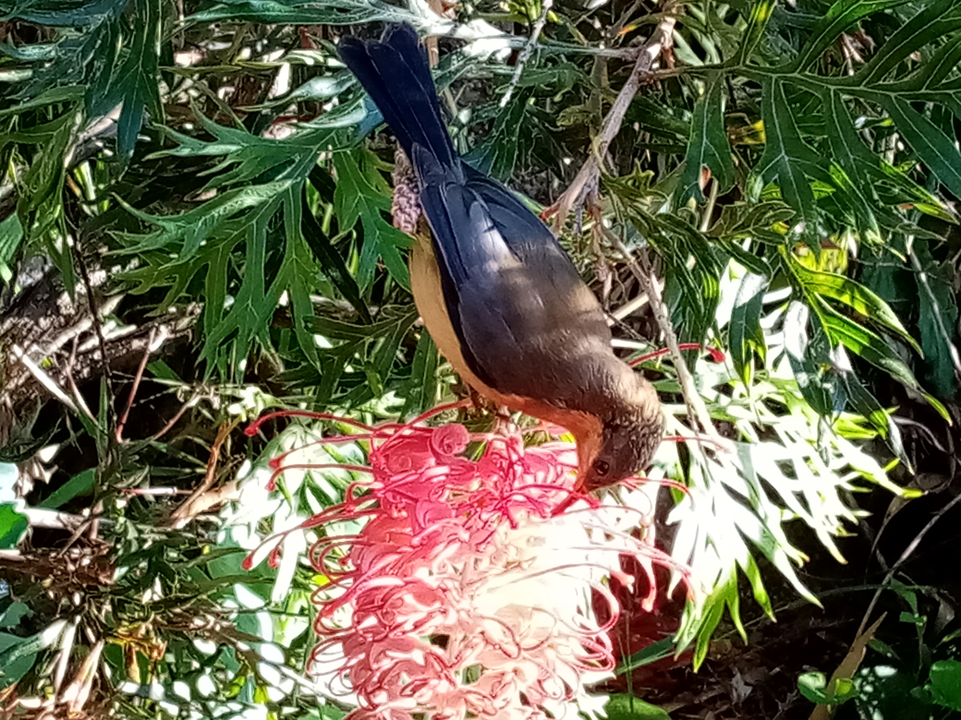

Slide 19
Genesis 45:1-15 NIV Then Joseph could no longer control himself before all his attendants, and he cried out, “Have everyone leave my presence!” So there was no one with Joseph when he made himself known to his brothers. And he wept so loudly that the Egyptians heard him, and Pharaoh’s household heard about it. Joseph said to his brothers, “I am Joseph! Is my father still living?”

Slide 20
But his brothers were not able to answer him, because they were terrified at his presence. Then Joseph said to his brothers, “Come close to me.” When they had done so, he said, “I am your brother Joseph, the one you sold into Egypt!

Slide 21
And now, do not be distressed and do not be angry with yourselves for selling me here, because it was to save lives that God sent me ahead of you. For two years now there has been famine in the land, and for the next five years there will be no ploughing and reaping.

Slide 22
But God sent me ahead of you to preserve for you a remnant on earth and to save your lives by a great deliverance. “So then, it was not you who sent me here, but God. He made me father to Pharaoh, lord of his entire household and ruler of all Egypt. Now hurry back to my father and say to him, ‘This is what your son Joseph says: God has made me lord of all Egypt. Come down to me; don’t delay.

Slide 23
You shall live in the region of Goshen and be near me—you, your children and grandchildren, your flocks and herds, and all you have. I will provide for you there, because five years of famine are still to come. Otherwise you and your household and all who belong to you will become destitute.’

Slide 24
“You can see for yourselves, and so can my brother Benjamin, that it is really I who am speaking to you. Tell my father about all the honour accorded me in Egypt and about everything you have seen. And bring my father down here quickly.” Then he threw his arms around his brother Benjamin and wept, and Benjamin embraced him, weeping. And he kissed all his brothers and wept over them. Afterward his brothers talked with him. 

Slide 25
Matthew 15:10-20 NIV Jesus called the crowd to him and said, “Listen and understand. What goes into someone’s mouth does not defile them, but what comes out of their mouth, that is what defiles them.” Then the disciples came to him and asked, “Do you know that the Pharisees were offended when they heard this?”

Slide 26
He replied, “Every plant that my heavenly Father has not planted will be pulled up by the roots. Leave them; they are blind guides. If the blind lead the blind, both will fall into a pit.” Peter said, “Explain the parable to us.” “Are you still so dull?”

Slide 27
Jesus asked them. “Don’t you see that whatever enters the mouth goes into the stomach and then out of the body? But the things that come out of a person’s mouth come from the heart, and these defile them. For out of the heart come evil thoughts—murder, adultery, sexual immorality, theft, false testimony, slander. These are what defile a person; but eating with unwashed hands does not defile them.”

Slide 28
Matthew 15:21-28 Leaving that place, Jesus withdrew to the region of Tyre and Sidon. A Canaanite woman from that vicinity came to him, crying out, “Lord, Son of David, have mercy on me! My daughter is demon-possessed and suffering terribly.” Jesus did not answer a word. So his disciples came to him and urged him, “Send her away, for she keeps crying out after us.” He answered, “I was sent only to the lost sheep of Israel.”

Slide 29
The woman came and knelt before him. “Lord, help me!” she said. He replied, “It is not right to take the children’s bread and toss it to the dogs.” “Yes it is, Lord,” she said. “Even the dogs eat the crumbs that fall from their master’s table.” Then Jesus said to her, “Woman, you have great faith! Your request is granted.” And her daughter was healed at that moment. 

Slide 31
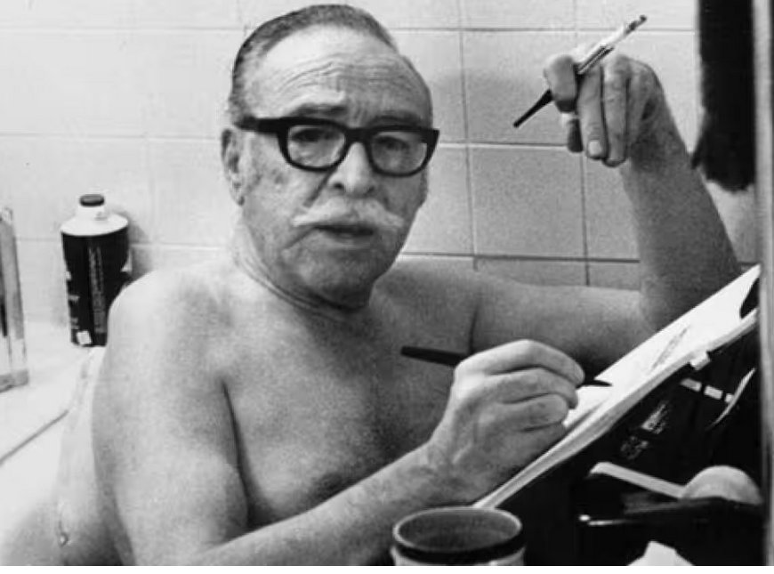
Dalton Trumbo

Slide 34
Help us to accept each other as Christ accepted us teach us, as sister and brother each person to embrace. Be present, Lord, among us and bring us to believe we are ourselves accepted and meant to love and live

Slide 35
Teach us, O Lord, your lessons, As in our daily life We struggle to be human And search for hope and faith. Teach us to care for people for all- not just for some, to love them as we find them or as they may become.

Slide 36
Let your acceptance change us, so that we may be moved in living situations to do the truth in love; to practice your acceptance until we know by heart the table of forgiveness and laughter’s healing art.

Slide 37
Lord, for today’s encounters with all who are in need, who hunger for acceptance, for righteousness and bread, we need new eyes for seeing, new hands for holding on: renew us with your spirit; Lord, free us, make us one! TiS 648 Frederick Kaan CCLI 222909

Slide 38
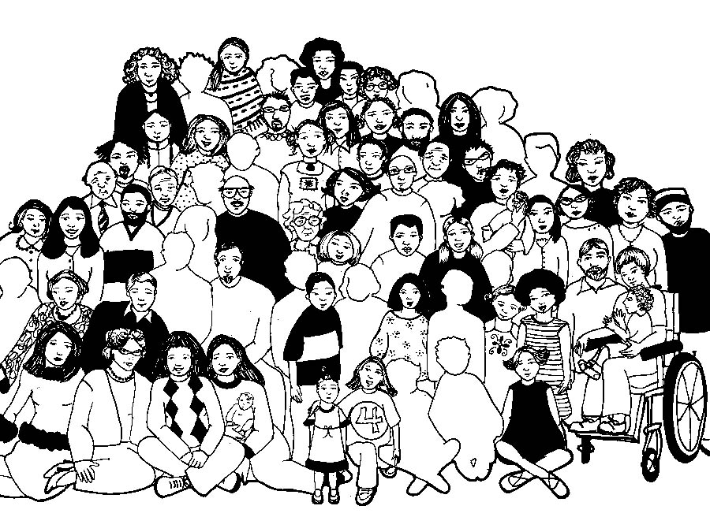

Slide 39
Lord’s Prayer
Our Father in Heaven,
Hallowed be your name,
your kingdom come,
your will be done, on earth as in heaven.
Give us today our daily bread.
Forgive our sins
as we forgive those who sin against us.
Save us from the time of trial
and deliver us from evil.
For the Kingdom, the power,
and the glory are yours now and forever. Amen
Notes:
39

Slide 40
O for a thousand tongues to sing
my great Redeemer’s praise
my great Redeemer’s praise
the glories of our God and King,
the triumphs of His grace,
the triumphs of His grace,
the triumphs of His grace!

Slide 41
Jesus! the name that charms our fears,
that bids our sorrows cease;
that bids our sorrows cease;
‘tis music in the sinner’s ears,
‘tis life, and health, and peace
‘tis life, and health, and peace
‘tis life, and health, and peace

Slide 42
He breaks the power of cancelled sin,
he sets the prisoner free;
he sets the prisoner free;
his blood can make the foulest clean,
his blood availed for me,
his blood availed for me,
his blood availed for me.

Slide 43
He speaks, and listening to his voice new life the dead receive new life the dead receive. The mournful broken hearts rejoice the humble poor believe the humble poor believe the humble poor believe.

Slide 44
Hear Him, ye deaf;
his praise, ye dumb,
your loosened tongues employ;
your loosened tongues employ;
ye blind, behold your Saviour come;
and leap, ye lame, for joy!
and leap, ye lame, for joy!
and leap, ye lame, for joy!

Slide 45
My gracious Master and my God
assist me to proclaim,
assist me to proclaim.
To spread through all the earth abroad the honours of your name, the honours of your name, the honours of your name.
Charles Wesley

Slide 46
Please follow us over for a drink and a chat after the service

