Slide 2
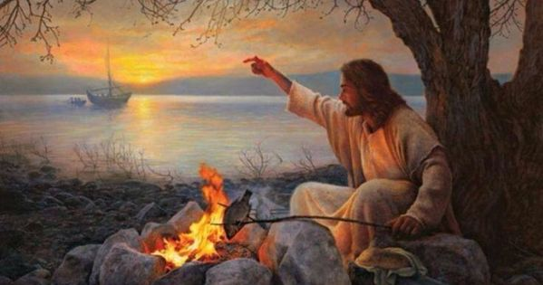
Welcome to worship
at Eden Uniting Church
After the nature of His Lordship- HOSPITALITY

Slide 3
We acknowledge the sovereign First Peoples of these lands and waters
where we meet, the Yuin Nation. We pay our respects to their elders past and present and to all Aboriginal people who have cared for this place since creation.

Slide 5
House of the Lord Hillsong

Slide 6
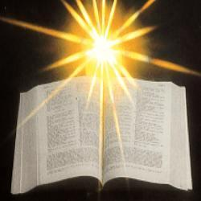

Slide 7
Acts 10 and 11 Peter and Cornelius
In Caesarea there was a man named Cornelius, a centurion of the Italian Cohort, as it was called. He was a devout man who feared God with all his household; he gave alms generously to the people and prayed constantly to God. One afternoon at about three o’clock he had a vision in which he clearly saw an angel of God coming in and saying to him, ‘Cornelius.’ He stared at him in terror and said, ‘What is it, Lord?’

Slide 8
He answered, ‘Your prayers and your alms have ascended as a memorial before God. Now send men to Joppa for a certain Simon who is called Peter; he is lodging with Simon, a tanner, whose house is by the seaside.’ When the angel who spoke to him had left, he called two of his slaves and a devout soldier from the ranks of those who served him, and after telling them everything, he sent them to Joppa.

Slide 9
About noon the next day, as they were on their journey and approaching the city, Peter went up on the roof to pray. He became hungry and wanted something to eat; and while it was being prepared, he fell into a trance. He saw the heaven opened and something like a large sheet coming down, being lowered to the ground by its four corners.

Slide 10
In it were all kinds of four-footed creatures and reptiles and birds of the air. Then he heard a voice saying, ‘Get up, Peter; kill and eat.’ But Peter said, ‘By no means, Lord; for I have never eaten anything that is profane or unclean.’ The voice said to him again, a second time, ‘What God has made clean, you must not call profane.’ This happened three times, and the thing was suddenly taken up to heaven.

Slide 11
Now while Peter was greatly puzzled about what to make of the vision that he had seen, suddenly the men sent by Cornelius appeared. They were asking for Simon’s house and were standing by the gate. They called out to ask whether Simon, who was called Peter, was staying there. While Peter was still thinking about the vision, the Spirit said to him, ‘Look, three men are searching for you. Now get up, go down, and go with them without hesitation; for I have sent them.’

Slide 12
So Peter went down to the men and said, ‘I am the one you are looking for; what is the reason for your coming?’ They answered, ‘Cornelius, a centurion, an upright and God-fearing man, who is well spoken of by the whole Jewish nation, was directed by a holy angel to send for you to come to his house and to hear what you have to say.’ So Peter invited them in and gave them lodging.

Slide 13
The next day he got up and went with them, and some of the believers from Joppa accompanied him. The following day they came to Caesarea. Cornelius was expecting them and had called together his relatives and close friends. On Peter’s arrival Cornelius met him, and falling at his feet, worshipped him. But Peter made him get up, saying, ‘Stand up; I am only a mortal.’

Slide 14
And as he talked with him, he went in and found that many had assembled; and he said to them, ‘You yourselves know that it is unlawful for a Jew to associate with or to visit a Gentile; but God has shown me that I should not call anyone profane or unclean. So when I was sent for, I came without objection. Now may I ask why you sent for me?’

Slide 15
Cornelius replied, ‘Four days ago at this very hour, at three o’clock, I was praying in my house when suddenly a man in dazzling clothes stood before me. He said, “Cornelius, your prayer has been heard and your alms have been remembered before God. Send therefore to Joppa and ask for Simon, who is called Peter; he is staying in the home of Simon, a tanner, by the sea.”

Slide 16
Therefore I sent for you immediately, and you have been kind enough to come. So now all of us are here in the presence of God to listen to all that the Lord has commanded you to say.’

Slide 17
Then Peter began to speak to them: ‘I truly understand that God shows no partiality, but in every nation anyone who fears him and does what is right is acceptable to him. You know the message he sent to the people of Israel, preaching peace by Jesus Christ—he is Lord of all. That message spread throughout Judea, beginning in Galilee after the baptism that John announced: how God anointed Jesus of Nazareth with the Holy Spirit and with power; how he went about doing good and healing all who were oppressed by the devil, for God was with him.

Slide 18
We are witnesses to all that he did both in Judea and in Jerusalem. They put him to death by hanging him on a tree; but God raised him on the third day and allowed him to appear, not to all the people but to us who were chosen by God as witnesses, and who ate and drank with him after he rose from the dead.

Slide 19
He commanded us to preach to the people and to testify that he is the one ordained by God as judge of the living and the dead. All the prophets testify about him that everyone who believes in him receives forgiveness of sins through his name.’

Slide 20
While Peter was still speaking, the Holy Spirit fell upon all who heard the word. The circumcised believers who had come with Peter were astounded that the gift of the Holy Spirit had been poured out even on the Gentiles, for they heard them speaking in tongues and extolling God.

Slide 21
Then Peter said, ‘Can anyone withhold the water for baptizing these people who have received the Holy Spirit just as we have?’ So he ordered them to be baptized in the name of Jesus Christ. Then they invited him to stay for several days.

Slide 22
Now the apostles and the believers who were in Judea heard that the Gentiles had also accepted the word of God. So when Peter went up to Jerusalem, the circumcised believers criticized him, saying, ‘Why did you go to uncircumcised men and eat with them?’

Slide 23
Then Peter began to explain it to them, step by step, saying, ‘I was in the city of Joppa praying, and in a trance I saw a vision. There was something like a large sheet coming down from heaven, being lowered by its four corners; and it came close to me. As I looked at it closely I saw four-footed animals, beasts of prey, reptiles, and birds of the air. I also heard a voice saying to me, “Get up, Peter; kill and eat.”

Slide 24
But I replied, “By no means, Lord; for nothing profane or unclean has ever entered my mouth.” But a second time the voice answered from heaven, “What God has made clean, you must not call profane.” This happened three times; then everything was pulled up again to heaven. At that very moment three men, sent to me from Caesarea, arrived at the house where we were.

Slide 25
The Spirit told me to go with them and not to make a distinction between them and us. These six brothers also accompanied me, and we entered the man’s house. He told us how he had seen the angel standing in his house and saying, “Send to Joppa and bring Simon, who is called Peter; he will give you a message by which you and your entire household will be saved.”

Slide 26
And as I began to speak, the Holy Spirit fell upon them just as it had upon us at the beginning. And I remembered the word of the Lord, how he had said, “John baptized with water, but you will be baptized with the Holy Spirit.” If then God gave them the same gift that he gave us when we believed in the Lord Jesus Christ, who was I that I could hinder God?’ When they heard this, they were silenced. And they praised God, saying, ‘Then God has given even to the Gentiles the repentance that leads to life.’ _____

Slide 27
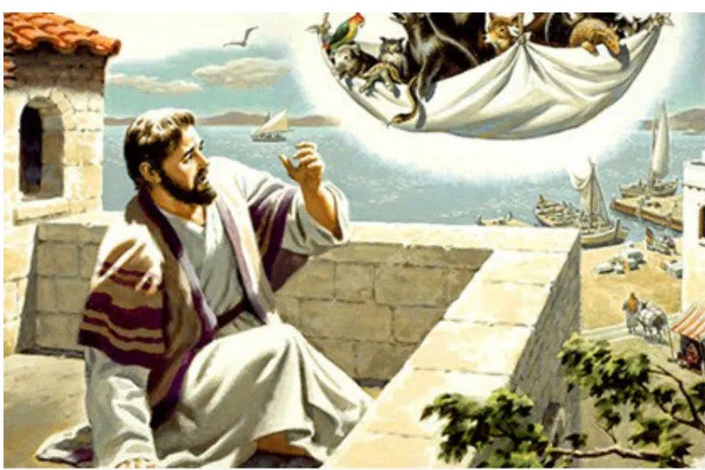
A talk for those under 100
Michael spoke about the Bible
in 3 words –
Same, Pure and Different

Slide 28
Song This I believe Our Father everlasting The all-creating One God Almighty Through your Holy Spirit Conceiving Christ the Son Jesus our Saviour

Slide 30
John 21: 1-15 From Laughing Bird Australian version One of the places where Jesus appeared to his followers after his resurrection was at Lake Galilee. A few of them had gathered there: Simon Peter; Thomas the Twin; Nathaniel, who came from Cana in Galilee; the two sons of Zebedee; and a couple of others. Simon Peter had decided to go fishing, and the rest of them had said, “You can count us in. We’ll come too.” They spent the night in the boat, but they didn’t catch a thing.

Slide 31
They were heading back in to shore as the sun came up, when they saw a man standing on the beach. It was Jesus, but they didn’t recognise him. Jesus called out to them, “Morning boys! How are the fish biting?”

Slide 32
“We haven’t caught a thing,” they replied. Jesus said, “Try casting off the right hand side of the boat instead. You’ll find some there.” So they did, and suddenly there were fish everywhere – more than they could pull in. The disciple with whom Jesus had been most intimate said to Peter, “It’s got to be the Lord!”

Slide 33
Simon Peter had been stripped for work, but when he heard it was the Lord, he threw his shirt back on, dived into the sea, and struck out for the shore. They weren’t far off the beach – no more than a hundred metres – so the rest of them dragged the boat in with the load of fish. When they arrived on the beach, they found that Jesus had a fire going and was baking some damper-bread and barbecuing some fish. He looked up and said to them, “Put on some of the fish you’ve just caught.”

Slide 34
Simon Peter dragged in the catch. There were a hundred and fifty three fish in all, most of them whoppers. It was surprising that the fishing tackle was still intact after landing them all. Jesus said, “Breakfast’s ready. Come and get it!” Some of the disciples half wanted to say, “Who are you?” but none dared because they knew it was the Lord. Jesus divided up the bread among them and then did the same with the fish. This was the third time the disciples had seen Jesus alive since he had been raised from the dead.

Slide 35
When they had finished eating breakfast, Jesus said to Simon Peter, “Simon, son of John, do you love me above anyone else?” Simon Peter replied, “Yes, Lord. You know I do.” Jesus said to him, “Then feed my lambs.” Then he asked him again, “Simon, son of John, do you love me?” He replied, “Yes, Lord; you know that I love you.” Jesus said to him, “Well, take care of my sheep.”

Slide 36
Jesus asked him a third time, “Simon, son of John, do you love me?” Peter was starting to feel hurt that Jesus kept questioning his love, and the third time he replied, “Lord, you know everything. You know how much I love you.” Jesus said to him, “Feed my sheep. 

Slide 37
Another talk for those under 100
Hospitality

Slide 38
Hospitality

Slide 39
Acts 2:42-47 NIV Fellowship of the Believers ⁴² They devoted themselves to the apostles’ teaching and to fellowship, to the breaking of bread and to prayer. ⁴³ Everyone was filled with awe at the many wonders and signs performed by the apostles. ⁴⁴ All the believers were together and had everything in common.

Slide 40
⁴⁵ They sold property and possessions to give to anyone who had need. ⁴⁶ Every day they continued to meet together in the temple courts. They broke bread in their homes and ate together with glad and sincere hearts, ⁴⁷ praising God and enjoying the favour of all the people. And the Lord added to their number daily those who were being saved. 

Slide 41
Hospitality

Slide 43
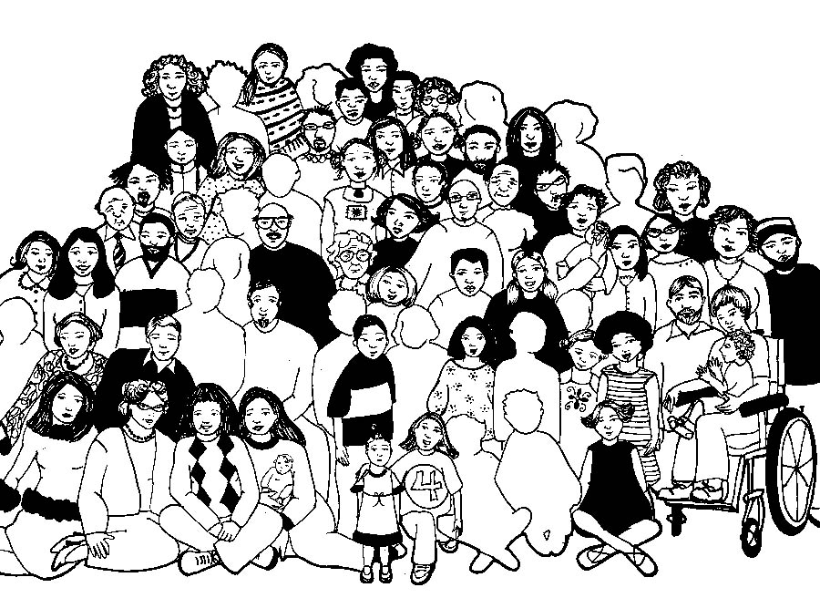

Slide 44
Lord’s Prayer
Our Father in Heaven,
Hallowed be your name,
your kingdom come,
your will be done, on earth as in heaven.
Give us today our daily bread.
Forgive our sins
as we forgive those who sin against us.
Save us from the time of trial
and deliver us from evil.
For the Kingdom, the power,
and the glory are yours now and forever. Amen
Notes:
44

Slide 45
Beauty for Brokenness
-Graham Kendrick

Slide 46
Please follow us over for a drink and a chat after the service

Slide 47
House of the Lord We worship the God who was We worship the God who is We worship the God who evermore will be He opened the prison doors He parted the raging sea My God, He holds the victory

Slide 48
There's joy in the house of the Lord There's joy in the house of the Lord today And we won't be quiet We shout out Your praise

Slide 49
There's joy in the house of the Lord Our God is surely in this place And we won't be quiet We shout out Your praise (Oh-oh, oh) we shout out Your praise (Oh-oh, oh)

Slide 50
We sing to the God who heals We sing to the God who saves We sing to the God who always makes a way 'Cause He hung up on that cross Then He rose up from that grave My God's still rolling stones away

Slide 51
There's joy in the house of the Lord There's joy in the house of the Lord today And we won't be quiet We shout out Your praise

Slide 52
There's joy in the house of the Lord Our God is surely in this place And we won't be quiet We shout out Your praise We were the beggars

Slide 53
Now we're royalty We were the prisoners Now we're running free We are forgiven, accepted Redeemed by His grace Let the house of the Lord sing praise 'Cause we were the beggars

Slide 54
Now we're royalty We were the prisoners Now we're running free We are forgiven, accepted Redeemed by His grace Let the house of the Lord sing praise

Slide 55
There's joy in the house of the Lord (there is joy in the house) There's joy in the house of the Lord today And we won't be quiet (oh yeah) We shout out Your praise (I wanna shout out Your praise)

Slide 56
There's joy in the house of the Lord (there is joy) Our God is surely in this place (there is joy) And we won't be quiet We shout out Your praise (we gonna shout out Your praise) Hillsong

Slide 57
This I believe Our Father everlasting The all-creating One God Almighty Through your Holy Spirit Conceiving Christ the Son Jesus our Saviour
SoF TiS Red Bk

Slide 58
I believe in God our Father I believe in Christ the Son I believe in the Holy Spirit Our God is three in One I believe in the resurrection That we will rise again

Slide 59
For I believe in the Name of Jesus Our Judge and our Defender Suffered and crucified Forgiveness is in You Descended into darkness You rose in glorious light Forever seated high

Slide 60
I believe in God our Father I believe in Christ the Son I believe in the Holy Spirit Our God is three in One I believe in the resurrection That we will rise again For I believe in the Name of Jesus

Slide 61
I believe in You I believe You rose again I believe that Jesus Christ is Lord And I believe in You I believe You rose again I believe that Jesus Christ is Lord

Slide 62
I believe in God our Father I believe in Christ the Son I believe in the Holy Spirit Our God is three in One I believe in the resurrection That we will rise again For I believe in the Name of Jesus

Slide 63
I believe in life eternal I believe in the virgin birth I believe in the saints' communion And in Your Holy Church I believe in the resurrection When Jesus comes again For I believe in the Name of Jesus For I believe in the Name of Jesus Hillsong

