Slide 2
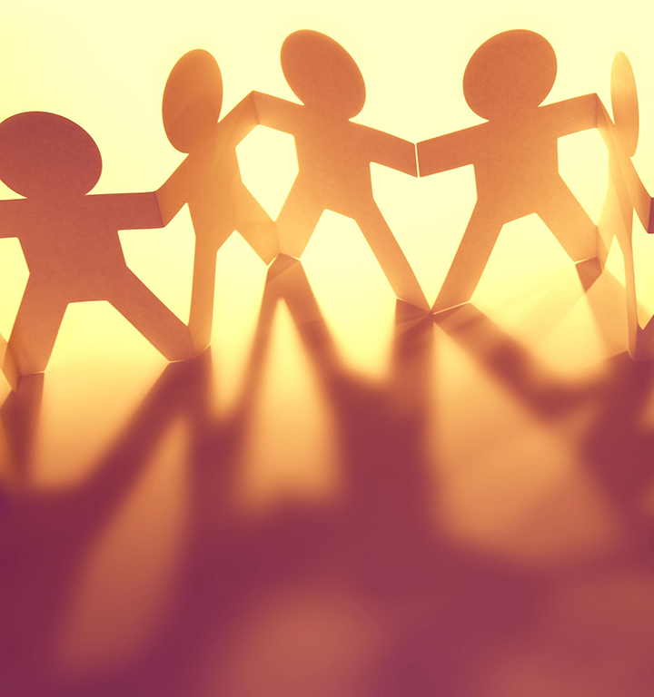
Welcome to worship
at St Georges - Eden
Live in Friendship and Peace With One Another

Slide 3
We acknowledge the sovereign First Peoples of these lands and waters
where we meet, the Yuin Nation. We pay our respects to their elders past and present and to all Aboriginal people who have cared for this place since creation.

Slide 4
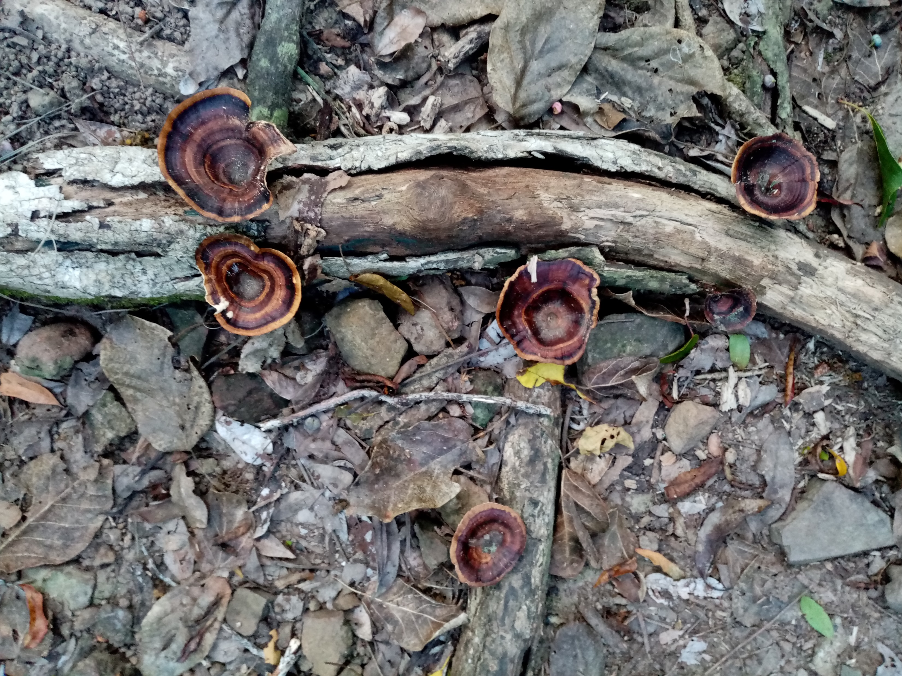

Slide 5
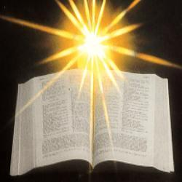

Slide 6
Mark 9:38-50
John said to him, “Teacher, we saw someone casting out demons in your name, and we tried to stop him, because he was not following us.” But Jesus said, “Do not stop him; for no one who does a deed of power in my name will be able soon afterward to speak evil of me. Whoever is not against us is for us. For truly I tell you, whoever gives you a cup of water to drink because you bear the name of Christ will by no means lose the reward.

Slide 7
“If any of you put a stumbling block before one of these little ones who believe in me, it would be better for you if a great millstone were hung around your neck and you were thrown into the sea. If your hand causes you to stumble, cut it off; it is better for you to enter life maimed than to have two hands and to go to hell, to the unquenchable fire. And if your foot causes you to stumble, cut it off; it is better for you to enter life lame than to have two feet and to be thrown into hell. And if your eye causes you to stumble, tear it out; it is better for you to enter the kingdom of God with one eye than to have two eyes and to be thrown into hell, where their worm never dies, and the fire is never quenched.

Slide 8
“For everyone will be salted with fire. Salt is good; but if salt has lost its saltiness, how can you season it? Have salt in yourselves, and be at peace with one another.”

Slide 9
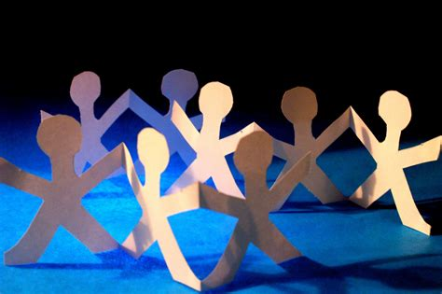

Slide 10
Whenever God Shines His Light

Slide 11
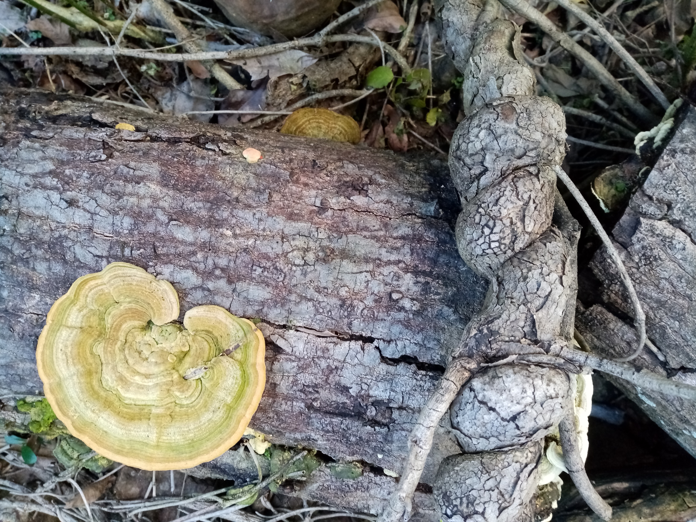

Slide 12
James 5:13-20
Are any among you suffering? They should pray. Are any cheerful? They should sing songs of praise. Are any among you sick? They should call for the elders of the church and have them pray over them, anointing them with oil in the name of the Lord. The prayer of faith will save the sick, and the Lord will raise them up; and anyone who has committed sins will be forgiven. Therefore, confess your sins to one another, and pray for one another, so that you may be healed. The prayer of the righteous is powerful and effective.

Slide 13
Elijah was a human being like us, and he prayed fervently that it might not rain, and for three years and six months it did not rain on the earth. Then he prayed again, and the heaven gave rain and the earth yielded its harvest. My brothers and sisters, if anyone among you wanders from the truth and is brought back by another, you should know that whoever brings back a sinner from wandering will save the sinner’s soul from death and will cover a multitude of sins.

Slide 14
John said to him, “Teacher, we saw someone casting out demons in your name, and we tried to stop him, because he was not following us.” But Jesus said, “Do not stop him; for no one who does a deed of power in my name will be able soon afterward to speak evil of me. Whoever is not against us is for us. For truly I tell you, whoever gives you a cup of water to drink because you bear the name of Christ will by no means lose the reward.

Slide 15
“Any person who causes one of these little ones who trust me to stumble, it would be better for him if a great millstone were hung around his neck and he was thrown into the sea”

Slide 16
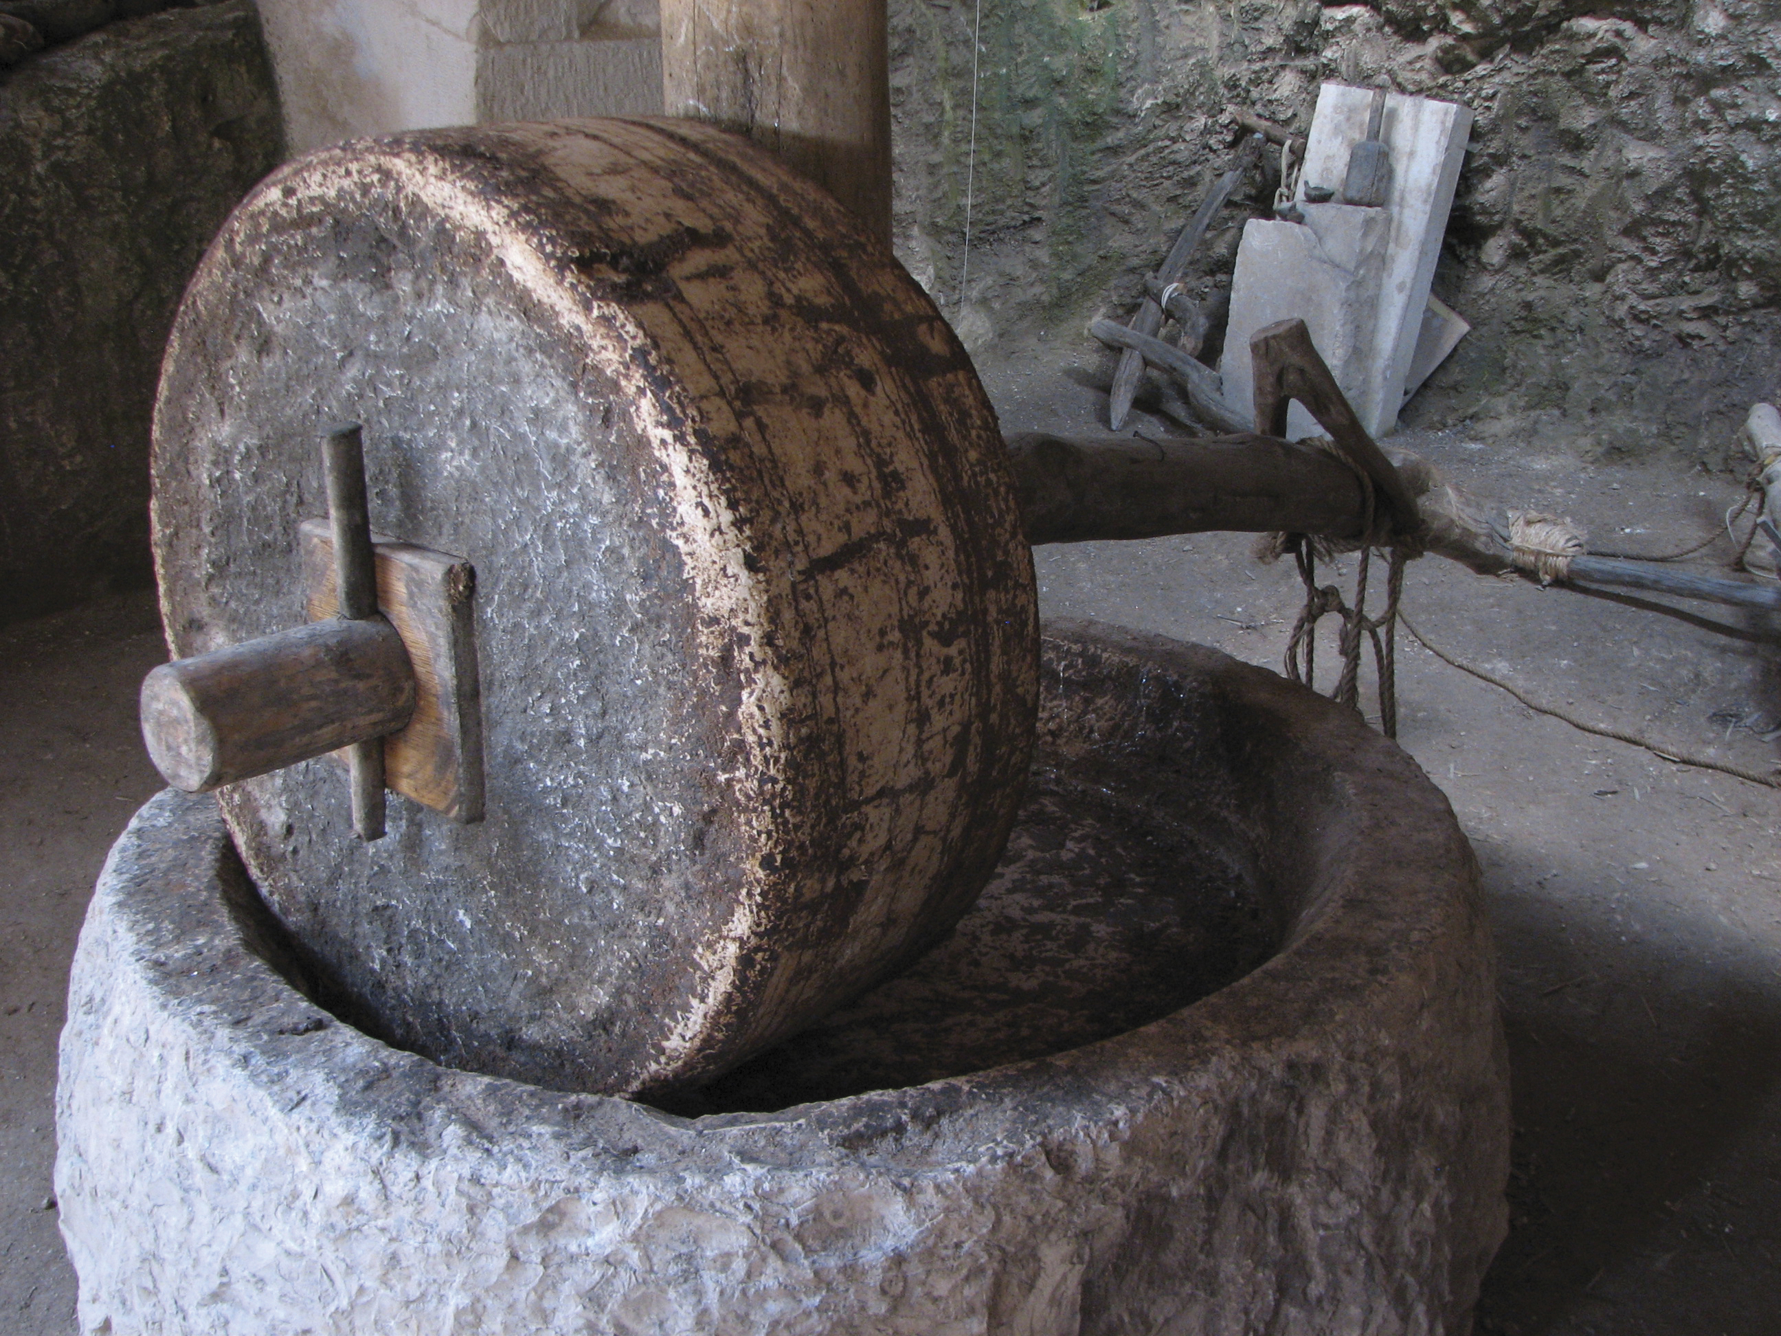
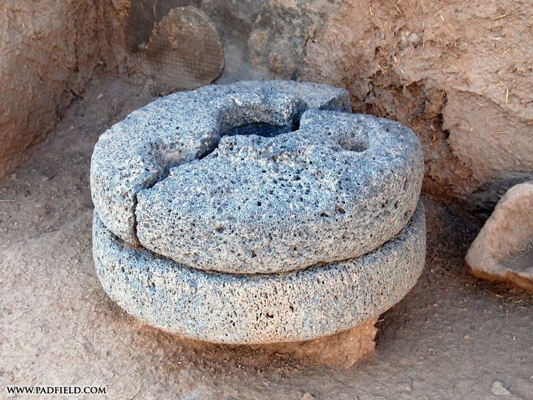

Slide 17
³⁶He took a little child whom he placed among them. Taking the child in his arms, he said to them,
³⁷"Whoever welcomes one of these little children in my name welcomes me; and whoever welcomes me does not welcome me but the one who sent me."

Slide 18
James 5:20
My brothers and sisters, if anyone among you wanders from the truth and is brought back by another, you should know that whoever brings back a sinner from wandering will save the sinner’s soul from death and will cover a multitude of sins.

Slide 20
Have I told you lately that I love you?

Slide 21
Please follow us over for a drink and a chat after the service

Slide 22
● Esther 7:1-6
So the king and Haman went in to feast with Queen Esther. On the second day, as they were drinking wine, the king again said to Esther, “What is your petition, Queen Esther? It shall be granted you. And what is your request? Even to the half of my kingdom, it shall be fulfilled.” Then Queen Esther answered, “If I have won your favour, O king, and if it pleases the king, let my life be given me—that is my petition—and the lives of my people—that is my request. For we have been sold, I and my people, to be destroyed, to be killed, and to be annihilated. If we had been sold merely as slaves, men and women, I would have held my peace; but no enemy can compensate for this damage to the king.”

Slide 23
Then King Ahasuerus said to Queen Esther, “Who is he, and where is he, who has presumed to do this?” Esther said, “A foe and enemy, this wicked Haman!” Then Haman was terrified before the king and the queen.

Slide 24
Psalm 124
If it had not been the Lord who was on our side—let Israel now say—
if it had not been the Lord who was on our side, when our enemies attacked us,
then they would have swallowed us up alive, when their anger was kindled against us;
then the flood would have swept us away, the torrent would have gone over us;
then over us would have gone the raging waters.
Blessed be the Lord, who has not given us as prey to their teeth.
We have escaped like a bird from the snare of the fowlers; the snare is broken, and we have escaped.
Our help is in the name of the Lord, who made heaven and earth.

