Slide 1
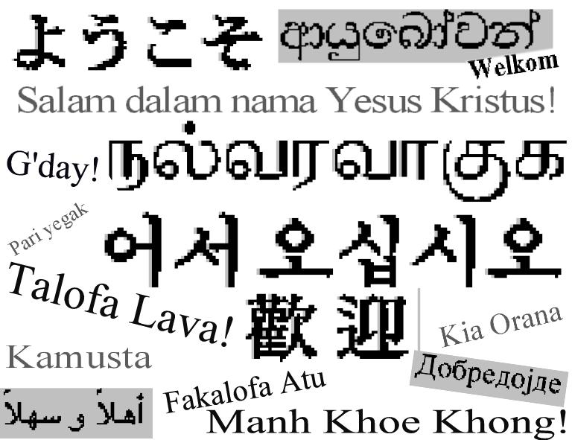
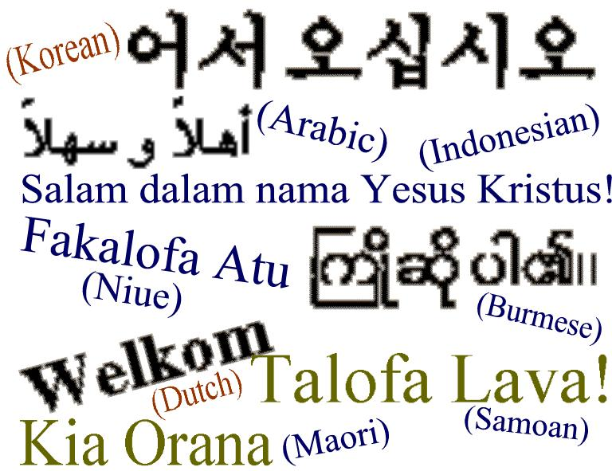
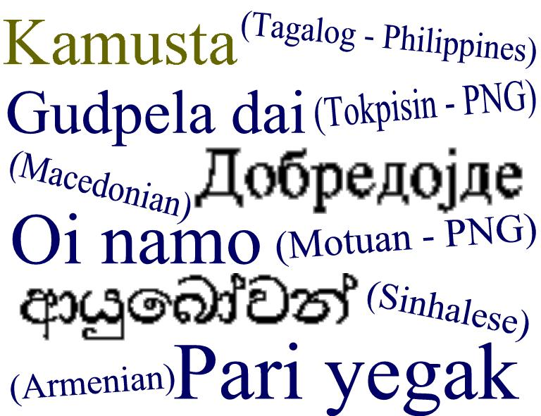

Slide 2
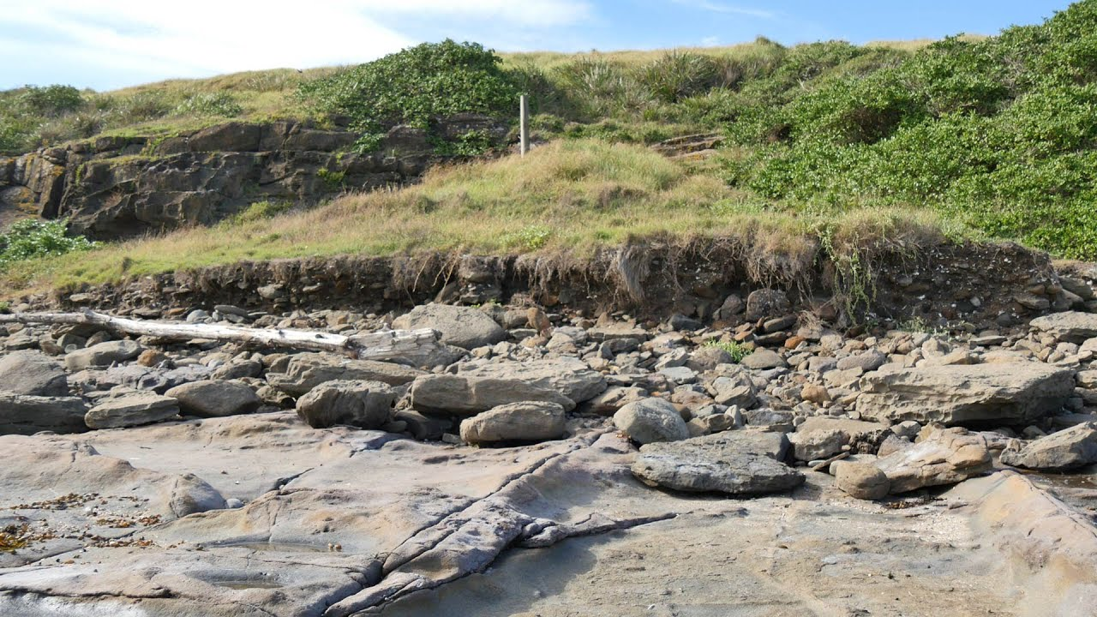
We acknowledge the sovereign First Peoples of these lands and waters
where we meet, the Yuin Nation. We pay our respects to their elders past and present and to all Aboriginal people who have cared for this place since creation.

Slide 3
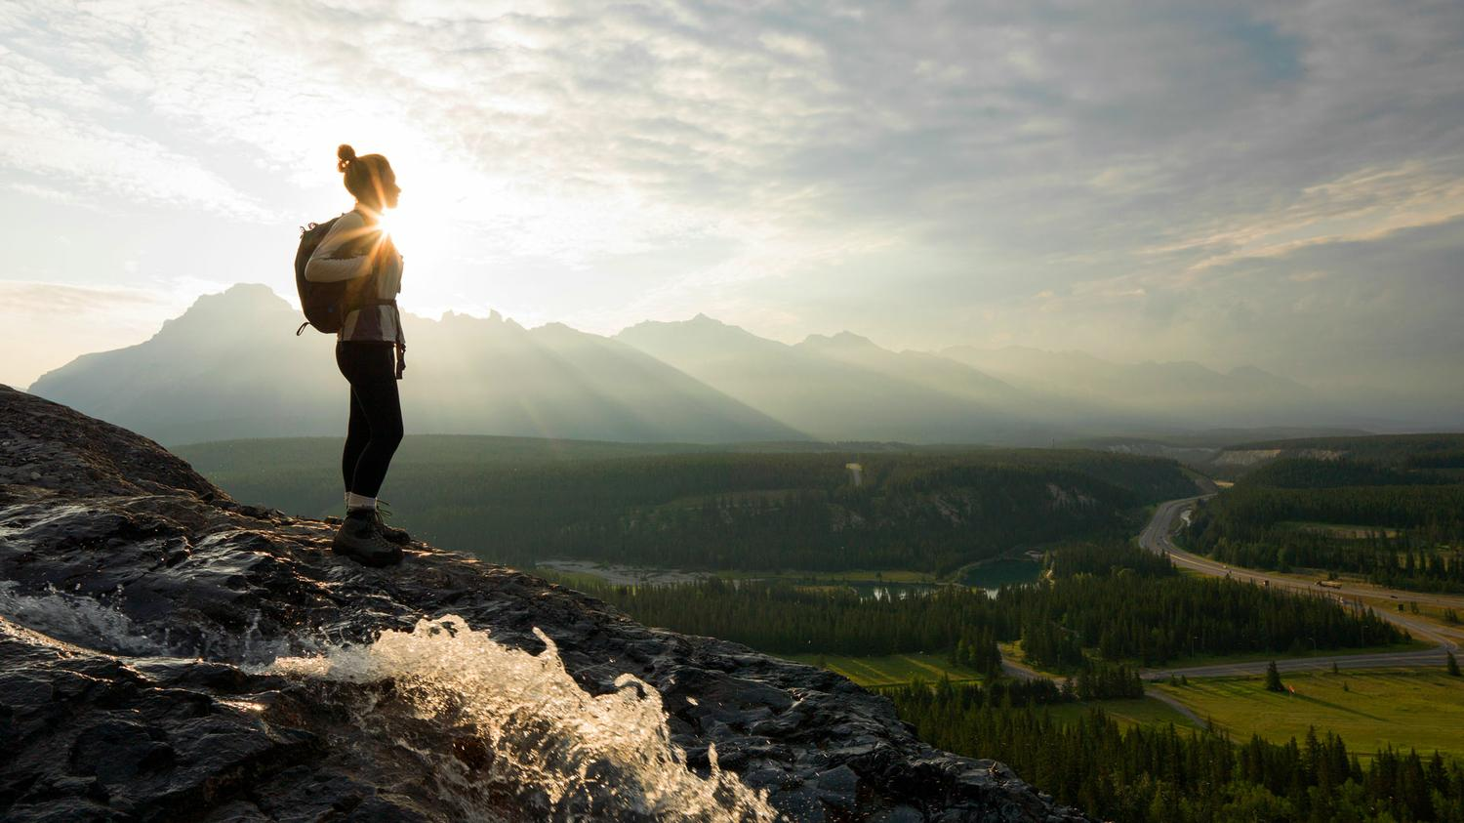
Welcome to worship
at
St Georges - Eden
For the love of the world

Slide 4
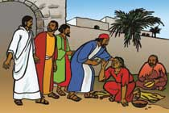
Bring many names, beautiful and good,
celebrate in parable and story,
holiness in glory, living, loving God.
Hail and hosanna!
bring many names!

Slide 5
Strong mother God, working night and day,
planning all the wonders of creation,
setting each equation,
genius at play:
Hail and hosanna,
strong mother God!

Slide 6
Warm father God, hugging every child,
feeling all the strains of human living,
caring and forgiving,
till we’re reconciled:
Hail and hosanna,
warm father God!

Slide 7
Old aching God, grey with endless care,
calmly piercing evil’s new disguises,
glad of good surprises,
wiser than despair:
Hail and hosanna,
old ,aching God.

Slide 8
Young, growing God, eager, on the move,
saying no to falsehood and unkindness,
crying out for justice,
giving all you have:
Hail and hosanna,
Young, growing God!

Slide 9
Great, living God, never fully known,
joyful darkness far beyond our seeing,
closer yet than breathing,
everlasting home:
Hail and hosanna,
great, living God!
Brian Arthur Wren CCLI 222909

Slide 10
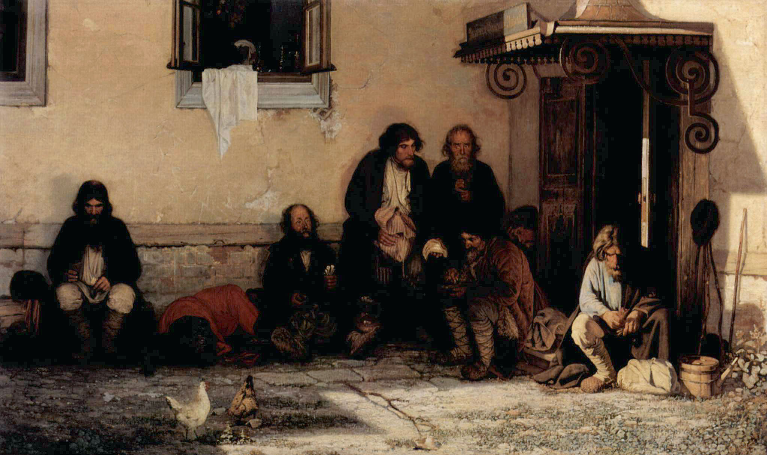

Slide 11
INTERACTIVE

Slide 12
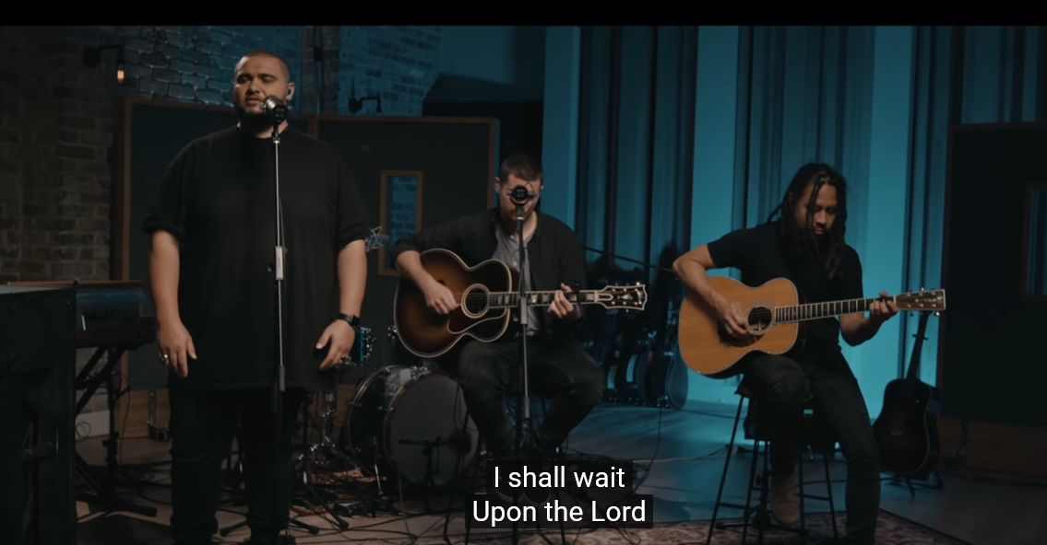
For God So Loved the World -Hillsong

Slide 13
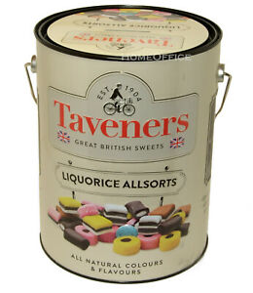
Offertory online – see our website eden.uca.org.au in the allsorts tin in the foyer of the church

Slide 14
.

Slide 15
Romans 8:12-17 So then, brothers and sisters, we are debtors, not to the flesh, to live according to the flesh—for if you live according to the flesh, you will die; but if by the Spirit you put to death the deeds of the body, you will live. For all who are led by the Spirit of God are children of God. You did not receive a spirit of slavery to fall back into fear but you have received a spirit of adoption. When we cry, ‘Abba! Father!’ it is that very Spirit bearing witness with our spirit that we are children of God, and if children, then heirs, heirs of God and joint heirs with Christ—if, in fact, we suffer with him so that we may also be glorified with him. ********************************************

Slide 16
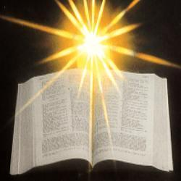

Slide 17
John 3:1-17 Now there was a Pharisee named Nicodemus, a leader of the Jews. He came to Jesus by night and said to him, ‘Rabbi, we know that you are a teacher who has come from God; for no one can do these signs that you do apart from the presence of God.’ Jesus answered him, ‘Very truly, I tell you, no one can see the kingdom of God without being born from above.’ Nicodemus said to him, ‘How can anyone be born after having grown old? Can one enter a second time into the mother’s womb and be born?’

Slide 18
Jesus answered, ‘Very truly, I tell you, no one can enter the kingdom of God without being born of water and Spirit. What is born of the flesh is flesh, and what is born of the Spirit is spirit. Do not be astonished that I said to you, “You must be born from above.” The wind blows where it chooses, and you hear the sound of it, but you do not know where it comes from or where it goes. So it is with everyone who is born of the Spirit.’ Nicodemus said to him, ‘How can these things be?’ Jesus answered him, ‘Are you a teacher of Israel, and yet you do not understand these things?

Slide 19
‘Very truly, I tell you, we speak of what we know and testify to what we have seen; yet you do not receive our testimony. If I have told you about earthly things and you do not believe, how can you believe if I tell you about heavenly things? No one has ascended into heaven except the one who descended from heaven, the Son of Man. And just as Moses lifted up the serpent in the wilderness, so must the Son of Man be lifted up, that whoever believes in him may have eternal life. ‘For God so loved the world that he gave his only Son, so that everyone who believes in him may not perish but may have eternal life. ‘Indeed, God did not send the Son into the world to condemn the world, but in order that the world might be saved through him. ***********************************

Slide 20
Majesty, worship His majesty Unto Jesus be all glory, power and praise Majesty, Kingdom authority Flow from his throne Unto his own His anthem raise!
SoF 379

Slide 21
So exalt, lift up on high The name of Jesus Magnify, come glorify Christ Jesus the King Majesty, worship His majesty Jesus who died, now glorified King of all Kings
Used by permission Christian Copyright Licensing - License No. 222909

Slide 22
For the love of the world

Slide 23
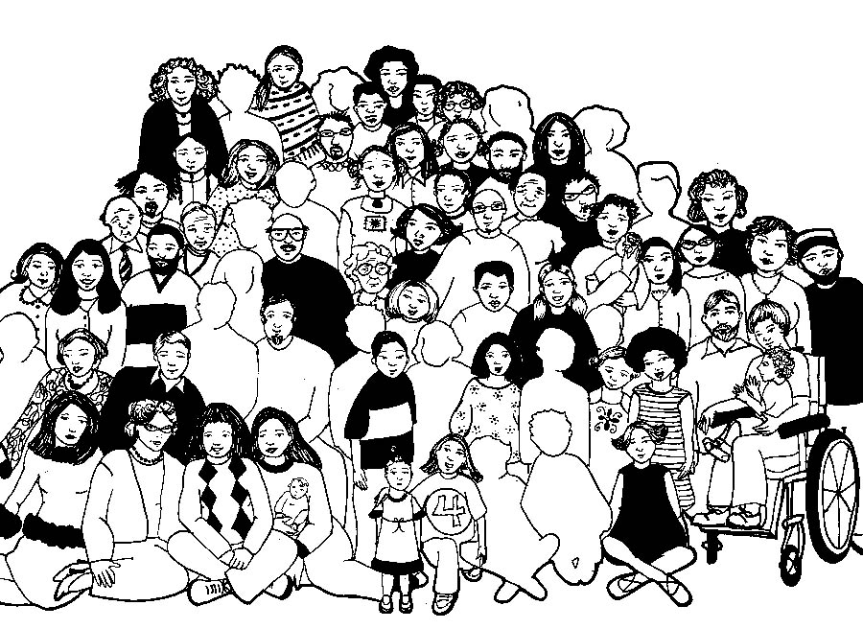

Slide 24
To God be the glory
Great things he has done
So loved He the world that he gave us his Son
Who yielded his life, an atonement for sin
And opened the life-gate that all may go in

Slide 25
Praise the Lord, Praise the Lord
Let the earth hear His voice
Praise the Lord, Praise the Lord
Let the people rejoice
O come to the Father through Jesus the Son,
And give him the glory great things He has done

Slide 26
O perfect redemption, the purchase of blood
To every believer the promise of God
The vilest offender who truly believes
That moment from Jesus a pardon receives

Slide 27
Praise the Lord, Praise the Lord
Let the earth hear His voice
Praise the Lord, Praise the Lord
Let the people rejoice
O come to the Father through Jesus the Son,
And give him the glory great things He has done

Slide 28
Great things he has taught us,
Great things he has done
And great our rejoicing through Jesus the Son
But purer and higher and greater will be
Our wonder, our rapture when Jesus we see.

Slide 29
Praise the Lord, Praise the Lord
Let the earth hear His voice
Praise the Lord, Praise the Lord
Let the people rejoice
O come to the Father through Jesus the Son,
And give him the glory great things He has done
SOF 559 1,2,3, G C

Slide 30
Please join us for refreshments in the hall after the service
You are welcome to leave a note in the visitors’ book in the church foyer

Slide 31
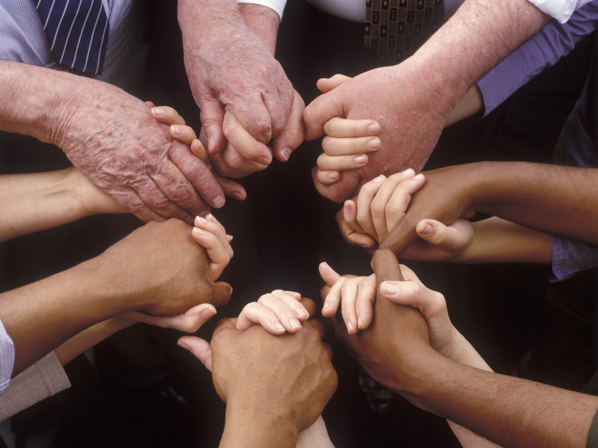
Please join us for a cuppa in the hall after the service

Slide 32
Please follow us over
for a drink in the hall

